Slide 1

Statistical Analysis of Campus Recruitments

Slide 2
Under the guidance of :
Project Team:
Shraddha Bhagwat
Roopa M.S.
Krutika Gawale
Krishna Agarwal
Oshin Bhatt
Gayatri Shinde
Mr. Rahul Kulkarni

Slide 3

Project Objectives
Statistical Analysis of Campus Recruitment
Analysis of reports of students selected from different colleges by different companies.

Slide 4
Project Flow
UNIVERSE
EXTRACT
Heterogeneous Sources i.e. operational data (Flat files)
TRANSFORM
Reports Based On Universe
Data warehouse (Oracle)
LOAD
(BO XI Rich WebI/WebI)
(BO IDT)
(Informatica)

Slide 5
Source Data
Company source data :
Date
College Name
Company Name
Head office location
Country
Package
Students Selected
Students Participated
Criteria
College source data:
Date
College Name
Location
Survey Name
Number of Indian Students
Number of Foreign Students
Fees
Rank

Slide 6
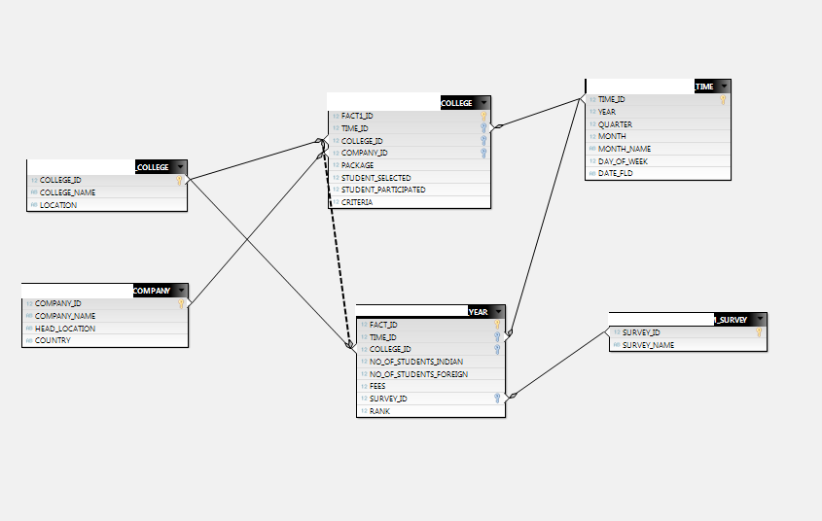
Data Warehouse Star Schema

Slide 7
Staging Tables
Source
(Company)
Data conversion
(Source)
Sort
Data cleansing
(Ltrim,Rtrim)
Conditional split
(Data validation)
Staging Area 1
Source
(College)
Data conversion
(Source)
Sort
Data cleansing
(Ltrim,Rtrim)
Conditional split
(Data validation)
Staging Area 2

Slide 8
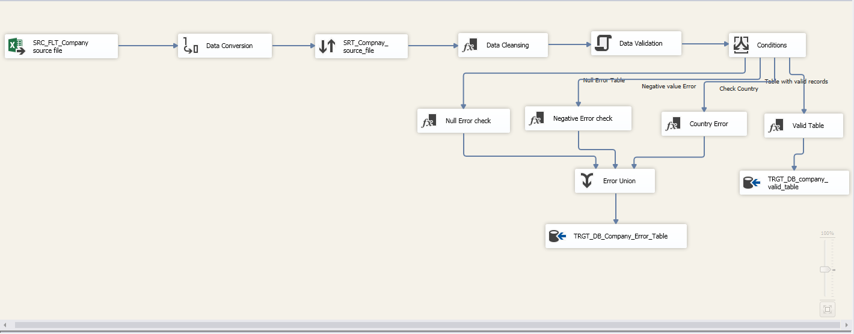
Company Staging Table

Slide 9
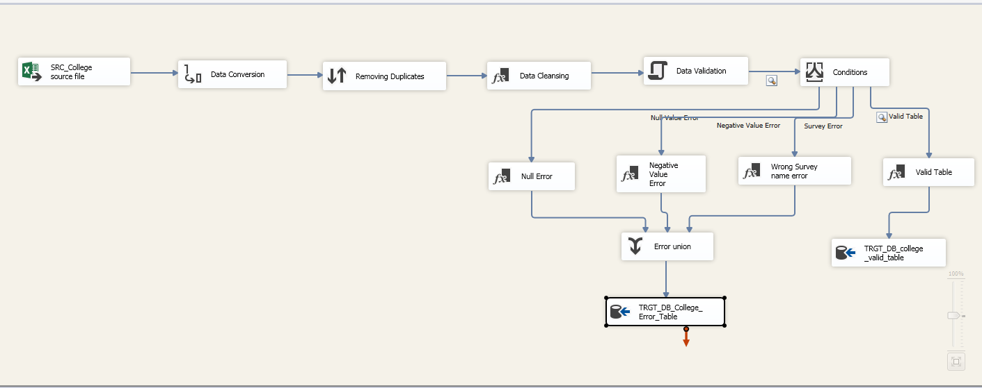
College Staging Table

Slide 10
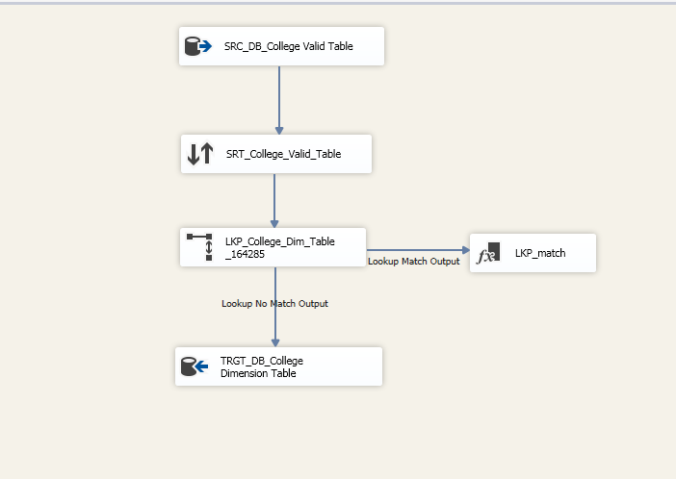
College Dimension Table

Slide 11
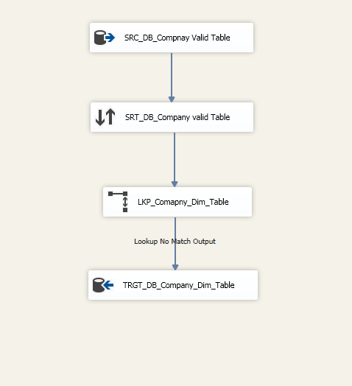
Company Dimension Table

Slide 12
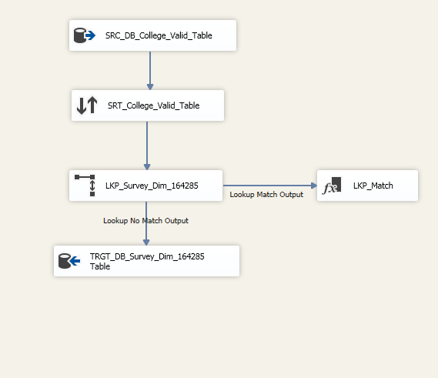
Survey Dimension Table

Slide 13
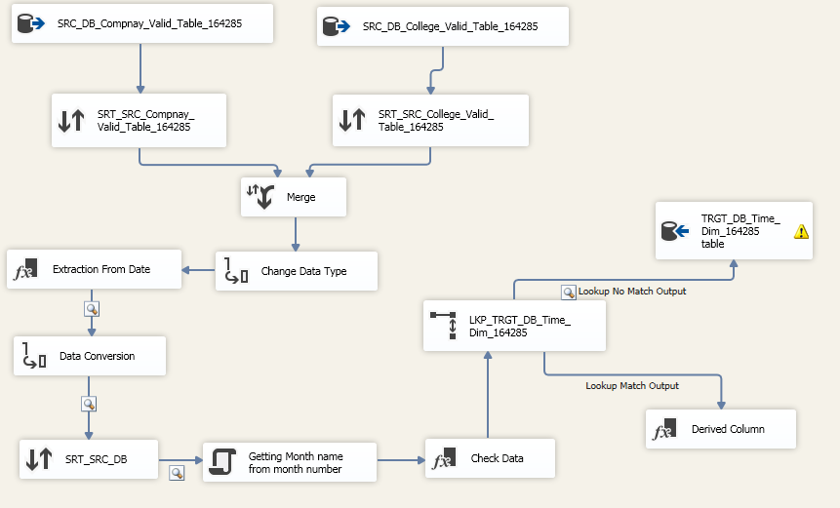
Time Dimension Table

Slide 14
Populating Fact tables
College Dimension
(Lookup)
Source
(Staging Area)
College Fact
Survey Fact
Company Dimension (Lookup)
Company Dimension (Lookup)
Company Dimension (Lookup)

Slide 15
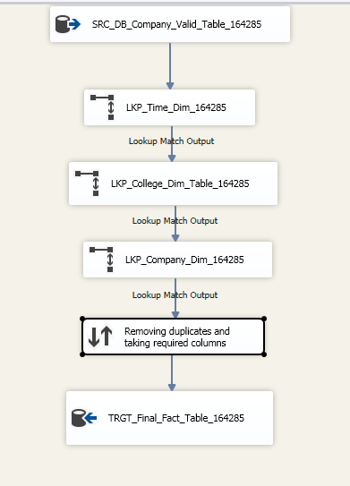
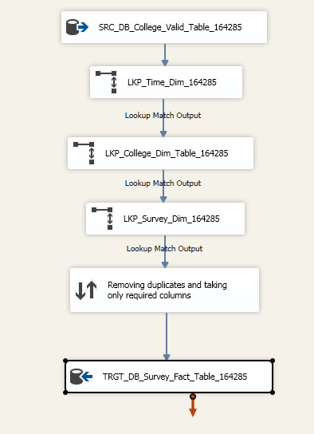
Fact tables

Slide 16
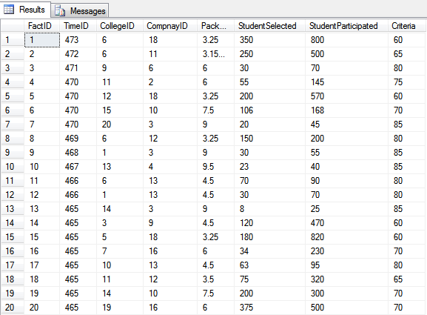
College Fact Table Data

Slide 17
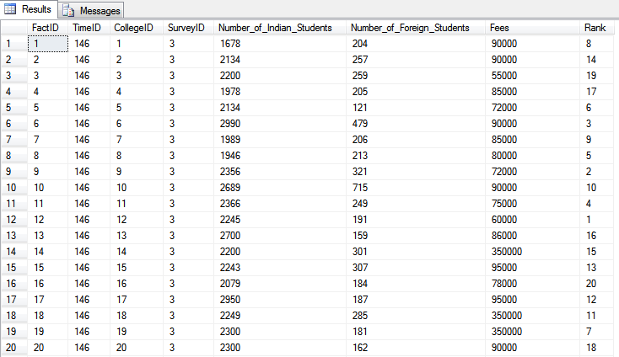
Survey Fact Table Data

Slide 18
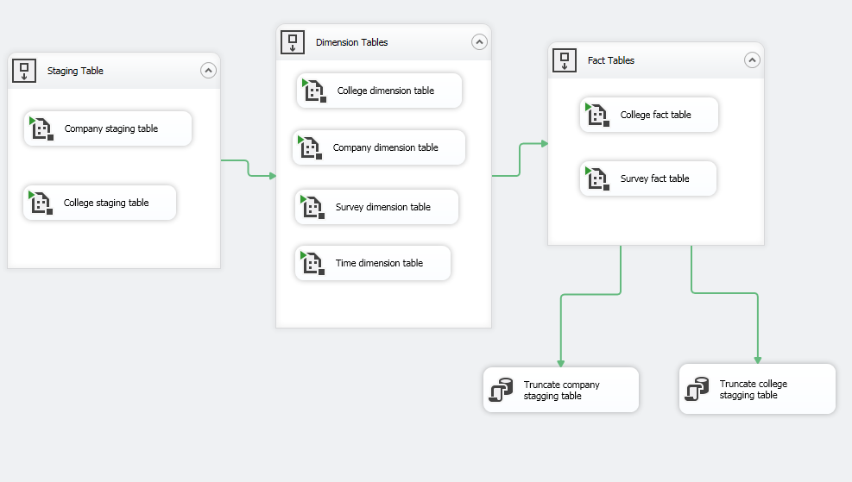
Automation

Slide 19
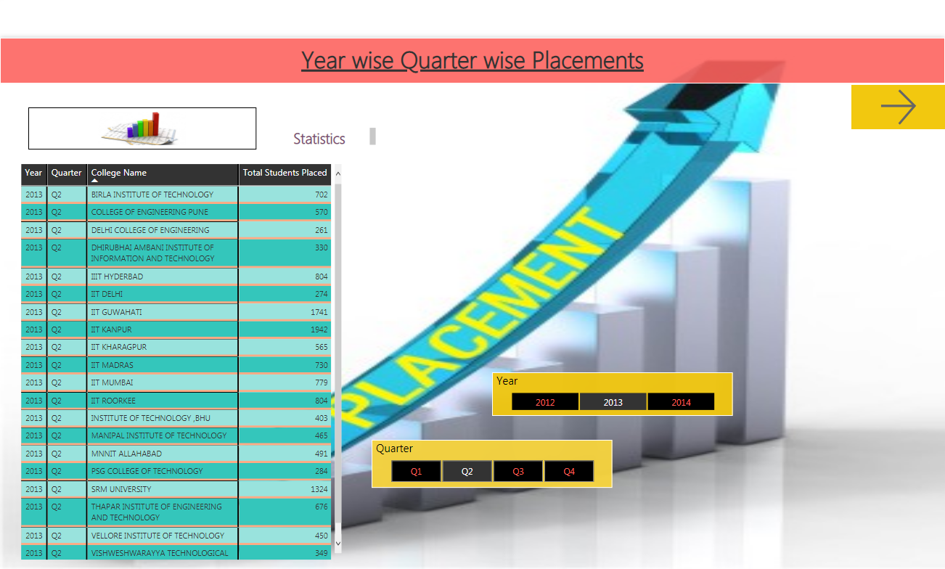
Statistical Analysis of Campus Recruitment

Slide 20
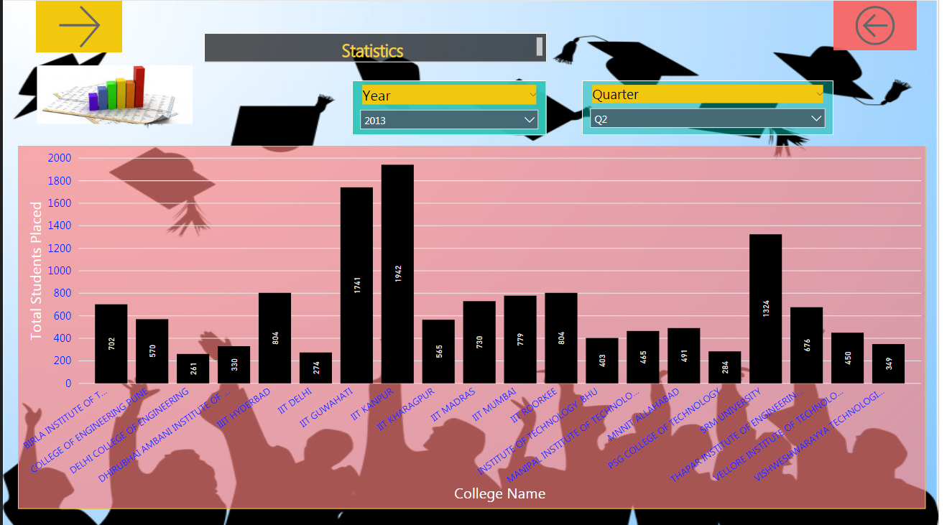

Slide 21
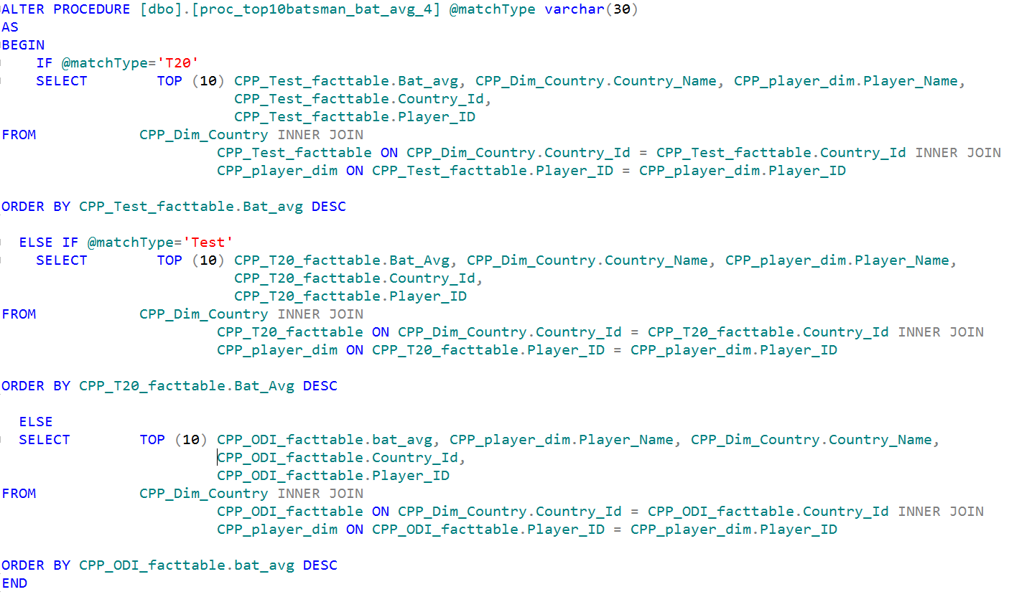
Stored Procedure for selecting dataset at Runtime

Slide 22
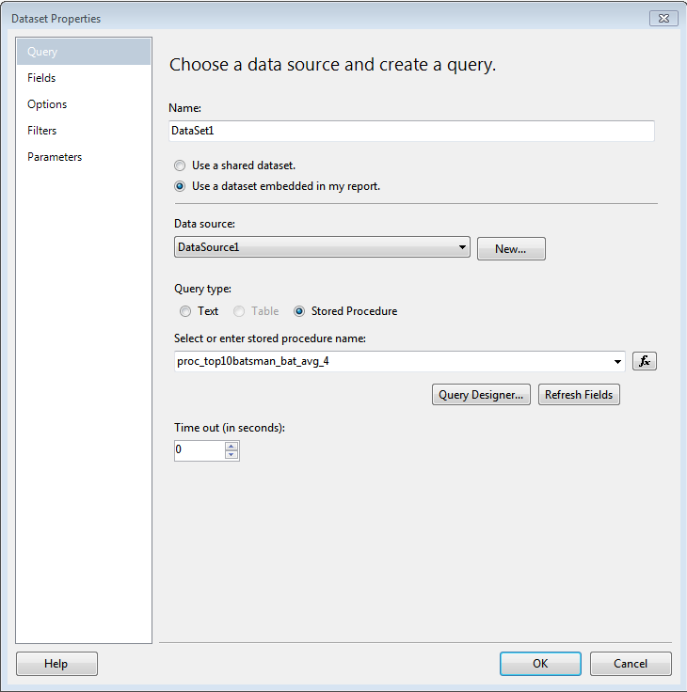

Slide 23
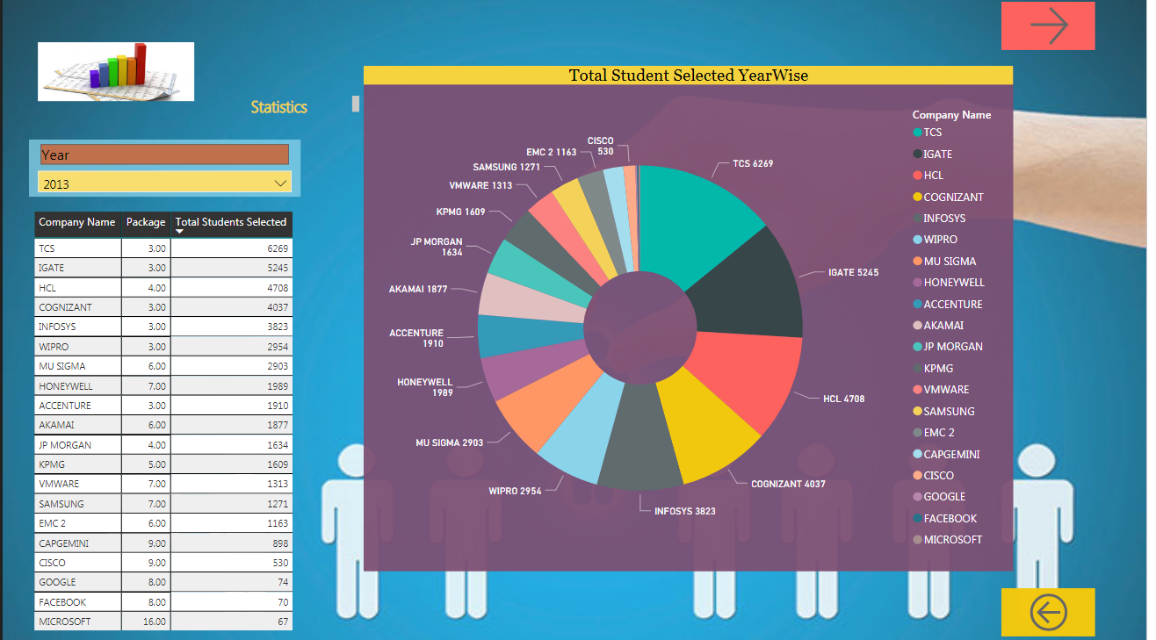

Slide 24
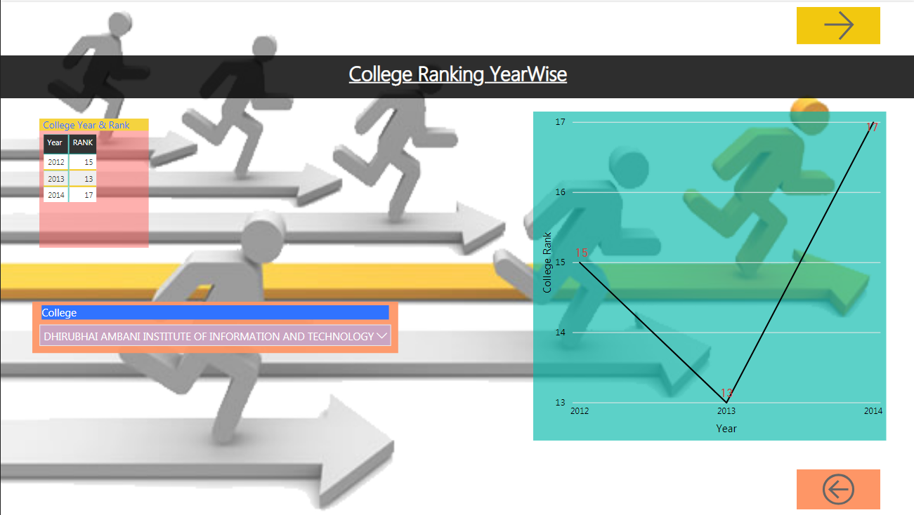

Slide 25
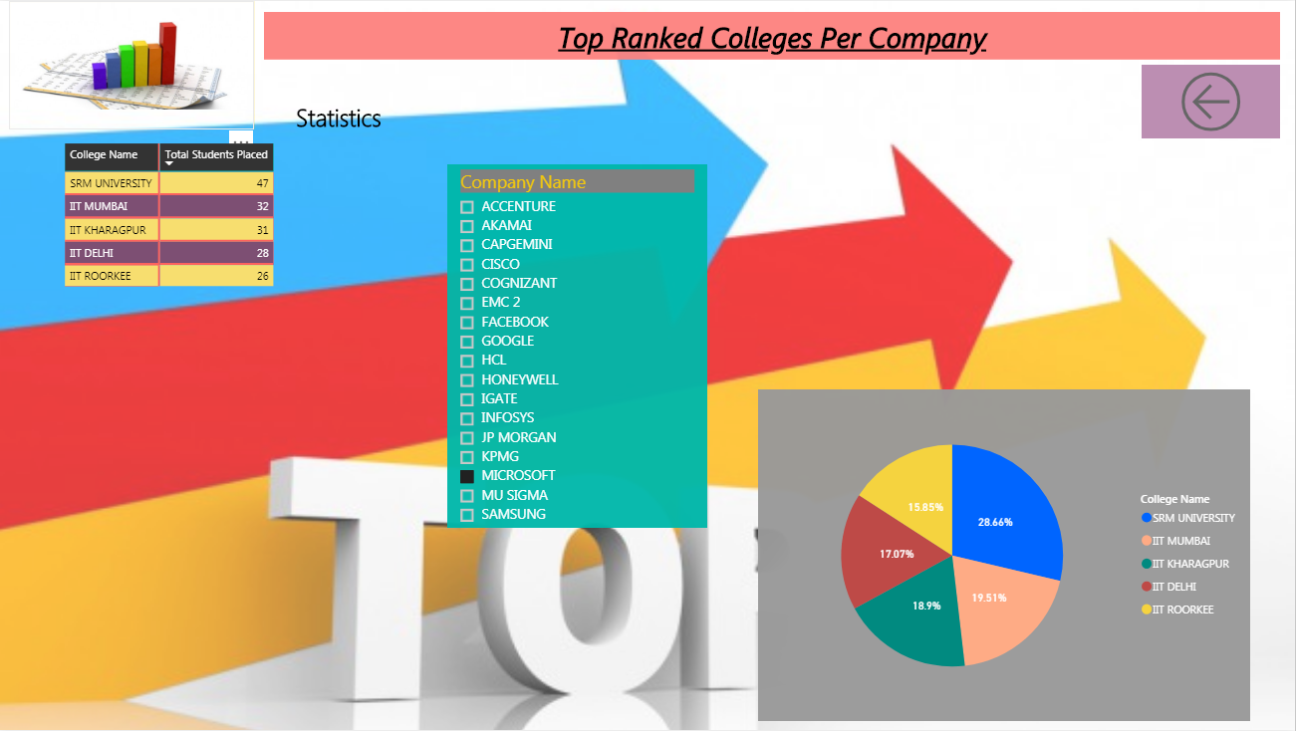

Slide 26

Any Queries?

Slide 27
Thank You

