Slide 1

Statistical Analysis of Campus Recruitments

Slide 2
Under the guidance of :
Project Team:
Shraddha Bhagwat
Roopa M.S.
Krutika Gawale
Krishna Agarwal
Oshin Bhatt
Gayatri Shinde
Mr. Rahul Kulkarni

Slide 3

Project Objectives
Statistical Analysis of Campus Recruitment
Analysis of reports of students selected from different colleges by different companies.

Slide 4
Project Flow
UNIVERSE
EXTRACT
Heterogeneous Sources i.e. operational data (Flat files)
TRANSFORM
Reports Based On Universe
Data warehouse (Oracle)
LOAD
(BO XI Rich WebI/WebI)
(BO IDT)
(Informatica)

Slide 5
Source Data
Company source data :
Date
College Name
Company Name
Head office location
Country
Package
Students Selected
Students Participated
Criteria
College source data:
Date
College Name
Location
Survey Name
Number of Indian Students
Number of Foreign Students
Fees
Rank

Slide 6
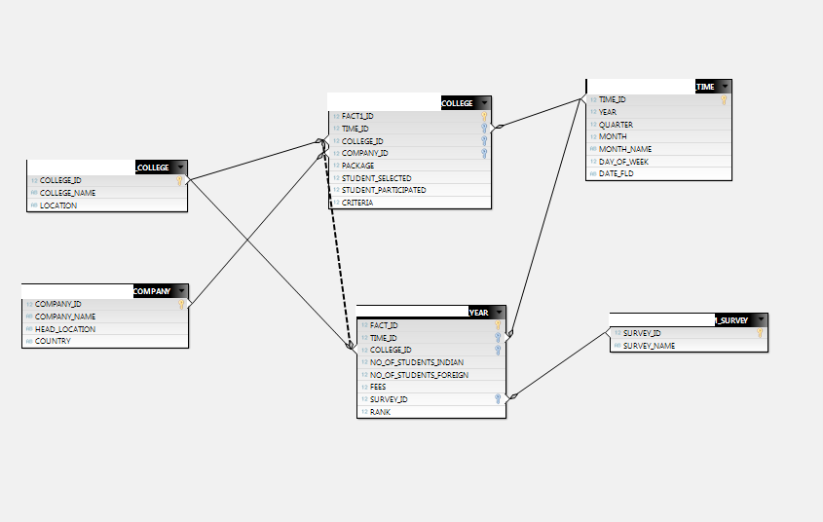
Data Warehouse Star Schema

Slide 7
Staging Tables
Data conversion
(Source)
Sort
Data cleansing
(Ltrim,Rtrim)
Conditional split
(Data validation)
Source
(Company)
Staging Area 1
Sort
Data cleansing
(Ltrim,Rtrim)
Source
(College)
Data conversion
(Source)
Conditional split
(Data validation)
Staging Area 2

Slide 8
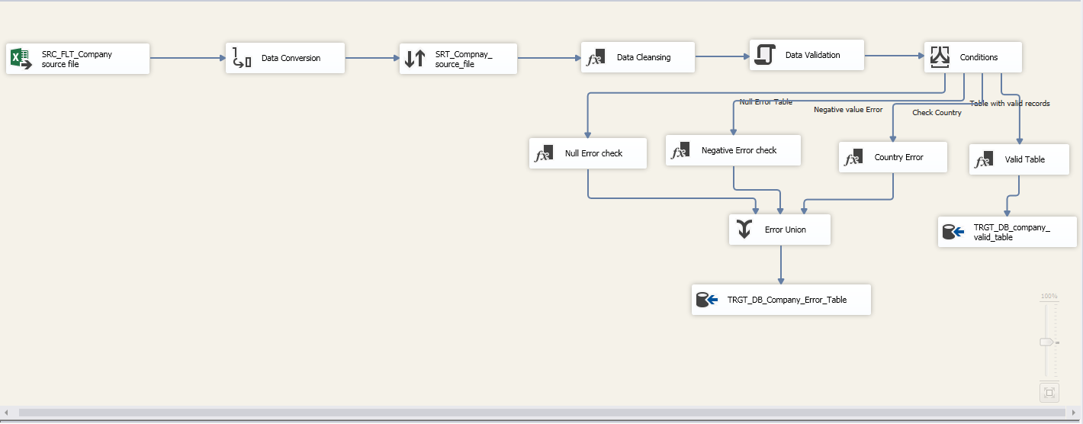
Company Staging Table

Slide 9
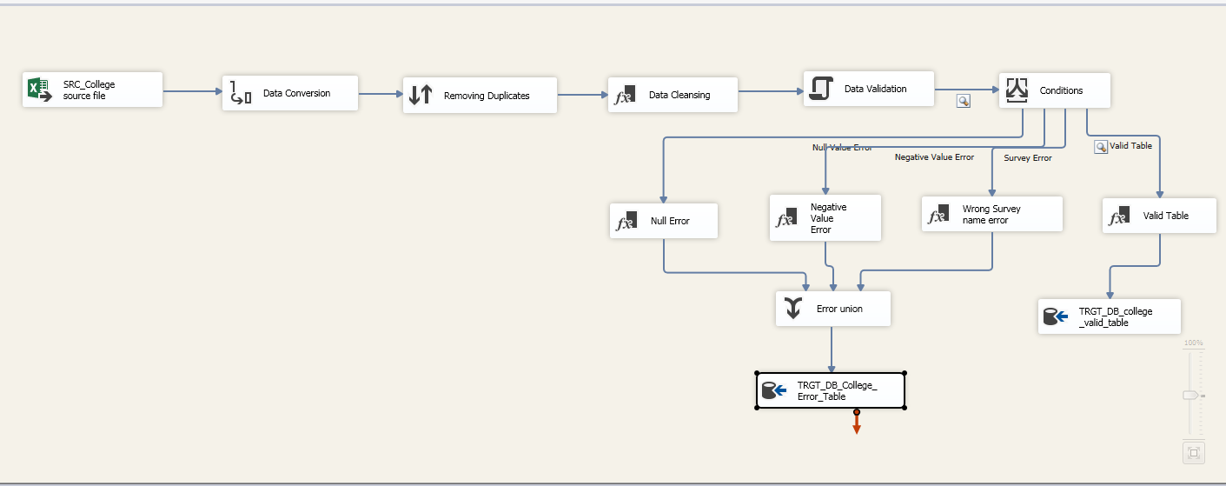
College Staging Table

Slide 10
Data Combination for Batting, Bowling & Fielding
Only batting
Only Fielding
Batting
Bowling
(Lookup)
Fielding
(Lookup)
Bat and Bowl
Bat, Bowl and Field
Player Data
(All Combined)
Derived Column
Replace Nulls

Slide 11
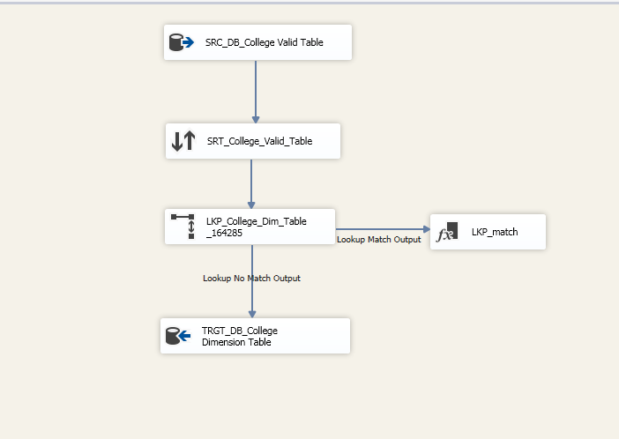
College Dimension Table

Slide 12
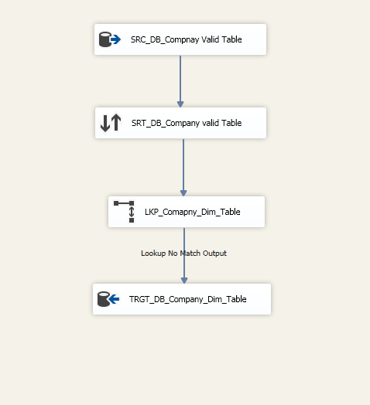
Company Dimension Table

Slide 13
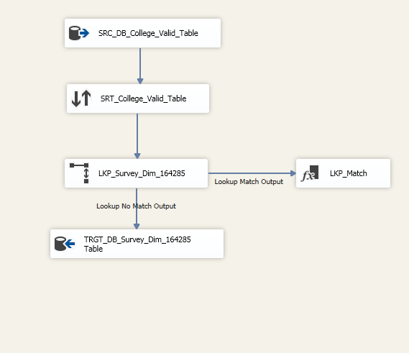
Survey Dimension Table

Slide 14
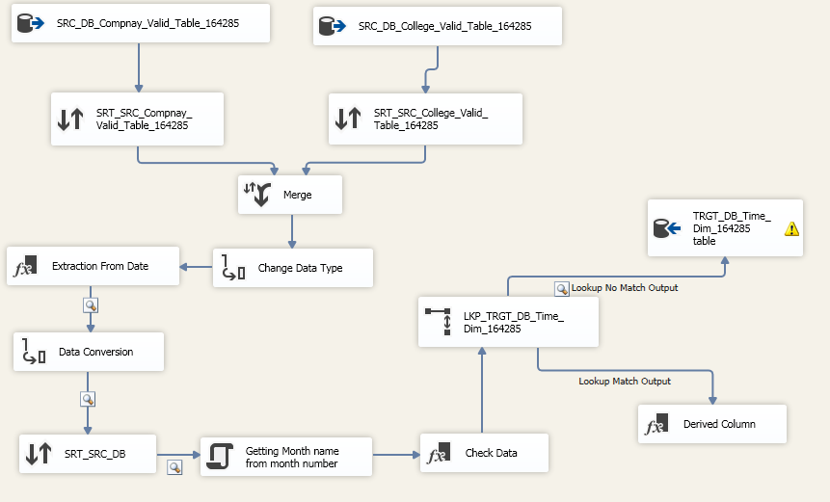
Time Dimension Table

Slide 15
Creation of Player Dimension Table
OLEDB Cleaned Data Tables
(Source)
Player Dimension
T20 Merged Table
Test Merged Table
ODI Merged Table

Slide 16
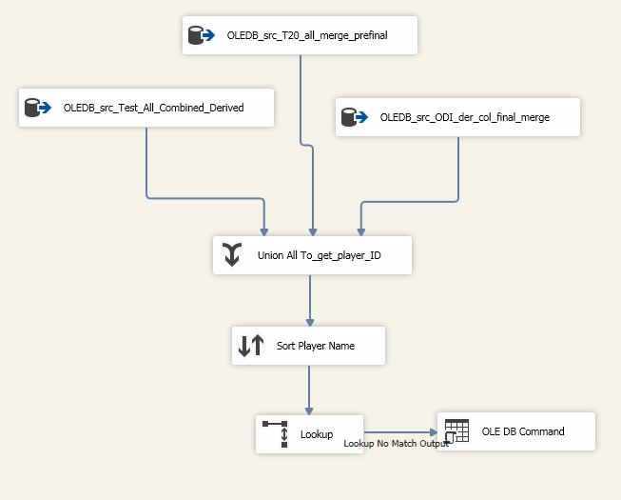

Slide 17
Populating Fact tables
College Dimension
(Lookup)
Source
(Staging Area)
College Fact
Survey Fact
Company Dimension (Lookup)
Company Dimension (Lookup)
Company Dimension (Lookup)

Slide 18
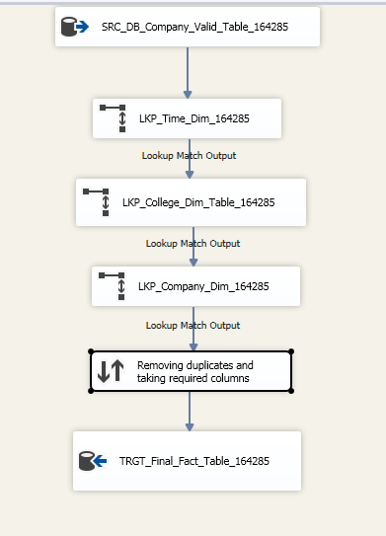
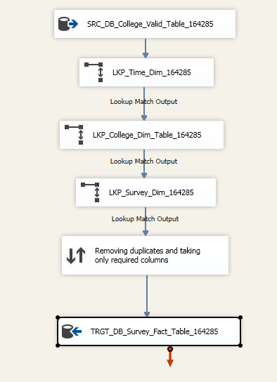
Fact tables

Slide 19
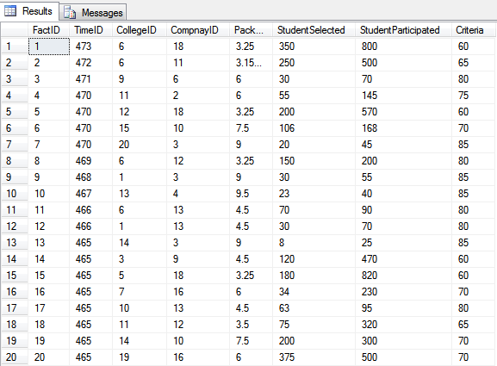
College Fact Table Data

Slide 20
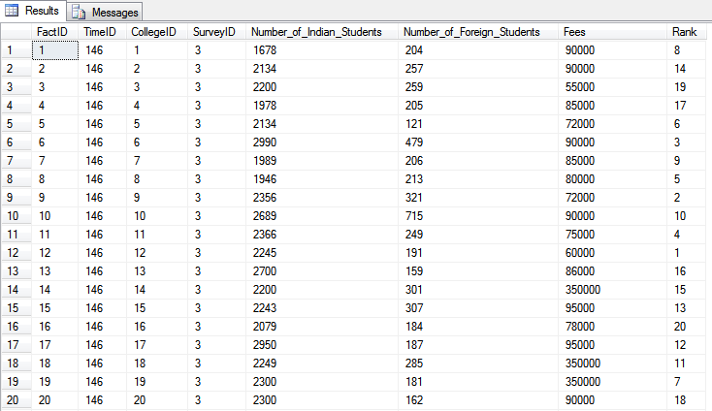
Survey Fact Table Data

Slide 21
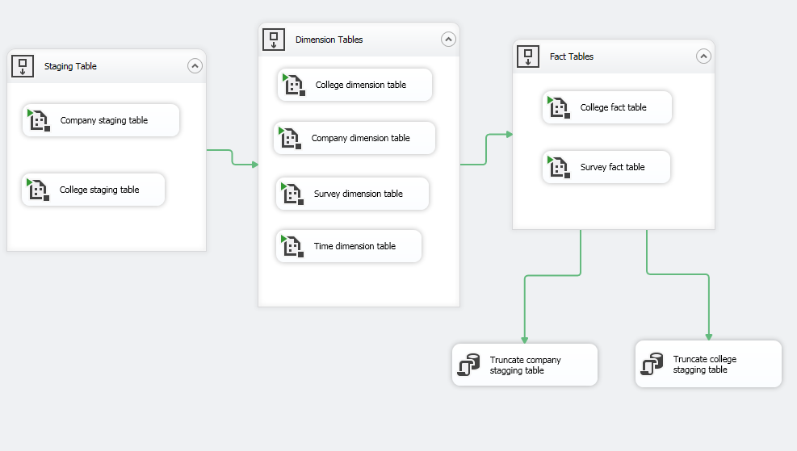
Automation

Slide 22
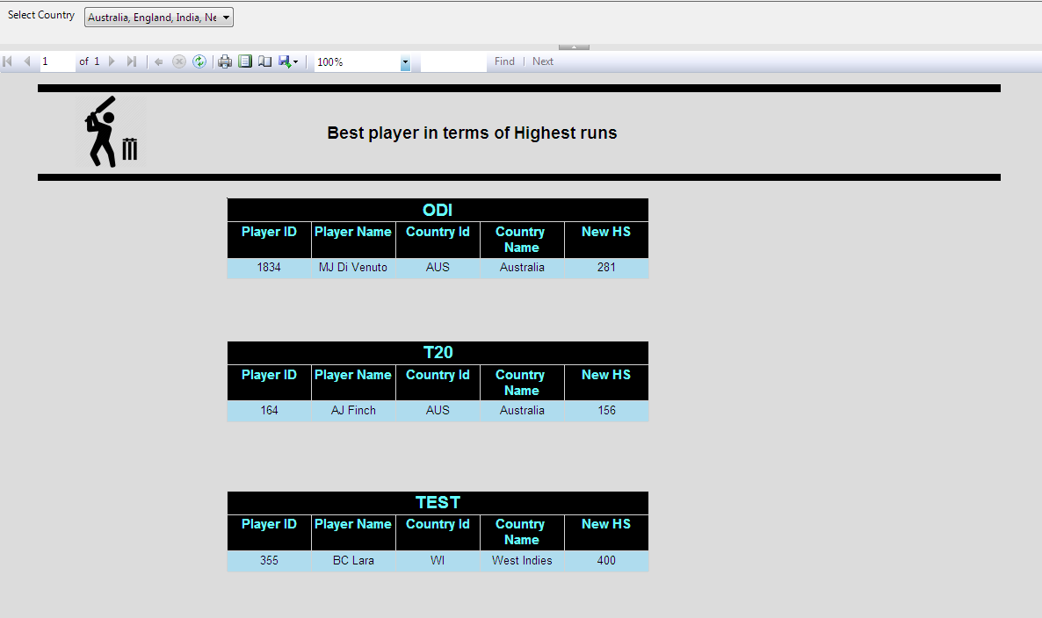
Cricket Performance Analysis Reports

Slide 23
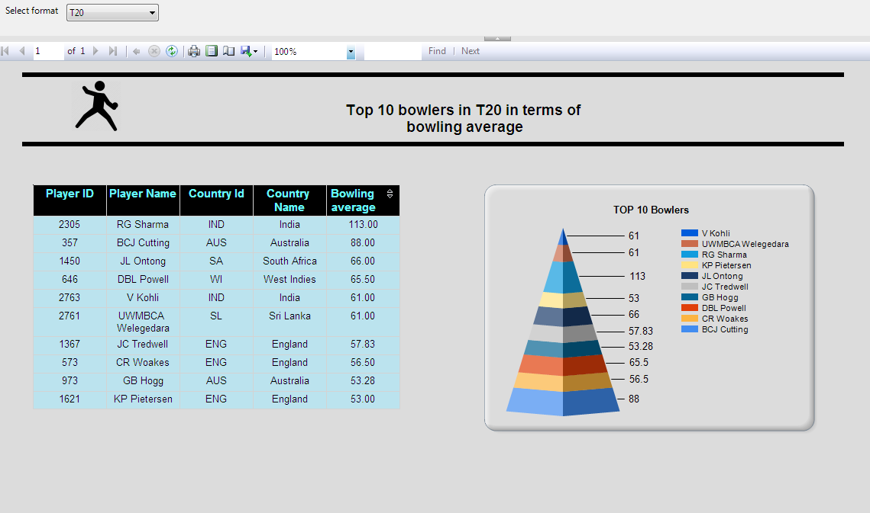

Slide 24
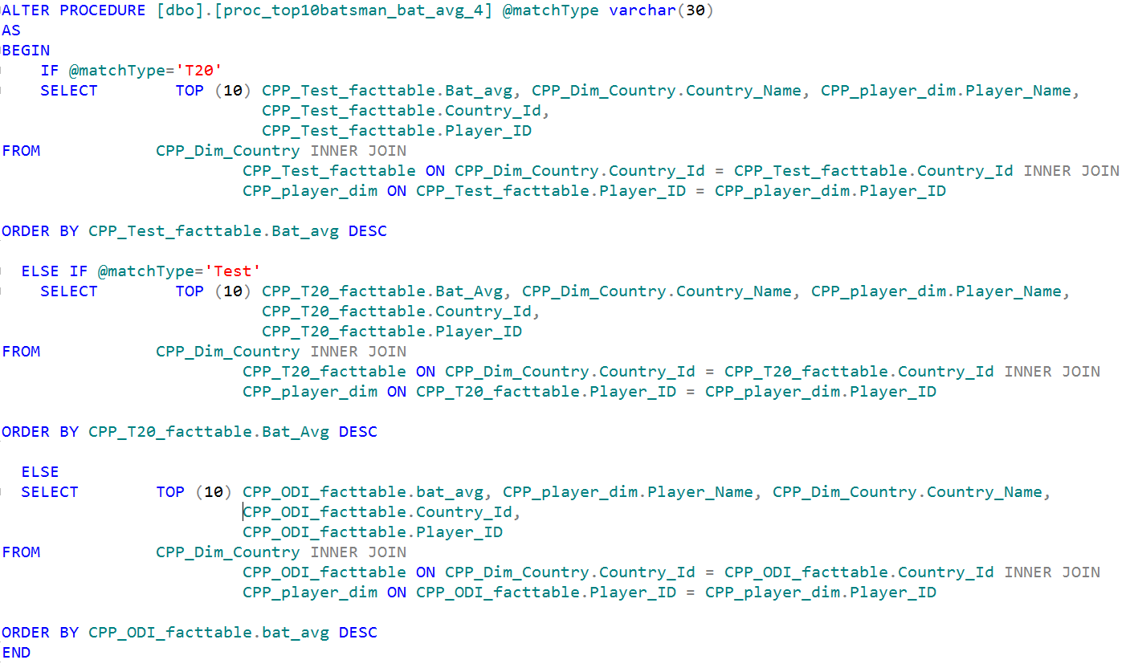
Stored Procedure for selecting dataset at Runtime

Slide 25
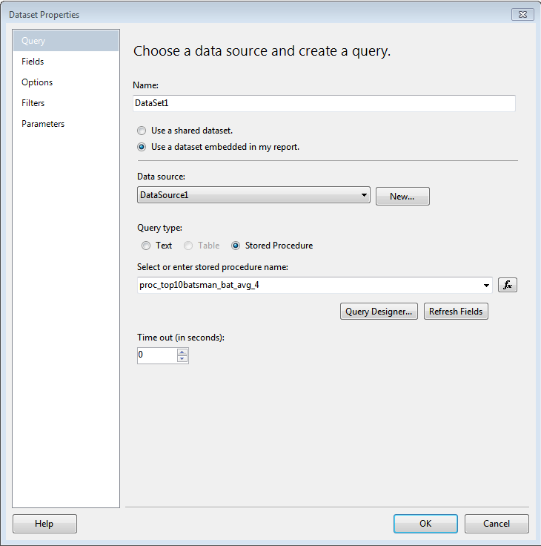

Slide 26
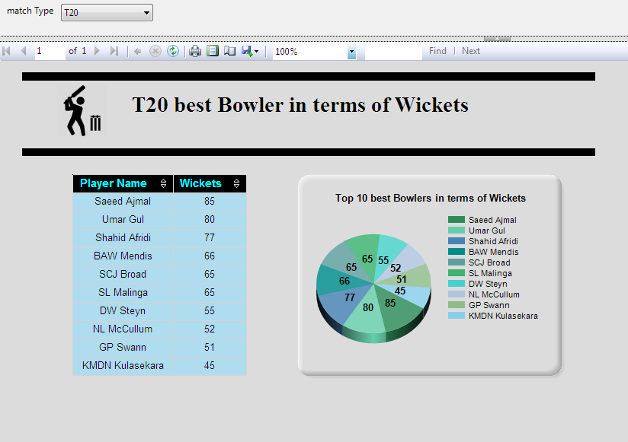

Slide 27
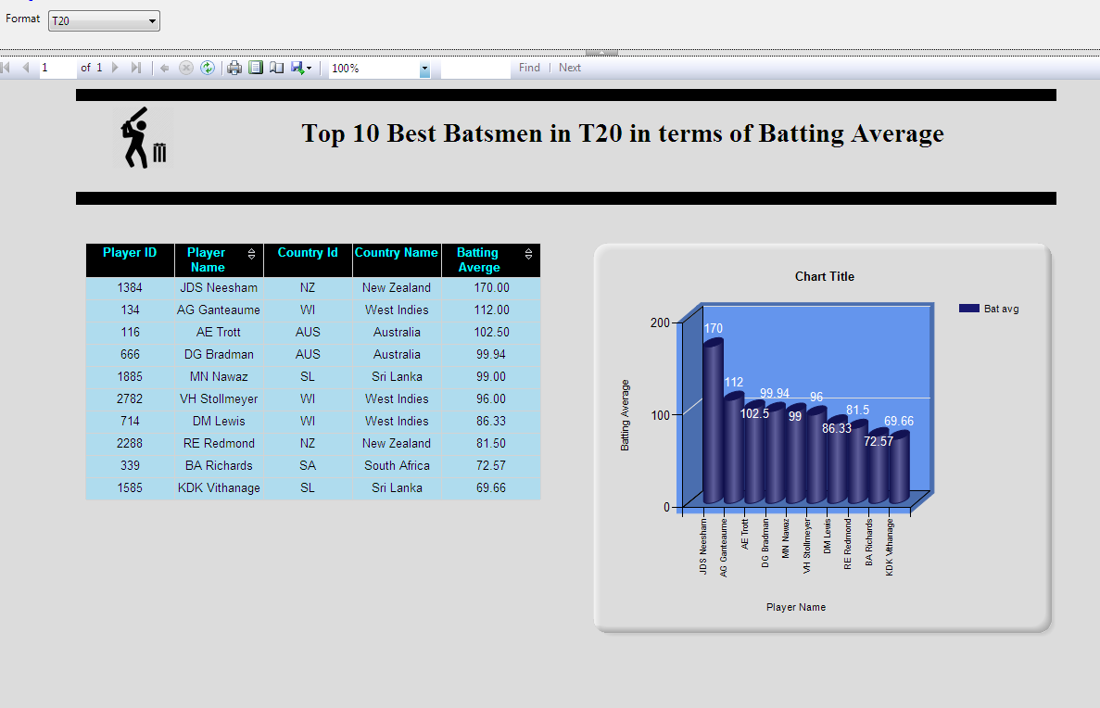

Slide 28
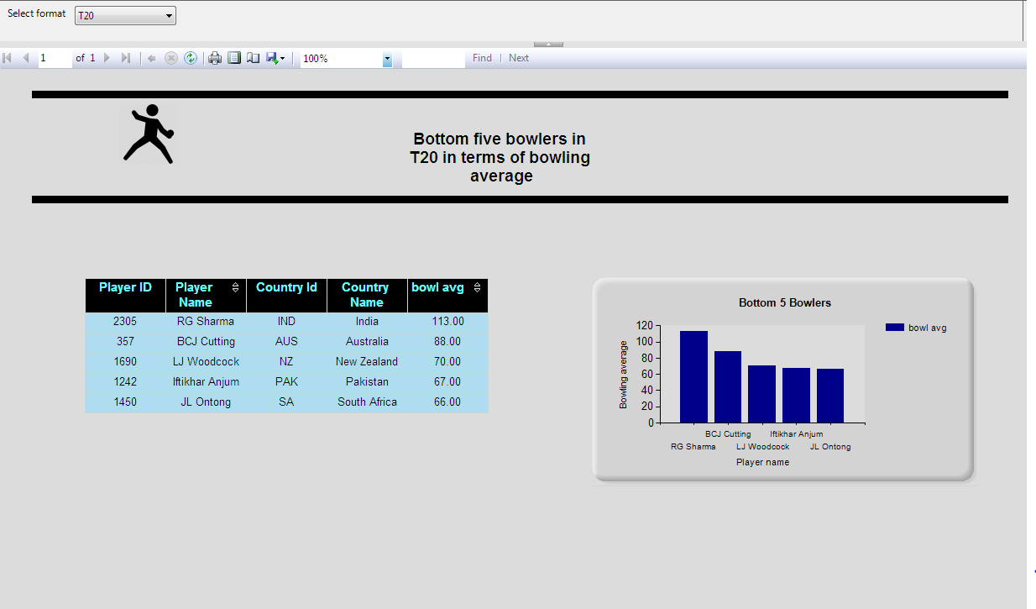

Slide 29

Any Queries?

Slide 30
Thank You

