Slide 1

CardioCog: An Explainable AI Framework for Cognitive Health Assessment and Early Prediction of Cognitive Decline Using Cardiovascular, Genetic, and Clinical Factors
Final Review – B.Tech Project
Akula Akhil Vighnesh – CB.SC.U4AIE23303
Vada Gouri Hansika Reddy – CB.SC.U4AIE23304
Pilli Venkata Bhargav Reddy – CB.SC.U4AIE23329
Marella Venkata Mahidhar Reddy – CB.SC.U4AIE23354
Team D07 | Supervisor: Dr. Manoj Bhat K, Professor

Slide 2
Introduction & Motivation
Domain: AI / Healthcare Analytics / XAI / Biomedical Data Science
Introduction
Dementia and Alzheimer's disease are increasing worldwide, affecting memory, thinking and quality of life.
Hypertension, diabetes, obesity and stroke are associated with a higher risk of cognitive decline.
Clinics already record cognition, vascular history, genetics and sometimes PET, but rarely combine them into one explainable estimate of near-term risk.
Motivation
Decline is hard to reverse once noticeable, so the years before diagnosis are the window for intervention.
Early identification allows low-cost steps and gives families time to plan.
In NACC, 14.5% of people without dementia converted within three years; among those with MCI, 41.5%.
2

Slide 3
Problem Statement
Clinical, cardiovascular, genetic and PET information is rarely combined into one explainable estimate of near-term decline, and it is unclear which source actually adds information.
For a person without dementia at a visit, CardioCog estimates over the next three years:
the risk of dementia
the risk of a CDR-SB rise ≥ 1
the expected change in CDR-SB
In scope | Out of scope
3-year dementia and CDR-SB decline risk | Clinical diagnosis
Demographic, cardiovascular, genetic, cognitive, clinical-stage and PET data | Treatment recommendation
SHAP explanations and quoted published evidence (RAG) | Post-diagnosis prognosis
Validation at 9 held-out NACC centres | Validation on a non-NACC cohort
3

Slide 4
Research Questions
RQ | Question
1 | How accurately can dementia and CDR-SB decline be predicted, within normal and MCI groups separately?
2 | Does cardiovascular history add to demographics, genetics and current cognition?
3 | Do amyloid and tau PET add to the clinical model?
4 | Do deep models, including a modality-encoder fusion network, beat classical ones?
5 | Do earlier visits help?
6 | Can one model cope with whole categories of missing information?
7 | Can each estimate be explained and supported with published evidence?
4

Slide 5
Literature Review
Work | Core method | Relevance / limitation
Livingston et al. (2020) | Lancet Commission, 12 modifiable risk factors | Vascular risk matters over the life course; mostly midlife exposure
Alaka et al. (2025) | CAIDE + resting heart rate, random forest, NACC | Same database; AUC 0.80–0.91, no within-stage results
Stern & Linial (2026) | CatBoost on UK Biobank codes + APOE | AUROC 0.773 without cognitive inputs
Aschwanden et al. (2020) | Random survival forests, 52 predictors | Cardiovascular factors less important than expected
Yi et al. (2023) | XGBoost + SHAP for diagnosis | CDR-SB most important; diagnosis, not prediction
Gorishniy et al. (2021) | FT-Transformer for tabular data | No deep model consistently beats boosted trees
Lewis et al. (2020) | Retrieval-augmented generation | Grounds generated text in a fixed library
5

Slide 6
Research Gap and Our Approach
Research gap
Few studies measure what cardiovascular factors add once current cognition is known.
Results are rarely reported within normal and MCI groups, where the clinical question lies.
Many models lack held-out sites and checks for information leakage.
Our approach
One leakage-controlled NACC cohort: 19,470 people, nine whole centres held out.
Category-by-category ablation, with results within diagnostic groups.
17 independent verification checks on the whole pipeline.
6

Slide 7
Objectives
Build a leakage-free three-year cohort from NACC with person-level splits and nine whole centres held out.
Predict dementia and CDR-SB decline, and estimate the three-year CDR-SB change, from 48 features in five categories.
Measure what cardiovascular history, genetics, PET and earlier visits add once current cognition is known.
Compare classical models, deep tabular models and a modality-encoder fusion network that copes with missing categories.
Explain each estimate with SHAP and quoted published evidence in a research prototype, and verify the pipeline independently.
7

Slide 8
Changes After the First Review
First-review prototype
3D CNN on raw amyloid PET + 34 clinical features; outcome: 1-year CDR-SB rise ≥ 0.5. Mean AUROC 0.786 at the review, 0.652 when the same notebook was re-run.
Diagnosis
Only 198 people and 17 events, so a handful of participants decides the score. PET time frames were mixed, with no registration, and SHAP was fitted on all data.
Decision
Move to the full clinical cohort with three-year outcomes and thousands of events, and treat PET images as a separate, validated pipeline.
8

Slide 9
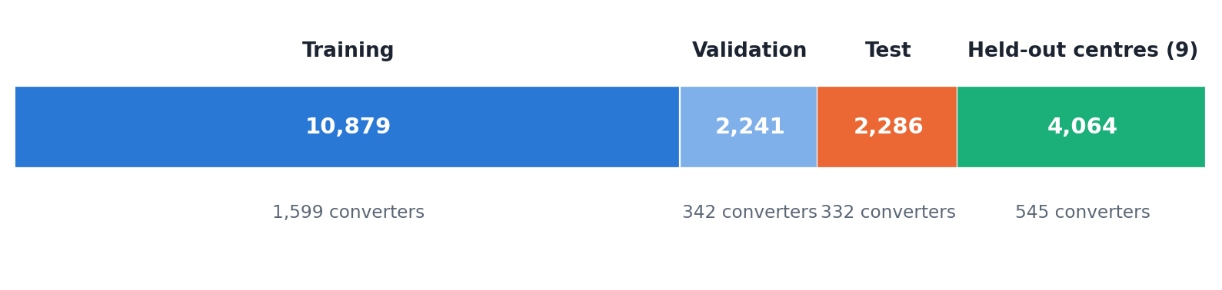
Data: NACC Freeze 74 and the Cohort
Step | Participants
All participants | 57,038
First visit, in person, UDS v1–3 | 55,461
not demented at that visit | 38,107
outcome known at 3 years | 19,470
converted to dementia | 2,818 (14.5%)
Three groups, very different risk
Normal: 12,377 (1.6% convert)
MCI: 5,993 (41.5%)
Impaired, not MCI: 1,100 (12.3%)
Person-level split 70 / 15 / 15; 9 of 46 centres held out; everything learned from data is fitted on training only.
9

Slide 10
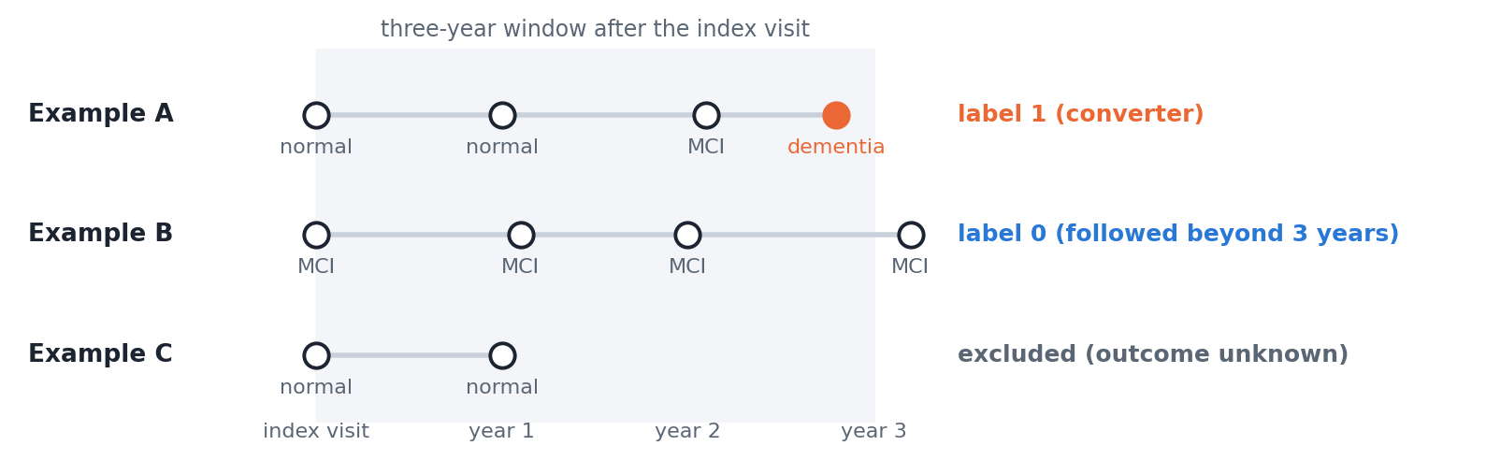
Outcomes and Censoring
Primary: dementia within 3 years
1 if diagnosed within 3 years; 0 if not and followed for 3 years; otherwise unknown and left out.
Secondary outcomes
CDR-SB rise ≥ 1 within 3 years (20,355 people, 5,035 events) and the 3-year change in CDR-SB. A Cox model that keeps censored people gives the same conclusions.
10

Slide 11
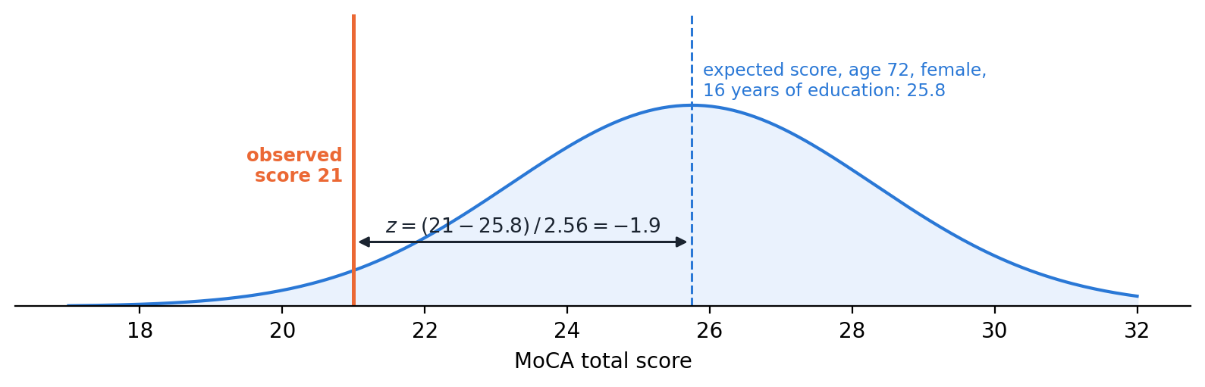
48 Features in Five Categories
Category | Features
Demographics | 8
Cardiovascular and medical | 25
Cognitive tests (z-scores) | 9
Clinical stage (CDR-SB, diagnosis) | 3
Genetics (APOE ε4, family history) | 3
PET (second-stage model only) | 4
Harmonising tests across form versions
Each score is compared with the expected score for the person's age, sex and education (fitted on cognitively normal people): z = (score − expected) / SD. MoCA 21 for a 72-year-old woman with 16 years of education: expected 25.8, z = −1.9.
11

Slide 12
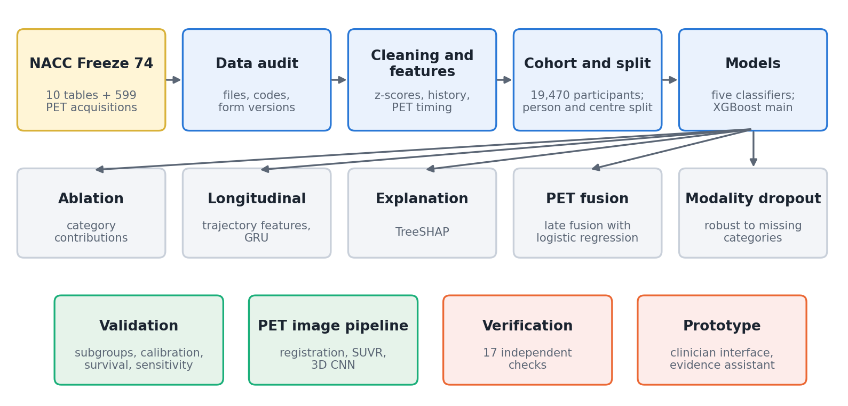
Methodology: The CardioCog Pipeline
Rule for every step
Only information available at the index visit is used; anything learned from data is fitted on the training set; results are reported on the test set and on centres never seen in training.
12

Slide 13
Techniques & Tools
Models compared on the same 48 features
Logistic regression, random forest, XGBoost (main model), MLP, FT-Transformer
Modality-encoder fusion network with attention, risk and progression heads
Evaluation
AUROC, AUPRC, Brier score, calibration, net benefit; 1,000 bootstrap resamples
Explainability and evidence
SHAP, category ablation, Grad-CAM for the PET CNN
Hybrid retrieval: MiniLM embeddings + BM25, merged by rank fusion
Data and platforms
NACC Freeze 74: UDS clinical visits (v1–3), PET core values and PET images
Python (scikit-learn, XGBoost, PyTorch, SHAP, lifelines, SimpleITK); FastAPI + React prototype
13

Slide 14
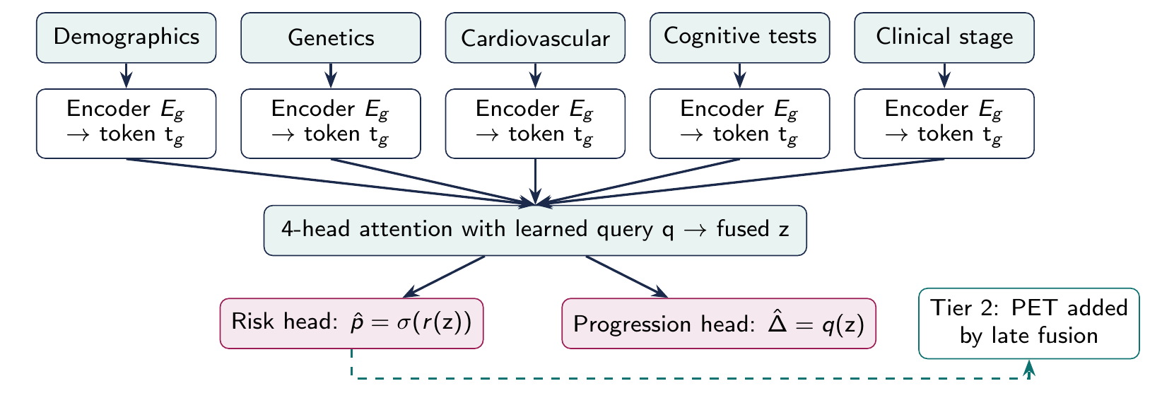
Modality-Encoder Fusion Network
Each category has its own encoder; attention combines the five tokens into one summary.
A missing category gets a learned token; whole categories are hidden with probability 0.35 in training.
Loss: cross-entropy for risk + 0.5 × Huber loss for the CDR-SB change.
14

Slide 15
Results: Dementia Within Three Years
Model | Test AUROC (95% CI) | AUPRC | Brier | Held-out AUROC | Brier
Logistic regression | 0.936 (0.924–0.949) | 0.721 | 0.066 | 0.945 | 0.060
Random forest | 0.932 (0.919–0.944) | 0.704 | 0.070 | 0.940 | 0.064
XGBoost | 0.938 (0.925–0.948) | 0.713 | 0.066 | 0.946 | 0.059
MLP | 0.938 (0.926–0.949) | 0.721 | 0.066 | 0.946 | 0.059
FT-Transformer | 0.939 (0.927–0.949) | 0.720 | 0.066 | 0.945 | 0.061
Test set: 2,286 people, 332 events. Held-out centres: 4,064 people, 545 events.
What it shows
All five models discriminate well and are well calibrated, at new centres as well as on the test set.
What it does not show
The intervals overlap almost completely: deep models give no gain over logistic regression or boosted trees.
15

Slide 16
Is 0.94 Too Good? Results Within Groups
Group | Test | Held-out
All not demented | 0.937 | 0.946
Cognitively normal | 0.884 | 0.876
MCI | 0.835 | 0.846
Critical check
Removing all current-cognition information drops AUROC from 0.937 to 0.746.
Converters: normal 24 / 37, MCI 289 / 496 (test / held-out).
Interpretation
Diagnosis alone gives AUROC 0.84, because MCI converts 25 times as often as normal cognition. Within MCI the model still ranks risk at 0.84.
Meaning
The model estimates short-term progression given the current clinical stage. It is not leakage: inputs come from the index visit, the label from later visits.
16

Slide 17
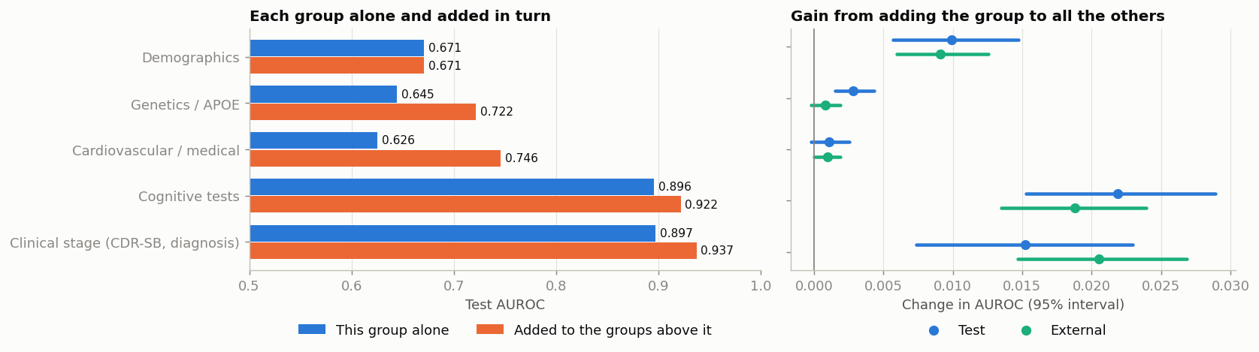
What Drives the Prediction?
Category | Alone | Gain added last (test) | Gain (held-out)
Cognitive tests | 0.896 | +0.022 | +0.019
Clinical stage | 0.897 | +0.015 | +0.021
Demographics | 0.671 | +0.010 | +0.009
Genetics (APOE) | 0.645 | +0.003 | +0.001
Cardiovascular / medical | 0.626 | +0.001 | +0.001
17

Slide 18
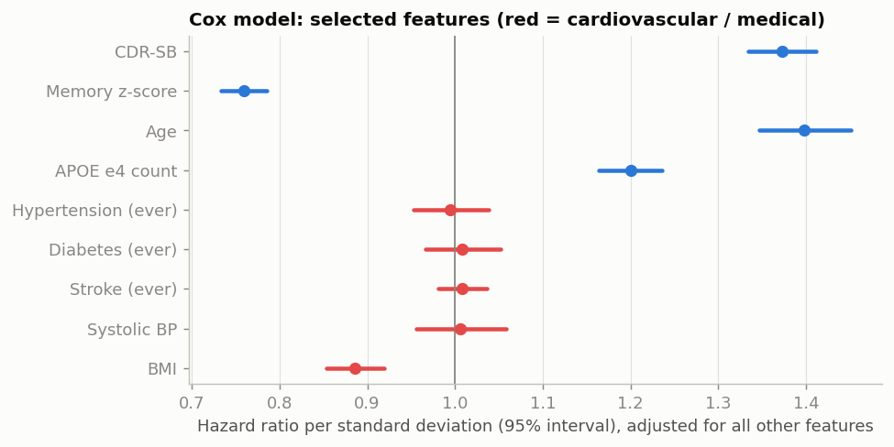
The Cardiovascular Question (RQ2)
Alone: AUROC 0.626.
After cognition: +0.001 for dementia, +0.0004 for CDR-SB decline.
Cox model: hypertension HR 0.995; diabetes and stroke ≈ 1.
Interpretation
Limited added value in this cohort, not evidence that vascular health is unimportant: median age 71, midlife exposure unobserved, and past damage already shows in the cognitive scores.
18

Slide 19
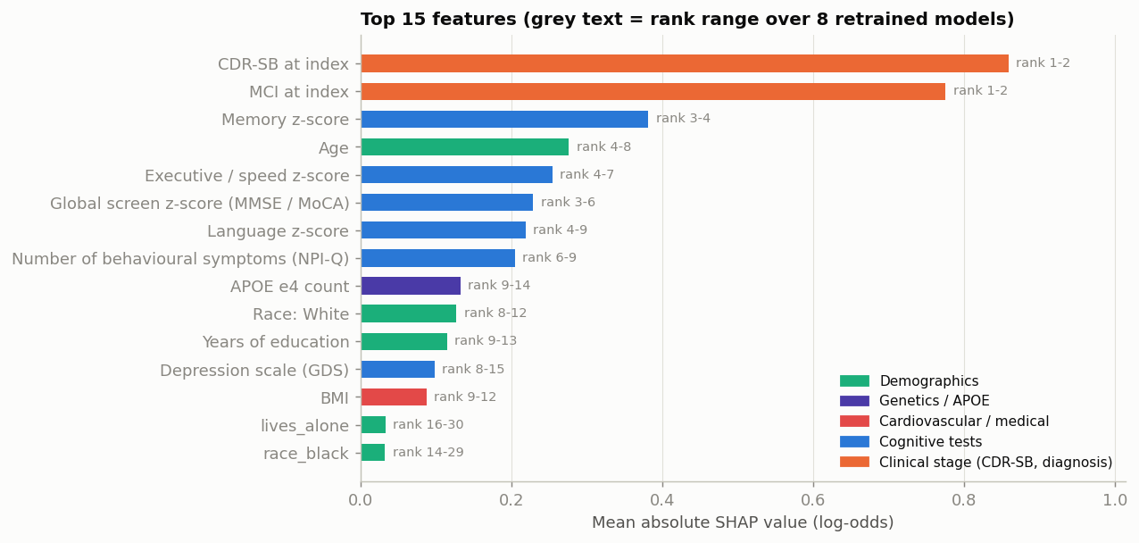
Explainability: Shapley Values
Category | SHAP share
Clinical stage | 40.8%
Cognitive tests | 35.0%
Demographics | 15.5%
Cardiovascular | 5.1%
Genetics | 3.5%
Each prediction is split into contributions from each feature.
Rankings are stable over 8 refits (Spearman 0.89–0.97).
Low BMI raises the estimated risk: weight loss before diagnosis, not a causal effect.
19

Slide 20
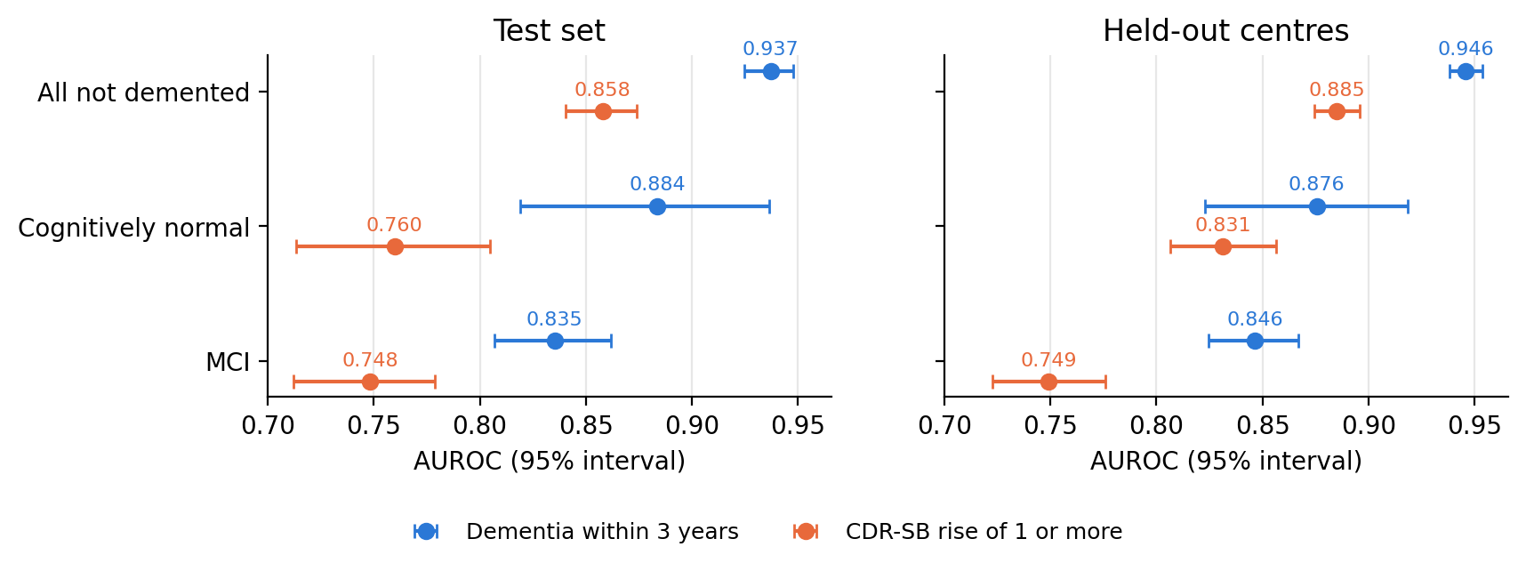
Cognitive Decline as the Outcome
CDR-SB rise ≥ 1
20,355 people, 5,035 events. AUROC 0.858 test, 0.885 held-out; within normal cognition 0.76–0.83.
Predicted 3-year CDR-SB change
Mean absolute error 0.69 → 0.60 (test), 0.82 → 0.72 (held-out); MCI 1.90 → 1.59; no gain for normal cognition.
20

Slide 21
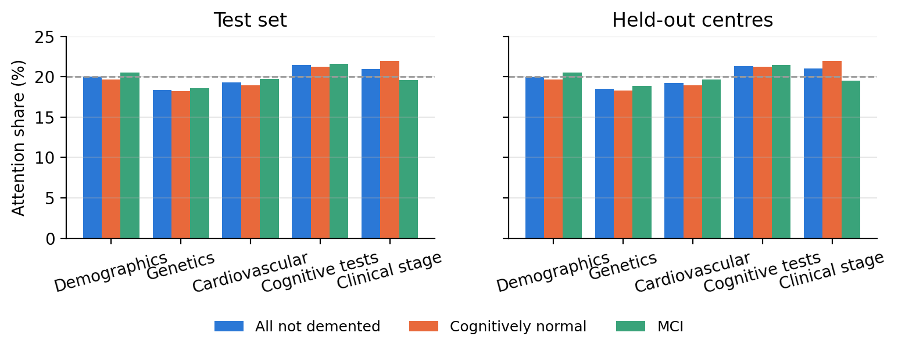
Fusion Network: Results
AUROC | Fusion net | XGBoost
Test | 0.934 | 0.937
Held-out | 0.943 | 0.946
MCI (test) | 0.831 | 0.835
Finding
As good as XGBoost but no better. Attention is 18–22% for every category (uniform = 20%), so it does not explain predictions; SHAP and ablation are used instead.
21

Slide 22
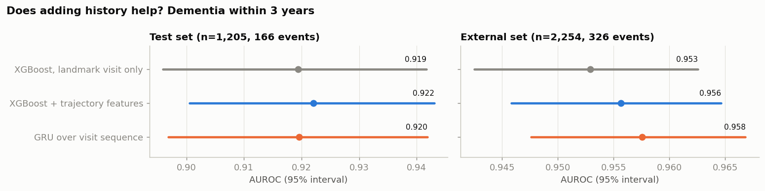
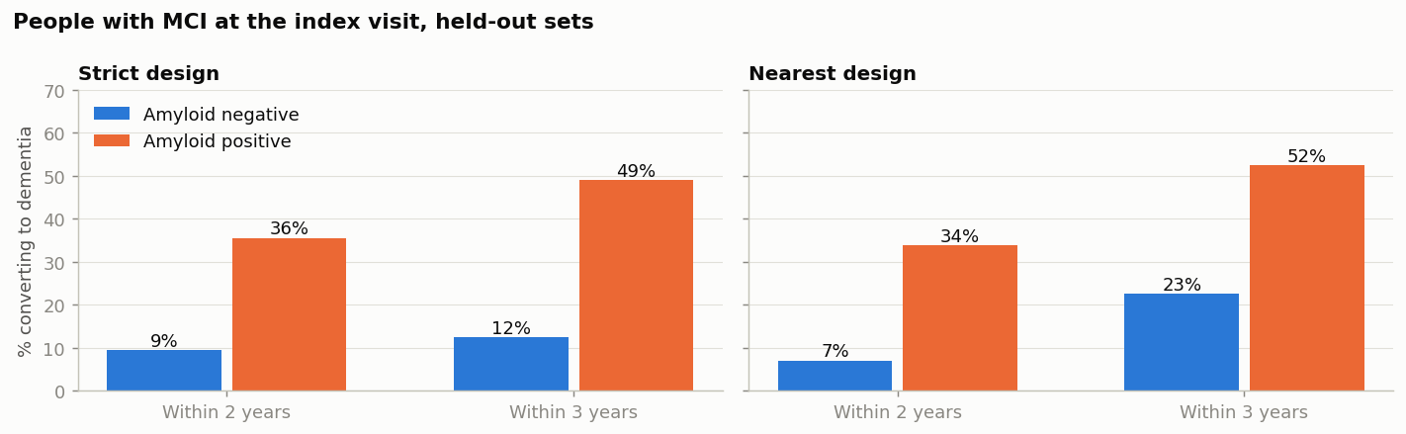
Earlier Visits and PET Measures
Visit history (RQ5)
Using up to all earlier visits adds +0.000 to +0.005 AUROC.
Amyloid and tau PET (RQ3)
In MCI, 34% of amyloid-positive vs 7% of negative people convert within 2 years, but adding PET to the model gives no demonstrable gain (243 people, 33 events).
22

Slide 23
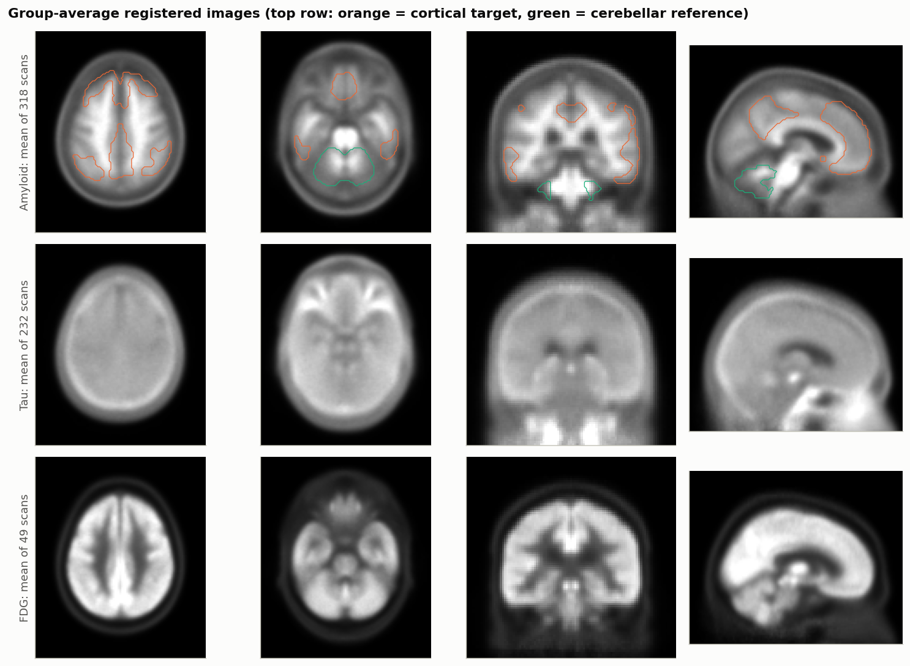
PET Image Pipeline: DICOM to SUVR
Convert: 599 dynamic DICOM series → one static volume.
Register: to MNI152, then to a study PET template.
Quantify: SUVR = mean cortex ÷ mean cerebellum.
Group averages only (318 amyloid, 232 tau, 49 FDG scans).
Validation against the NACC PET core
Pearson r = 0.977 over 318 scans (0.96–0.99 per tracer); mean difference −0.043.
23

Slide 24
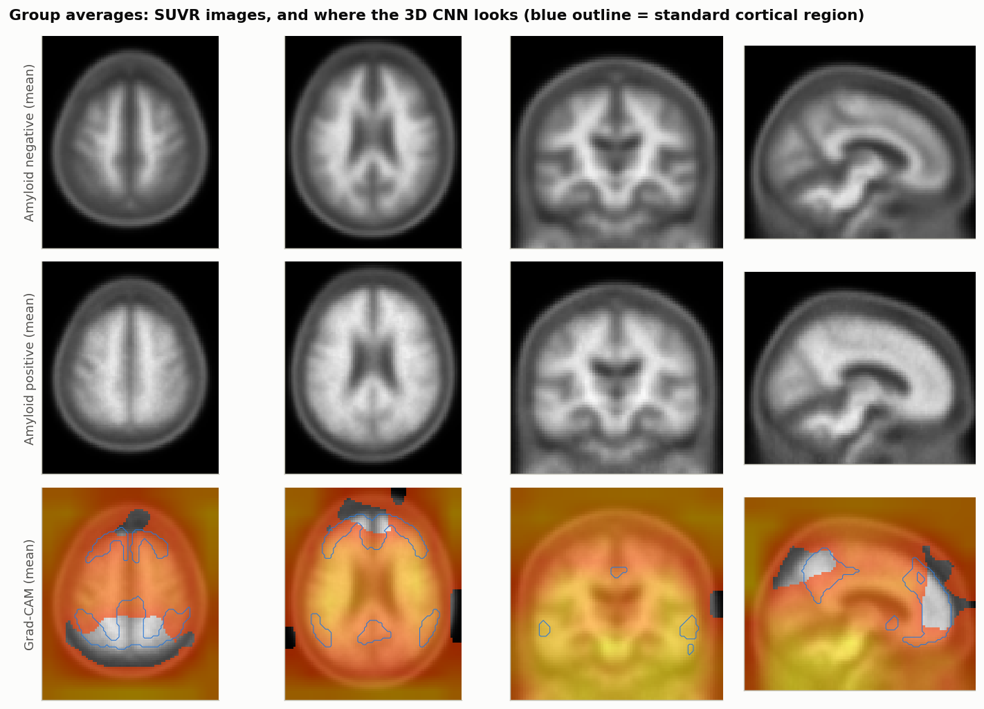
3D CNN for Amyloid Status
Method (292 scans, 84 positive) | AUROC
Cortical SUVR (one number) | 0.982
Regional logistic model | 0.971
3D CNN | 0.960
Interpretation
The image model works, but the label itself comes from cortical SUVR, so one number is hard to beat.
Limitation
Grad-CAM maps were diffuse, and only 5 imaged people converted, so images were not used to predict dementia.
24

Slide 25
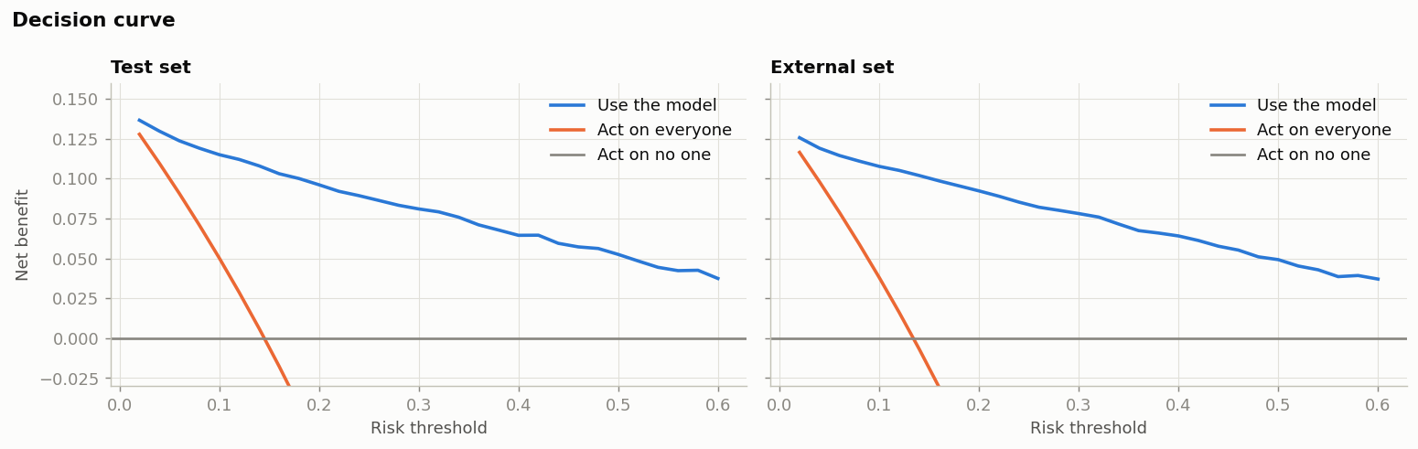
Validation: Calibration, Usefulness, Missing Data
Predicted 14.5% = observed 14.5% (test).
At 20% risk: sensitivity 83%, specificity 88%.
Useful (net benefit) from 2% to 60% risk.
Brier score | Standard | Dropout | Specialist
Everything | 0.066 | 0.067 | 0.066
No clinical stage | 0.185 | 0.076 | 0.074
No cognition at all | 0.441 | 0.115 | 0.111
Demographics only | 0.444 | 0.120 | 0.118
Modality dropout keeps one model close to a specialist model.
25

Slide 26
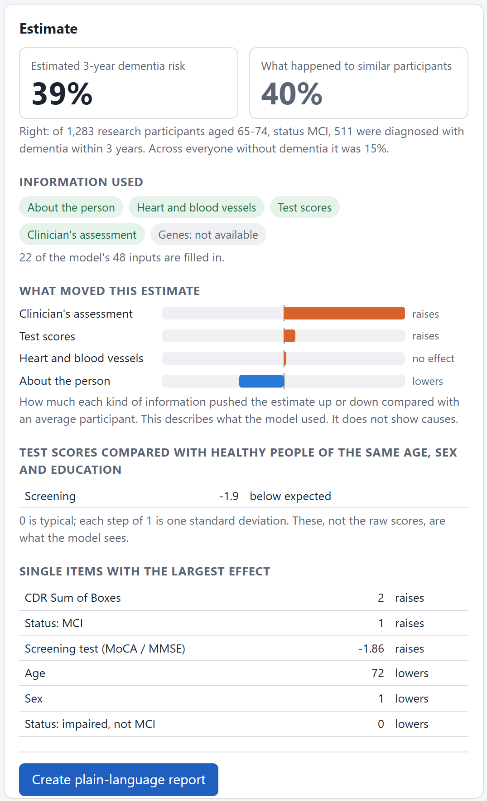
Research Prototype for Clinicians
Example: 72-year-old woman, 16 years of education, MCI, CDR-SB 2, MoCA 21.
FastAPI + React; the form is generated from the 48 trained features.
Risk shown next to the observed rate of similar people, with SHAP by category.
Plausibility checks flag contradictory entries.
27 of 28 behaviour checks pass.
26

Slide 27
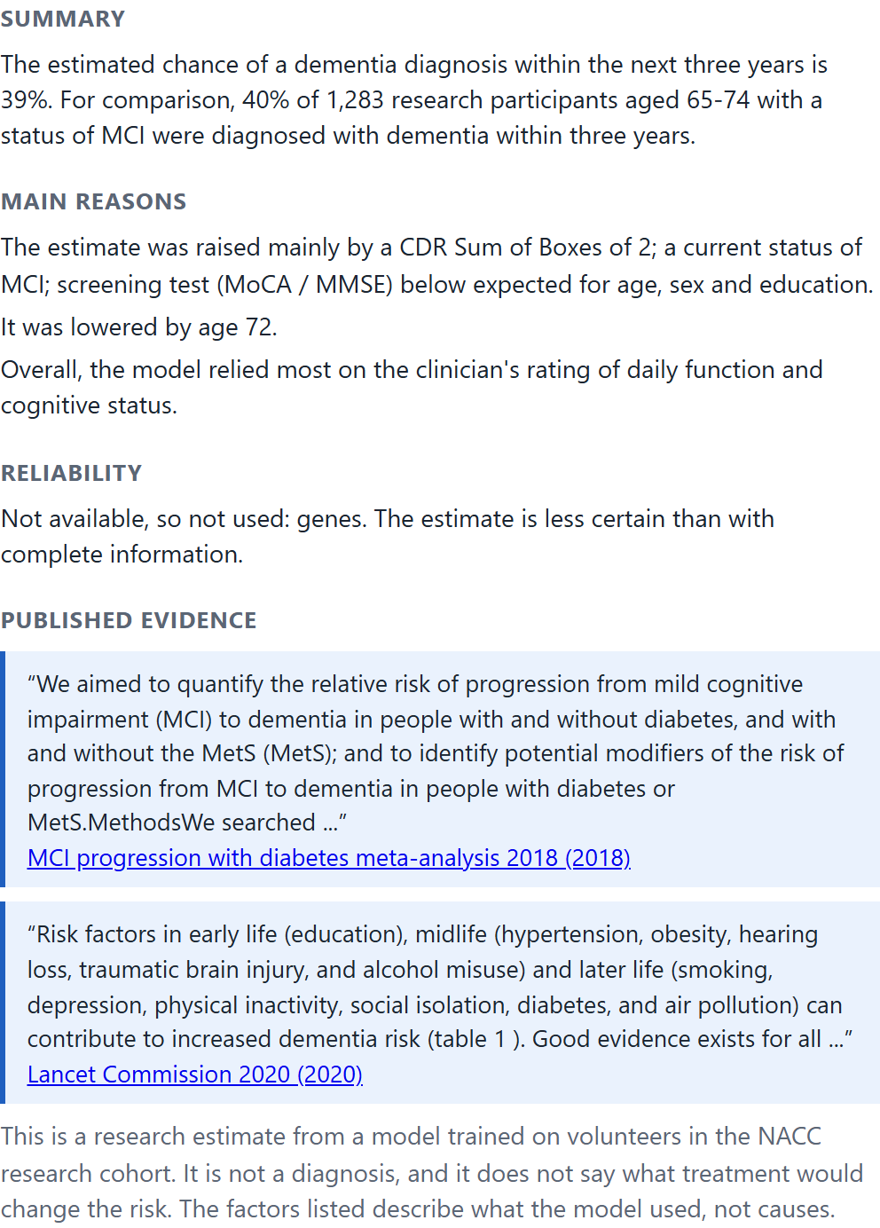
Plain-Language Report
Summary: risk next to the observed rate of similar people (39% vs 40%).
Main reasons: largest SHAP contributions in plain words.
Reliability: missing categories and warnings.
Published evidence: quoted passages with their source.
Limits: a fixed statement that it is not a diagnosis.
Evidence is quoted, never generated, so the report cannot state anything the model or the literature did not provide.
27

Slide 28
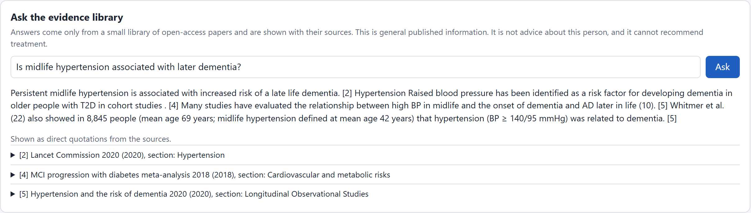
Evidence Assistant (RAG)
MiniLM embeddings + BM25 keyword search, merged by rank fusion.
If nothing is similar enough, it says the library has no evidence.
Test (11 papers, 447 passages) | Result
Correct source first | 32 / 32
Personal-advice questions flagged | 8 / 8
Out-of-scope questions declined | 6 / 6
28

Slide 29
Independent Verification
Check | Result
No person or held-out centre in more than one partition | 0 shared
Features unchanged when all later visits are deleted | Identical (1,500 people × 67 features)
No PET value newer than the visit that uses it | 0 of 1,481 amyloid, 713 tau
Labels recomputed independently | 0 disagreements in 11,403 visits
Shuffled labels | AUROC 0.508 (chance)
Retrain with a new seed | 0.937 / 0.946 (reported 0.938 / 0.946)
Errors the checks found, and we fixed
Education and race filled from a later visit (0.1% of people); PET scans matched to visits weeks before the scan. After fixing, every model was retrained; results moved only in the third decimal. 17 of 17 checks pass.
29

Slide 30
What Each Research Question Found
Research question | Answer
RQ1 Prediction accuracy | Dementia 0.94 (0.84 in MCI); decline 0.86 (0.75 in MCI)
RQ2 Cardiovascular history | +0.001 AUROC once cognition is known
RQ3 Amyloid and tau PET | Strong association, no demonstrable gain yet
RQ4 Deep models / fusion net | No gain over logistic regression or XGBoost
RQ5 Earlier visits | +0.000 to +0.005 AUROC
RQ6 Missing categories | Modality dropout keeps calibration close to specialist models
RQ7 Explanation and evidence | SHAP, plausibility checks, report with quoted evidence
Final takeaway
How a person is functioning today carries most of the three-year signal; vascular and genetic history leave their trace in that measurement rather than adding to it.
30

Slide 31
Limitations & Future Work
Held-out centres are still within NACC; validation on another cohort is the next step.
NACC is a research cohort, mostly White and highly educated; about half of eligible people lacked a 3-year outcome.
Few cognitively normal converters; normal cognition needs a 5- to 10-year model.
Richer vascular data (repeated blood pressure, treatment, imaging) may capture what yes/no history misses.
PET registered without MRI and tau not quantified; longer follow-up will allow a proper PET test.
Evidence library of 11 papers; a larger curated library would help.
31

Slide 32
Industry / Research Relevance
Clinical screening: flags elevated short-term risk for earlier specialist follow-up, with reasons and evidence, without making a diagnosis.
Clinical trials: within MCI the model ranks risk at AUROC 0.84, which helps select people likely to progress.
Research: a reusable method for measuring what each data source adds and for checking a pipeline against information leakage.
32

Slide 33
Team Roles
Members | Responsibility
Bhargav, Hansika | Cardiovascular and demographic features, baseline models
Akhil, Bhargav | Visit-history models, CDR-SB progression regression
Mahidhar, Hansika, Bhargav | PET image pipeline and 3D CNN, modality-encoder fusion network
Akhil, Hansika, Mahidhar | RAG evidence assistant, evaluation framework, ablations
33

Slide 34
References
[1] G. Livingston et al., "Dementia prevention, intervention, and care: 2020 report of the Lancet Commission," The Lancet, vol. 396, pp. 413–446, 2020.
[2] S. A. Alaka et al., "Enhancing the validity of CAIDE dementia risk scores with resting heart rate and machine learning: an analysis from the National Alzheimer's Coordinating Center," Alzheimer's & Dementia, vol. 21, e70442, 2025.
[3] A. Stern and M. Linial, "Integrative machine learning approach to risk prediction for dementia and Alzheimer's disease," GeroScience, vol. 48, pp. 3007–3023, 2026.
[4] D. Aschwanden et al., "Predicting cognitive impairment and dementia: a machine learning approach," J. Alzheimer's Disease, vol. 75, pp. 717–728, 2020.
[5] F. Yi et al., "XGBoost-SHAP-based interpretable diagnostic framework for Alzheimer's disease," BMC Med. Inform. Decis. Mak., vol. 23, 137, 2023.
[6] Y. Gorishniy et al., "Revisiting deep learning models for tabular data," NeurIPS, vol. 34, 2021.
[7] P. Lewis et al., "Retrieval-augmented generation for knowledge-intensive NLP tasks," NeurIPS, vol. 33, 2020.
[8] T. Chen and C. Guestrin, "XGBoost: a scalable tree boosting system," Proc. ACM SIGKDD, pp. 785–794, 2016.
[9] S. M. Lundberg and S.-I. Lee, "A unified approach to interpreting model predictions," NeurIPS, vol. 30, 2017.
[10] W. E. Klunk et al., "The Centiloid Project: standardizing quantitative amyloid plaque estimation by PET," Alzheimer's & Dementia, vol. 11, pp. 1–15, 2015.
34

Slide 35
Thank You
Questions are welcome.
Data: National Alzheimer's Coordinating Center (NACC), Freeze 74, used under the NACC data use agreement. All results are aggregates.

