Slide 1

CardioCog: Cognitive Health Assessment and Early Prediction of Cognitive Decline Using Cardiovascular, Genetic, and Clinical factors
Student Details:
1. Akula Akhil Vighnesh – CB.SC.U4AIE23303
2. Vada Gouri Hansika Reddy – CB.SC.U4AIE23304
3. Pilli Venkata Bhargav Reddy – CB.SC.U4AIE23329
4. Marella Venkata Mahidhar Reddy – CB.SC.U4AIE23354
Team Number: D07
Supervisor: Dr.Manoj Bhat.K

Slide 2
Introduction & Motivation
Domain: AI/Healthcare Analytics/XAI/Biomedical Data Science
Introduction
Dementia and Alzheimer's disease are rapidly increasing worldwide, affecting memory, thinking ability, and the quality of life of millions of people.
Research indicates that cardiovascular conditions such as hypertension, diabetes, obesity, and stroke are strongly associated with an increased risk of cognitive decline and dementia.
Early prediction using Artificial Intelligence can help identify high-risk individuals, enabling timely intervention and supporting better clinical decision-making.
Motivation and Need in the outside world
Cognitive decline often becomes irreversible once it's clinically noticeable, so early detection is the main window where intervention can actually slow or delay progression.
Catching decline early allows for simple, low-cost interventions (lifestyle changes, medication, monitoring) instead of intensive care needed at later, more severe stages.
Early diagnosis gives patients and families more time to plan — for care, finances, and support — before the condition significantly affects independence.

Slide 3
Literature Review
No. | Paper / Year (full title) | Dataset (short) | Method / Technique (full) | Key Result (short) | Paper‑Specific Gap (short)
1 | Kuchibhatla et al. (2025), “Enhancing the validity of CAIDE dementia risk scores with resting heart rate and machine learning: An analysis from the National Alzheimer’s Coordinating Center across all races/ethnicities” | NACC, multi‑ethnic cohort. | Random forest CAIDE models with and without resting heart rate (CAIDE vs CAIDE‑RHR), evaluated by race/ethnicity using AUC, MCC and Brier score. | Resting heart rate improves CAIDE dementia risk prediction in most groups (AUC ≈0.80–0.91), but not in American Indians. | Volunteer NACC sample with limited external validation and unequal ethnic performance; not benchmarked against newer multimodal ML dementia risk scores.
2 | Jia et al. (2024), “Cardiovascular disease risk models and dementia or cognitive decline: a systematic review” | 22 cohorts, 15 CVD scores. | PRISMA systematic review of studies using cardiovascular risk scores to predict later dementia/cognitive decline; quality rated via Newcastle–Ottawa and AHRQ. | Most CVD scores show positive associations with dementia/cognitive decline; several report AUCs in the mid‑0.7 range. | Strong heterogeneity and inconsistent metrics prevent clear “best model” identification; few standardized, recalibrated or ML‑extended dementia‑specific scores.
3 | Song et al. (2020), “Associations Between Cardiovascular Risk, Structural Brain Changes, and Cognitive Decline” | Rush Memory and Aging Project. | Baseline Framingham General Cardiovascular Risk Score; mixed‑effects models for longitudinal cognition; regression linking FGCRS to MRI‑based brain volumes and white matter hyperintensities. | Higher CV risk predicts faster decline in multiple cognitive domains and more neurodegeneration (smaller volumes, more WMH). | Single traditional score in an older U.S. cohort with MRI only in a subset; no predictive ML or multimodal dementia risk framework.
5 | Ding et al. / GeroScience (2025), “Integrative machine learning approach to risk prediction for dementia and Alzheimer’s disease” | UK Biobank (AD cases + controls). | Comparison of multiple ML algorithms on ICD‑10 diagnoses, lifestyle factors and genetics (including APOE), with sex‑specific and vascular vs non‑vascular dementia models; CatBoost selected as best. | CatBoost reaches ROC‑AUC ≈0.77 for AD risk and highlights comorbidities, education, activity, diet and CV health as key predictors. | Moderate AUC and reliance on UK Biobank volunteers without imaging/cognitive tests limit external validity and multimodal richness.

Slide 4
No. | Paper / Year (full title) | Dataset (short) | Method / Technique (full) | Key Result (short) | Paper‑Specific Gap (short)
6 | Aschwanden et al. (2020), “Predicting Cognitive Impairment and Dementia: A Machine Learning Approach” | Health and Retirement Study (HRS). | Split‑sample pipeline: random‑forest survival importance over 52 predictors, followed by Cox models for hazard ratios across demographics, psychological traits, health, lifestyle, CV factors and polygenic scores | Emotional distress, subjective health and sociodemographic factors dominate risk; CV factors and polygenic scores contribute less when considered jointly. | Provides predictor rankings instead of a deployable dementia risk score; lacks neuroimaging, multimodal ML and external validation.pubmed.ncbi.nlm.nih+1
7 | Yi et al. (2023), “XGBoost‑SHAP‑based interpretable diagnostic framework for Alzheimer’s disease” | ADNI and NACC. | Class‑weighted XGBoost for NC/MCI/AD classification, combined with SHAP explanations; benchmarked against RF, Bagging, AdaBoost, Naïve Bayes and unweighted XGBoost. | High diagnostic performance (AUC ≈0.91 on ADNI, ≈0.88 on NACC) with interpretable SHAP‑based feature importance. | Requires MRI and genetic data, limiting use in low‑resource settings; focuses on cross‑sectional diagnosis, not longitudinal risk or time‑to‑conversion.pmc.ncbi.nlm.nih+1
8 | El‑Sappagh et al. (2021), “A multilayer multimodal detection and prediction model based on explainable artificial intelligence for Alzheimer’s disease” | ADNI, 4 classes, 11 modalities. | Two‑layer multimodal RF framework: Layer 1 multi‑class diagnosis (NC, stable MCI, progressive MCI, AD); Layer 2 3‑year MCI→AD progression prediction; explainability via SHAP, tree‑based and fuzzy‑rule explainers with natural‑language outputs. | Very high cross‑validated accuracy for diagnosis (~93.9%) and progression (~87.1%) using reduced multimodal feature sets. | Highly complex, ADNI‑dependent model with no external cohort validation or clear strategy for cost, missing modalities or simpler clinical‑only baselines.pubmed.ncbi.nlm.nih+1

Slide 5

Research Gap and addressing it
Cardiovascular biomarkers have demonstrated strong associations with cognitive decline but remain underutilized in AI-based prediction models.
Most models lack longitudinal disease progression modeling and interpretable AI-based explanations.
Large-scale multimodal datasets remain underutilized due to the limited integration of available clinical biomarkers.
So the proposed direction to address this gap is to develop a clinically applicable multimodal AI framework that bridges the gap between cardiovascular health and cognitive disease prediction by integrating cardiovascular risk factors, longitudinal cognitive assessments, and PET biomarkers. The framework aims to provide accurate, explainable, and personalized risk assessment to support early clinical intervention.

Slide 6
Problem Statement
Existing AI models often rely on limited clinical information for cognitive disease prediction, reducing their ability to capture the complex relationship between cardiovascular health and cognitive decline. This project develops an explainable multimodal AI framework using cardiovascular, cognitive, PET, and demographic biomarkers from large-scale longitudinal datasets for early cognitive disease risk assessment. The scope is limited to risk assessment and progression prediction and does not include clinical diagnosis, treatment recommendation, or prognosis.
In scope | Out of scope
Risk assessment & progression prediction | Clinical diagnosis
Multimodal integration: cardiovascular, cognitive, PET, demographic biomarkers | Treatment recommendation
RAG-based retrieval of clinical evidence for grounding predictions | Post-diagnosis prognosis (e.g., survival, symptom trajectory)
Explainable model outputs (interpretable risk drivers) | External cohort validation

Slide 7
Objectives
Design a multimodal AI framework that combines cardiovascular, cognitive, PET, and demographic data to assess cognitive decline risk, instead of relying on a single data type the way most existing models do.
Work with real-world longitudinal data (NACC cohort,NHANES and more) and address a key practical challenge — most patients don't have complete data across all modalities, especially PET — by building a model that still performs well with partial information.
Incorporate a retrieval-augmented (RAG) component so the model's predictions are backed by relevant clinical evidence, rather than just producing a risk score with no explanation of "why."
Make the model's decisions interpretable, using explainability techniques (e.g., SHAP, DiCE) so clinicians and researchers can understand which factors are driving a given risk prediction.
Distinguish between predicting a patient's current risk level and predicting how their condition might progress over time, since these are related but different problems that need to be handled thoughtfully.

Slide 8
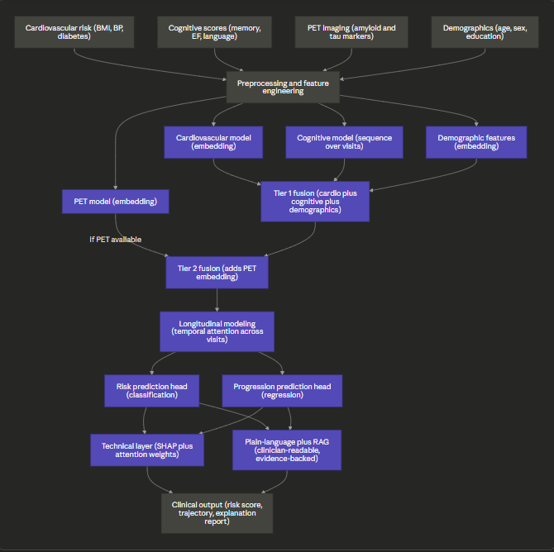
Proposed Methodology / Framework

Slide 9
Techniques & Tools
Algorithms & why chosen
  Gradient-boosted trees (XGBoost/CatBoost) for cardio/demographic data — captures non-linear risk interactions better than logistic regression
  LSTM/Transformer for cognitive trajectories — models rate of decline, not just latest score, unlike static averaging
  CNN (3D ResNet) for PET scans — standard for volumetric imaging, pairs with Grad-CAM
  RAG (dense retrieval) — grounds predictions in evidence, generalizes better than a fixed rule-based knowledge base
  Attention-based fusion — down-weights missing modalities per patient, avoiding blanket imputation
Explainability
  SHAP (tabular), Grad-CAM (PET), attention weights (RAG), DiCE (counterfactuals)
Dataset
  NACC cohort via ADSP-PHC harmonized release (Feb 2026, ng00067.v20)
Platforms & hardware
  Python (PyTorch/TensorFlow), GPU compute for CNN/transformer training
  FAISS/Chroma (vector DB for RAG), SHAP/Captum/DiCE-ML (explainability libs)

Slide 10
Expected Outcomes
Deliverables
A trained two-tier multimodal model producing cognitive-decline risk classification and progression estimates from cardiovascular, cognitive, PET, and demographic data
A working RAG module retrieving relevant clinical evidence to help ground predictions
An explainability layer providing per-prediction attributions via a subset of SHAP, Grad-CAM, attention weights, and DiCE (finalized during implementation)
Target Metrics
Classification performance competitive with or exceeding single-modality baselines (exact AUC target TBD after baseline runs — likely in the 0.70–0.78 range given known class imbalance and cohort heterogeneity)
Retrieval relevance evaluated via precision@k, compared against a no-retrieval ablation, with improvement direction expected but magnitude to be determined empirically
Graceful degradation under missing PET data — model remains usable on the full cohort, with performance drop on PET-absent cases measured rather than assumed

Slide 11
Industry /Research Relevance
Clinical screening: flags elevated-risk patients for earlier specialist referral, without making a diagnostic call itself
Pharmaceutical & clinical trial research — patient stratification for Alzheimer's drug trials, where early/high-risk cohorts are hard to identify
Academic & biomedical AI research — advancing multimodal fusion and retrieval-augmented methods for longitudinal healthcare prediction

Slide 12
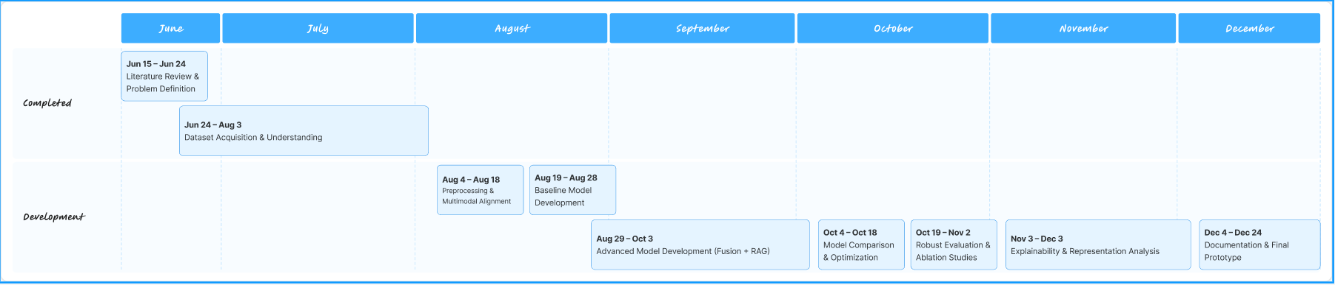
Timeline

Slide 13
Team Roles
Bhargav,Hansika | Cardio + demographic encoder, baseline models
Akhil,Bhargav | Cognitive trajectory encoder (LSTM/Transformer), progression head
Mahidhar,Hansika,Bhargav | PET encoder (CNN), two-tier fusion architecture
Akhil,Hansika,Mahidhar | RAG retrieval module, evaluation framework, ablations

Slide 14
References
[1] M. Kuchibhatla et al., "Enhancing the validity of CAIDE dementia risk scores with
resting heart rate and machine learning: An analysis from the National Alzheimer's
Coordinating Center across all races/ethnicities," 2025. PMID: 40778563.
[2] "Cardiovascular disease risk models and dementia or cognitive decline: a systematic
review," Front. Aging Neurosci., vol. 15, 2024, Art. no. 1355151. PMID: 37904838.
[3] "Associations Between Cardiovascular Risk, Structural Brain Changes, and Cognitive
Decline," 2020. PMID: 32439001.
[4] "Integrative machine learning approach to risk prediction for dementia and
Alzheimer's disease," GeroScience, 2025. PMID: 40864401.
[5] "Predicting Cognitive Impairment and Dementia: A Machine Learning Approach," 2020.
PMID: 32333585.
[6] "XGBoost-SHAP-based interpretable diagnostic framework for Alzheimer's disease,"
2023. PMID: 37491248.
[7] "A multilayer multimodal detection and prediction model based on explainable
artificial intelligence for Alzheimer's disease," 2021. PMID: 33514817.

