Slide 1
CardioCog: An Explainable AI Framework for Cognitive Health Assessment and Early Prediction of Cognitive Decline Using Cardiovascular, Genetic, and Clinical Factors
FINAL REVIEW – B.TECH PROJECT
Team No.: D07
Akula Akhil Vighnesh
Vada Gouri Hansika Reddy
Pilli Venkata Bhargav Reddy
Marella Venkata Mahidhar Reddy
CB.SC.U4AIE23303
CB.SC.U4AIE23304
CB.SC.U4AIE23329
CB.SC.U4AIE23354
Supervisor: Dr. Manoj Bhat K, Professor
AMRITA VISHWA VIDYAPEETHAM – SCHOOL OF ARTIFICIAL INTELLIGENCE, COIMBATORE

Slide 2
01 | Research Progress: From Proposal to Evidence
Research progression
Zeroth review: multimodal framework → first review: 3D amyloid-PET prototype (198 people, 17 events) → full NACC clinical cohort (19,470 people, 2,818 events) → two decline outcomes, five models, fusion network → PET image pipeline, prototype, 17 verification checks.
Milestone | Evidence and outcome
First-review prototype | 3D CNN + cross-attention on amyloid PET: AUROC 0.786 in one run, 0.652 on re-run. Too few events to conclude.
Leakage-free cohort | First visit, not demented, UDS v1–3; person-level split with 9 whole centres held out.
Dementia in 3 years | XGBoost AUROC 0.938 (test), 0.946 (held-out centres); 0.84 within MCI.
Cognitive decline | CDR-SB rise ≥ 1: AUROC 0.858 / 0.885; CDR-SB change regression helps MCI.
Independent checks | 17 of 17 checks pass; two future-information errors found and fixed.
1 / 27

Slide 3
02 | Motivation and Problem Statement
Problem
Clinics already record cognition, vascular history, genetics and sometimes PET for older adults without dementia, but rarely combine them into one explainable estimate of near-term decline. Which of these sources actually adds information, and can the estimate be trusted?
For a person without dementia at visit t₀, estimate over the next three years:
p̂_dem = P(dementia | x), p̂_dec = P(ΔCDR-SB ≥ 1 | x), Δ̂ = E(ΔCDR-SB | x)
1. How accurately can both outcomes be predicted, for normal and MCI groups separately?
2. Does cardiovascular history add to demographics, genetics and current cognition?
3. Do amyloid and tau PET add to the clinical model?
4. Do deep models, including a modality-encoder fusion network, beat classical ones?
5. Do earlier visits help?
6. Can one model cope with whole categories of information missing?
7. Can each estimate be explained and supported with published evidence?
2 / 27

Slide 4
03 | Literature Review and Research Gap
Work | Core method | Relevance / limitation for CardioCog
Livingston et al. (2020) | Lancet Commission, 12 modifiable risk factors | Vascular risk matters over the life course; mostly midlife exposure
Alaka et al. (2025) | CAIDE + heart rate, random forest, NACC | Same database; AUC 0.80–0.91, no within-stage results
Stern & Linial (2026) | CatBoost on UK Biobank codes + APOE | AUROC 0.773 without cognitive inputs
Aschwanden et al. (2020) | Random survival forests, 52 predictors | Cardiovascular factors less important than expected
Yi et al. (2023) | XGBoost + SHAP for diagnosis | CDR-SB most important; diagnosis, not prediction
Gorishniy et al. (2021) | FT-Transformer for tabular data | No deep model consistently beats boosted trees
Lewis et al. (2020) | Retrieval-augmented generation | Grounds generated text in a fixed library
Research gap
Few studies measure, on one large leakage-controlled cohort, how much each source adds once current cognition is known, with results within normal and MCI groups.
3 / 27

Slide 5
Why the design changed after the first review
First-review prototype
Diagnosis
3D CNN on raw amyloid PET + 34 clinical features, spatial cross-attention, 1-year CDR-SB rise ≥ 0.5.
Only 198 people and 17 events: a handful of participants decides the score. The pipeline also mixed PET time frames, had no registration, read one non-existent column and fitted SHAP on all data.
Run | Mean AUROC (SD)
Reported at review | 0.786 (0.134)
Re-run, same notebook | 0.652 (0.153)
Decision
Move to the full clinical cohort with three-year outcomes and thousands of events; treat PET images as a separate, validated pipeline.
4 / 27

Slide 6
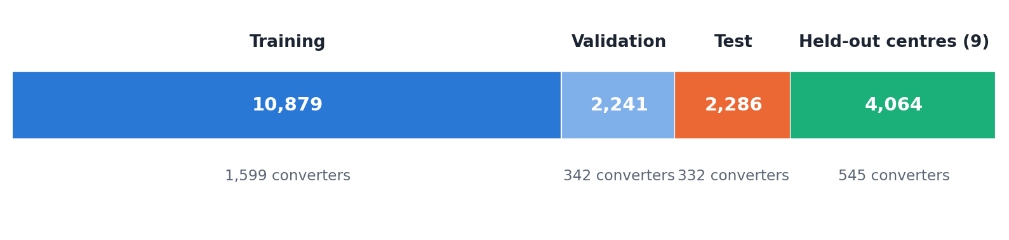
04 | Data: NACC Freeze 74 and the Cohort
Step | Participants
All participants | 57,038
First visit, in person, UDS v1–3 | 55,461
not demented at that visit | 38,107
outcome known at 3 years | 19,470
converted to dementia | 2,818 (14.5%)
• Person-level split; 9 of 46 centres held out entirely.
• Train 70% / validation 15% / test 15%, seed 2026.
• Every normaliser and imputer fitted on training data only.
Three groups, very different risk
Normal 12,377 (1.6% convert)
MCI 5,993 (41.5%)
Impaired, not MCI 1,100 (12.3%)
5 / 27

Slide 7
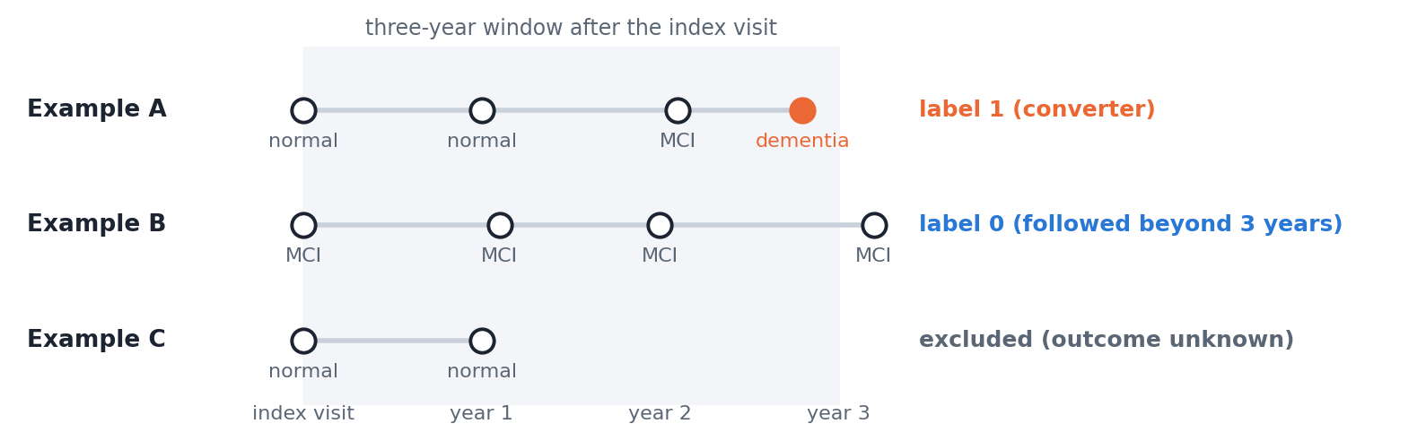
Outcomes and censoring
y = 1 if T ≤ 3
y = 0 if T > 3 and C ≥ 3
y unknown if T > 3 and C < 3
T: years to dementia diagnosis; C: years to last visit.
Secondary outcomes
CDR-SB rise ≥ 1 within 3 years (20,355 people, 5,035 events) and the 3-year change Δ in CDR-SB.
Robustness
A Cox model that keeps censored participants gives the same conclusions.
6 / 27

Slide 8
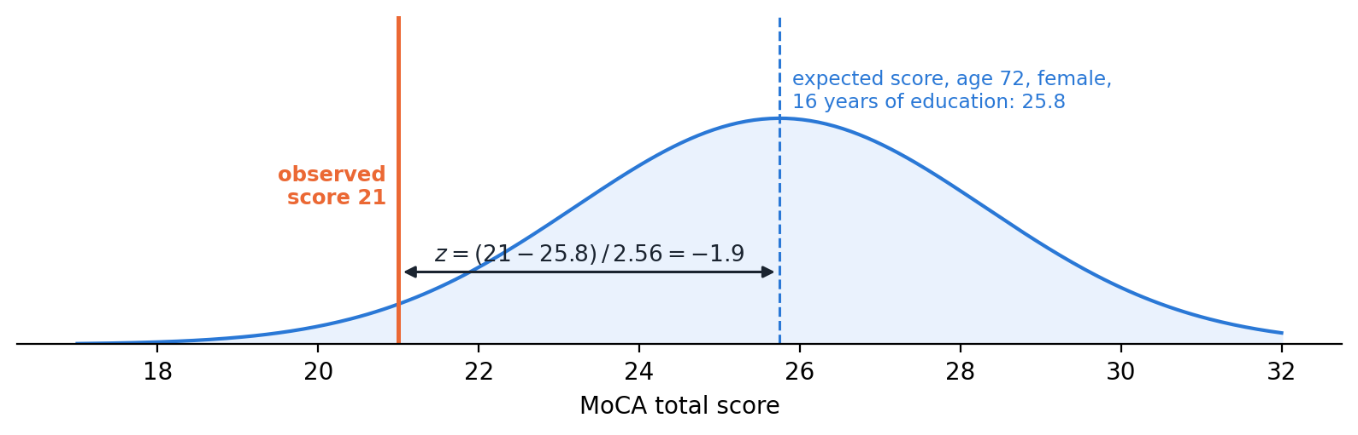
05 | 48 Features in Five Categories
Category | Features
Demographics | 8
Cardiovascular and medical | 25
Cognitive tests (z-scores) | 9
Clinical stage (CDR-SB, diagnosis) | 3
Genetics (APOE ε4, family history) | 3
PET (second-stage model only) | 4
MoCA example: expected 25.8 for a 72-year-old woman with 16 years of education, so a score of 21 gives z = −1.9. Healthy people not used for fitting score within 0.1 of zero in every UDS version.
Harmonising tests across form versions
ŝ = β₀ + β₁·age + β₂·female + β₃·education
z = (s − ŝ) / σ_res
Fitted on cognitively normal training participants.
7 / 27

Slide 9
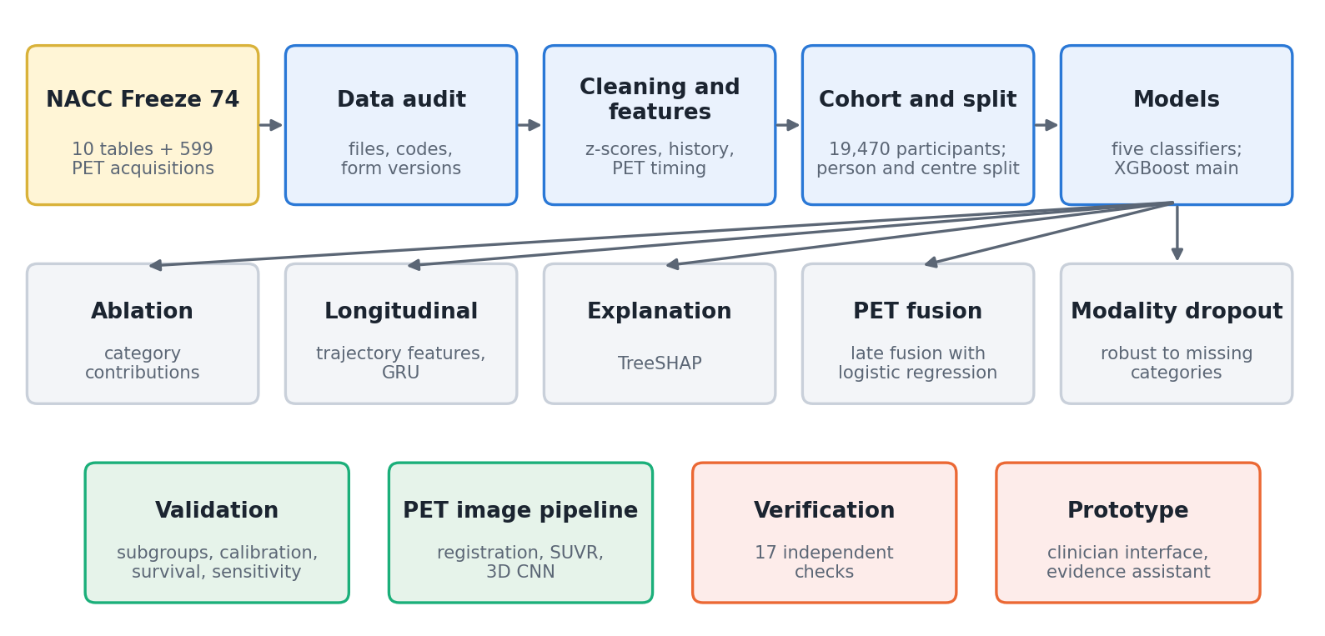
06 | Methodology: the CardioCog Pipeline
Rule for every step
Only information available at the index visit; anything learned from data is fitted on the training set; results are reported on the test set and on centres never seen in training.
8 / 27

Slide 10
Models compared on the same 48 features
Model | Key settings
Logistic regression | L2 penalty, C from 5 values
Random forest | 500 trees, √p features per split
XGBoost | η = 0.03, depth 3–6, λ = 2, early stopping
MLP | 128–64 units, dropout 0.2
FT-Transformer | 64-d tokens, 3 layers, 8 heads
XGBoost objective
f_M(x) = Σₘ η·gₘ(x)
w*ⱼ = −Σ Gᵢ / (Σ Hᵢ + λ)
G, H: first and second derivatives of the loss
Loss and evaluation
L = −(1/n) Σ [y log p̂ + (1−y) log(1−p̂)]
AUROC, AUPRC, Brier, calibration slope, net benefit; 1,000 paired bootstrap resamples.
Three seeds averaged; XGBoost chosen as the main model (handles missing values, exact SHAP).
9 / 27

Slide 11
Modality-encoder fusion network (proposed architecture)
Demographics
Genetics
Cardiovascular
Cognitive tests
Clinical stage
Encoder E_g → token t_g
Encoder E_g → token t_g
Encoder E_g → token t_g
Encoder E_g → token t_g
Encoder E_g → token t_g
4-head attention with learned query q → fused z
Risk head: p̂ = σ(r(z))
Progression head: Δ̂ = q(z)
Tier 2: PET by late fusion
A missing modality gets a learned token m_g; each token gets a type embedding τ_g; whole modalities are hidden with probability 0.35 in training.
L = L_BCE + 0.5 · Huber(Δ − Δ̂), α_g = softmax_g((W_Q q)ᵀ W_K t_g / √8)
10 / 27

Slide 12
07 | Results: Dementia Within Three Years
Model | Test AUROC (95% CI) | AUPRC | Brier | Held-out AUROC | Held-out Brier
Logistic regression | 0.936 (0.924–0.949) | 0.721 | 0.066 | 0.945 | 0.060
Random forest | 0.932 (0.919–0.944) | 0.704 | 0.070 | 0.940 | 0.064
XGBoost | 0.938 (0.925–0.948) | 0.713 | 0.066 | 0.946 | 0.059
MLP | 0.938 (0.926–0.949) | 0.721 | 0.066 | 0.946 | 0.059
FT-Transformer | 0.939 (0.927–0.949) | 0.720 | 0.066 | 0.945 | 0.061
Test set: 2,286 participants, 332 events. Held-out centres: 4,064 participants, 545 events.
What the result does establish
All five models discriminate well and are well calibrated (constant-prediction Brier 0.124), at new centres as well as on the test set.
What it does not establish
Intervals overlap almost completely: deep models give no gain over logistic regression or boosted trees.
11 / 27

Slide 13
Is 0.94 too good? Results within diagnostic groups
Group (test / held-out events) | Test | Held-out
All not demented | 0.937 | 0.946
Cognitively normal (24 / 37) | 0.884 | 0.876
MCI (289 / 496) | 0.835 | 0.846
Critical check
Removing all current-cognition information drops AUROC from 0.937 to 0.746.
Meaning
The model estimates short-term progression given the current clinical stage. It is not leakage: inputs are from the index visit, the label from later visits.
Interpretation
Diagnosis alone gives AUROC 0.84, because MCI converts 25 times as often as normal cognition. Within MCI the model still ranks risk at 0.84.
12 / 27

Slide 14
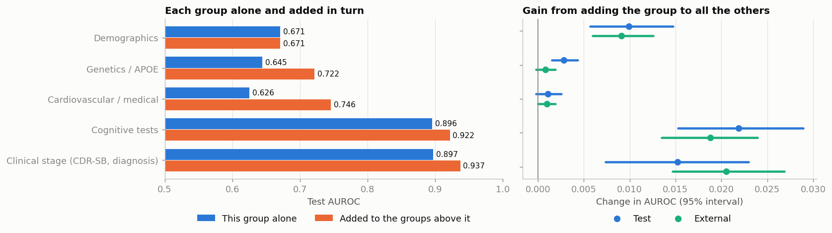
What drives the prediction? Category ablation
Category | Alone | Gain added last (test) | Gain (held-out)
Cognitive tests | 0.896 | +0.022 | +0.019
Clinical stage | 0.897 | +0.015 | +0.021
Demographics | 0.671 | +0.010 | +0.009
Genetics (APOE) | 0.645 | +0.003 | +0.001
Cardiovascular / medical | 0.626 | +0.001 | +0.001
13 / 27

Slide 15
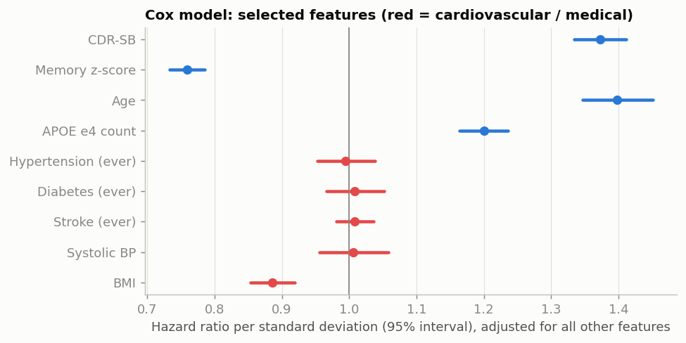
The cardiovascular question (RQ2)
• Alone: AUROC 0.626; before cognition: +0.024 (test), +0.004 (held-out).
• After cognition: +0.001 for dementia, +0.0004 for CDR-SB decline.
• Cox model: hypertension HR 0.995, diabetes and stroke ≈ 1.
Interpretation
Limited incremental value in this cohort, not evidence that vascular health is unimportant: median age 71, midlife exposure unobserved, and past damage already shows in the cognitive scores.
14 / 27

Slide 16
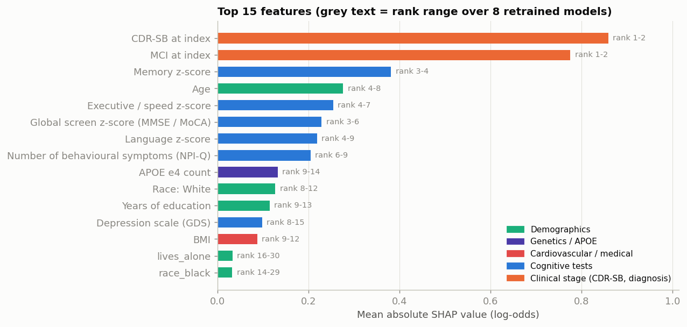
Explainability: Shapley values
f(x) = φ₀ + Σⱼ φⱼ
Category | SHAP share
Clinical stage | 40.8%
Cognitive tests | 35.0%
Demographics | 15.5%
Cardiovascular | 5.1%
Genetics | 3.5%
Stable over 8 refits (Spearman 0.89–0.97). Low BMI raises risk: weight loss before diagnosis, not causal.
15 / 27

Slide 17
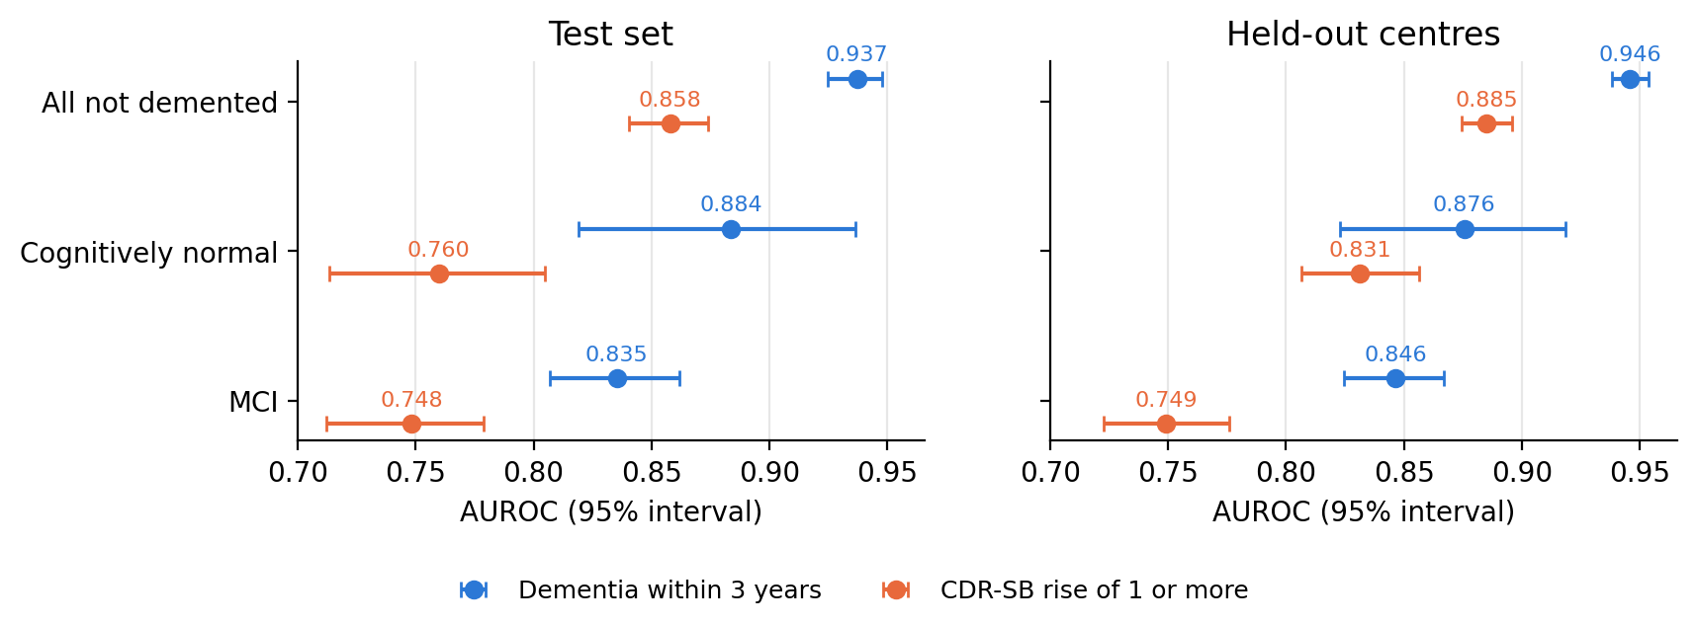
Cognitive decline as the outcome
CDR-SB rise ≥ 1 (20,355 / 5,035 events)
Predicted 3-year CDR-SB change
AUROC 0.858 test, 0.885 held-out; normal 0.76–0.83 with 129 and 215 events, so more reliable than the dementia estimate for normal cognition.
MAE 0.69 → 0.60 (test), 0.82 → 0.72 (held-out); MCI 1.90 → 1.59; normal 0.17 = 0.17, no gain.
16 / 27

Slide 18
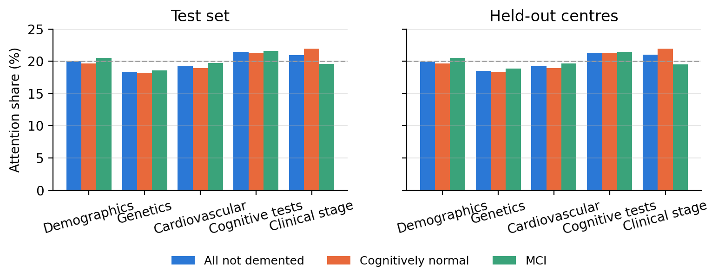
Fusion network: works, but no gain and uninformative attention
AUROC | Fusion net | XGBoost
Test | 0.934 | 0.937
Held-out | 0.943 | 0.946
MCI (test) | 0.831 | 0.835
Progression head MAE 0.72 → 0.65. Without cognition: AUROC 0.72, Brier 0.114.
Finding
Attention is 18–22% for every modality (uniform = 20%), so it does not explain predictions. SHAP and ablation are used instead.
17 / 27

Slide 19
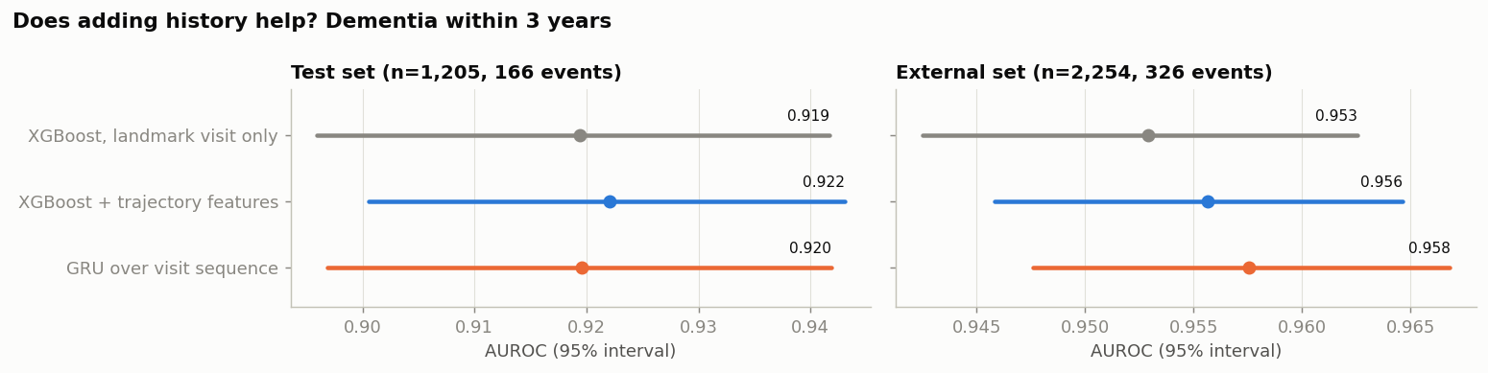
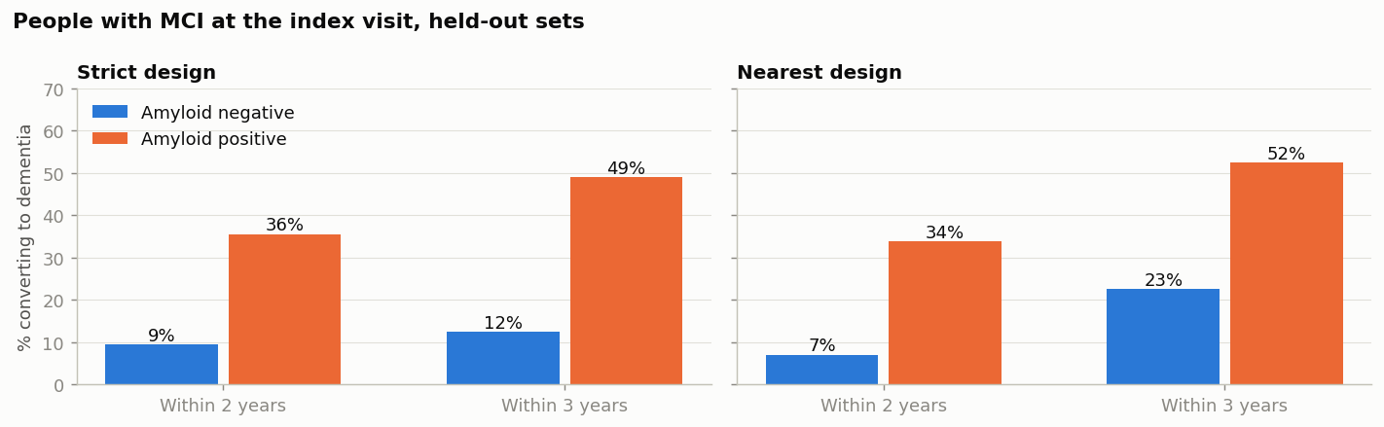
Earlier visits and PET measures (RQ3, RQ5)
Visit history
Landmark visits with ≥ 2 earlier visits: trajectory features +0.003, GRU +0.000 to +0.005 AUROC.
Amyloid and tau PET
MCI: 34% of amyloid-positive vs 7% of negative convert within 2 years. Late fusion: 0.964 vs 0.944 on 243 people (33 events); gain interval −0.009 to +0.066 includes zero.
18 / 27

Slide 20
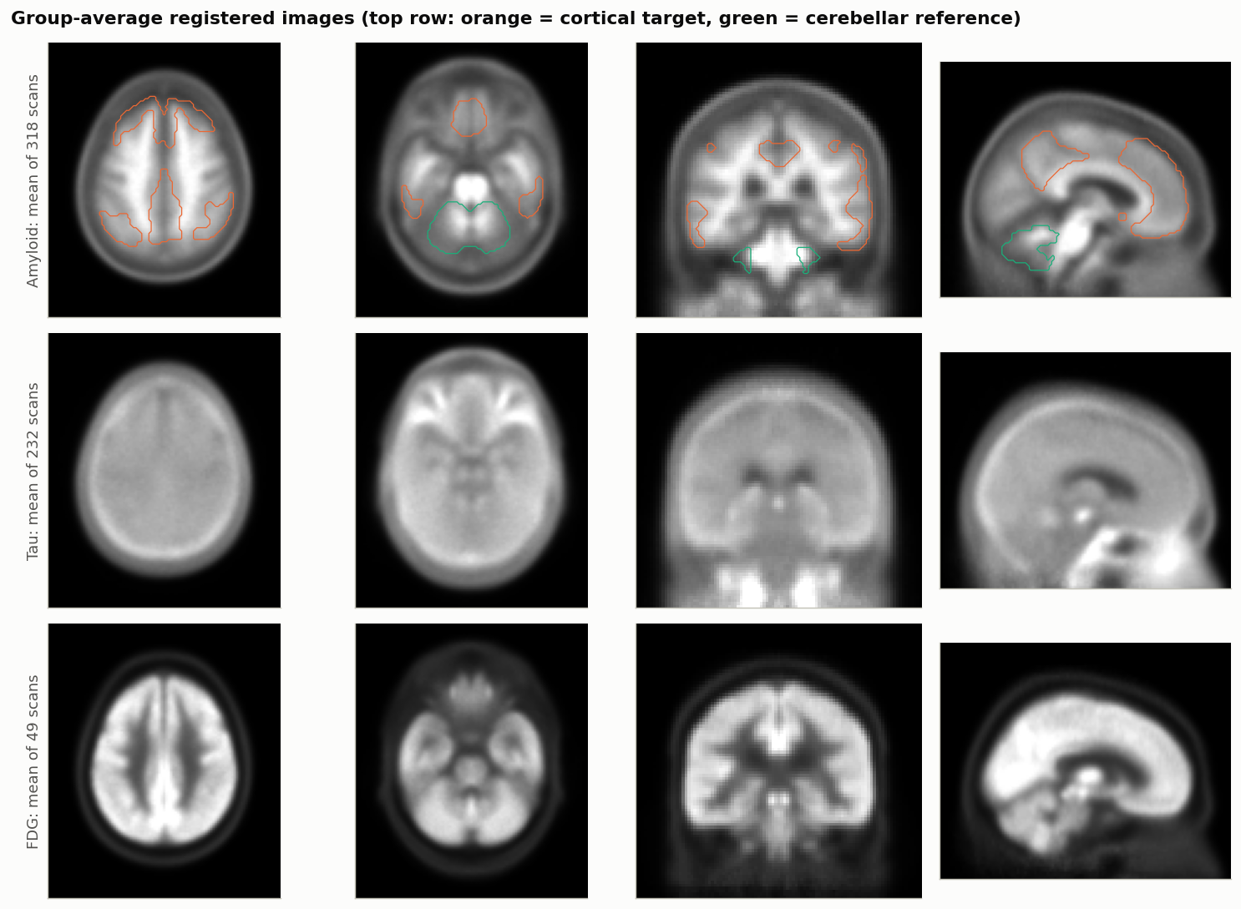
08 | PET Image Pipeline: From DICOM to SUVR
1. Convert: 599 dynamic DICOM series → static volume, V = Σ dₖVₖ / Σ dₖ over the standard window.
2. Register: rigid to MNI152, then 12-parameter affine to a study PET template (Mattes mutual information).
3. Quantify: Centiloid masks, SUVR = mean cortex / mean cerebellum.
Validation against the NACC PET core
Pearson r = 0.977 over 318 scans (0.96–0.99 per tracer); mean difference −0.043.
Group averages only (318 amyloid, 232 tau, 49 FDG scans).
19 / 27

Slide 21
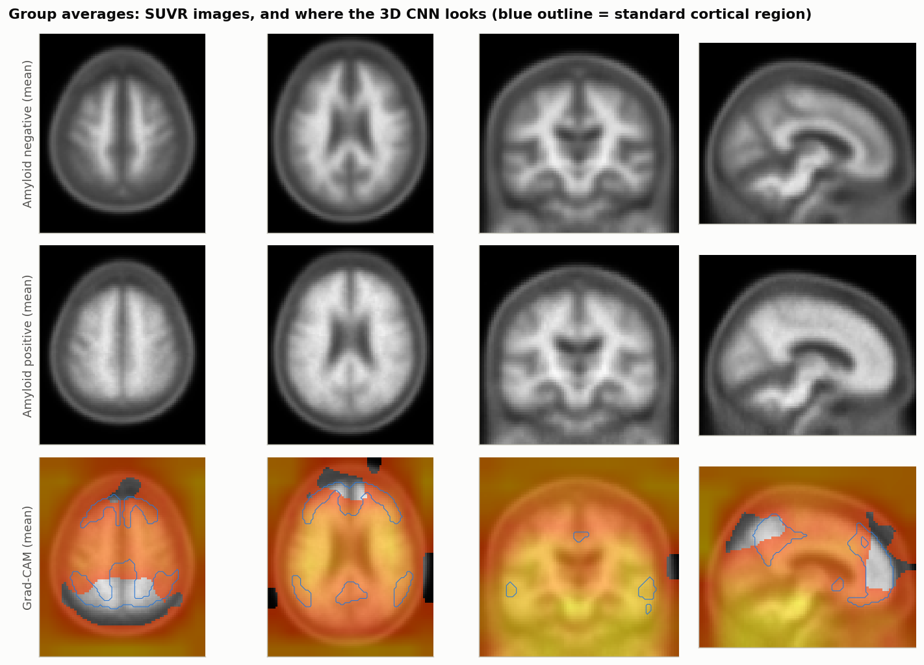
3D CNN for amyloid status and Grad-CAM
Method (292 scans, 84 positive) | AUROC
Cortical SUVR (one number) | 0.982
Regional logistic model | 0.971
3D CNN (494,917 weights) | 0.960
Interpretation
The pipeline supports a working image model, but the label is itself derived from cortical SUVR, so one number is hard to beat.
Limitation
Grad-CAM was diffuse (1.7% of top voxels in the cortical region vs 3.8% by chance), and only 5 imaged people converted, so images were not used to predict dementia.
20 / 27

Slide 22
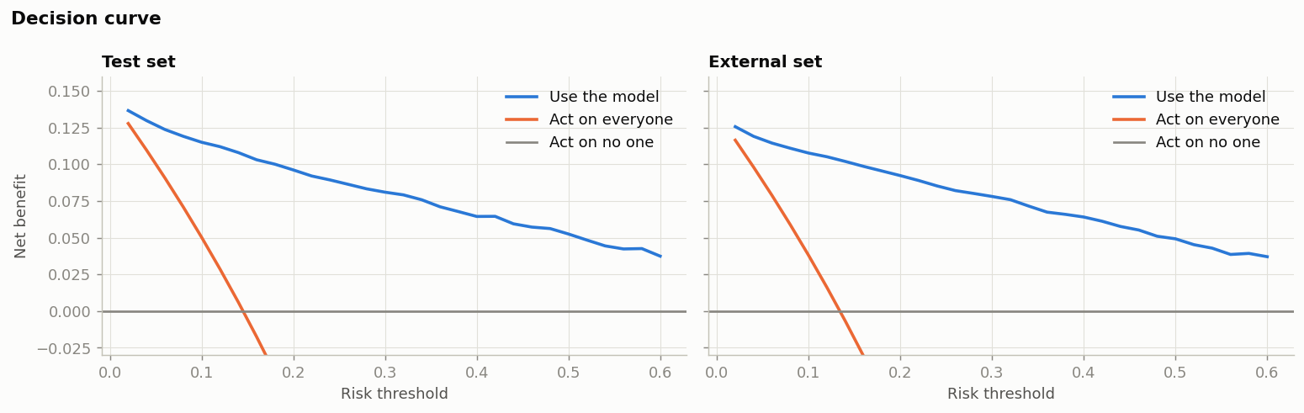
09 | Validation: Calibration, Usefulness, Missing Data
Brier score | Standard | Dropout | Specialist
Everything | 0.066 | 0.067 | 0.066
No clinical stage | 0.185 | 0.076 | 0.074
No cognition at all | 0.441 | 0.115 | 0.111
Demographics only | 0.444 | 0.120 | 0.118
• Test: predicted 14.5% = observed 14.5%, slope 1.01.
• Held-out: 15.0% vs 13.4%, slope 1.10.
• At 20% risk: sensitivity 83%, specificity 88%, NPV 97%.
• Net benefit above treat-all and treat-none from 2% to 60%.
Modality dropout (p = 0.35)
One model stays close to a specialist retrained for each missing pattern; a standard model becomes worse than the base rate.
21 / 27

Slide 23
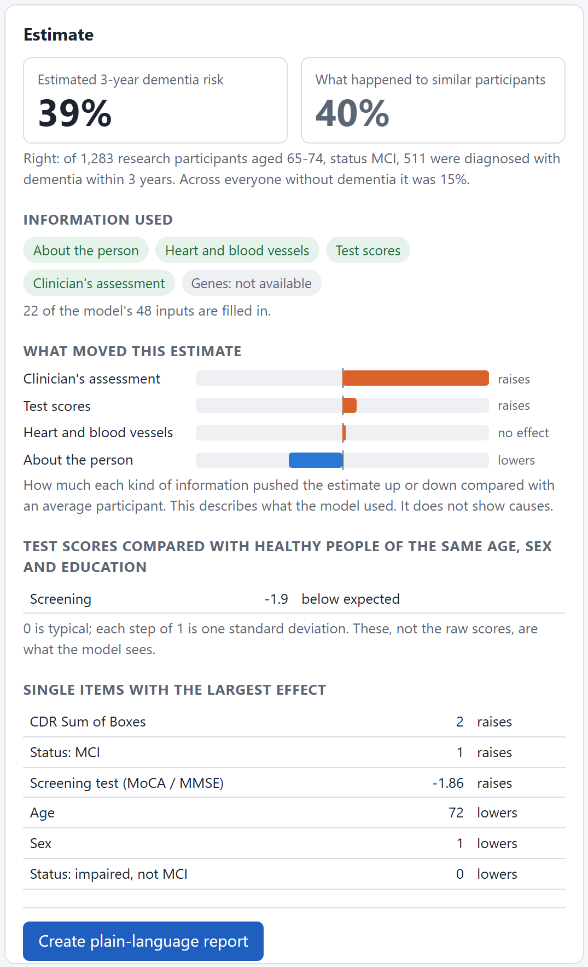
10 | Research Prototype for Clinicians
Example: 72-year-old woman, 16 years of education, MCI, CDR-SB 2, MoCA 21.
• FastAPI + React; form generated from the 48 trained features.
• Risk shown next to the observed rate of similar people (39% vs 40%), with SHAP by category.
• Plausibility checks flag contradictory entries.
• Plain-language report with quoted evidence.
• 27 of 28 behaviour checks pass; MCI under 65 over-predicted (35% vs 27%).
22 / 27

Slide 24
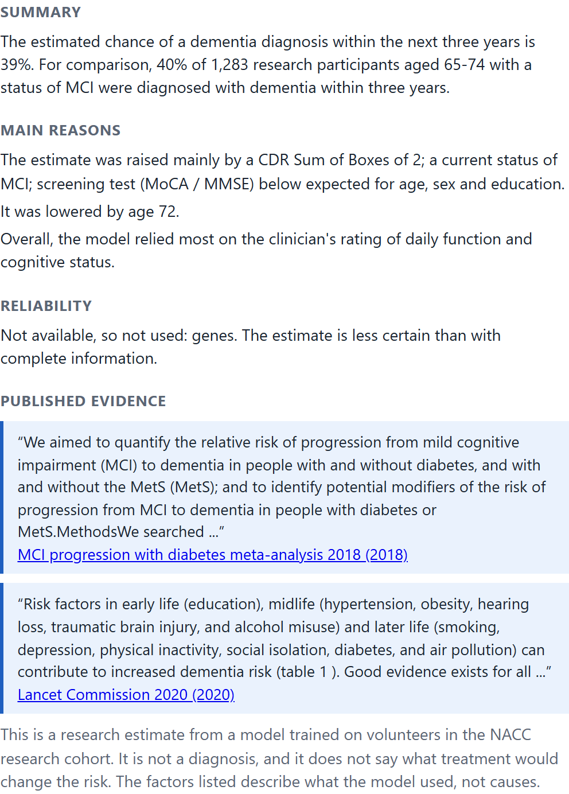
Plain-language report for the same patient
1. Summary: risk next to the observed rate of similar people.
2. Main reasons: largest SHAP contributions in plain words.
3. Reliability: missing categories and plausibility warnings.
4. Published evidence: quoted passages with their source.
5. Limits: fixed statement that it is not a diagnosis.
Design choice
Templates are filled with the person's own numbers and evidence is quoted, so the report cannot state anything the model or the literature did not provide.
23 / 27

Slide 25
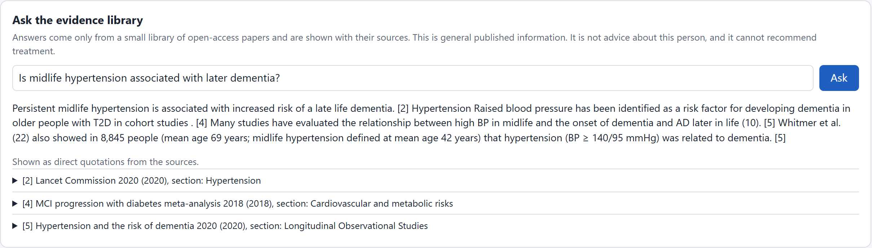
Evidence assistant (retrieval-augmented generation)
s_RRF(d) = 1/(60 + rank_sem(d)) + 1/(60 + rank_BM25(d))
MiniLM embeddings + BM25 (k₁ = 1.5, b = 0.75), merged by rank fusion. Below similarity 0.35 the assistant says the library has no evidence.
Test (11 papers, 447 passages) | Result
Correct source first: hybrid | 32 / 32
embeddings only / BM25 only | 28 / 31
Personal-advice questions flagged | 8 / 8
Out-of-scope questions declined | 6 / 6
24 / 27

Slide 26
11 | Independent Verification
Check | Result
No person or held-out centre in more than one partition | 0 shared
Features unchanged when all later visits are deleted | Identical for 1,500 people × 67 features
No PET value newer than the visit that uses it | 0 of 1,481 amyloid, 713 tau
Labels recomputed independently | 0 disagreements in 11,403 visits
Shuffled labels | AUROC 0.508 (chance)
Retrain with a new seed | 0.937 / 0.946 (reported 0.938 / 0.946)
Errors the checks found and we fixed
Education and race filled from a later visit (0.1% of people); PET scans matched to visits weeks before the scan. After fixing, every model was retrained: results moved only in the third decimal. 17 of 17 checks pass.
25 / 27

Slide 27
Synthesis: what each research question found
Research question | Answer and evidence
RQ1 Prediction accuracy | Dementia 0.94 (0.84 in MCI); decline 0.86 (0.75 in MCI); change regression helps MCI only
RQ2 Cardiovascular history | +0.001 AUROC once cognition is known; Cox agrees
RQ3 Amyloid and tau PET | Strong association, no demonstrable gain with current follow-up
RQ4 Deep models / fusion net | No gain over logistic regression or XGBoost; attention uniform
RQ5 Earlier visits | +0.000 to +0.005 AUROC
RQ6 Missing categories | Modality dropout keeps calibration close to specialist models
RQ7 Explanation and evidence | SHAP, plausibility checks, report with quoted published evidence
Final takeaway
How a person is functioning today carries most of the three-year signal; decades of vascular and genetic history leave their trace in that measurement rather than adding to it.
26 / 27

Slide 28
Limitations, Future Work and Final Takeaway
• Held-out centres are site-level validation within NACC; external and temporal validation on another cohort is the next step.
• NACC is a research cohort, mostly White and highly educated; about half of eligible people lacked a 3-year outcome (Cox check agrees).
• Only 24 and 37 cognitively normal converters in test and held-out sets; a dedicated 5- to 10-year model for normal cognition is needed.
• Richer vascular exposure (repeated blood pressure, treatment, small-vessel imaging) may capture what yes/no history misses.
• PET registration without MRI, tau not quantified; more follow-up will allow a powered PET test.
• Evidence library of 11 papers and team-written questions; a curated library and stronger local model would help.
Contribution
A leakage-free, verified pipeline that measures what each source of information adds, reports results within diagnostic groups, and delivers explainable, evidence-backed estimates.
27 / 27

Slide 29
Thank you
Questions are welcome.
Data: National Alzheimer's Coordinating Center (NACC), Freeze 74, used under the NACC data use agreement.
All results are aggregates.

