Slide 1
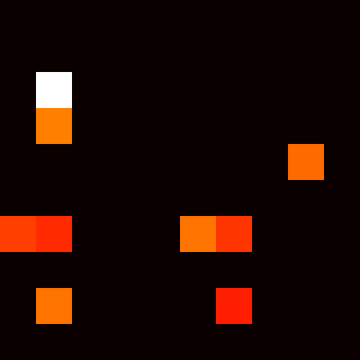

Inhib. = 0
Serial Search
Search Time = 1000ms
25
4
3
20
Saliency
Map
Threshold
15
1
10
Stimulus (SS 8)
2
5
0
Inhib. = 10
Serial Search
Search Time = 750ms
16
3
14
Threshold
2
12
10
8
6
4
1
2
0
Notes:
Para

Slide 2
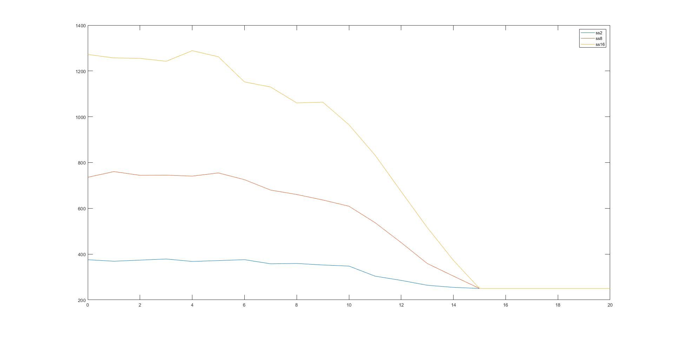
RT
Inhibition

