Slide 1
ARIT Market
AR & Android Flea Market application
손하민 : Android + DB
이홍균 : AR + ppt + test
임현묵 : Android + AR
한상미 : Android + UI + DB
Team #5 Final Presentation

Slide 2
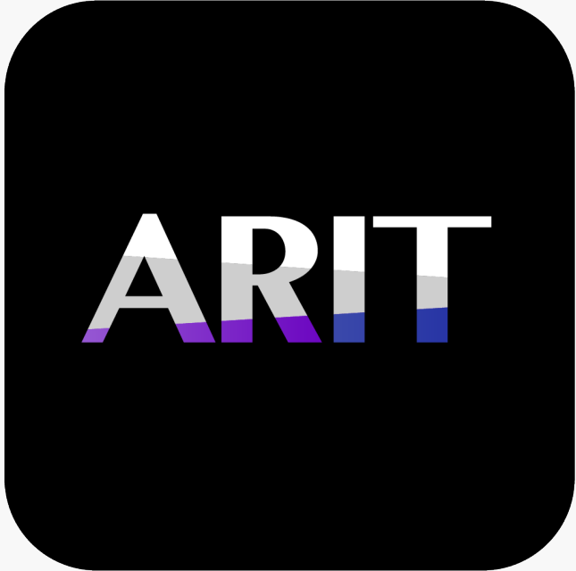
#01. Overview of target system
ARIT application
1. Offers a more systematic option for selling used IT products
2. Potential consumers can use AR to arrange any product in the comfort of their room
3. Sellers can use AR measure to easily post the dimensions of their product

Slide 3
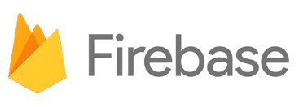

#02. Overall system architecture
ARIT application
DB
AR
User DB
Home & My page
User Management
AR Arrangement
Product DB
Comment DB
Category & Search
Product & Post
AR Measure
Wishlist DB
Wish List

Slide 4
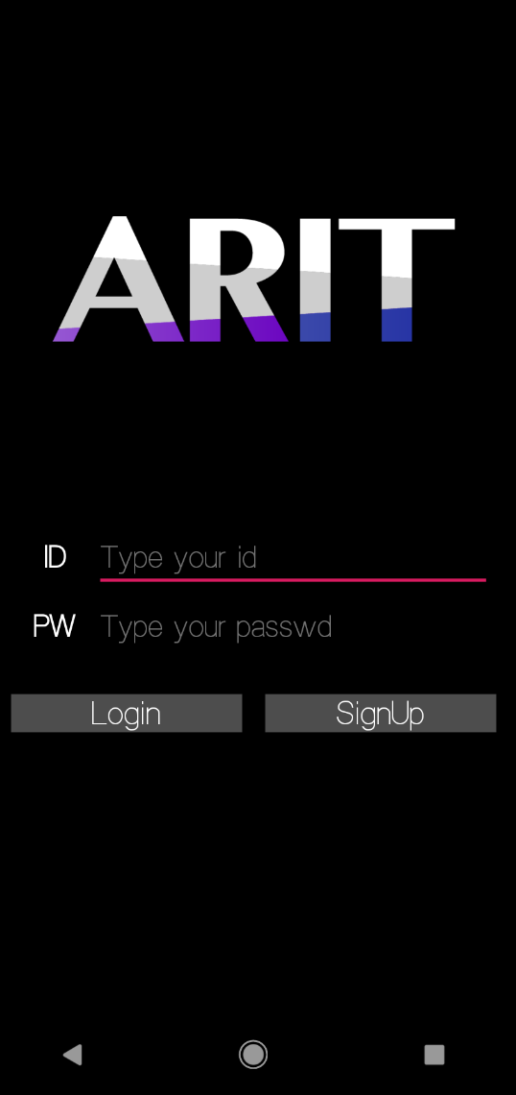
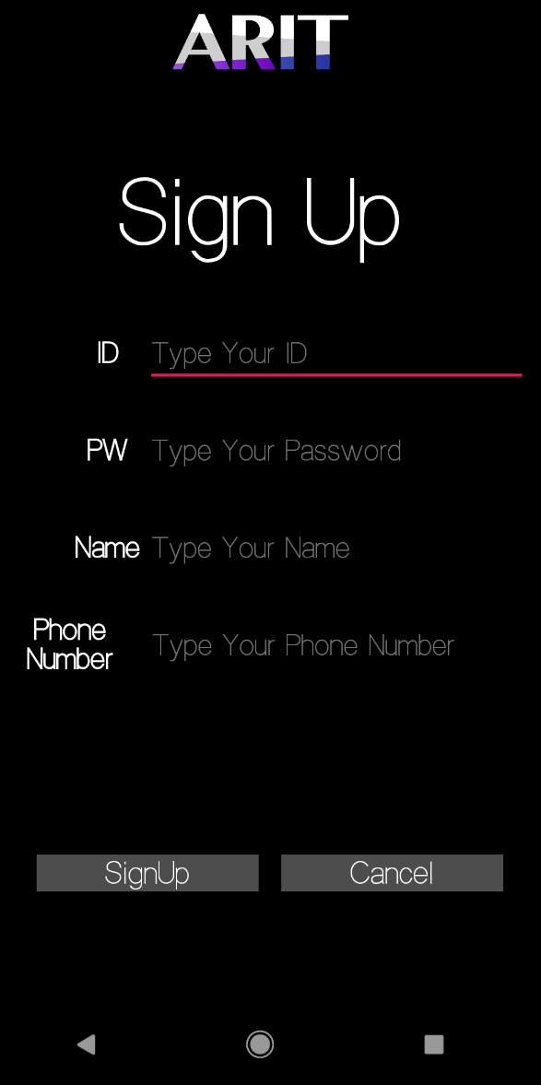
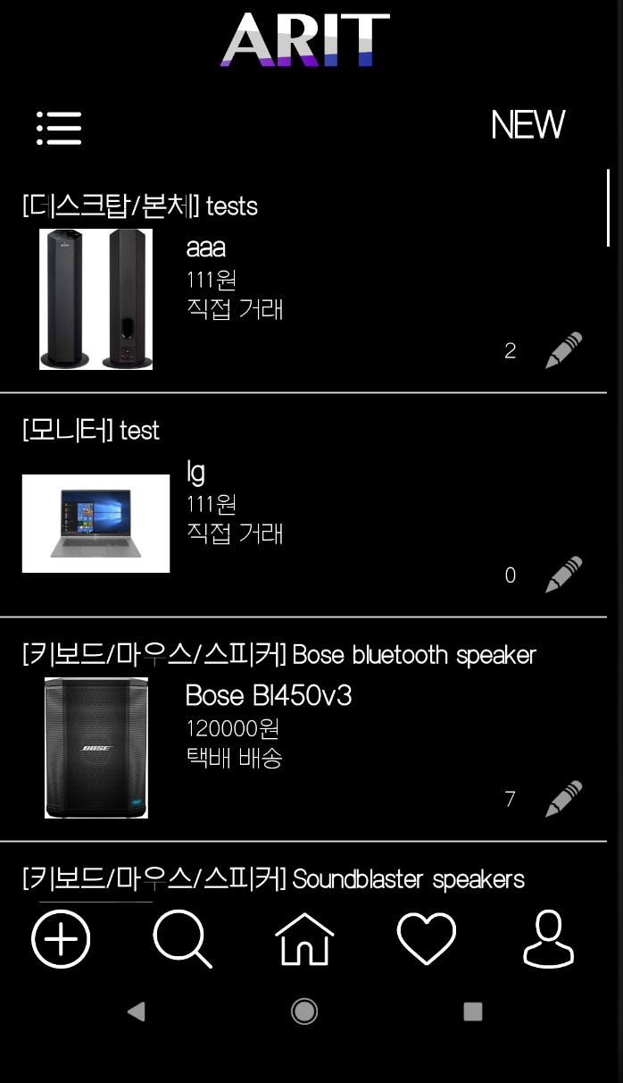
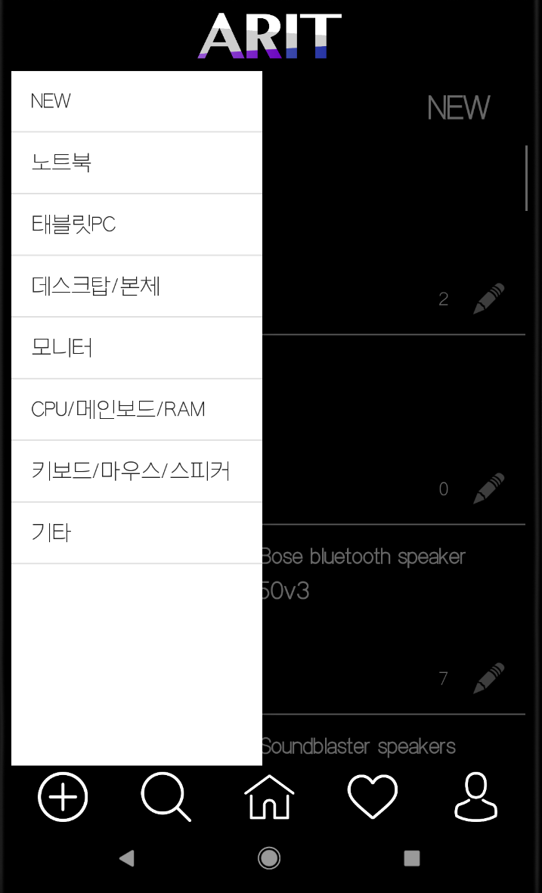
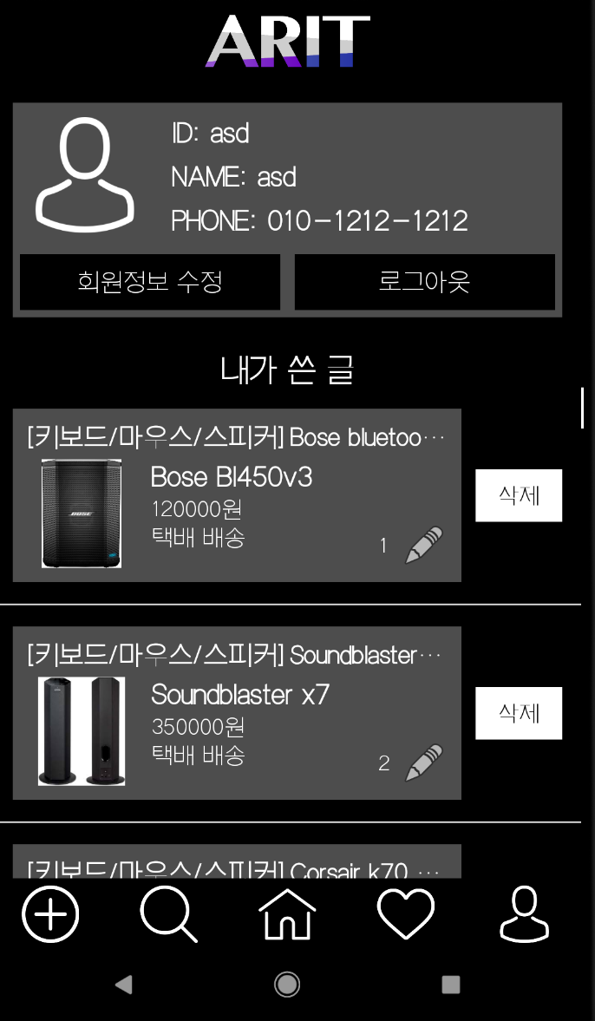
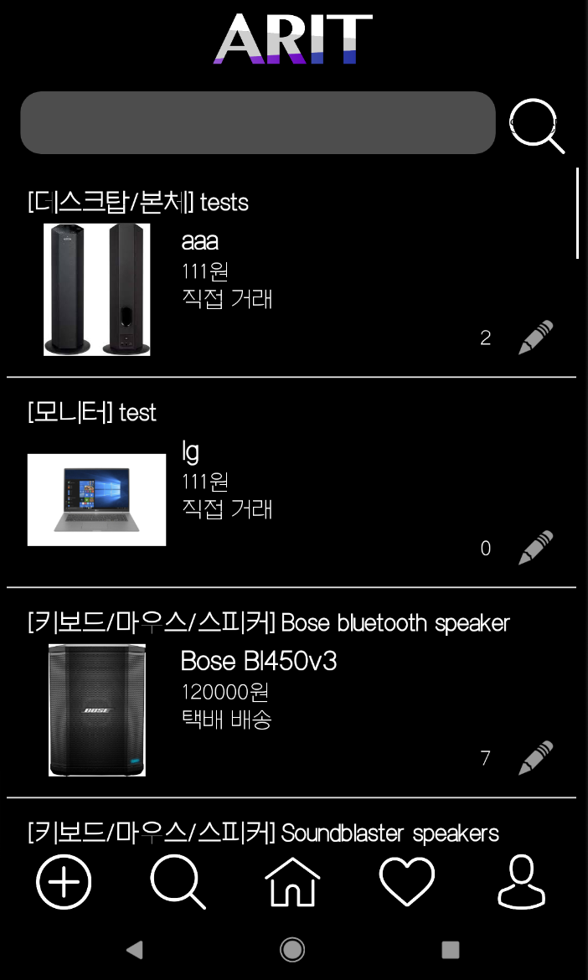
#03. Main features
ARIT application
User Management:
Home & Category :
My Page & Search:
Sign In and Sign Up functionality.
During sign up, user information is updated to the UserDB.
During sign in, user ID and PW are matched against the UserDB.
The first page to show after sign in is the Home page. This page shows the latest products that other users have uploaded.
The category section can be accessed by swiping right on the left edge of the screen or by clicking the button on the top left corner. This page shows the available category of products.
My Page and Search can be accessed from the action bar located at the bottom.
My Page shows user’s profiles and the products they have uploaded, while Search allows user to search for product names

Slide 5
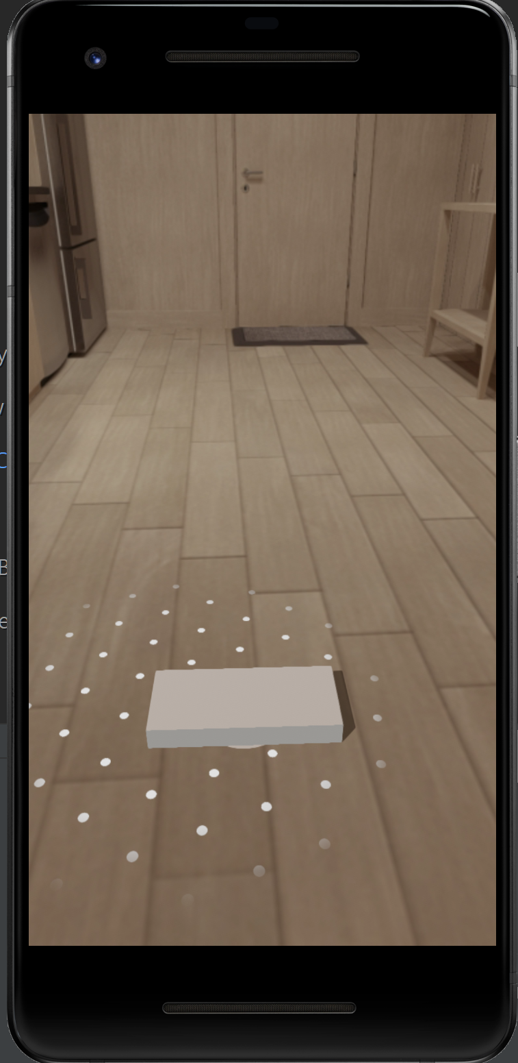
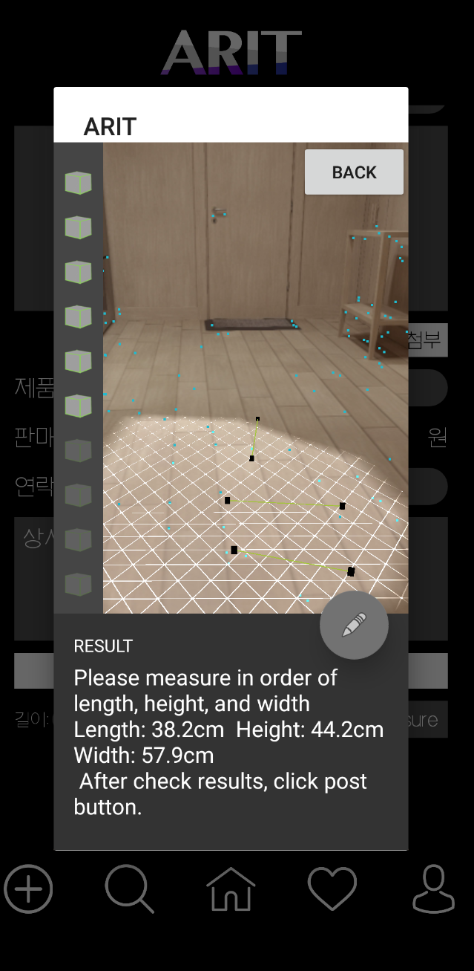
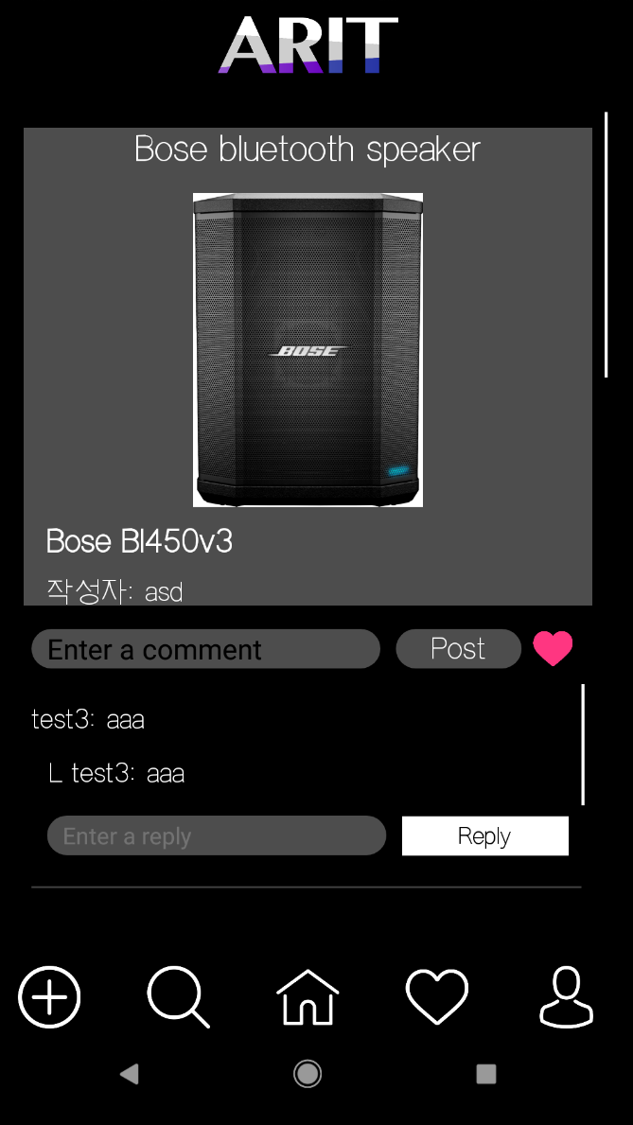
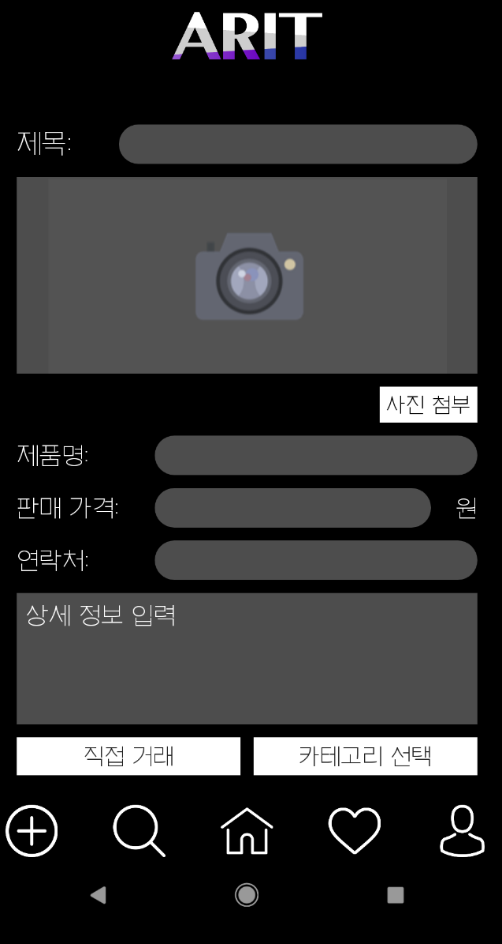
#03. Main features
ARIT application
Product & Post:
Clicking a listed product allows users to view the product details, within which user can comment any text.
The Post option allows users to upload their own product.
AR Arrangement:
AR Measure:
A 3D AR Model is created to allow potential buyers to view any product in their preferred environment
Sellers can upload the dimensions of their product using AR with no need for other tools

Slide 6
#04. System completeness
ARIT application
DB
AR
User DB
Home & My page
User Management
AR Arrangement
Product DB
Comment DB
Category & Search
Product & Post
AR Measure
(Push Alarm)
Wishlist DB
Wish List

Slide 7
#05. Actual development schedule
ARIT application

Slide 8
#06. Open sources SW used
ARIT application
Fire Base - For Database
https://firebase.google.com/
hl3hl3/ARCoreMeasure - For AR Measuring
https://github.com/hl3hl3/ARCoreMeasure
MrCrambo/Android-Projects - For AR Arrangement
https://github.com/MrCrambo/Android-Projects

Slide 9
#07. The risks we faced during the project
ARIT application
1. Using AR:
As members had no previous experience with AR development and as 3 out of 4 members do not own Android phones, the integration stage was delayed by learning and testing.
OSS that use Arcore were infrequent, too old, or did not work correctly.
Functionality errors occurred because of conflicts during the integration stage, as the version of functions implemented in OSS were different from the ARIT app version. Because of this, integration and validation were delayed
2. Using OSS:
As many functionalities were added and modified during the development and designing stage, members were forced to rebuild and debug the app frequently. Lots of effort and time was used because of the frequent changes to the structure of the system.
3. App design:

Slide 10
ARIT application
#08. Lesson learned or epilogue of each team mate
임현묵:
졸업 하기 전 마지막학기에, 프로젝트 경험이 많지 않았던 것이 아쉬워서 이 수업을 태하게 되었습니다. 물론 쉽지는 않았습니다. 프로젝트 외에도 많은 것들을 따로 공부 해야 하는 수업이었고, 하나의 완성된 프로젝트를 만드는 것이 말처럼 그렇게 쉬운 것은 아니었습니다. 하지만 서로 도와가면서 프로젝트를 완성해 나가면서, 안드로이드 스튜디오 에 관한 지식 뿐만 아니라 소프트웨어 개발을 하는데 있어서 많은 것을 배울 수 있어서 힘들었지만 보람 된 수업이었습니다.
한상미:
이렇게 개발을 진행하기에 앞서 요구 사항을 작성하고 그 요구 사항대로 개발을 진행한 적은 처음이었습니다. 요구 사항 그대로 소프트웨어를 만든다는 것은 매우 어려운 작업이었고 개발을 진행하면서도 새로운 요구 사항이 계속 등장해서 힘들었습니다. 그리고 github을 제대로 사용하여 팀원들과 함께 구현한 적은 처음이었는데 본 프로젝트를 진행하면서 많은 것을 배울 수 있었습니다.

Slide 11
ARIT application
#08. Lesson learned or epilogue of each team mate
Even with such the small system that we created in this semester, I learned the importance of Software Engineering. We constantly emphasized in class the importance of documentation and we were given the chance to experience its importance first-hand. Management and development of large system seems impossible without SE, and I’m thankful I had a chance to learn this before I graduated. Though I wish we had more time to add functionalities to our systems, I’m proud of what I have learned through this process.
손하민:
이홍균:
소프트웨어 공학을 적용하며 프로젝트를 진행한 건 처음입니다. 소프트웨어 공학이 많은 도움이 됐을 것이라 생각되지만, 개발자의 입장에서는 결국 개발을 하는 것은 똑같았습니다. 그렇기에 좀더 많은 경험을 겪고 많은 일을 해야 이해가 갈 분야인 것만은 알았습니다. 한학기동안 부족한 저를 이끌어준 팀원들과 열정으로 학생들을 가르쳐 주신 교수님, 그리고 항상 학생들을 배려해 주셨던 조교님들께 감사드립니다.

Slide 12
Q&A
Thank You

