Slide 1

Twitch Visualizations

Slide 2
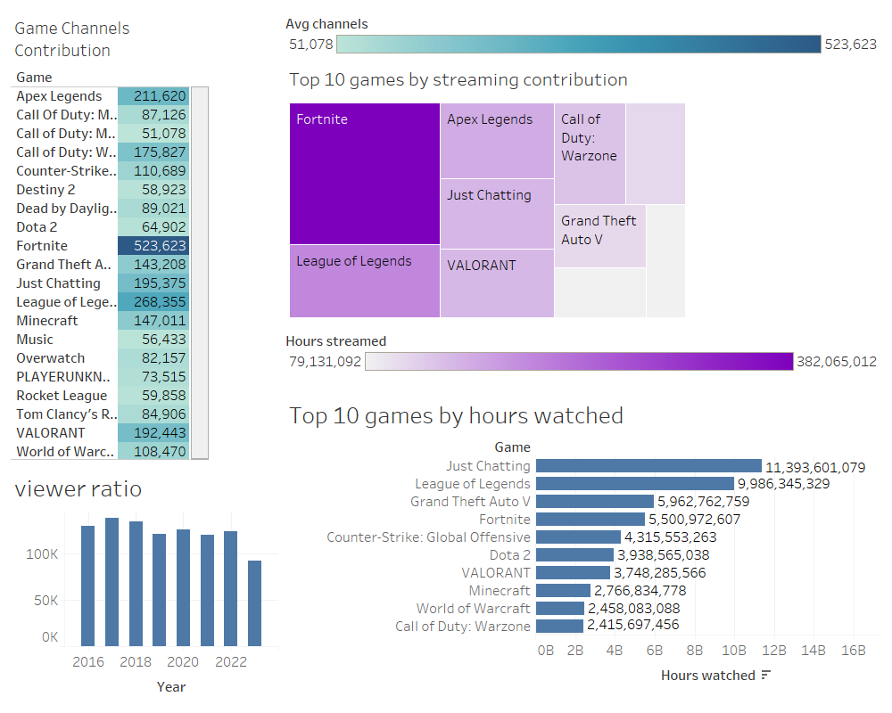

Slide 3
