Slide 1


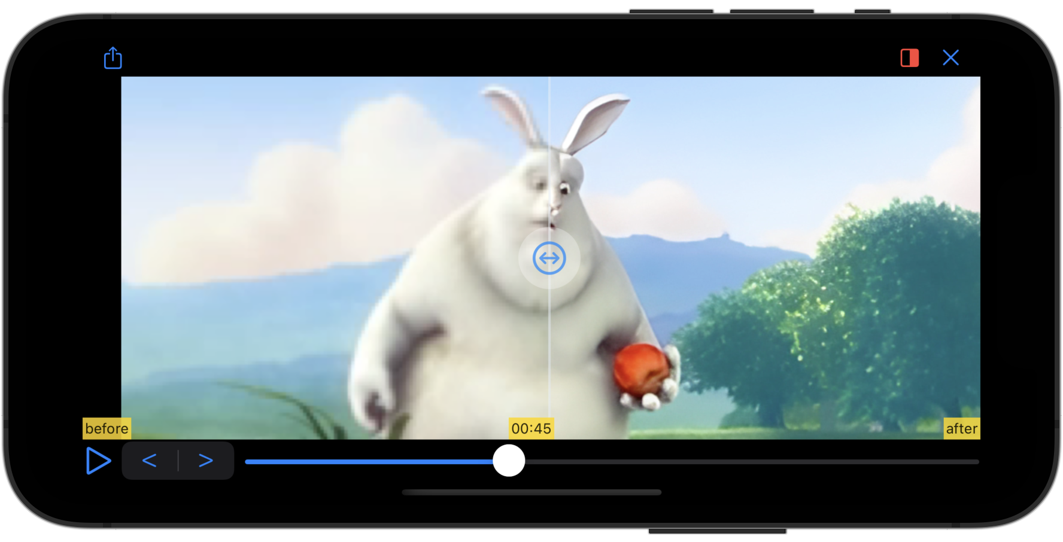


Low Resolution Video
High Resolution Video

Slide 2
Super Resolution
Video Processing

Slide 3
Super Resolution
Video Before/After
Comparison

