Slide 1
RELIANCE DIGITAL · AI-NATIVE SERVICE
resQ 2.0
The appliance-service agent that lives on WhatsApp.
• One AI agent · four WhatsApp numbers · thirteen journeys
• Event-sourced core · machine-first ledger · 8 protective rules
▶ Open the live demo
★ Source on GitHub
https://resq-2-jrec.onrender.com

Slide 2
THE PROBLEM
Service today leaks trust at every step
• Customers chase updates over calls — no single thread, no status.
• Jobs bounce between owner, technician and desk with no system of record.
• Cash paid before work is verified; disputes have no audit trail.
• Field edge-cases (wrong serial, no-show, damage) fall through the cracks.

Slide 3
THE SOLUTION
One agent on the channel people already use
• Customer, owner, field and area each get their own WhatsApp number.
• The agent books, assigns, tracks and closes — in plain language (incl. Hindi).
• Every action is an append-only event: the ledger is the source of truth.
• When a human must step in, the desk takes over the thread — then hands back.

Slide 4
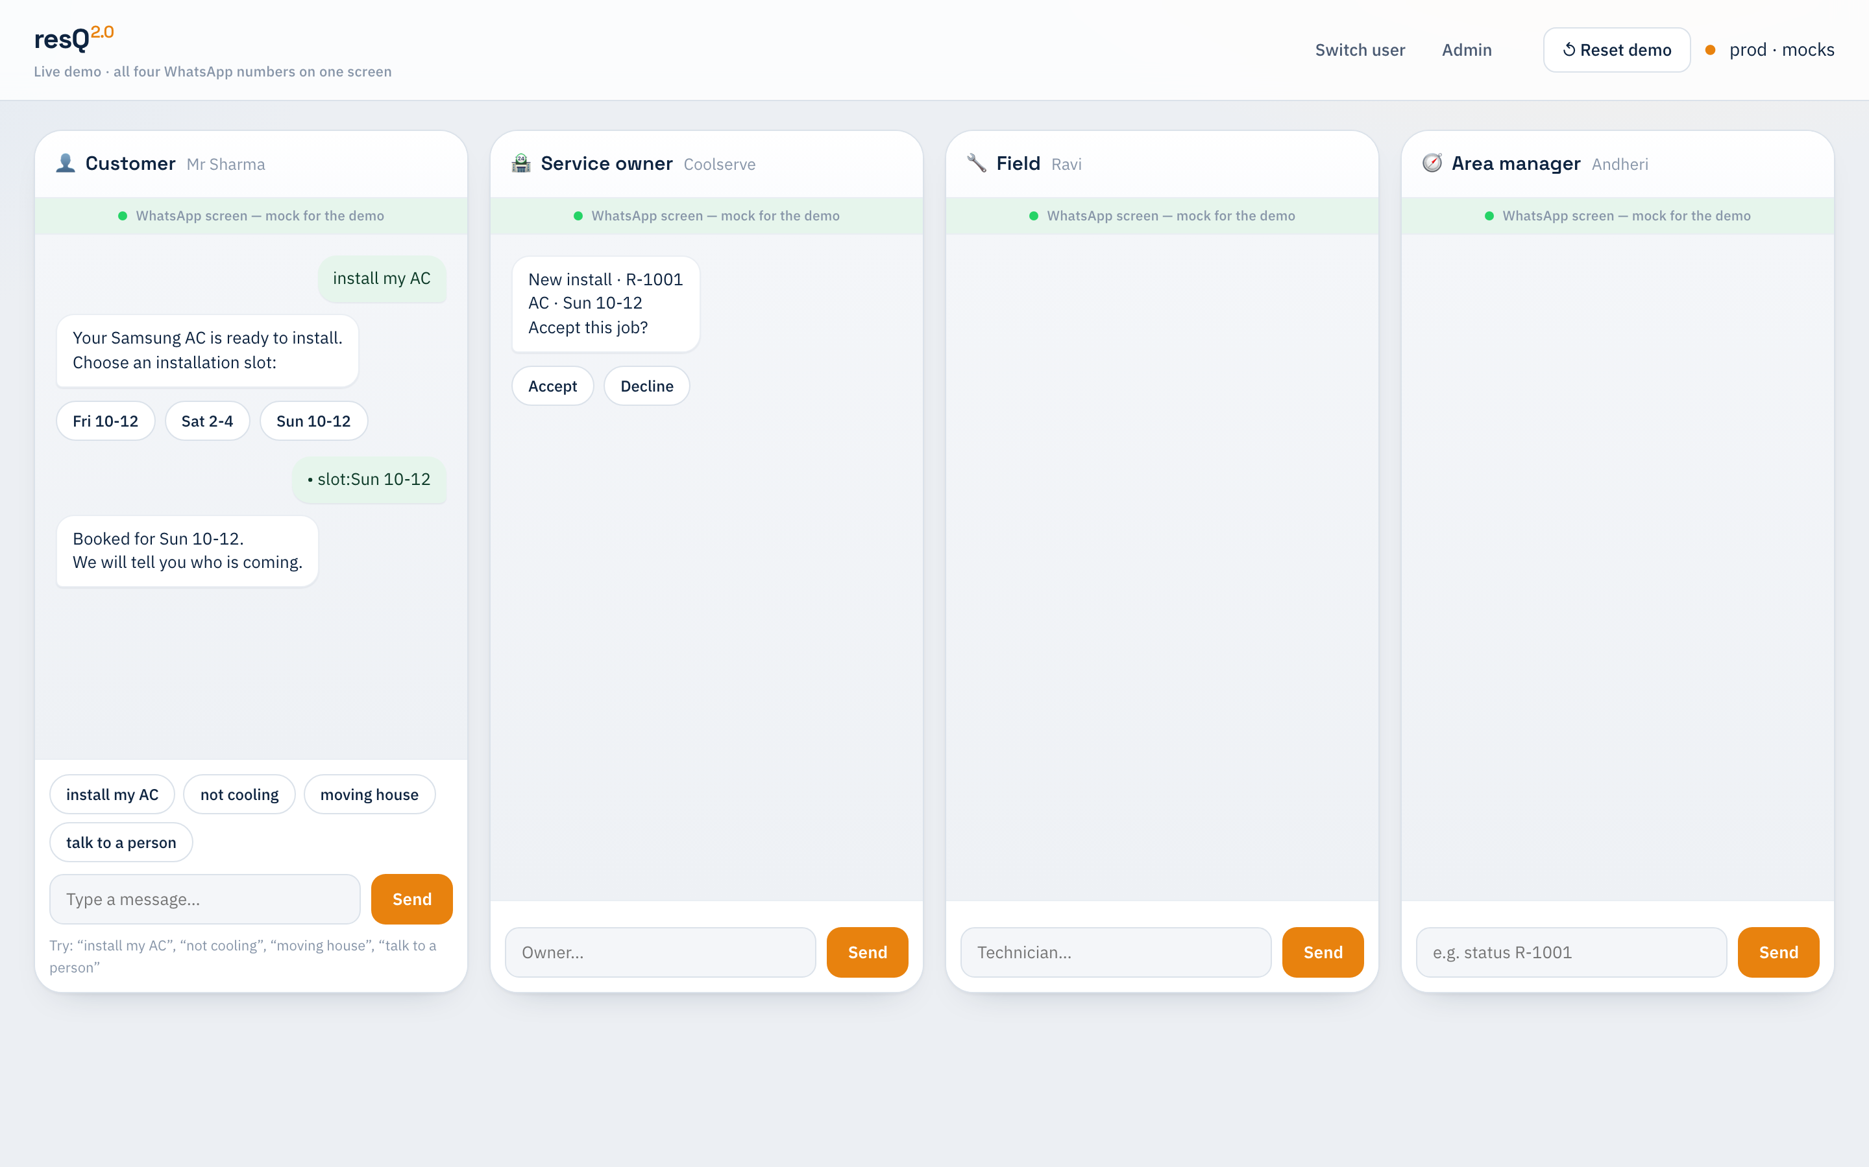
LIVE DEMO
Four phones, one engine, in real time
Install booked by the customer → offered to the owner → tracked by the area desk — all driven by the same event-sourced agent.
→ Open /demo

Slide 5
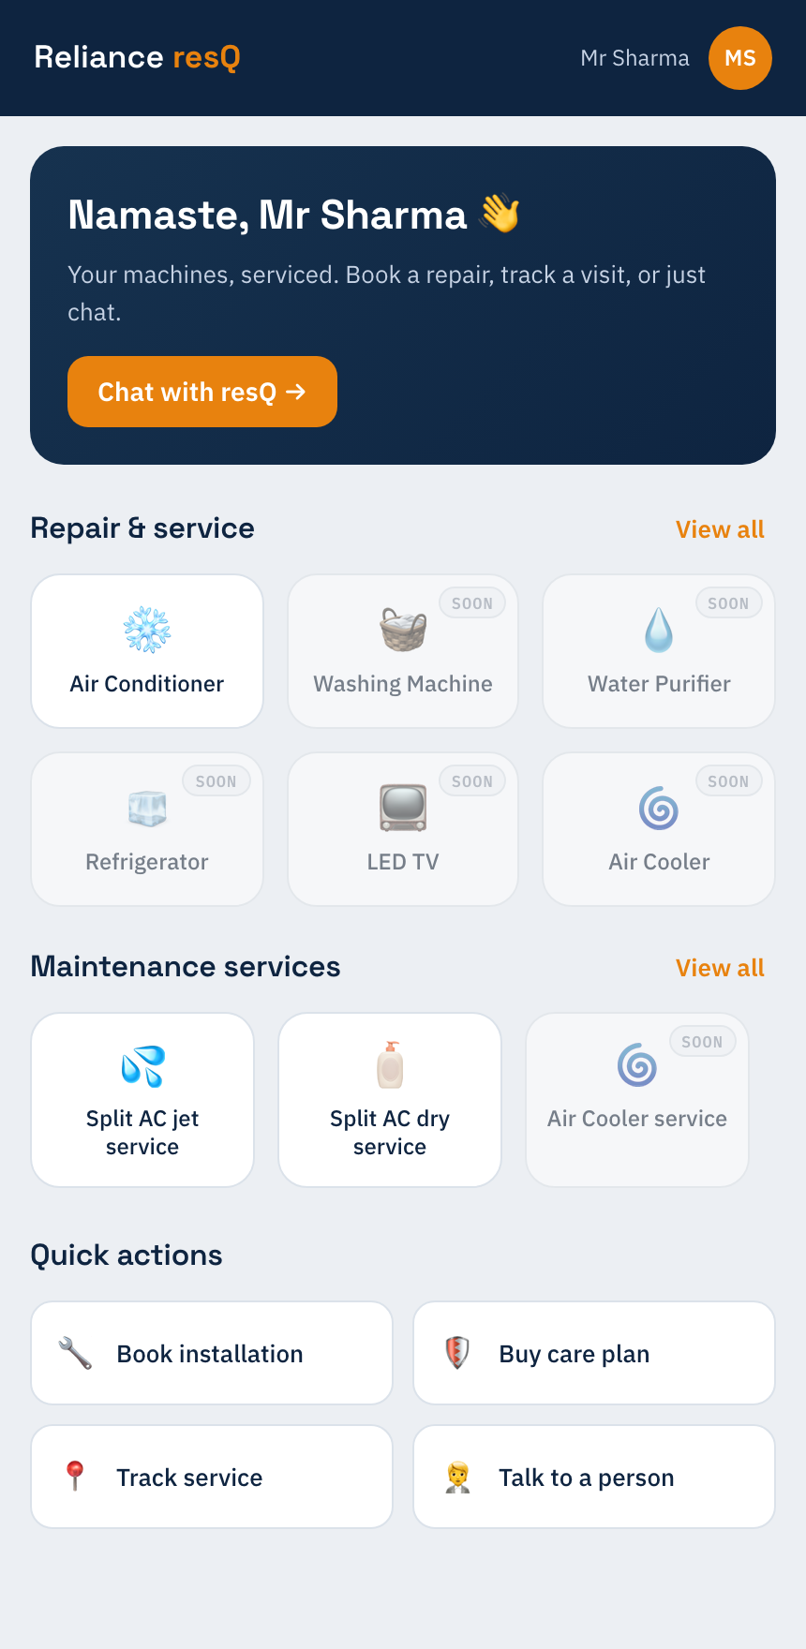
CUSTOMER EXPERIENCE
A branded app that falls back to chat
Repair & maintenance tiles open the WhatsApp thread and trigger the real journey intent. Photo, voice and Hindi all supported.
→ Open /customer

Slide 6
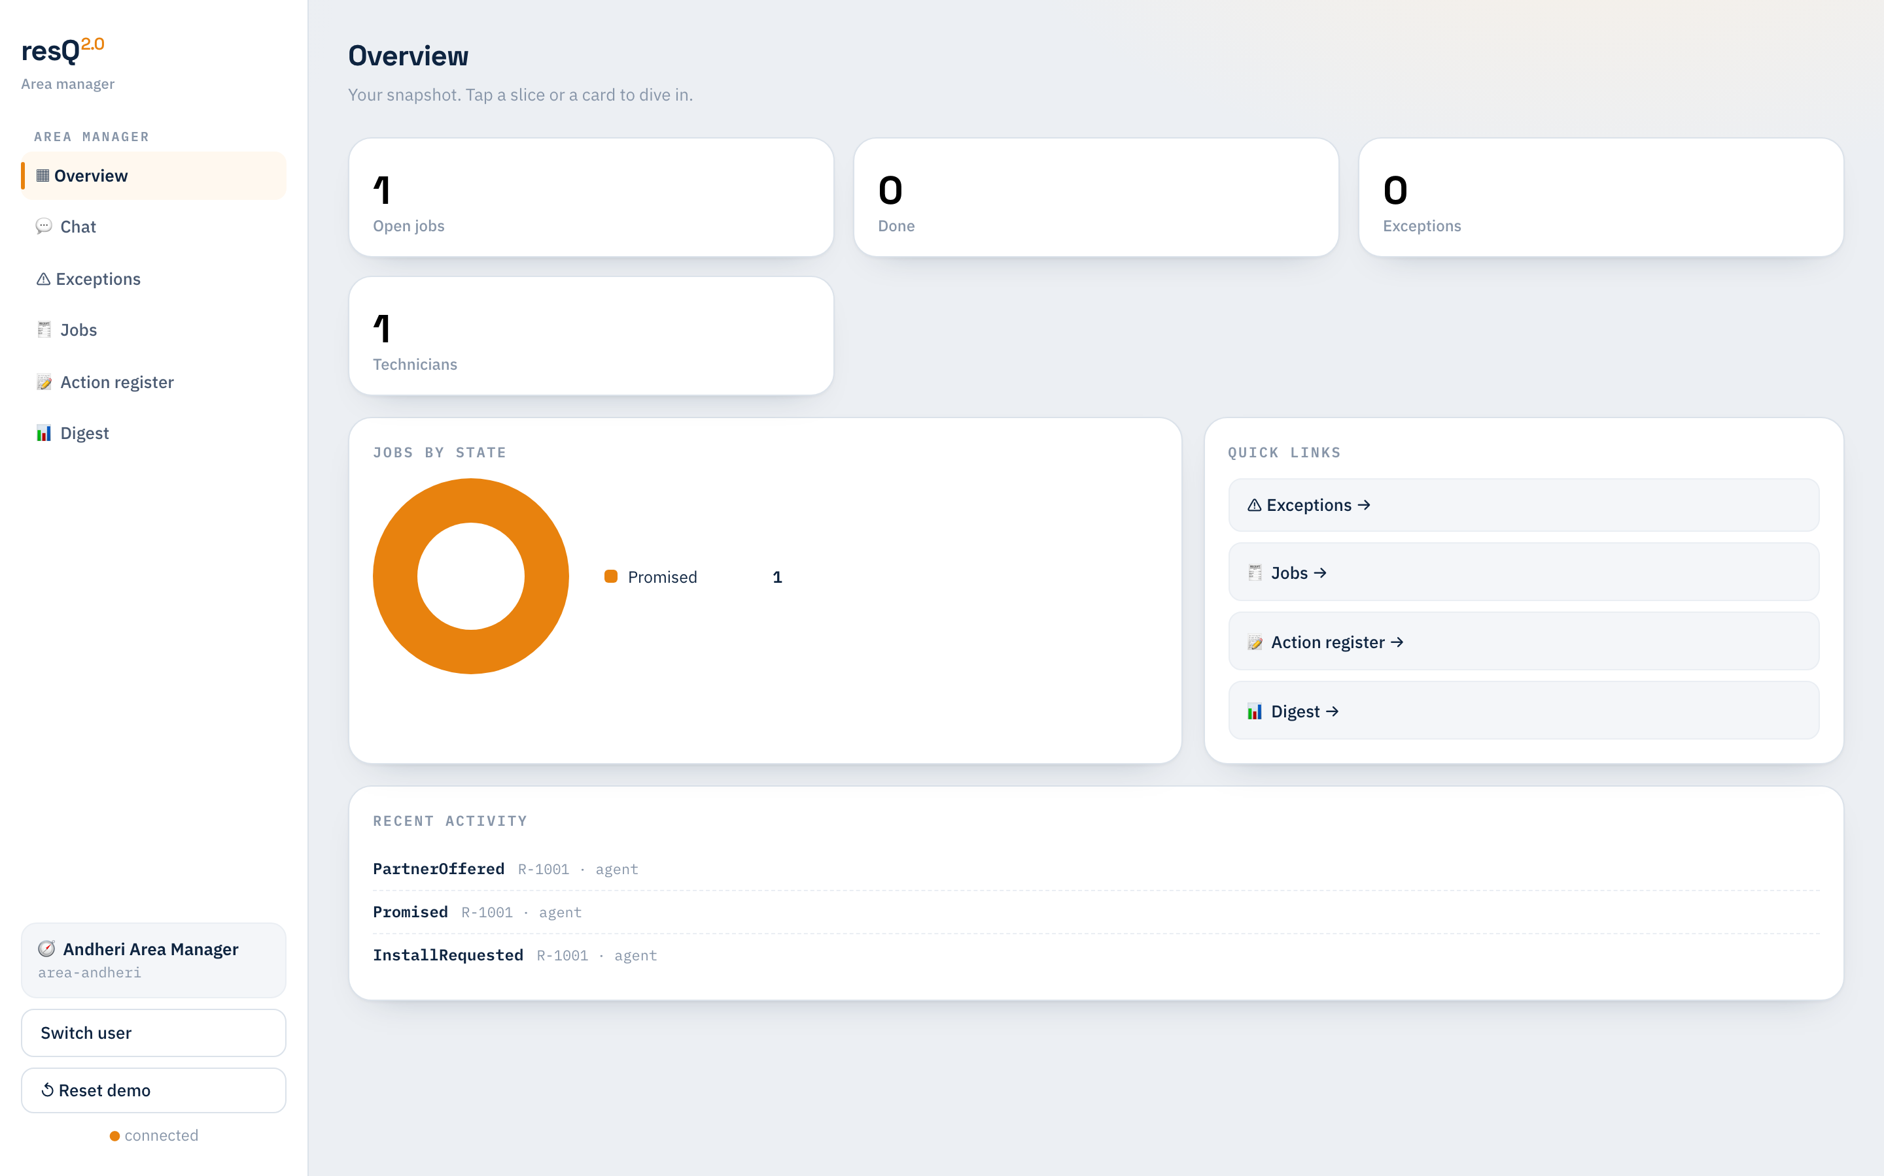
OPERATIONS
Role consoles for owner, field & area
Area managers act only on exceptions; everything else the agent handles. Live jobs-by-state, action register (accept/reject), digest.
→ /area
→ /owner
→ /field

Slide 7
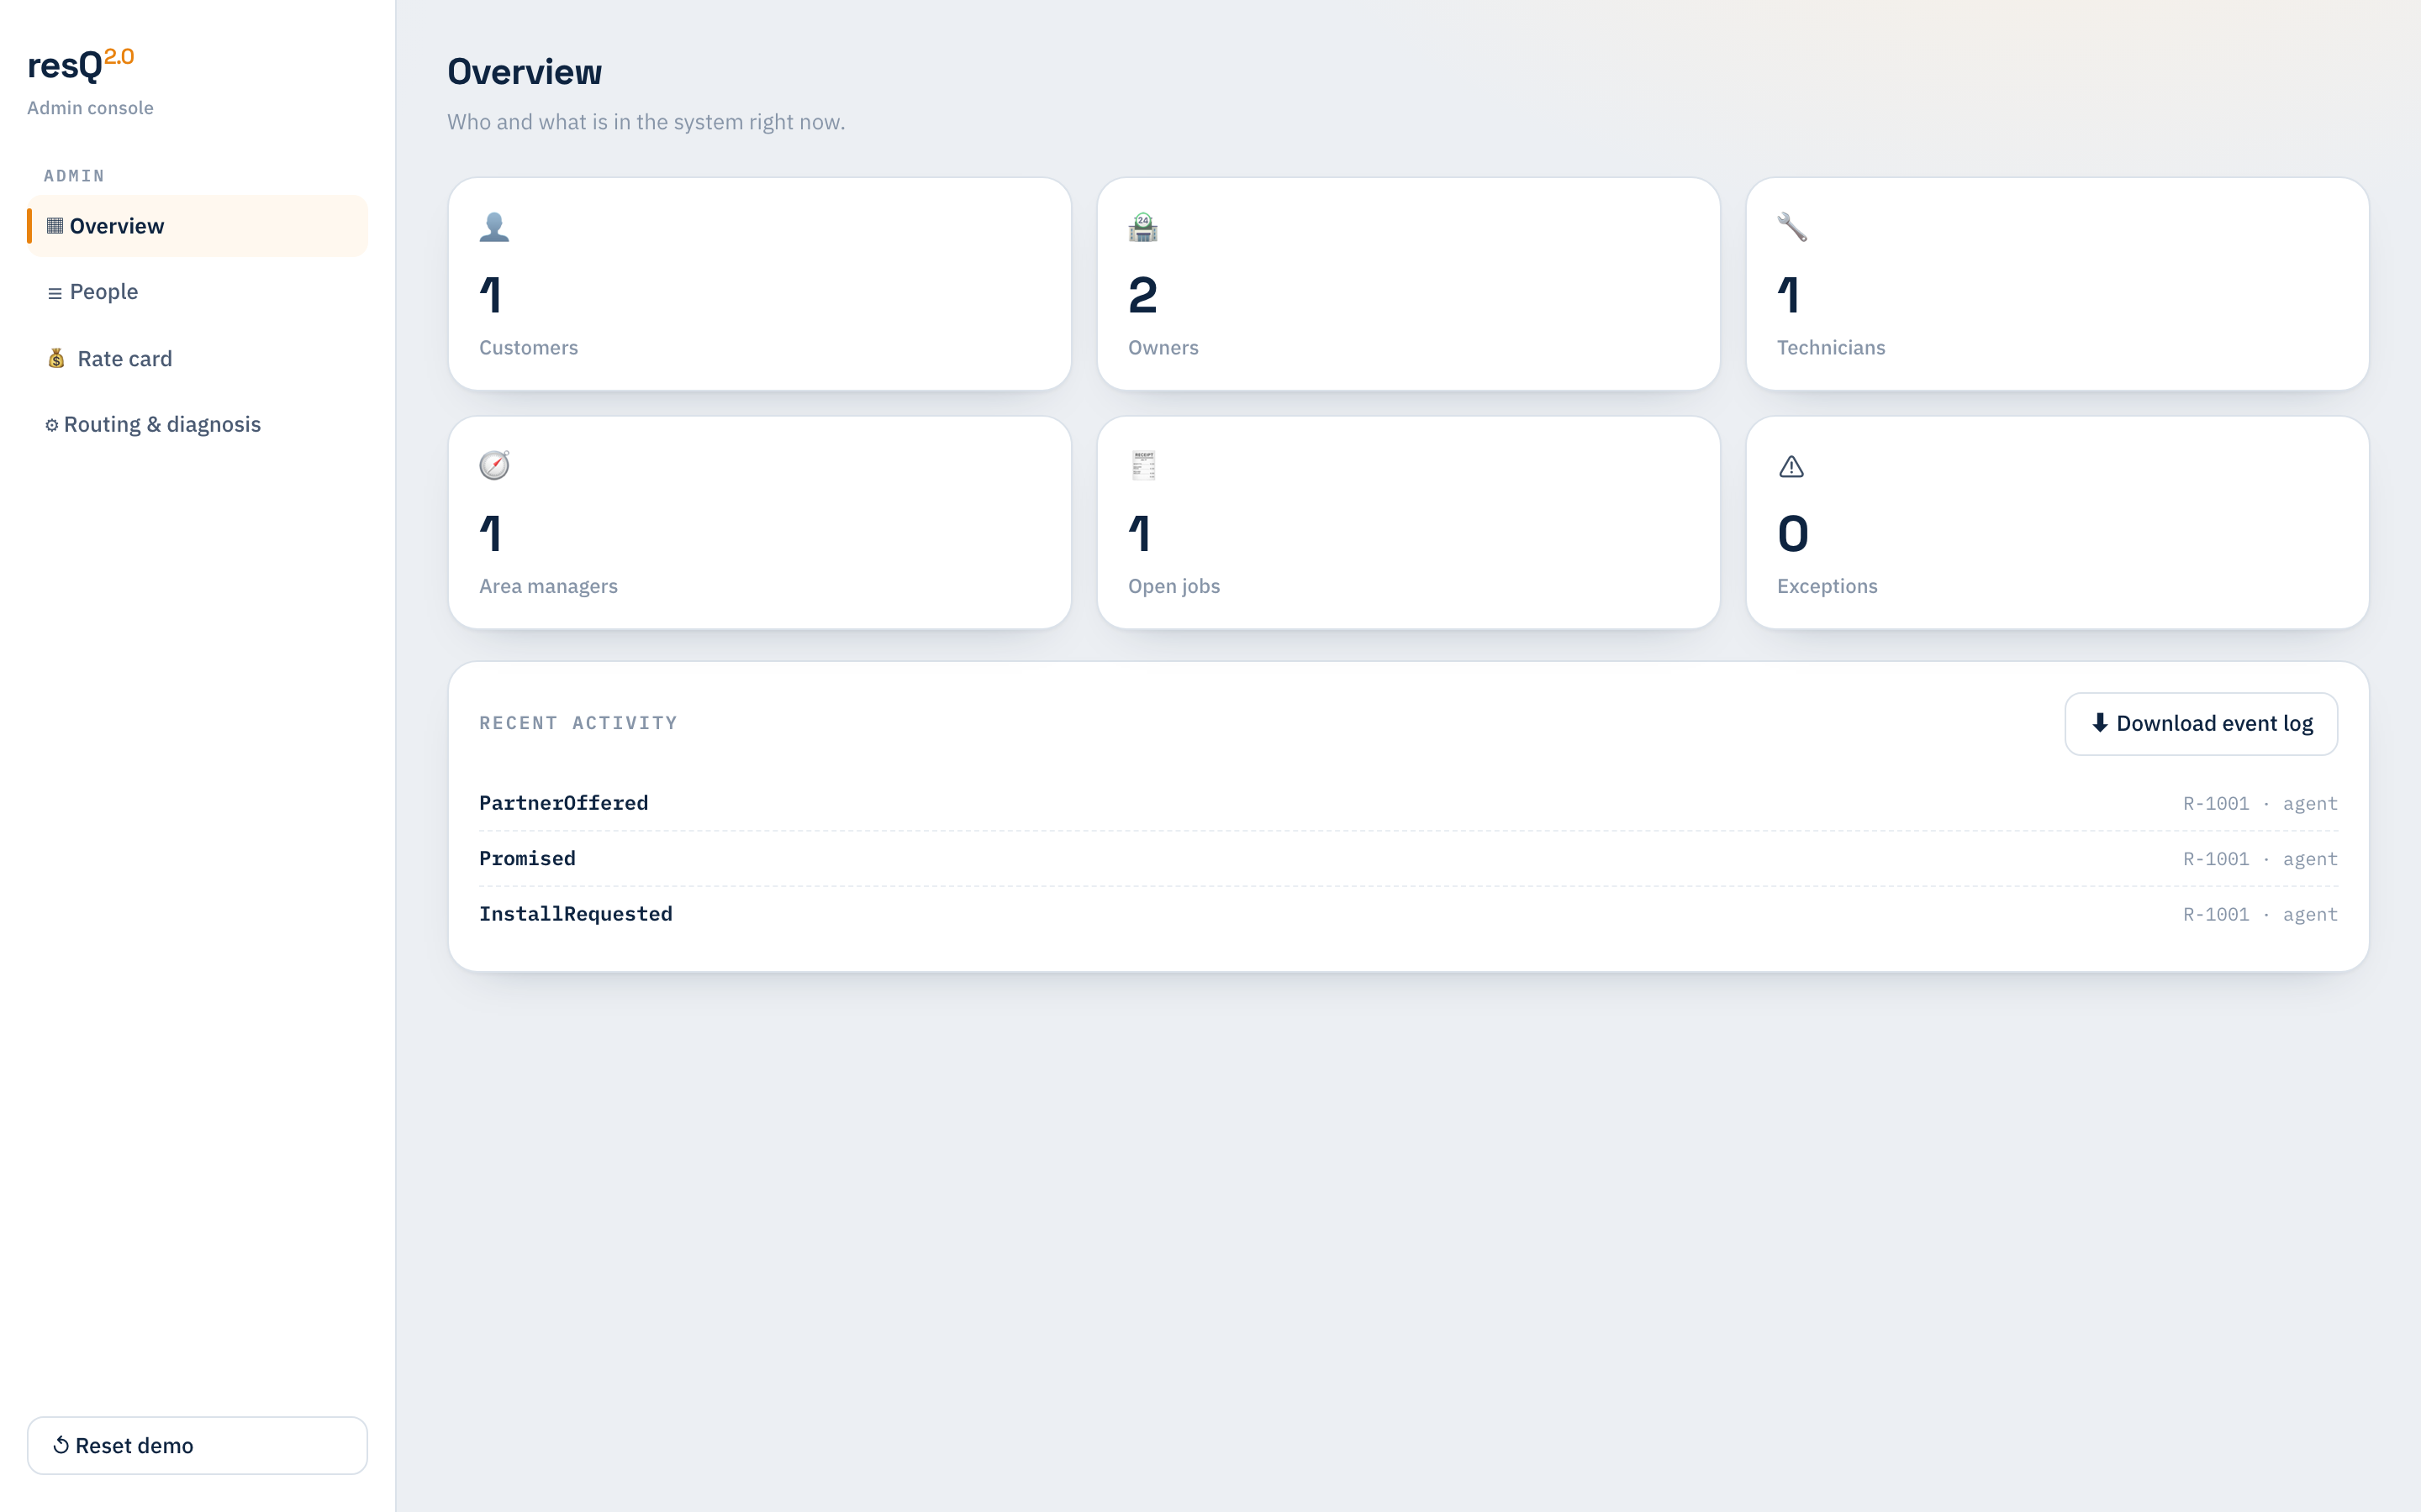
CONFIGURATION
No-code control of the agent
Onboard people, edit the rate card and routing/diagnosis as human-friendly tables — no deploy. Rules & SLAs stay hard-coded for safety.
→ Open /admin

Slide 8
COVERAGE
All thirteen journeys, end to end
J1 Install
J2 Repair
J3 Maintenance
J4 AMC / plan
J5 Reschedule
J6 Spare part
J7 Payment
J8 Warranty
J9 Relocation
J10 Complaint
J11 Feedback
J12 Roster
J13 Area ops
Plus shared assign/visit flows, the §4.1 exception table and an 11-timer scheduler.

Slide 9
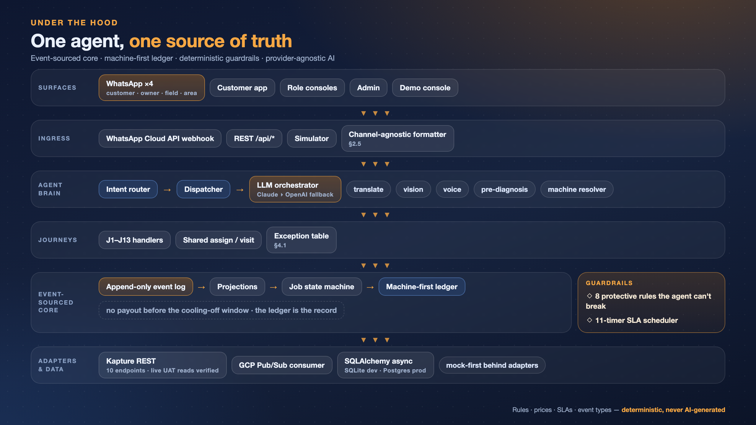

Slide 10
TRUST BY DESIGN
Eight protective rules the agent cannot break
• Technicians can never take cash in hand.
• No payout is released before the cooling-off window.
• Serial mismatch halts the job and alerts the desk.
• Every suggestion the agent makes is logged for accept/reject review.
Prices, SLAs, event types and the state machine are hard-coded — never AI-generated.

Slide 11
TRY IT YOURSELF
Every surface is live right now
Tap any link — the deployed app resets cleanly and runs the real engine.
Live demo console
https://resq-2-jrec.onrender.com/demo
Customer app
https://resq-2-jrec.onrender.com/customer
Store owner
https://resq-2-jrec.onrender.com/owner
Field technician
https://resq-2-jrec.onrender.com/field
Area manager
https://resq-2-jrec.onrender.com/area
Admin (no-code)
https://resq-2-jrec.onrender.com/admin

