Slide 1
Tools for integation test
General tools
Fitnesse
Cucumber
JBehave
RIT (Rational Integration tester)
Used for Web services
SOAP UI (web services)
Postman (web services, prototyping)
XML-Spy (ad hoc)
JUnit + WireMock

Slide 2
TDD – BDD – (PDD?)
TDD (Test Driven Development) - Testing / Development in parallell - Write automated tests first even before implementation code!?
BDD (Behavior Driven Development) - From user stories - Gherkin PDD ? (Prototype Driven Development) - Start with a working prototype through all layers

Slide 3
Gherkin (JBehave, Cucumber)
Test description language must be simple and can be written by testers without Java knowledge.
Simple text files
User story: Scenario: When a user increases a counter, its value is increased by 1
➔Given a counter
And the counter has any integral value
When the user increases the counter Then the value of the counter must be 1 greater than previous value.

Slide 4
JBehave – BDD based
public class IncreaseSteps {
private int counter;
private int previousValue;
@Given("a counter")
public void aCounter() {}
@Given("the counter has any integral value")
public void counterHasAnyIntegralValue() {
counter = new Random().nextInt();
previousValue = counter;
}
// Text must exactly match text in story file
@When("the user increases the counter")
public void IncreasesTheCounter() {
counter++;
}
@Then("the value of the counter must be 1 greater than previous value")
public void theValueOfTheCounterMustBe1Greater() {
assertTrue(1 == counter - previousValue);
}
}

Slide 5
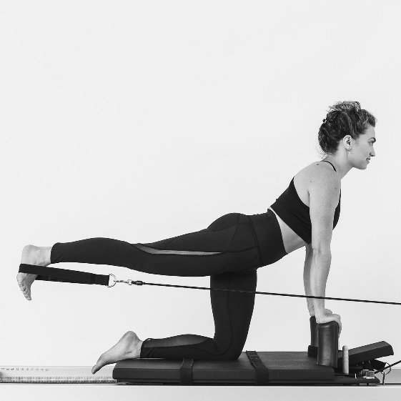
What is Fitnesse
GUI for Fit «Framework for Integration Testing» 2001
Collaboration tool - Tests - Developers - Customers
Open source, written in Java
Create test cases on a wiki.
Integrates with
Java
.Net,
Ruby,
Phyton
C
PHP

Slide 6
Fitnesse
Web server / Wiki
Common description language (testers / developers)
To design/run automated test suites
Slim or Fit? use Slim (newer, Fit not active developed)
Free Rest API test module (Smartrics)
Time consuming to write the code calling various APIs - Web services (SOAP, REST) - File based interfaces - Message based interfaces
Used at NAV - NAVs own Nitam test framework (written in Java) - Expanded and improved the framework

Slide 7
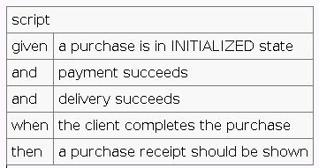
Fitnesse and BDD
Instead of Given / When / Then…
Write Wiki in “natural language” … and simple table layout.
Writing / reusing tests including test data in Fitnesse wiki language is simple
A tester can easily understand the Wiki language
Possible BDD in Fitnesse with SLIM script tables

Slide 8

Slim
Simple List Invocation Method
Alternative to Fit (original old method)
Rather than running all the HTML processing, comparisons, and colorizing in the System Under Test (SUT), Slim keeps all that behavior on in FitNesse.
What executes in the SUT is a very tiny kernel that implements the Slim Protocol.
Slim Java -> POJO (Plain Old Java Object)

Slide 9
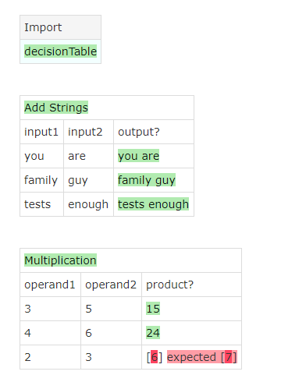
Fitnesse – Decision Table Fixture

Slide 10
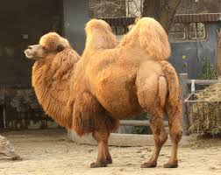
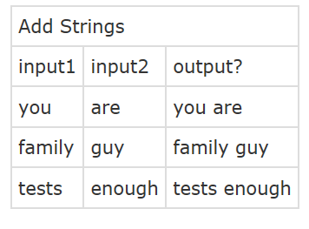
Fitnesse markup language
Camel Case
| Add Strings |
| input 1 | input 2 | output? |
| you | are |you are |
| family | guy | family guy|
Public class AddStrings {
Private String input
Private String input 2;

Slide 11
Edit page
Select edit at the top menu line
!contents -R2 -g -p -f -h
!define TEST_SYSTEM {slim}
!path /git/fitnesse/fitnesseSimpleSlimTest/target/classes
|Import|
|decisionTable|
|Add Strings|
|input1|input2|output?|
|you|are|you are|
|family|guy|family guy|
|tests|enough|tests enough|
|Multiplication|
|operand1|operand2|product?|
|3|5|15|
|4|6|24|
|2|3|7|

Slide 12
Fitnesse – Java POJO test code
package decisionTable;
public class AddStrings {
private String input1;
private String input2;
public void setInput1(final String i1) {
input1 = i1;
}
public void setInput2(final String i2) {
input2 = i2;
}
public String output() {
return input1 + " " + input2;
}
}
Is SUT or integrated with SUT
or interfaced with SUT
(e.g. using Rest call)

Slide 13
Fitnesse markup language
#List child pages with additional information
!contents -R2 -g -p -f –h
#use the SLIM protocol
!define TEST_SYSTEM {slim}
#classpath to Java
!path /git/fitnesse/fitnesseSimpleSlimTest/target/classes
#Table type
|Import|
|decisionTable|
#Test adding of Strings in this page
!|Add Strings|
| input1 | input2 | output? |
| wiki word | !-protect-!| wiki word !-protect-! |
| family | guy | family guy |
| tests | enough | tests enough |

Slide 14
Slim Tables
Decision Table – column value according to expected test result
Script Table - series of actions in rows, executed OK or not according to test script.
Scenario table - call from other tables (Decision/script) - analog to test scenario. - scenario parameters @{myVar}
Fit tables is somewhat analog to this, with other names, confusing… Fit Java uses inheritance

Slide 15
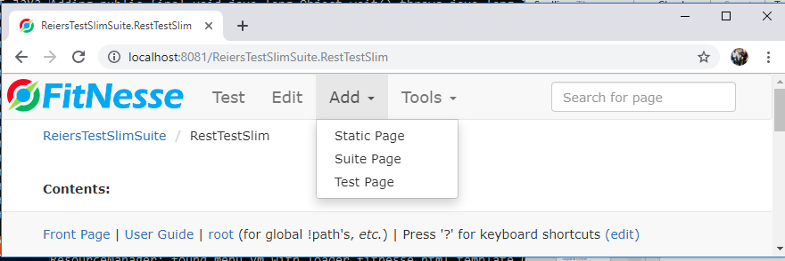
Add page
Add static page – Any text, no tests
Suite page – A suite of tests
Test page – Any test that can be run

Slide 16
Test Suites
A hierarchy of Parent and child wiki pages Suite page with Suite button - Static page 1 (just help text) - Static page 2 (common definitions for suite) - Test page 1
- Test page 2
- Test page 3
2. Cross reference suites !see reuse of pages
3. Run all pressing Suite button.

Slide 17
Wiki Programming Language?
You can define a Wiki “variable” in three ways:
!define var1 {text} - as a delimited block of text
!define var2 othervar - by copying the value of another variable
!define var3 {${= 10 / 2 =}} - as an expression
Evaluated before test executes!
Predefined global Fitnesse variables!
${var3} – Use of variable
${=expression=} expression may contain variables
Can read variables from other pages (and system.properties)
Loops and exit conditions in Fitnesse wiki ? Forget it! Not a programming language - E.g. testing asynchronous service
Use Java for logic like that.

Slide 18
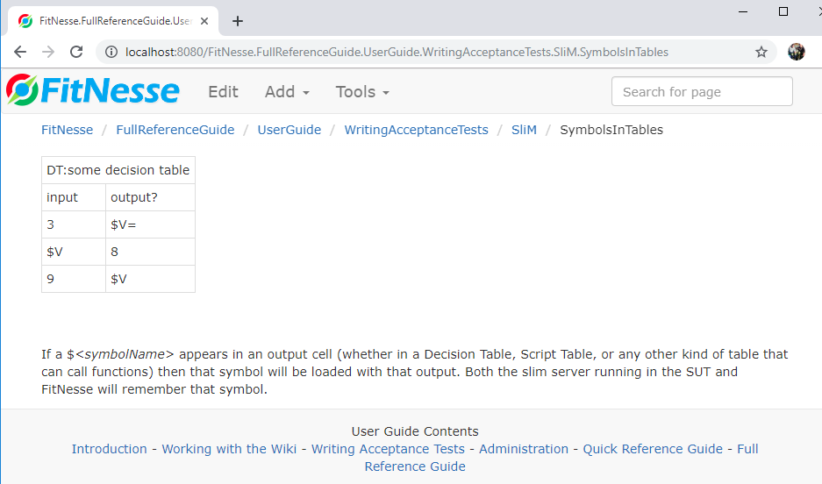
Wiki symbols

Slide 19
Download Fitnesse
http://fitnesse.org/FitNesseDownload
Download fitnesse_standalone.jar to empty dir
java -jar fitnesse-standalone.jar –p 8080
start.bat
http://localhost:8080 starts Fitnesse wiki
Ctrl c stops the web server
http://fitnesse.org/FitNesse.UserGuide always included in Wiki.

Slide 20
Download Intellij
https://www.jetbrains.com/idea/download/#section=windows
Ultimate edition. The licensed version.
Community edition might work for this workshop. Unsure if you can use FitnessePlugin with it.
For professional development use Community edition.

Slide 21
Fitnesse plugin
https://plugins.jetbrains.com/plugin/1143-fitnesse-integration Intellij should autodetect plugin when loading project
Here are the features:
Syntax highlighting
Start/stop and configuration of fitnesse server
navigation between wiki markup and fixture (not implemented yet)
stubbing of tables and fixtures (not implemented yet)

Slide 22
Fitnesse plugin
https://github.com/gshakhn/idea-fitnesse/wiki/Configuring-the-plugin
Define “Run configurations”
Settings, search for Fitnesse
Color marking of Wiki words / tables does not work properly in editor.

Slide 23
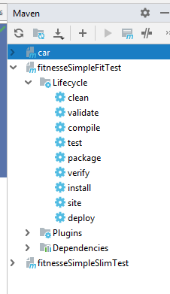
Maven plugin
Are integrated in Intellij
View, tool windows, maven …………………….
Clean
Install
With unit tests
Without unit tests
Test

Slide 24
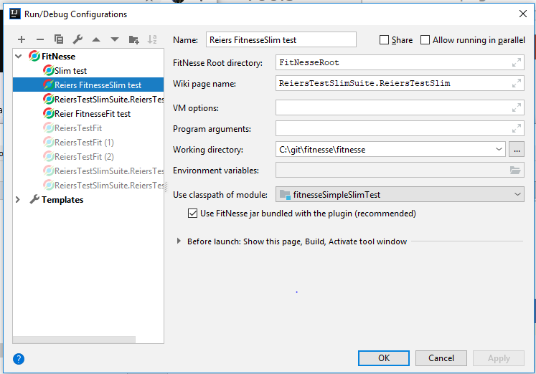
Run / Debug configuration

Slide 25
Reier’s Fitnesse examples
Open as one project in Intellij, use Fitnesse plugin
Fitnesse
The fitnesse wiki
FitnesseSimpleSlimTest
The Java code for Slim test
FitnesseSimpleFitTest
The Java code for Fit test
FitnesseSlim (open in a separate window in IJ)
A combined Java / Fitnesse Wiki project
Including Smartrics Rest testing
Fitnesse tests can be run as Junit tests.

Slide 26
TrainTrip.wiki Script Table
Open as one project in Intellij, use Fitnesse plugin
---
Help: Reiers train trip
Test
---
!define name {Reier}
|Import|
|scriptTable|
| script | train trip | ${name} |
| check | start destination | Moelv with ${name} |
| check | stop1 | Hamar with ${name} |
| check not | stop1 | Hamar with Bente |
| check | stop2 | Gardermoen with ${name} |
| check | end destination | Oslo S with ${name} |
New format: *.wiki
Old format: content.txt Properties.xml in named catalog

Slide 27
Update Fitnesse on existing site
Place jar file in directory with start.bat Reier site: C:/git/fitnesse/fitnesse
java -jar fitnesse-standalone.jar –p 8080
start.bat
http://localhost:8080
Should update site without destroying existing project contents.

Slide 28
Fitnesse – Smartrics Rest testing
!contents -R2 -g -p -f -h
!define TEST_SYSTEM {slim}
!path C:/git/fitnesse/fitnesseSlim/target/dependencies/*
!path C:/git/fitnesse/fitnesseSlim/target/fitnesseSlim-0.0.1-SNAPSHOT.jar
#timeout in milliseconds (10 seconds here)
Table:smartrics.rest.fitnesse.fixture.RestFixtureConfig|
|http.client.connection.timeout |10000|
#comment
#|VERB| uri | ?ret | ?headers | ?body |
|Table:smartrics.rest.fitnesse.fixture.RestFixture | https://ws.geonorge.no/adresser/v1 |
| GET |!-/sok?sok=Almeveien+11-!| 200 | | |
|Table:smartrics.rest.fitnesse.fixture.RestFixture | http://www.sigmondsmart.com |
| GET | | 200 | | |

Slide 29
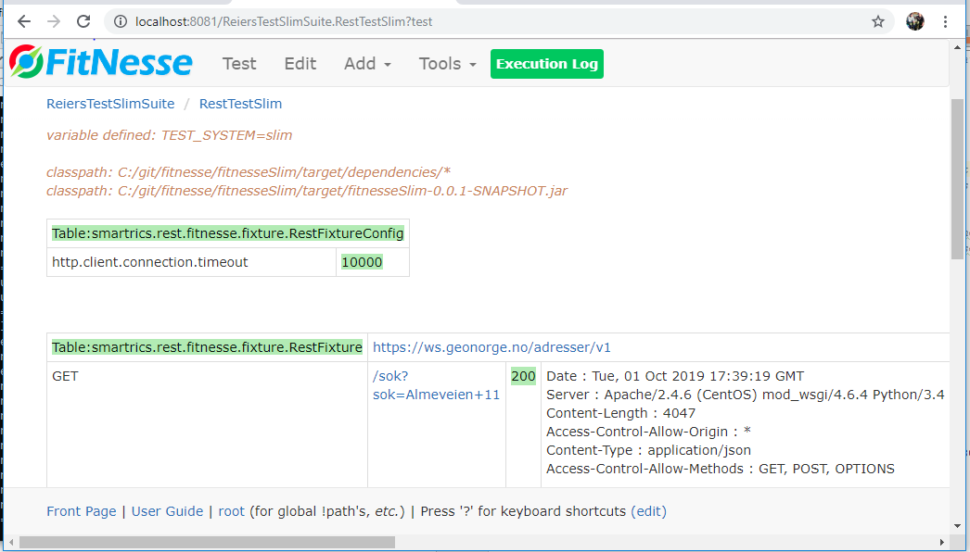
Fitnesse – Smartrics Rest testing
Click on execution log for details (Java logging and errors)

Slide 30
Fitnesse – Links
http://www.fitnesse.org
http://fitnesse.org/FitNesse.UserGuide
http://www.methodsandtools.com/tools/tools.php?fitnesse
http://www.softwaretestingclass.com/introduction-to-fitnesse-testing-tool-tutorial-for-beginners/
https://plugins.jetbrains.com/plugin/7908-fitnesse
https://github.com/smartrics/RestFixture

