Slide 1

THE
ZERO - G DINING
GUIDE
Loading...
NASA SPACE APP CHALLENGE SEOUL
TEAM PROJECT - AERO

Slide 2
ID: PROJECT - AERO
Problem
Edit
Done
Next
Next
Next
Nutrient deficiency and menu fatigue common in long missions. (NASA 2023)
Energy intake ↓ 25–30 % vs Earth baseline. (Stein 1999; Douglas 2023)
Vitamins C/D/B ↓, protein absorption reduced. (AIAA 2012; Smith 2019)
Body –2 kg, muscle –5 % during ISS stay. (Le Roux 2024; Stein 1996)
Vitamin C –50 %, B1 –35 % after 6 mo storage. (Cooper 2017)
Vit D deficiency → bone –2 %/mo. (Smith 2019; NASA Bone Study)
60 % crew eat less from repetitive menu. (Douglas 2020)
EVA = 194 kcal/hr energy use. (Waligora 1995)
Antioxidants –60 % during storage. (MDPI 2024)
C, B1 ↓ severely; B2, E stable. (Cooper 2017)
Psychological challenges of long-term space habitation
Let’s provide a fresh food management app with in-space production!
ISS menu 80 % fixed, 20 % personal. (Douglas 2020)
Shared meals ↑ team cohesion +25 %. (Landon 2019)
TEAM PROJECT - AERO
Microbiome diversity –40 % in microgravity. (Turroni 2022)
Protein loss / negative N-balance. (Stein 1996)
Space crops: Ca, Mg –20 %. (Nature 2025)
Veggie: Bok choy & kale grown successfully. (NASA 2021)
Polar analog: weight –10 %, Hb < 10. (Guly 2012; Feeney 1997)
Cold env. ↑ Vit C/E need +50 %. (Reynolds 2001)
Storage → protein oxidation, flavor loss. (Douglas 2023)
Self-production ≥ 30 % needed. (ESA 2024)

Slide 3
Solution
Next
Next
Method input
Paper input
Build Data base
Personal Data input
Personal Food Output by Database and Health Data
• A personalized diet recommendation system based on astronaut biometric data
• Weight, activity level, and gender analysis → Optimal meal suggestions that provide nutritional balance and variety and even increase self-sufficiency.
TEAM PROJECT - AERO

Slide 4

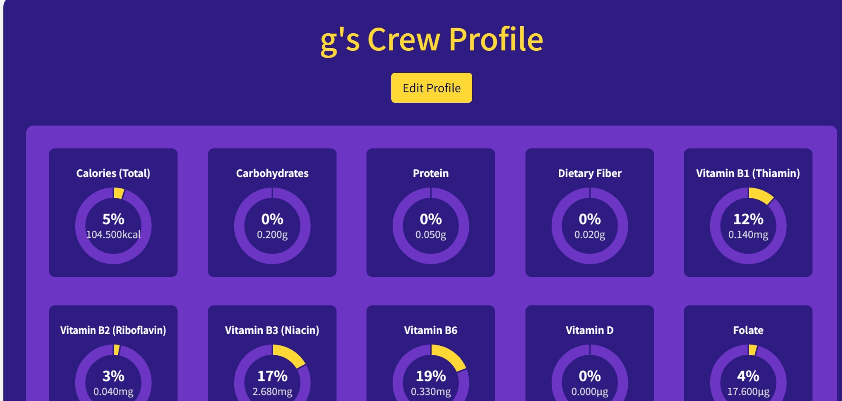
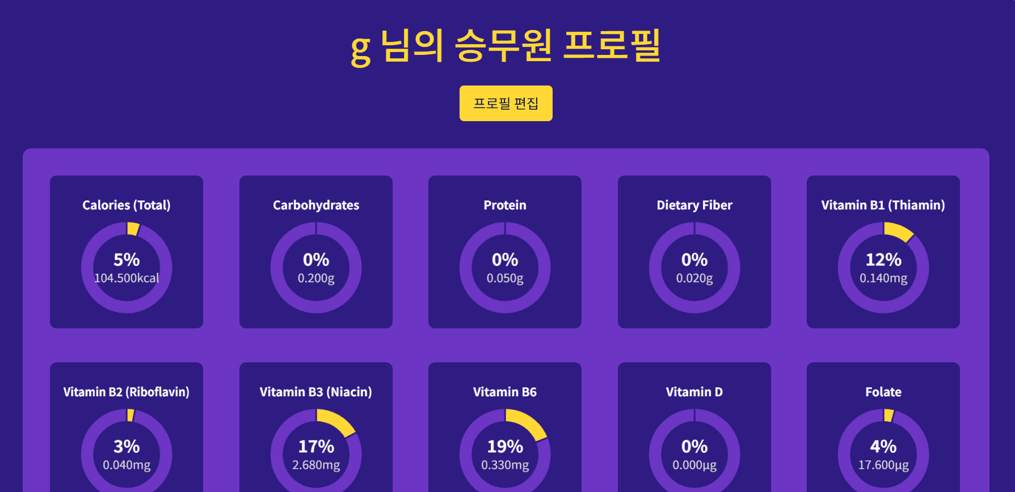
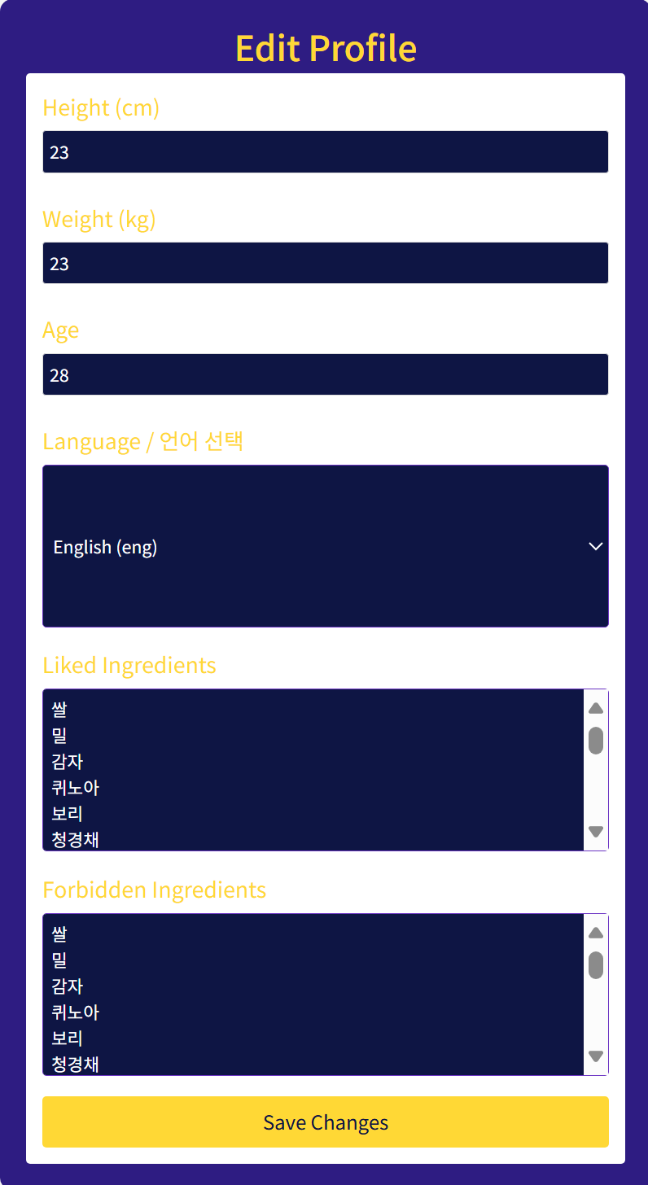
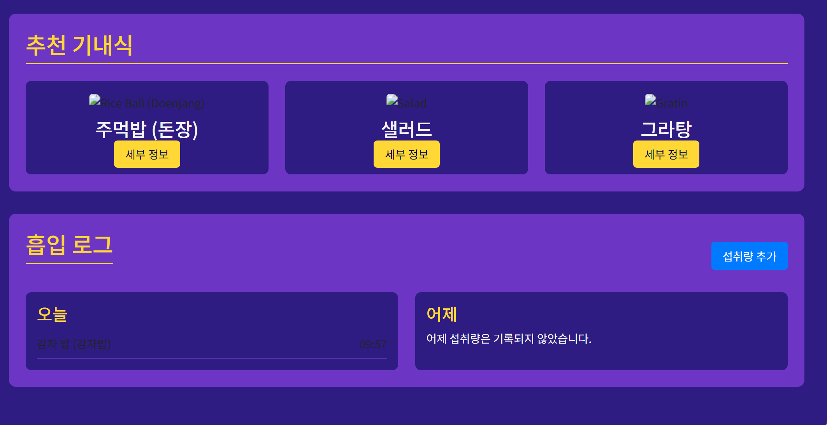
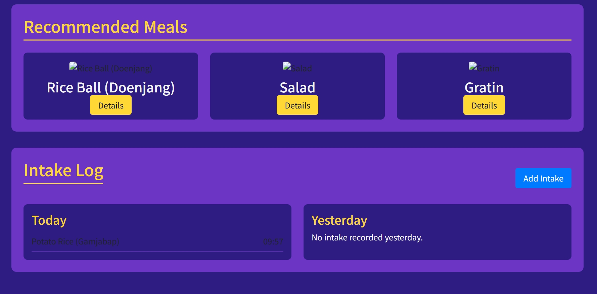
ID: PROJECT - AERO
Preview I
Next
Next
Login screen
Nutrients consumed
Recommended food + food eaten
Edit Profile​
TEAM PROJECT - AERO

Slide 5
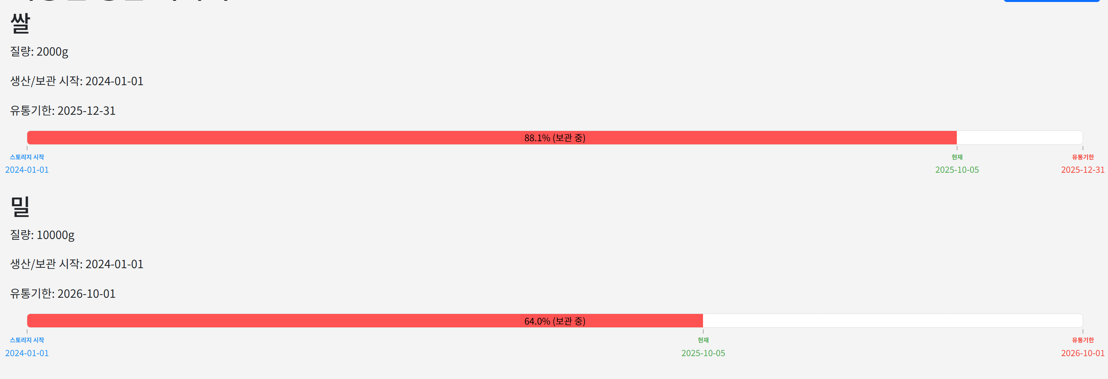
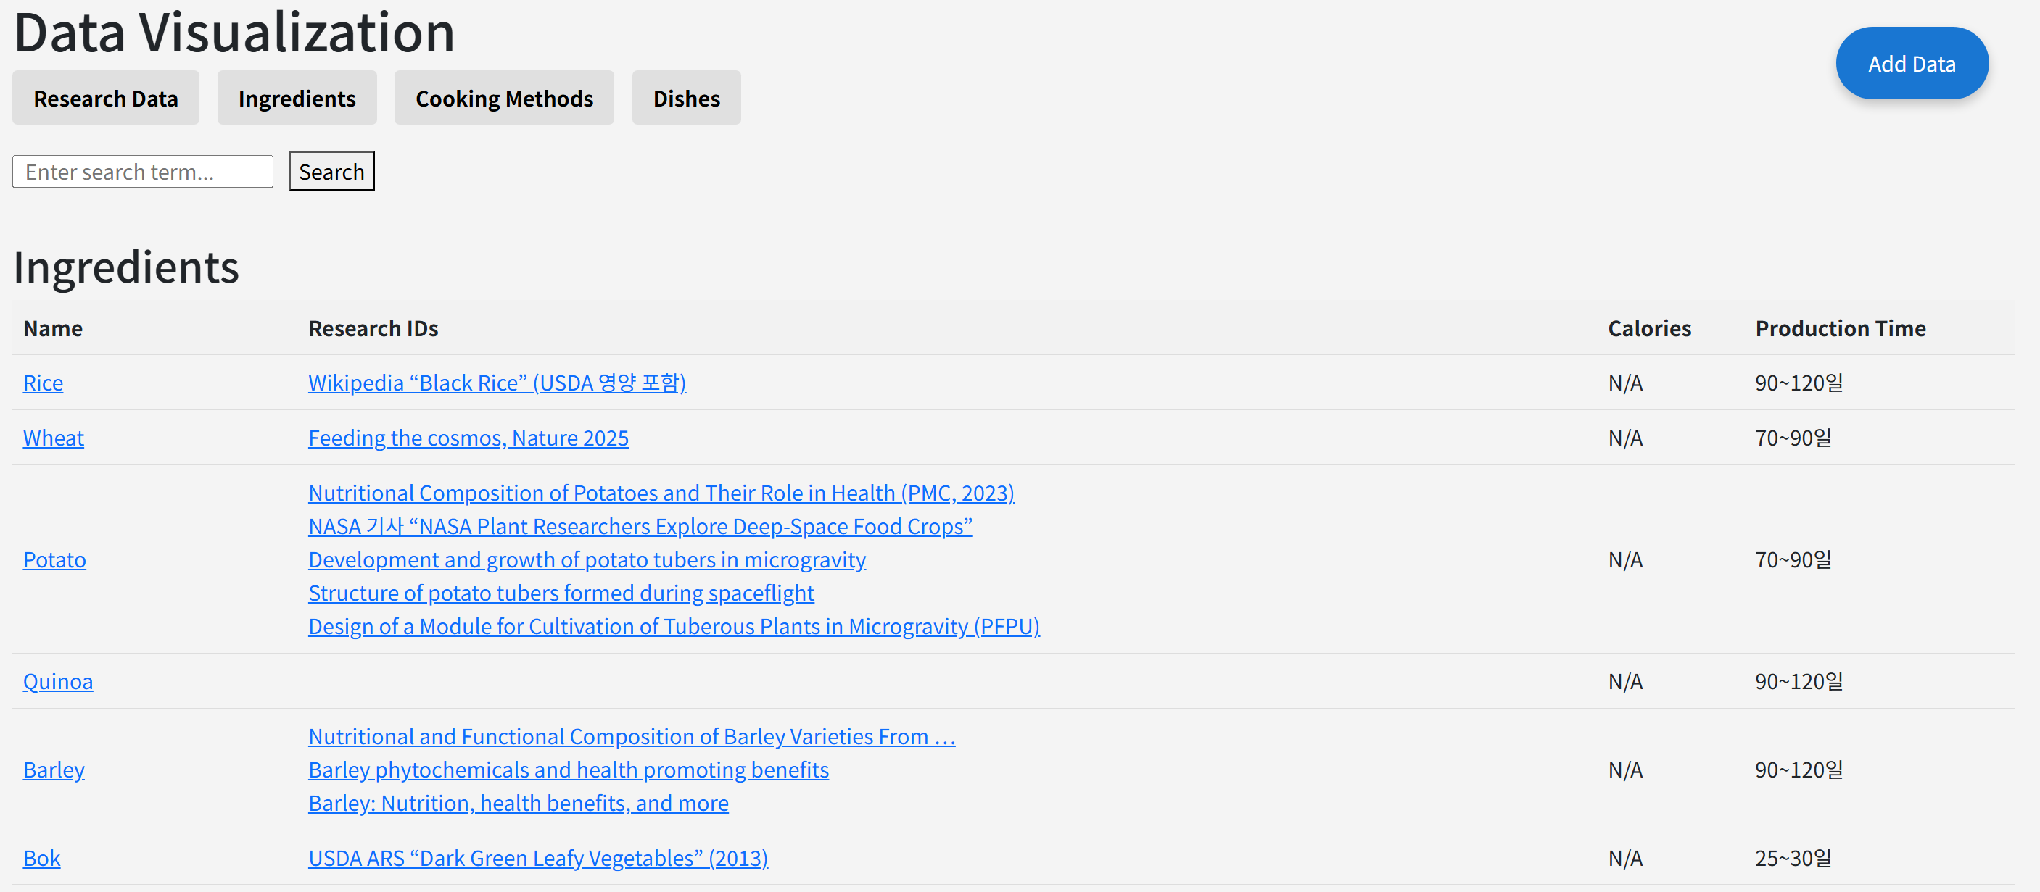
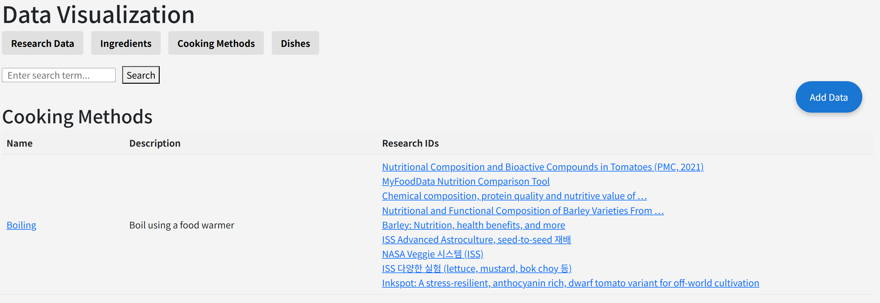
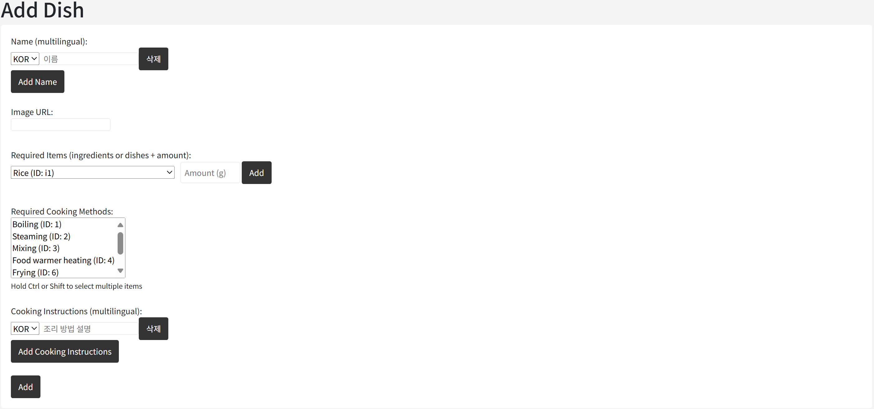
ID: PROJECT - AERO
Preview II
Next
Next
그래프
그래프
Stored Ingredient Visualization
Data Visualization - Ingredients
그래프
그래프
Data Visualization - Cooking Methods
Additional features (e.g. food)
TEAM PROJECT - AERO

Slide 6



ID: PROJECT - AERO
Impact/Significance
Next
Next
$∙$ Health & Performance Impact
A good meal in a small, confined environment is beneficial to the mental health of the crew.
Improving quality of life
by providing a more diverse menu
$∙$ System Efficiency
ID: PROJECT - AERO
ID: PROJECT - AERO
Shortening the data research period by building a database related to space food.
Growing crops in space reduces Earth's supply usage and reduces the frequency of resupply.
$∙$ Scientific/Operational Significance
Reduces reliance
on Earth resupply by ~30%
Extends shelf life of food system
by 1.5× (from 18 to 27 months)
ID: PROJECT - AERO
ID: PROJECT - AERO
TEAM PROJECT - AERO

Slide 7



ID: PROJECT - AERO
Conclusion/Future Outlook
Next
Next
$∙$ Conclusion
Space food, nutrition data
Data Base
Personal food recipe,
personalized diet plans
$∙$ Potential for future development
1. Designing cooking utensils usable in zero gravity
2. Suggesting more diverse and delicious recipes
3. Providing users with more accurate information by referencing more data
$∙$ Expected effect
Providing educational resources on space food
Raising public awareness of the space food industry
TEAM PROJECT - AERO

