Slide 1
THE
ZERO - G DINING
GUIDE
Loading...
NASA SPACE APP CHALLENGE SEOUL
TEAM PROJECT - AERO

Slide 2
ID: PROJECT - AERO
Problem
Edit
Done
Next
Next
Nutrient deficiency and menu fatigue common in long missions. (NASA 2023)
Energy intake ↓ 25–30 % vs Earth baseline. (Stein 1999; Douglas 2023)
Vitamins C/D/B ↓, protein absorption reduced. (AIAA 2012; Smith 2019)
Body –2 kg, muscle –5 % during ISS stay. (Le Roux 2024; Stein 1996)
Vitamin C –50 %, B1 –35 % after 6 mo storage. (Cooper 2017)
Vit D deficiency → bone –2 %/mo. (Smith 2019; NASA Bone Study)
60 % crew eat less from repetitive menu. (Douglas 2020)
EVA = 194 kcal/hr energy use. (Waligora 1995)
Antioxidants –60 % during storage. (MDPI 2024)
C, B1 ↓ severely; B2, E stable. (Cooper 2017)
ISS menu 80 % fixed, 20 % personal. (Douglas 2020)
Shared meals ↑ team cohesion +25 %. (Landon 2019)
Last Saved: (2025.10.04/16.31.20 GMT)
Microbiome diversity –40 % in microgravity. (Turroni 2022)
Protein loss / negative N-balance. (Stein 1996)
Space crops: Ca, Mg –20 %. (Nature 2025)
Veggie: Bok choy & kale grown successfully. (NASA 2021)
Polar analog: weight –10 %, Hb < 10. (Guly 2012; Feeney 1997)
Cold env. ↑ Vit C/E need +50 %. (Reynolds 2001)
Storage → protein oxidation, flavor loss. (Douglas 2023)
Self-production ≥ 30 % needed. (ESA 2024)
Crew Profile
Crew Profile
Crew Profile
Crew Profile
Crew Profile
Crew Profile
Crew Profile
Crew Profile
Crew Profile
Crew Profile
Crew Profile
Crew Profile
Crew Profile
Crew Profile
Crew Profile
Crew Profile

Slide 3
Solution
• A personalized diet recommendation system based on astronaut biometric data
• Weight, activity level, and gender analysis → Optimal meal suggestions that provide nutritional balance and variety and even increase self-sufficiency.
Input
AI Engine
Recipe Output

Slide 4
ID: PROJECT - AERO
Mockup
Next
그래프
그래프
ID: PROJECT - AERO
ID: PROJECT - AERO
그래프
그래프
ID: PROJECT - AERO
ID: PROJECT - AERO

Slide 5
ID: PROJECT - AERO
Mockup
Next
그래프
그래프
ID: PROJECT - AERO
ID: PROJECT - AERO
그래프
그래프
ID: PROJECT - AERO
ID: PROJECT - AERO

Slide 6



ID: PROJECT - AERO
Impact/Significance
Next
$∙$ Health & Performance Impact
Reduces reliance on Earth resupply by ~30%
Extends shelf life of food system by 1.5× (from 18 to 27 months)
$∙$ System Efficiency
ID: PROJECT - AERO
ID: PROJECT - AERO
Reduces reliance on Earth resupply by ~30%
Extends shelf life of food system by 1.5× (from 18 to 27 months)
$∙$ Scientific/Operational Significance
Reduces reliance on Earth resupply by ~30%
Extends shelf life of food system by 1.5× (from 18 to 27 months)
ID: PROJECT - AERO
ID: PROJECT - AERO

Slide 7
ID: PROJECT - AERO
Conclusion/Future Outlook
Next
Developed adaptive AI-based space nutrition system
Validated against 40+ NASA/AIAA physiological studies
Identified key nutrients most affected in long-duration missions (C, D, B-complex)
Summary of Findings
$∙$ System Efficiency
ID: PROJECT - AERO
ID: PROJECT - AERO
$∙$ Scientific/Operational Significance
ID: PROJECT - AERO
ID: PROJECT - AERO

Slide 8
ID: PROJECT - AERO
Conclusion/Future Outlook
Next
그래프
Crew Profile
Intake Log
Last Saved: (2025.10.04/16.31.20 GMT)

Slide 9
ID: PROJECT - AERO
Inventory
Back
1. 쌀
- Remains
- 보관
남은 양 막대그래프로
- 재배 기간
탄수화물
B 군
B 군
핵심 성분 나열
More Info
각종 원 그래프 등등.. 스크롤 형태로 /창으로 뜨도록
Last Saved: (2025.10.04/16.31.20 GMT)

Slide 10
ZERO – G DINING GUIDE
LOG - IN
ID
Passward
ENTER
NASA SPACE APP CHALLENGE SEOUL
TEAM PROJECT - AERO

Slide 11
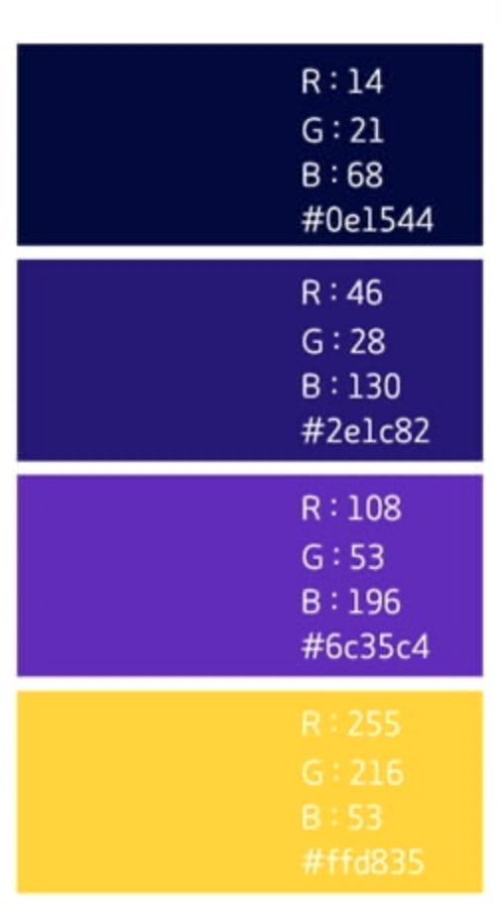
Title(Apple Braille – Regular, 32pt)
Subject(Apple Braille – Regular, 24pt)
Contents(Apple Braille – Regular, 20pt)
Foot note(Apple Braille – Regular, 12pt)

Slide 12
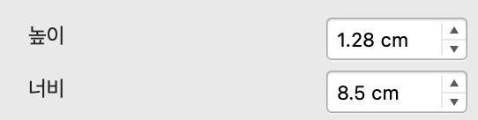
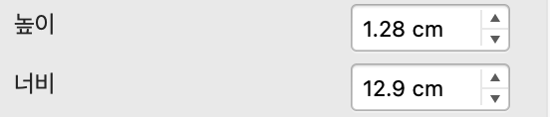
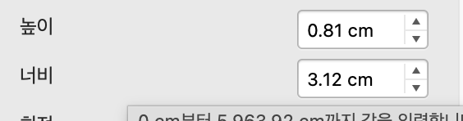
ENTER
ENTER
Crew Profile
Intake Log
Edit
Done
Next

Slide 13
ZERO – G DINING GUIDE
LOG - IN
ID
Passward
ENTER
NASA SPACE APP CHALLENGE SEOUL
TEAM PROJECT - AERO

Slide 14
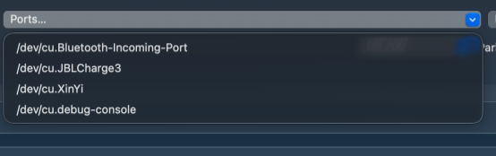
ID: PROJECT - AERO
Now we select Menu!
Next
Inventory
Key Ingredients
Last Saved: (2025.10.04/16.31.20 GMT)

