Slide 1
using typescript
Notes:
Open threejs
Sitting at my desk at home my 5 year old son walks in …
What I wanted to demonstrate here is how powerful web apps have become and how much functionality get implemented via javascript
Lots of code, lots of chances to screw up, tooling becomes more important, tooling gets better with typescript,
Ts offers many benefits that are applicable to most js development, client or server and with most libraries and frameworks
as first part of this I would like to give an overview of what typescript is and where it comes from (as far as I know)

Slide 2
About me
FORTRAN, Pascal, C/C++, C#, JS, Typescript
Engineer, currently at Pearson as UX developer
Been working with typescript since November 2012
Projects I currently work on have ~40k lines of ts
Notes:
Born in Germany, came in 99 , us citizen, long time in imaging, camera drivers in C/C++
JavaScript: Freedom, a bit like C

Slide 3
INTRO
Dart, Typescript, Facebook Flow…
Google (AngularJS team) ATScript, superset of typescript, no static type checker
Dynamic languages with optional static typing:
Where did this idea come from?
Notes:
http://www.slideshare.net/RichardWarburton/twins-oop-and-fp-31794436
Multiple paradigms in programming,
oop vs fp,
dynamic vs static,
strong vs weak
Sql vs nosql
I first gave this talk about three month ago at the angular meetup .
During my research I found a lot of things that I didn’t know before
It appears some times that we have to choose
but maybe we don’t have to maybe we can have all these things together
Recently there have been suggestions towards being more inclusive to many of these ideas at the same time as they might not be as contradicting as it seems

Slide 4
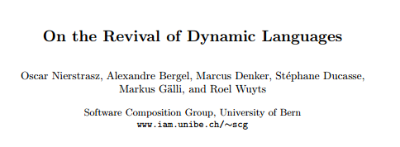

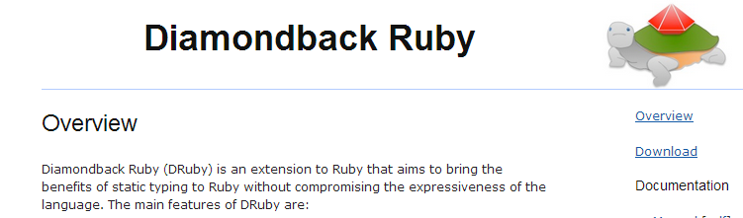
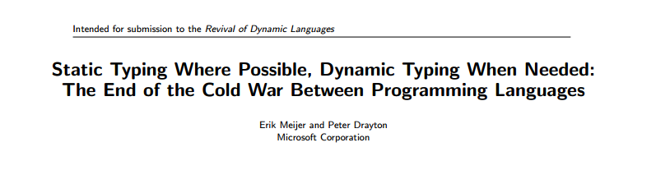
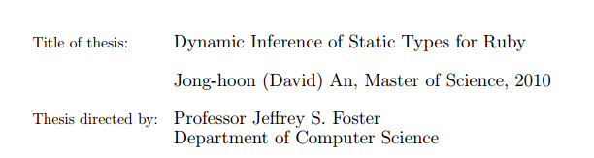
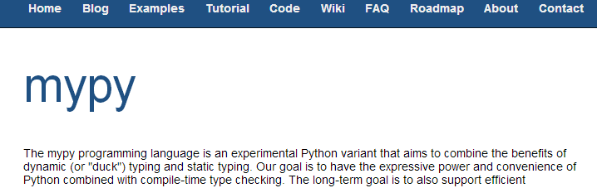
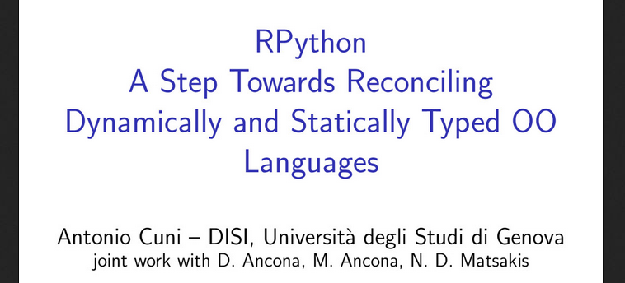
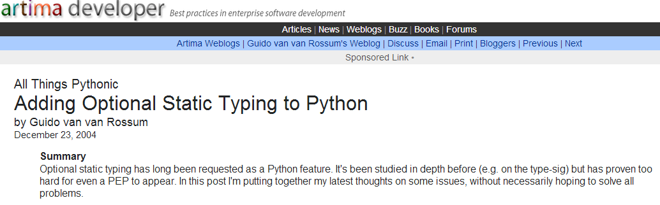

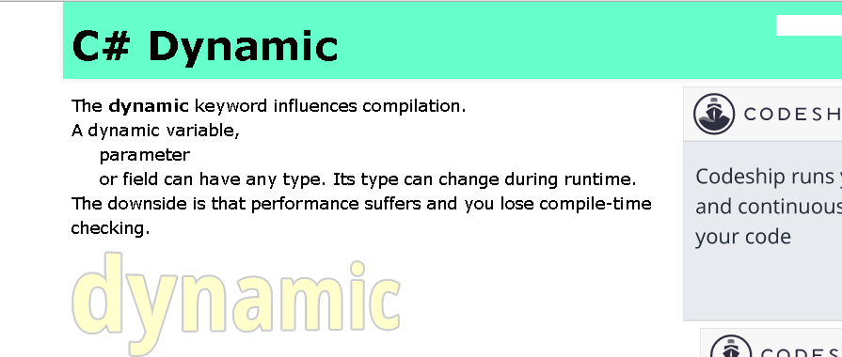
https:///sites.google.com/site/steveyegge2/is-weak-typing-strong-enough
http://herbsutter.com/2008/06/20/type-inference-vs-staticdynamic-typing

Slide 5
content of this talk
Background
Anders Hejlsberg
What typescript gives you: ES6 stuff, typing, tooling, documentation of intend
Where to get definition files => definitely typed
Demo
Notes:
Two situations :
writing your own code in ts
and using a js library , you probably want a definition file for that library
Install tool chain, VS2013, NTVS, Node, npm, typescript, grunt, grunt plugin, sublime plugin

Slide 6
BACKGROUND
Transpiler->JS,
https://github.com/jashkenas/coffee-script/wiki/List-of-languages-that-compile-to-JS
JS becomes a bit like byte code to Java or IL for C#, with the difference that it is human readable
Optional typing, platform independent
Very important: Typescript does not take away any of the Java script “coolness”, in my opinion
Notes:
open the link, do a search on “type”, show Ubuntu vm with subl compile a file
Platform independent As long as you have nodeJS

Slide 7

ANDERS HEJLSBERG
Language designer (his own words)
Turbo Pascal, Borland
Delphi
C#
“Can’t explain it in 5min -> not a good idea”, maybe
“Typescript filters out the semantic subset of java script that makes sense”
Notes:
The guy behind ts and many other things is …
Maybe, because even though you can wrap something like typescript into few sentences it still takes a bit longer to comprehend what that means , took me many month to realize the impact

Slide 8
WHAT YOU GET …
Ecmascript6 stuff: class, extends, arrow function,get/set
https://github.com/lukehoban/es6features?utm_source=javascriptweekly&utm_medium=email#arrows
https://wiki.mozilla.org/ES6_plans
=> handling of this pointer (lexically scoped)
~ like coffee script, but not a new language
“optional” static typing, interface, implements
interfaces open ended, multiple files can contribute
annotations
Static typing: not that there is anything wrong with that
inference, flowing the types via generics
inverse inference
lib.d.ts, the JS runtime lib and DOM
JS has type information but only at run time
typescript, not provably type safe
http://en.wikipedia.org/wiki/type_system
Notes:
Show the links in a browser
You get a compiler!!!!!!!!!!!!

Slide 9
…MORE
Statement completion
Sublime Text and many others, when working with large libraries helpful
documentation of intend
example: rest service format described via interface
write a test for what you actually get from the service against the interface
if you have to go back and talk with the backend people about their data, you have a piece of code as proof
No TS “engine”/VM, no runtime library
impact only at design time
Superset of JS
for people who know java script a shallow learning curve
Debugging in Chrome, Firefox, Visual Studio, intelliJ, Webstorm…
directly in TS files via source maps
Upgrading to a newer version of a library?
upgrade the .d.ts file and fix the errors
Handling of java script module systems AMD/CommonJS
via compiler flag
Notes:
Change the leader board in comp heatmap .
Change the exception handler

Slide 10
NODE TOOLS FOR VISUAL STUDIO
Install
NPM manager
Debugging
Break on exception
Immediate window context in broken context of app
Remote debugging (also on Linux) RemoteDebug.js
Profiling
VS 2015 now has Apache Cordova Typescript project template!

Slide 11
DEMO
Simple examples
Sanity
ES6 features: module, class, arrow
More examples
inference, reverse inference, refactoring
changing an interface from a staging to a production scenario, rest calls, js module systems
Code re-use
name spaces/modules simplify code reuse
more utility functions used in many places, changing these becomes very simple
Unit tests
saves unit tests.
Convert d3.js GIST , debugging in chrome with source map
Notes:
go with sublime could also use the play ground -> debug in node
Show classes and namespace
Open the inference.ts in subl, walk thru the code
Show gambit li code, change rest interface, show errors,
Show the d3 demo app, convert to ts

Slide 12
where does typescript not help?
Accidental closures when refactoring
Check types at run time (Dart does)
Versions of libraries and corresponding .d.ts file can be a problem
.d.ts files can be incorrect or incomplete or both
Notes:
Show the type test in compheatmap

Slide 13
INSTALL: WHAT IS YOUR TOOL CHAIN?
General
http://www.typescriptlang.org/
http://typescript.codeplex.com/documentation
Visual studio
http://www.microsoft.com/en-us/download/details.aspx?id=34790 needs windows 7 sp1 and IE
nodejs package
install node, node-inspector if you want to debug the example code
npm install typescript -g
gives you the command line compiler-> tsc
Node tools for VS
Grunt
http://gruntjs.com/ npm install -g grunt
https://npmjs.org/package/grunt-typescript
npm install grunt-typescript --save-dev
sublime text
browse packages, git clone https://github.com/Railk/T3S.git or git@github.com:Railk/T3S.git
Typescript compile
compile typescript script tags and ts files directly in the browser: https://github.com/niutech/typescript-compile
where to get the definitions -> definitely typed
https://github.com/borisyankov/DefinitelyTyped
https://github.com/definitelytyped/tsd
http://definitelytyped.github.io/tsd/
Notes:
there are many tools that support ts by now, emacs, webstorm, intellij, resharper, VI, eclipse open definitely typed

Slide 14
SUMMARY
Transpiler -> JS
Optional static typing
ES 6 features
IDEs and debuggers
Saves unit tests and lets you sleep better

Slide 15
QUESTIONS ?
Thank you!

