Slide 1


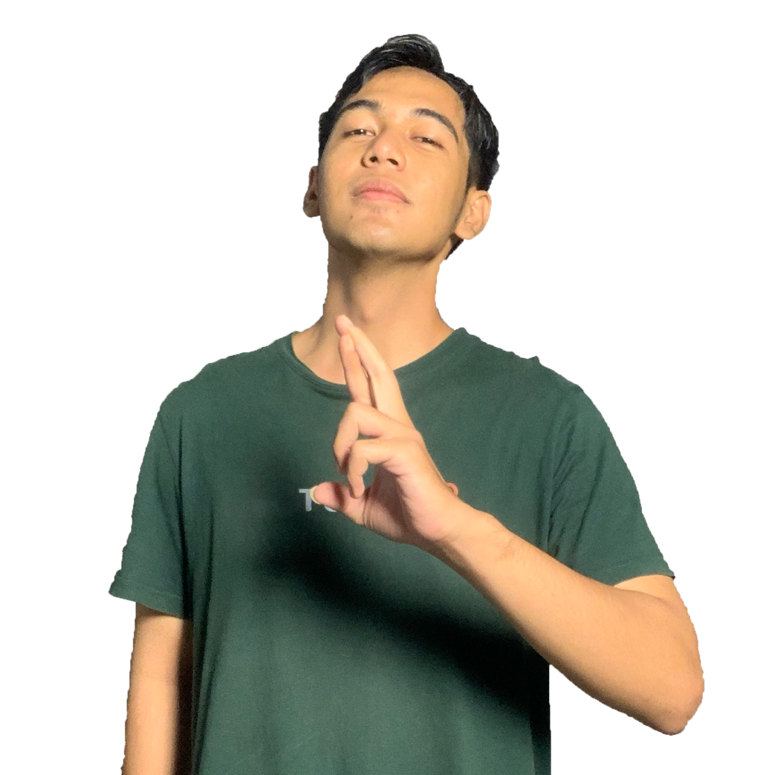


PORTFOLIO.
Contact Me
Hello Everyone.
I'M FARHAN AB.G
MOBILE DEVELOPER

Slide 2
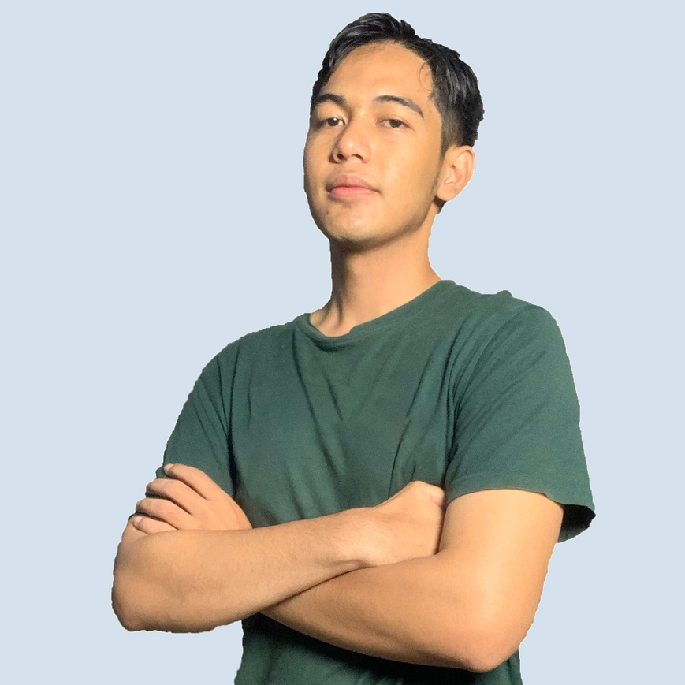
PORTFOLIO.
About Me
A freelance software developer with expertise in Flutter. I've built a variety of mobile app features, ranging from API integration to biometric-based authentication. My experience includes state management, app performance optimization, and local data storage. I focus on creating innovative solutions that are responsive and reliable.
Hire Me
Download CV

Slide 3
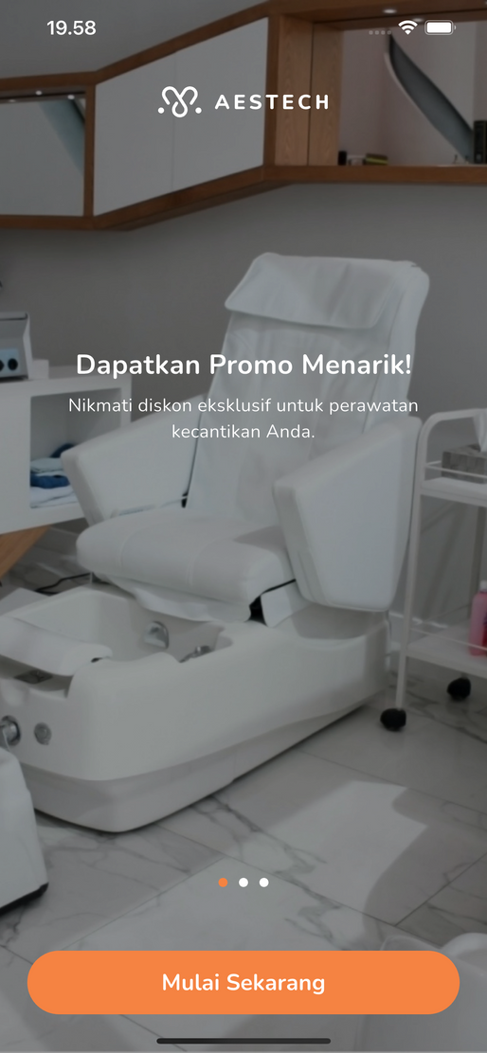
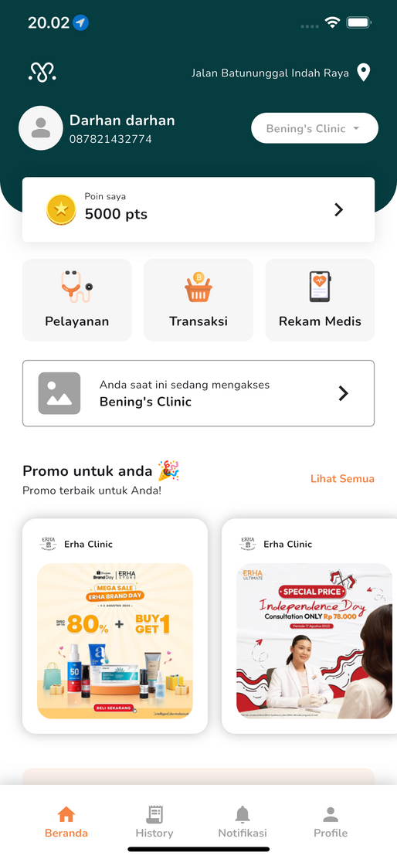
PORTFOLIO.
Aestech Customer
An application designed to make it easier for customers to make transactions and find the location of the nearest clinic through the interactive maps feature.
FEATURE
OTP
PIN
MAPS
Booking
Transaksi
Notifikasi
TECHNOLOGY
Flutter
Android
IOS

Slide 4
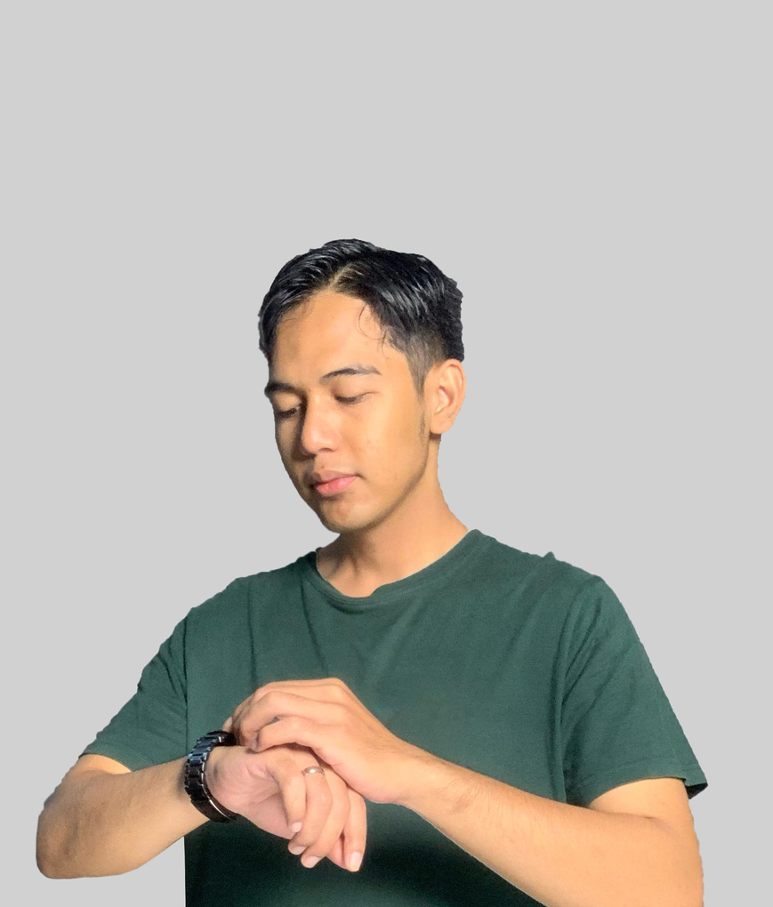


PORTFOLIO.
Personal Skills
a Flutter expert Mobile Developer and an experienced Web Developer with expertise in Vue.js. He is proficient in state management, API integration, and developing high-performance cross-platform and interactive web applications.
Mobile Developer
Web Developer

Slide 5

PORTFOLIO.
Contact Details
Email :
abgfarhan18@gmail.com
Linkedin
www.linkedin.com
Instagram :
@hansss18

Slide 6

PORTFOLIO.
Contact Me
2024 Porfolio Mobile Developer
THANK YOU
Committed to delivering innovative digital solutions of the highest quality, I am ready to help turn your ideas into reality.
See More My Portfolio
Contact Me!

