Slide 1
`Tips` for Taxi Drivers (. . . and taxi companies . . . and riders)
Mark Chen, Yihan Shen, and Andrew Yang

Slide 2
The Questions
How can we use taxicab data to help drivers predict their tips?
How can we ensure the data we use is private?
What happens if our data is not private?

Slide 3
Agenda
Discussing the problems with non-private data
Using differentially private data to predict driver tips
GAN Approach – Sketch
GAN: Solid Example – Regression
GAN: Solid Example – Classification
Further ideas: Zero-Knowledge and Federated Learning

Slide 4
The Two Sides of Data

Slide 5
Why Taxi Data is Dangerous
Groups can easily track the paths of taxis given the current available data
Time and location are the most helpful information to help tracking
Reducing the resolution of the data does not prevent tracking
Many affected by taxi tracking
Taxicab drivers do not want to be tracked
Problem for high-profile individuals and celebrities

Slide 6
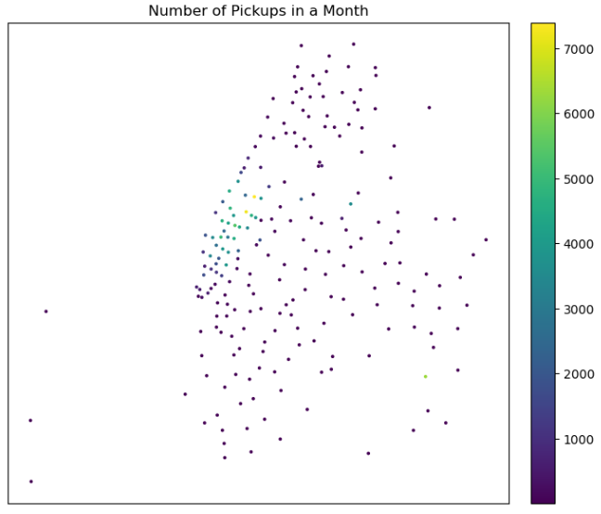
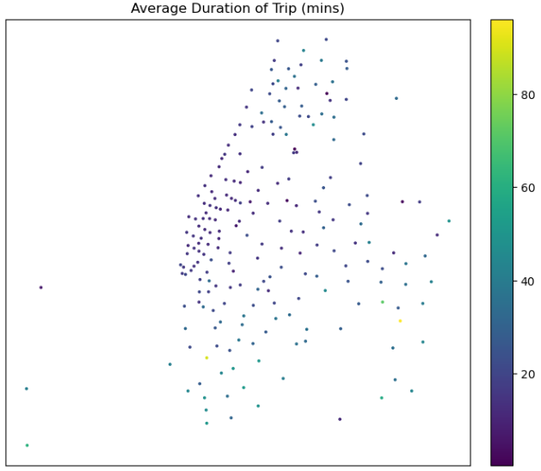
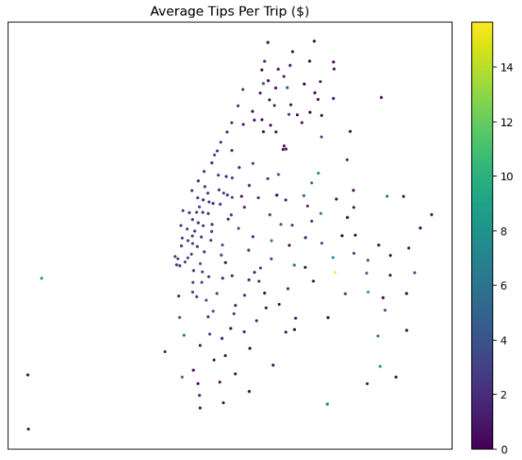
Why Taxi Data is Useful
Data like the popularity of a pickup location can help us predict the end location, duration, and tips expected for the next trip

Slide 7
Taxi Driver Tips
We decided to focus on predicting tip rate for taxi drivers
Give more incentives for taxi drivers
Support taxi businesses rather than large companies like Uber
In the future, an app can be created for taxi drivers to help predict their expected tips

Slide 8
GAN Approach

Slide 9
Idea: Sketch
Minimize Accuracy of Getting Correct Guesses Overall
Reverse Prediction Model
Guesses
Adjust ε
Mix with Laplacian noise based on ε
Prediction Model
Minimize error on predicting the output
Input
Output

Slide 10
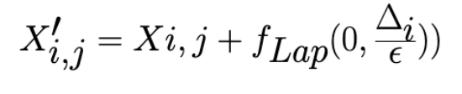
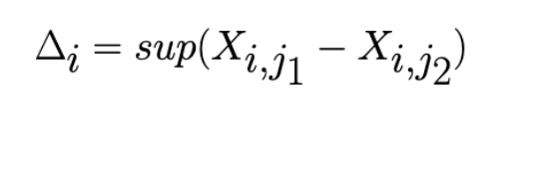
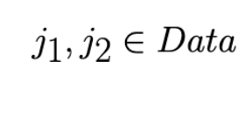
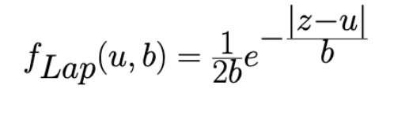
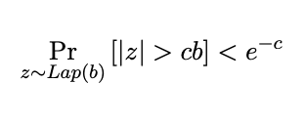
Randomization Scheme
Laplacian Mechanism
Works well with low-sensitivity data
Provides a good middle ground between Gaussian noise and exponential raise
We have 140,000 data points with low sensitivity; we want our predictions to be not traceable

Slide 11
Solid Example – Regression
∞
5
4
2
Prediction not bad;
Adversarial too good
Prediction alright;
Adversarial closer to ideal
Prediction tending bad;
Adversarial almost there
Probably almost good
Mean Squared Error | 8.3109513733% | 13.6571389876% | 15.3797713836% | 21.4699850483%
Manhattan Distance Error | 15.758377748% | 24.090737902% | 32.294020058% | 41.1323324129%
Generative training result to find the best epsilon (for predictions and guesses, we used XGBoost Regression)
We want to find the best correlation between pick-up and drop-off locations and times for tips for the drivers
While at the same time trip specifics used for predictions cannot be back traced in order to protect rider privacy.

Slide 12
Privacy and Error Tradeoff
Though our mean squared error increased from 8% to 23% when we made our data more differentially private, it still predicts better than other literature

Slide 13
Solid Example – Classification
∞
5
4
2
Prediction not bad;
Adversarial too good
Prediction alright;
Adversarial closer to ideal
Prediction tending bad;
Adversarial almost there
Probably almost good
Mean Squared Error | 7.7566809480% | 7.82790527% | 14.9479624352% | 19.8535003662%
Manhattan Distance Error | 12.6643380594% | 17.2506975185% | 29.2964963912% | 42.6387612893%
Support Vector Machine with Slacks
We want to find the best prediction of the duration of the trip based on the time and the location of the taxi driver.
Given the recent fatigued driving prevention law, the driver needs to be able to decide on a target location the with limiting hours that he/she can work.

Slide 14
Beyond
Homomorphic encryption (slow)
Federated learning mixed with differential privacy and decentralized encryption (like zero knowledge)
To ensure that actually no one even possesses the data
To ensure that the information is still accurate

