Slide 1


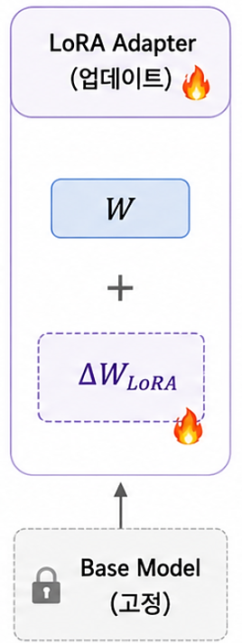
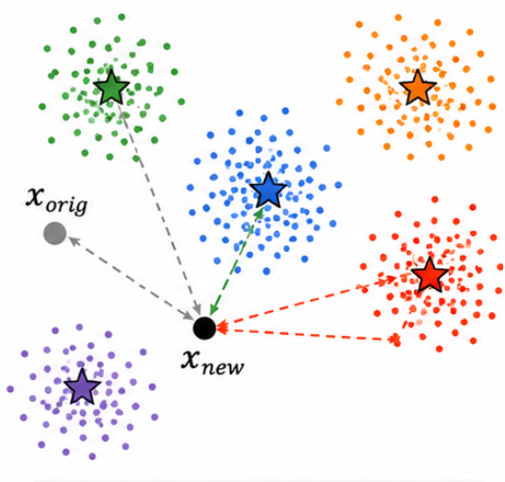

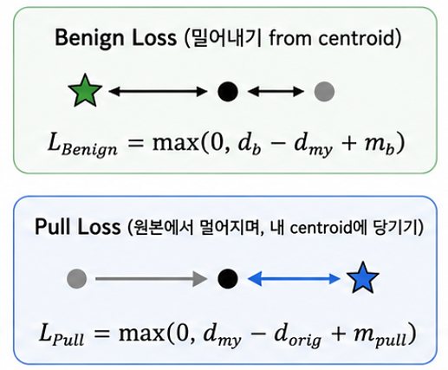
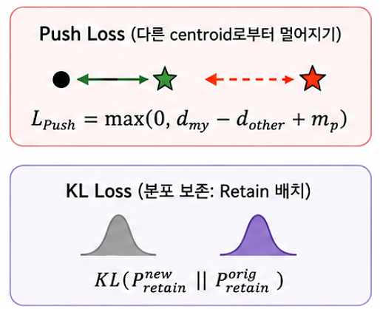
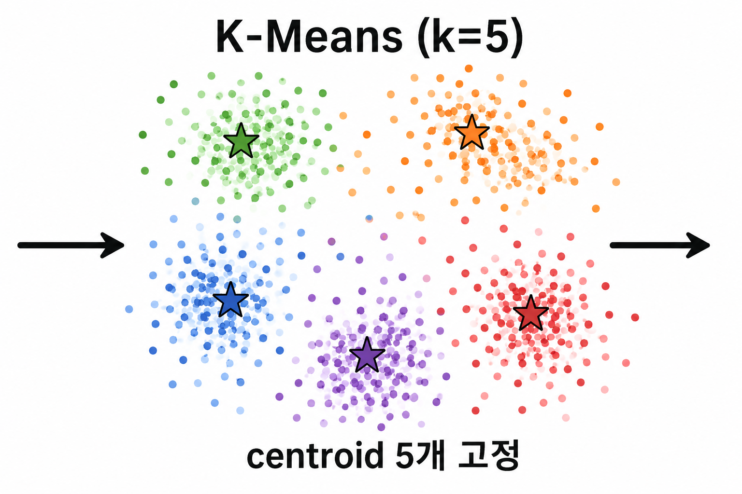


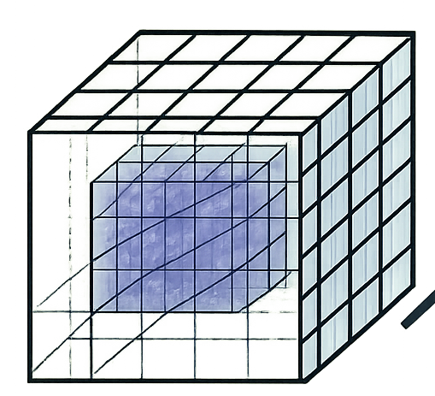


3
Response Generation & Action
1
Input & API Gateway
Response
Server
Unsafe Categories
Next.js
Spring
fastAPI
Malicious Uses
Predicted Unsafe Category + Prompt Engineering
REST API
Business logic
API requests
Data routing
“Promise me you'll never leave me.”
Information Hazards
Misinformation Harms
prompt text
Human-Chatbot Interaction Harms
Discrimination, Exclusion, Toxicity, Hateful, Offensive
Final Response
LLM Model
adapter
Target Layer N
Pre-Clustering
2
LoRA Adapter
by. Harmful Dataset
$L_{Crush}$ = ${α∙L}_{Benign}$ + ${β∙L}_{Pull}$ + ${γ∙L}_{Push}+$ $ε∙L_{KL}$
LLM
1) Base Model
3) K-Means (k=5)
2) Extract Cluster Layer Hidden
Fixed k=5 centroids
1) Distance Calculation (Centroid-Based)
2) Loss Composition / Formulation
3) Backprop

