Slide 1
Sequential Group Recommendations Method Hannemari Kuusisto
Collaborative filtering to produce predicted scores for users.
Aggregate scores with Borda Count Aggregation.
Calculate the satisfaction of each user with the recommendations.
In the next round use modified Borda.
Remember least satisfied user from last round.
When adding up users’ borda scores for a movie, if least satisfied user has the lowest score, adjust all scores to match it. This movie will be lower in the list of movies.
Calculate satisfaction again and repeat.

Slide 2
Least satisfied user from last round
User 1
User 2
User 3
Group Borda Score:
2 | 2 | 3
1 | 1 | 2
3 -> 1 | 2 -> 1 | 1
Movie 1
7
Movie 2
4
Movie 3
3

Slide 3
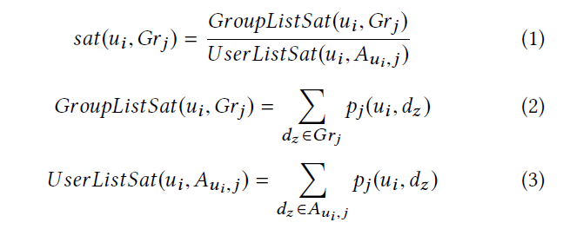
Satisfaction
(Stratigi et al., 2020)

Slide 4
References
Stratigi, M., Nummenmaa, J., Pitoura, E., & Stefanidis, K. (2020). Fair sequential group recommendations. Proceedings of the 35th Annual ACM Symposium on Applied Computing, 1443–1452. https://doi.org/10.1145/3341105.3375766

