Slide 1
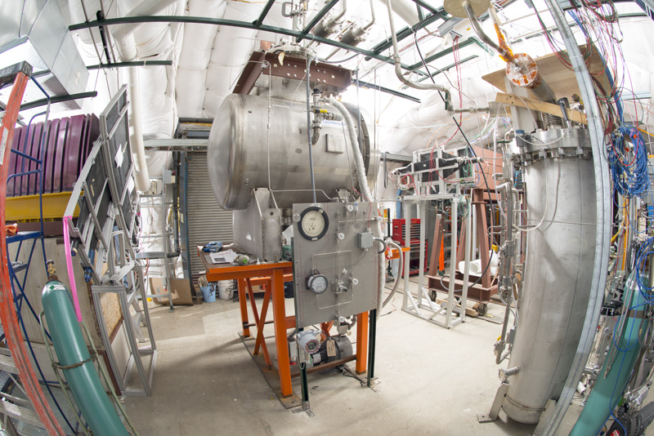
Optical properties of liquid Argon for use in Geant4 simulations
Hans Wenzel
17th May 2021

Slide 2
https://github.com/hanswenzel/CaTS/tree/master/scripts/LAr.C
implements formulae from ArXiv:1502.04213
Allows to plot/print Refraction index, intensity spectrum etc.
Creates gdml snippets that can be included in Geometry description files.
https://github.com/hanswenzel/CaTS/tree/master/scripts/wls.C
Implements plotting e.g. of TPB WLS intensity curve from Eur. Phys. J. C (2018) 78:329

Slide 3
Light yield ~ few 10,000’s of photons per MeV (depends on E field, particle type and purity)
(SCINTILLATIONYIELD: 50000/MeV when no electric field present)
Wavelength of emission is 128nm (FWHM= 10nm)
Light with two characteristic time constants:
- fast component (SCINTILLATIONTIMECONSTANT1): 6 ns
(SCINTILLATIONYIELD1): 0.75
- slow component (SCINTILLATIONTIMECONSTANT2): 1500 ns
(SCINTILLATIONYIELD2): 0.25
(RESOLUTIONSCALE): 1
Refraction Index: n = 1.358 ± 0.003 at 128 nm (M. Babicz et al 2020 JINST 15 P09009)
( compared to n= 1.45 ± 0.07 (ArXiv:1502.04213))
Group velocity: 1/ vg = 7.46 ± 0.08 ns/m at 128 nm
Argon is highly transparent to its own scintillation light. (ABSLENGTH)
>1.1 m (ArXiv:1511.07725)
Rayleigh scattering length (RAYLEIGH): 90 cm (M. Babicz et al 2020 JINST 15 P09009)
55+/- 5 cm (ArXiv:1502.04213)

Slide 4
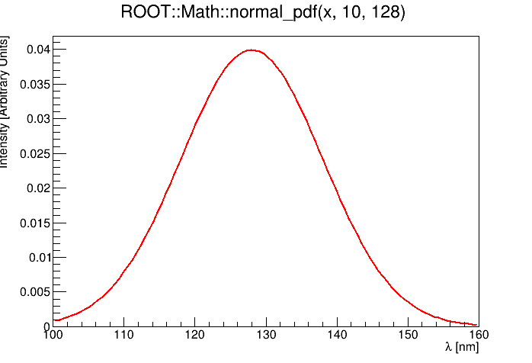
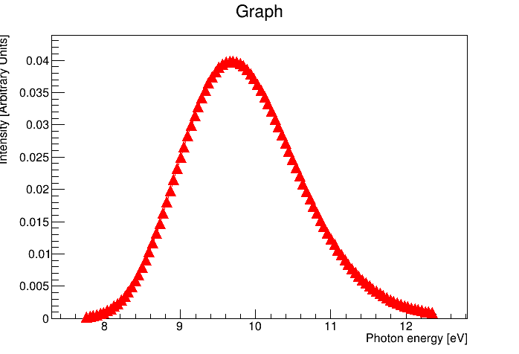
Scintillation Spectrum
root [0] .L LAr.C++
root [1] init(); // initialize
root [2] spectrum();
128nm (FWHM= 10nm)
Geant4 uses optical properties as a function of photon energy

Slide 5
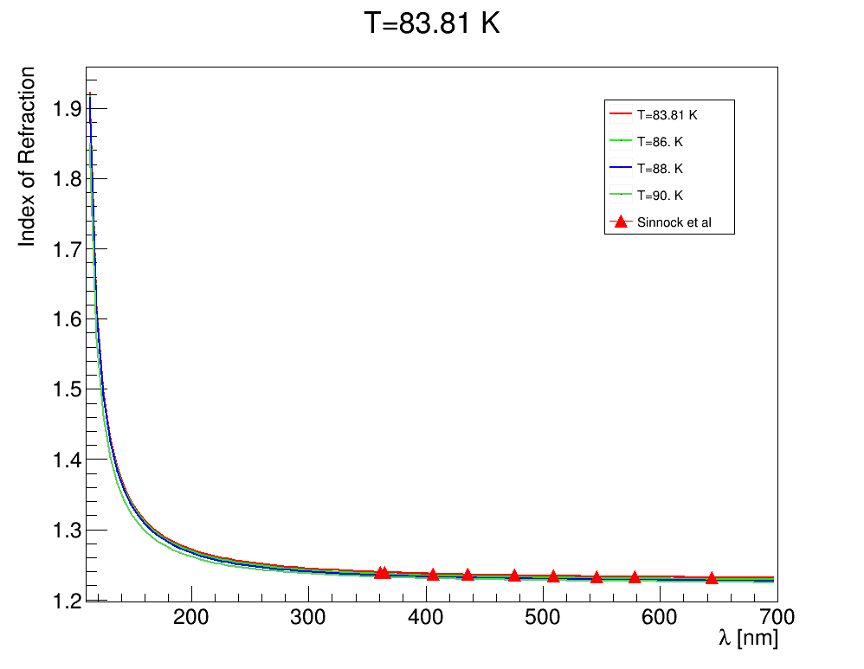
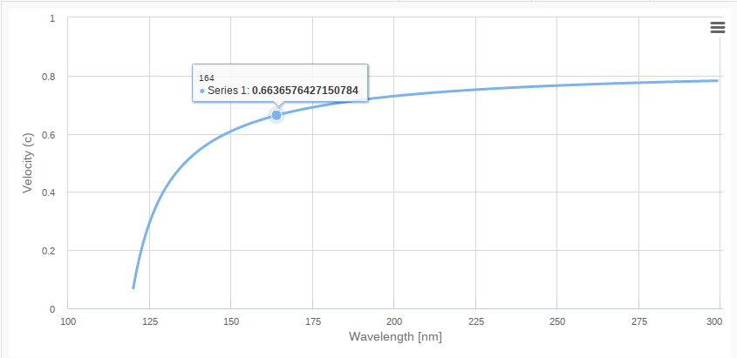

Refraction index and propagation speed
https://github.com/hanswenzel/CaTS/tree/master/scripts/LAr.C implements formula in ArXiv:1502.04213
ArXiv:1502.04213
root [0] .L LAr.C++
root [1] init(); // initialize
root [2] sellmeierLAr();
root [3] rindextable();
root [0] .L LAr.C++
root [1] init(); // initialize
root [2] sellmeierLAr();
root [3] rindextable();
root [0] .L LAr.C++
root [1] init(); // initialize
root [2] sellmeierLAr();
root [3] rindextable();
group velocity is equal to the phase velocity
vp=c/n only
when the refractive index is a constant
root [0] .L LAr.C++
root [1] init(); // initialize
root [2] sellmeierLAr();
root [3] rindextable();
<matrix name="RINDEX" coldim="2" values="1.7712*eV 1.23148
1.78626*eV 1.23154
1.80157*eV 1.2316
1.81715*eV 1.23166
.....
10.6975*eV 1.72744"/>
n = c/vp = ck/ω.

Slide 6

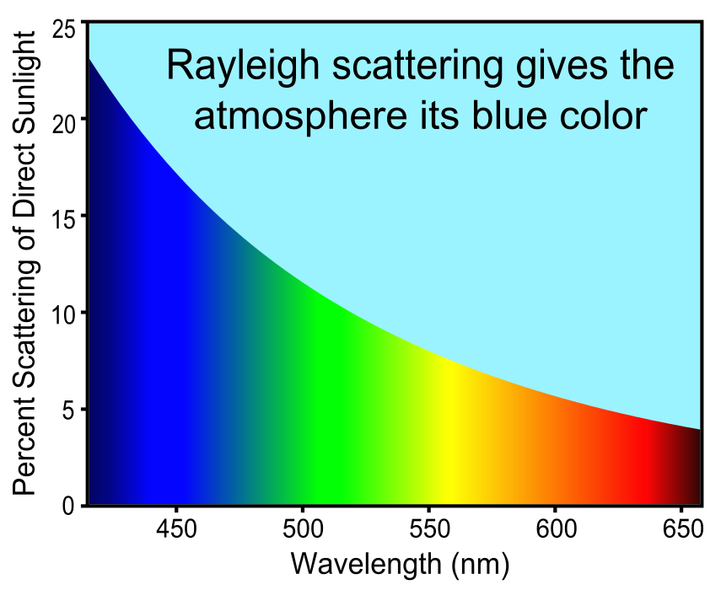
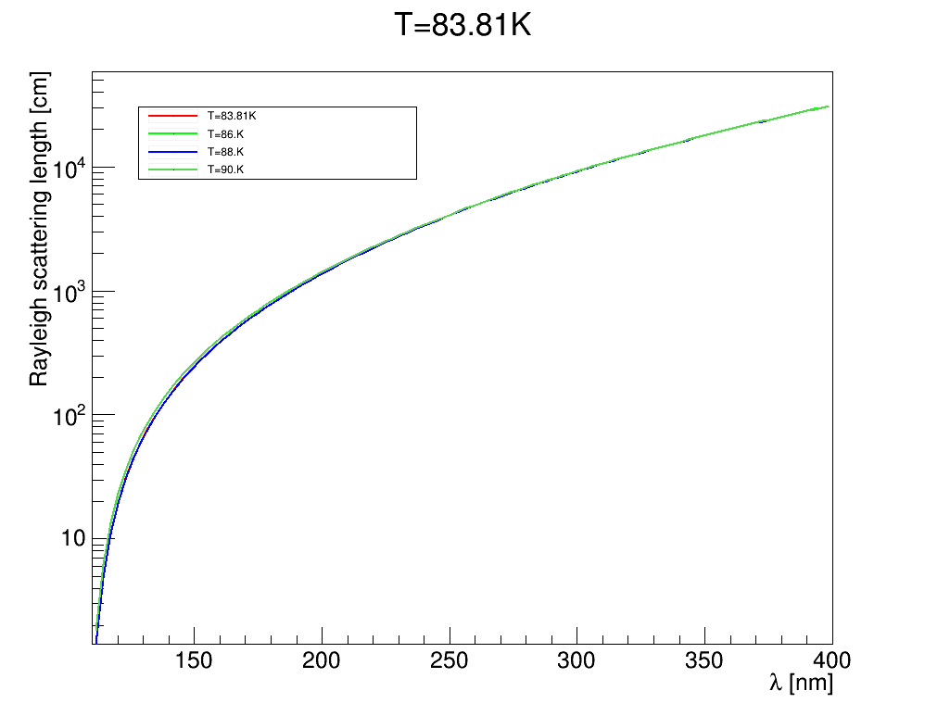
Rayleigh scattering
root [0] .L LAr.C++
root [1] init(); // initialize
root [2] rayleigh();
root [3] rayleightable()
ArXiv:1502.04213
At 128 nm:
90 cm (M. Babicz et al 2020 JINST 15 P09009)
55+/- 5 cm (ArXiv:1502.04213)

Slide 7
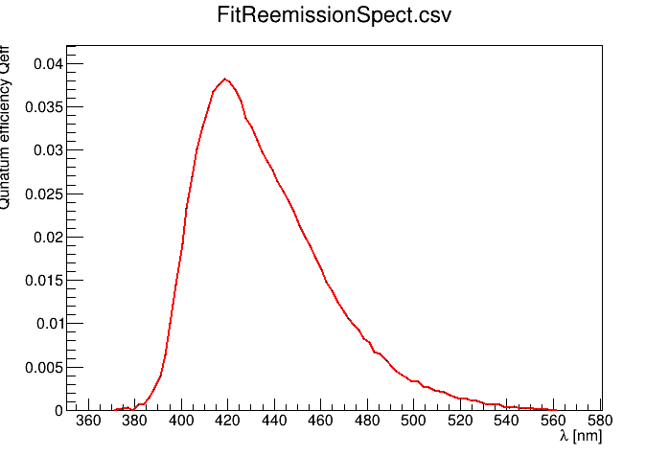
Wavelength shifter tetraphenyl butadiene (TPB)
Eur. Phys. J. C (2018) 78:329
https://github.com/hanswenzel/CaTS/tree/master/scripts/wls.C

Slide 8
References
Measurements of the intrinsic quantum efficiency and absorption
length of tetraphenyl butadiene thin films in the vacuum
ultraviolet regime: Eur. Phys. J. C (2018) 78:329
Index of refraction, Rayleigh scattering length, and Sellmeier coefficients in solid
and liquid argon and xenon: ArXiv:1502.04213,
Nucl. Instrum. Meth. A 867 (2017) 204
Ben Jones, Introduction to Scintillation Light in Liquid Argon
http://microboone-exp.fnal.gov
J Chem Phys vol 91 (1989)
1469 E Morikawa et al
A measurement of the group velocity of scintillation light in liquid argon
M. Babicz et al 2020 JINST 15 P09009

Slide 9
N. Ishida et al., Attenuation length measurements of scintillation light in liquid rare gases and their mixtures using an improved reflection suppresser, Nucl. Instrum. Meth. A 384 (1997) 380.
ArDM collaboration, Measurement of the attenuation length of argon scintillation light in the ArDM
LAr TPC, Astropart. Phys. 97 (2018) 186 [arXiv:1611.02481].
A. Neumeier et al., Attenuation of vacuum ultraviolet light in pure and xenon-doped liquid argon —An approach to an assignment of the near-infrared emission from the mixture, Europhys. Lett. 111
(2015) 12001 [arXiv:1511.07725].
O. Cheshnovsky, B. Raz and J. Jortner, Emission spectra of deep impurity states in solid and liquid rare gas alloys, J. Chem. Phys. 57 (1972) 4628.

