Slide 1
MIE-311 Mobile Network Security

Slide 2
Lecture 1: Introduction
The art of war teaches us to rely not on the likelihood of the enemy‘s not coming, but on our own readiness to receive him; not on the chance of his not attacking, but rather on the fact that we have made our position unassailable.
-The art of war, By Sun Tzu
故用兵之法，无恃其不来，恃吾有以待之；无恃其不攻，恃吾有所不可攻也。
-孙子兵法

Slide 3
Lecture 1: Introduction
What is mobile network security?
Brief history of cryptography
Course syllabus

Slide 4
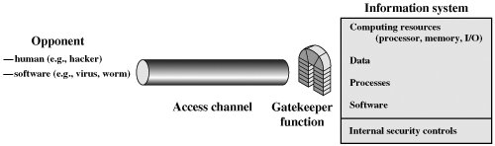
What is [mobile] [network][security]?
Confidentiality
Integrity
Availability

Slide 5


Confidentiality
Data in transmission or stored in a storage system could be very sensitive and only authorized people are allowed to read.
Keeping data confidentiality means preventing unauthorized reading of data
Alice
Bob

Slide 6

Confidentiality： how to?
Encryption & Decryption
Use a secret 1-to-1 mapping (function) to map a plaintext m into a ciphertext
To recover the plaintext from the ciphertext , apply the inverse mapping
Q: How to do en(de)cryption, so that it is safe and efficient?

Slide 7

Confidentiality： Example
Consider the English alphabet arranged in the order
a, b, c, d, · · · , w, x, y, z
Define the 1-to-1 mapping f by
f(x) = the 3rd letter after x,
where the 3rd letter after x, y, z is resp. a, b, c.
Then the plaintext “kill” is encrypted into
f(kill) = f(k)f(i)f(l)f(l) = nloo
Q：How to decrypt? Is there any weakness?

Slide 8
Integrity
For data in transmission or stored in a storage system the following could happen:
Modification: It could be modified by an unauthorized person.
Spoofing: It could be replaced with another data by an unauthorized person.
Repudiation: The sender or receiver may deny sending or receiving the message.
Alice
Bob

Slide 9
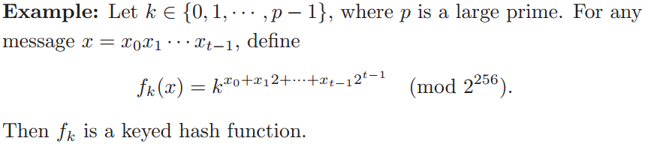
Integrity: how to?
Keyed Hash Functions
Let the message space be the set {0, 1}∗ of all finite binary strings. Let f_{k}(·) be a keyed function from the set {0, 1}∗ to the set {0, 1}²⁵⁶ of all binary strings of length 256. Such an f_{k} is called a keyed hash function

Slide 10
Integrity: how to?
Data authentication
Given a keyed hash function f_{k}(), a sender and a receiver share a secret key k.
To send a message m, the sender sends
c = m || f_{k}(m)
Q: When receiver receives c, how can he conclude whether c is authentic?

Slide 11
Integrity: how to?
Sender & receiver authentication
Q: If you received a message with alleged sender X, how could you be sure that the sender is indeed X?
Q: If you sent a message to a receiver Y , how could you be sure that the receiver is indeed Y?

Slide 12
Integrity: how to?
(Non)Repudiation
Q: If you received a message with alleged sender X, how could you prove that the sender is indeed X evne if X denied?
Q: If you sent a message to a receiver Y , how could you be sure that the receiver indeed received the message?
The solution is : Digital Signature

Slide 13
Availability
The information created and stored by an organization needs to be available to authorized entities any time
Distributed Denial of Service (DDoS) attack
Alice
Bob

Slide 14
Protocols to achieve security
Problem: A group of banks would have an electronic funds transfer system that does the following:
“Data confidentiality, data integrity, sender authentication, and nonrepudiation”
Suppose that you have an algorithm for doing each of the jobs above. How do you combine these algorithms so that they work as a whole?

Slide 15
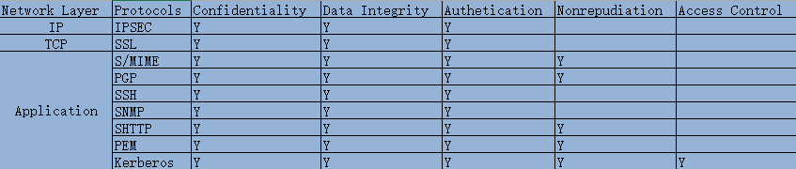
Network security protocols

Slide 16
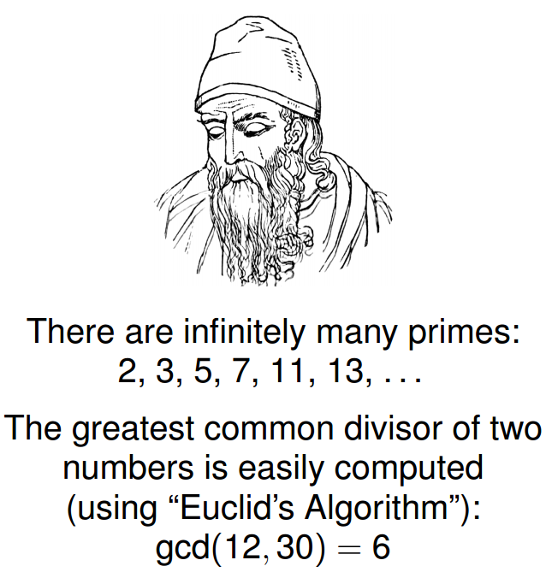
Brief history of cryptography
How to compute the gcd of any two numbers?
Given two large primes, you can compute their product easily, but how about the reverse?
Euclid, 300 B.C.

Slide 17
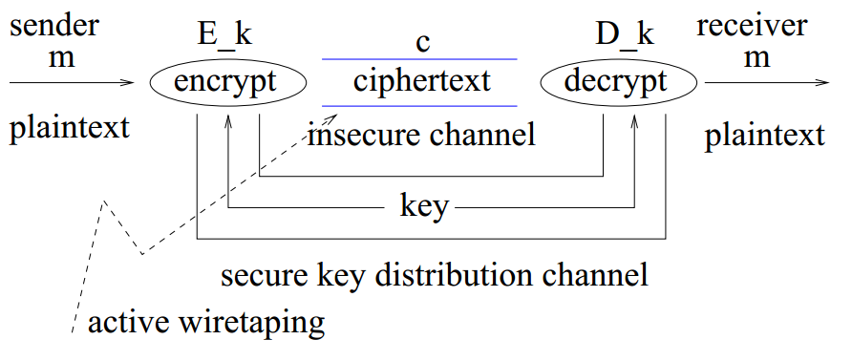
Brief history of cryptography
Symmetric cipher

Slide 18
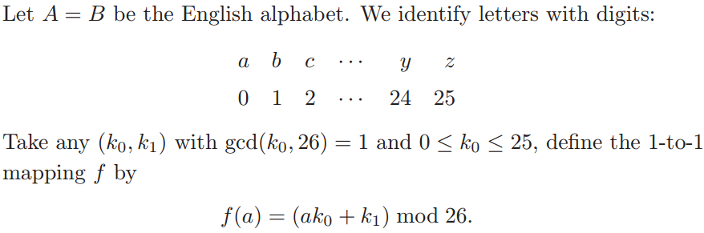
Brief history of cryptography
Transposition and substitution
Example：the Caesar cipher
Q: What is k₀ and k₁ in Caesar cipher?

Slide 19
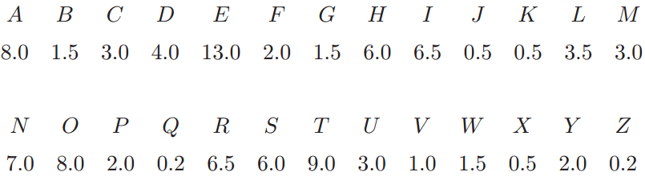
Brief history of cryptography
Is the Caesar cipher secure?
Frequency distribution of English letters
Language redundancy
Mob*le net*ork s*curity

Slide 20

Brief history of cryptography
Known-plaintext attack:
Suppose that we know two pairs of plaintext-ciphertext characters (m₁, c₁) and (m₂, c₂). Then
It is possible to solve this set of equations to obtain k₀ and k₁
Q: What if we only know ciphertext(s)?

Slide 21
Brief history of cryptography
Stream cipher, one time pad
The XOR operation
msg: 0 1 1 0 1 1 1
key: 1 0 1 1 0 1 0
CT:
⊕

Slide 22
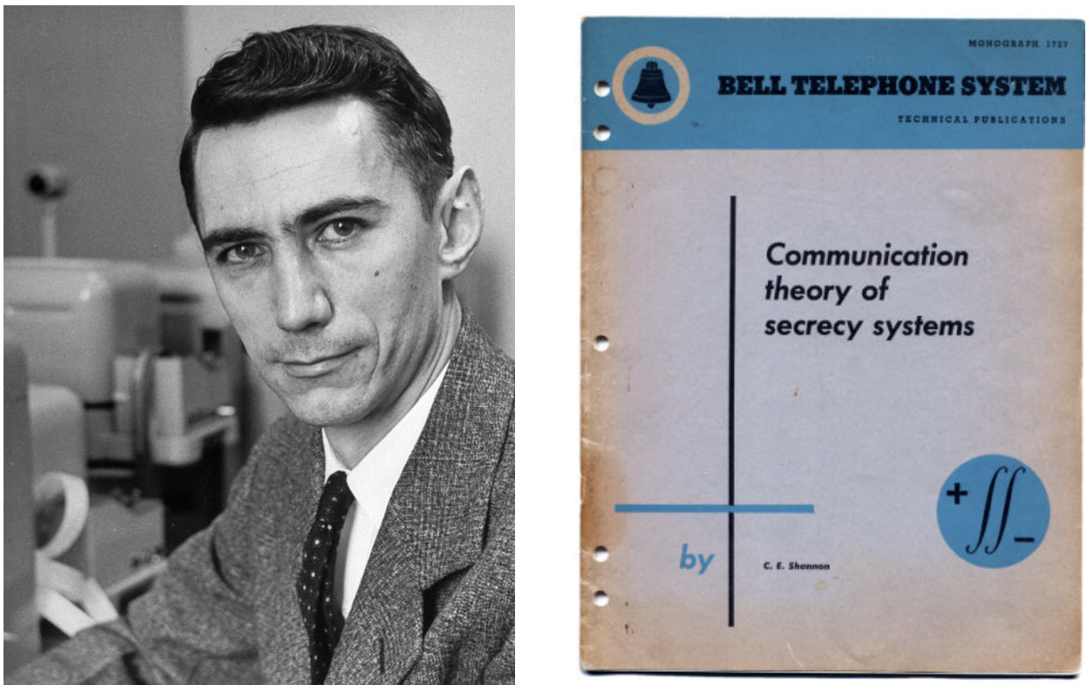
Brief history of cryptography
Information-theoretic in character—proves unbreakability of one-time pad.(published in 1949)
Q: What if the key is used many times in stream cipher?
Claude Shannon
1945, bell lab

Slide 23
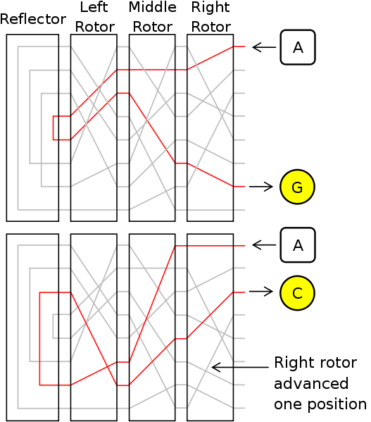
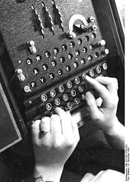
Brief history of cryptography
~1900
The Enigma
Given a key, the output of encryption of each letter is changed

Slide 24
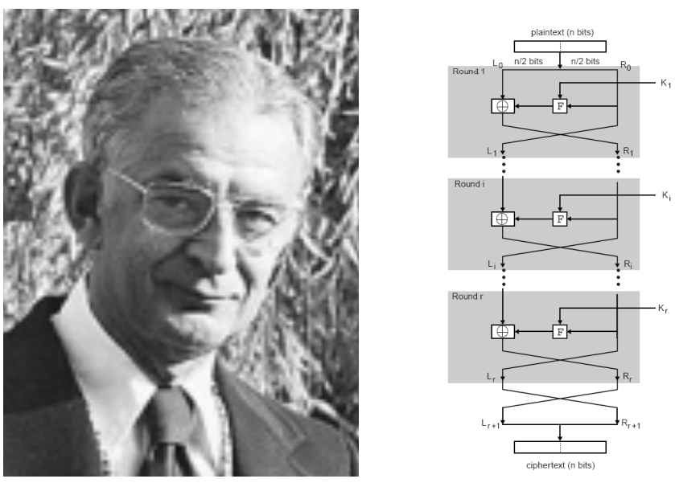
Brief history of cryptography
Data Encryption Standard (1974)
DES: # keys = 2⁵⁶
Today: AES (2001), Salsa20 (2008) (and many others)
Horst Feistel

Slide 25
Brief history of cryptography
Symmetric cipher requires a mechanism to distribute the key securely, which adds to system complexity.
Is it possible to do encoding without sharing the same key?
The invention of Public Key Cryptography
The invention of RSA

Slide 26

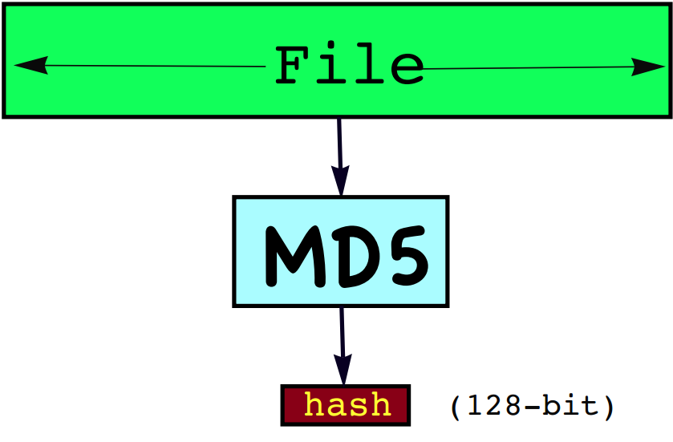
Brief history of cryptography
Xiaoyun Wang, born in 1966
Professor in Shandong University
Xiaoyun Wang make the contribution to cryptology and cryptologic mathematics. She gave the collision attack on the world widely used hash function standards MD5 and SHA-1, subkey recovery attack on Message Authentication Codes ALPHA-MAC, MD5-MAC and PELICAN, also gave the distinguishing attack on HMAC-MD5. There are 4 papers awarded the Best Paper, including CRYPTO 2005 and EUROCRYPT 2005 best papers. Her joint paper with Hongbo Yu “How to Break MD5 and other Hash Functions” was given Thomson Reuters Research Fronts Award 2008.

Slide 27
Cryptanalysis
Ciphertext Only
Brute force attack
Statistical attack
Known plaintext
Chosen Plaintext/Ciphertext

Slide 28
Course syllabus
Objective
Introduces theory and practice of network security and cryptographic protocols
Introduce mechanisms to protect network security at different layers

Slide 29
Course syllabus
Textbook:
Behrouz A. Forouzan, Cryptography and Network Security《大学计算机教育国外著名教材系列：密码学与网络安全（中文导读英文版）（影印版）》清华大学出版社 2009.
Reference books:
W. Stallings, Cryptography and Network Security, 4th Edition, Pearson Education, Inc., 2006.
D. R. Stinson, Cryptography: Theory and Practice (CRC Press, 1995).
Arto Salomaa, Public-Key Cryptography, 2nd Edition (Springer-Verlag, 1996)
Course Grading
Final grade = Assignments * 40% + Final * 60%
Final determines everything.

