Slide 1
MIE-311 Mobile Network Security
Zhe XuanYuan (轩辕哲) xuanyuanz@mail.sysu.edu.cn

Slide 2
Lecture 2: Symmetric encryption
Mathematical Foundations （I）
Modulo operation
Group, ring and field
Random and pseudorandom numbers
Symmetric encryption principles
Basic principles
Stream ciphers
Block ciphers
Cipher block modes of operation
Key management for one key ciphers

Slide 3
Modulo operation
Remainder: Let b > 0 be an integer and let a be any integer. Then there are two unique integers q and r such that
a = qb + r,
where q = ⌊a/b⌋, and 0 ≤ r < b. q and r are the quotient and
remainder.
We write
r = a mod b.
Example: 89 mod 7 = 5 and -13 mod 6 = ？

Slide 4
Set of residues: Z_{n}
The result of the modulo operation with modulus n is always an integer between 0 and n-1
The formed set is called the set of residues modulo n, or Z_{n}
For each n, we have one set of residues,
Z_{n}={0,1,2,…,(n-1)}
for example:
Z₂={0,1}, Z₆={0,1,2,3,4,5},

Slide 5
Modular arithmetic
Let n > 1 be an integer. We define
x ⊕_{n} y = (x + y) mod n, [12 ⊕₅ 7 = (12 + 7) mod 5 = 4]
x ⊖_{n} y = (x − y) mod n, [12 ⊖₅ 7 = (12 − 7) mod 5 = 0]
x ⊗_{n} y = (x × y) mod n, [12 ⊗₅ 7 = (12 × 7) mod 5 = 4]
Without causing confusion, we often use +, − and × in Z_{n} to denote these modulo operations.

Slide 6

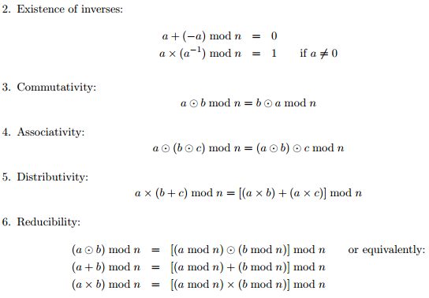
Properties of modular arithmetic

Slide 7
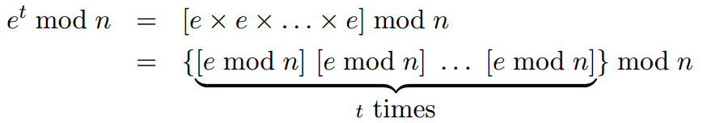
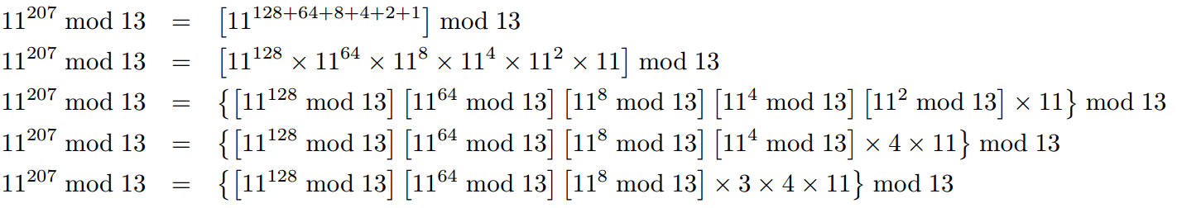
Modular exponentiation
Example：11²⁰⁷ mod 13

Slide 8
Multiplicative Inverse
Definition: Let x ∈ Z_{n}. If there is an integer y ∈ Z_{n} such that
x ⊗_{n} y = 1.
The integer y is called the multiplicative inverse of x, usually denoted x⁻¹.
Example: Let n = 15. Then 2 has the multiplicative inverse 8. But 3 does not have.
Q: Which elements of Z_{n} have a multiplicative inverse?
Q: If x ∈ Z_{n} has an multiplicative inverse, is it unique? How do you find it?
Q: What if n is a prime number?

Slide 9
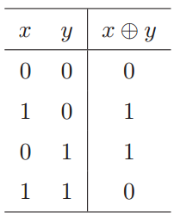
Modulo-2 Addition
Definition: The exclusive-or (xor, also called modulo-2 addition):
Remark: x ⊕ x = 0 for any x ∈ {0, 1}.
Remark: If x ⊕ y = z, then x = y ⊕ z.

Slide 10
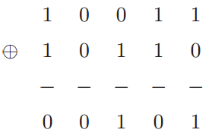
Modulo-2 Addition
Bitwise exclusive-or:
Let x = x₁x₂ · · · x_{n} and y = y₁y₂ · · · y_{n}. The bitwise exclusive-or of x and y is
x ⊕ y = (x₁ ⊕ y₁)(x₂ ⊕ y₂)· · ·(x_{n} ⊕ y_{n}).
Example:

Slide 11
Encoding Messages (Data): ASCII Code
Amer. Standard Code for Inform. Interchange:
blank 1, letters (capital + lower case) 26+26=52,
digits (0,1, ..., 9) 10
symbols 32 [punctuation symbols, accents, brackets, operators].
controls 33 (non-printable characters).
Altogether 128 characters. Each is encoded into a string of 7 bits. Example: e = 01100101, ” = 00100010.
Check out
http://www.neurophys.wisc.edu/comp/docs/ascii/

Slide 12
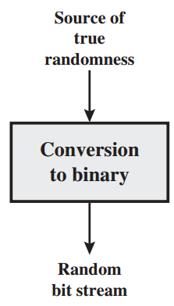
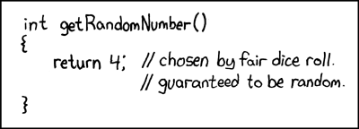
Random and pseudorandom numbers
Randomness is the basis for secure key generation
Criteria:
Uniform distribution
Independence
Generation of random numbers
Entropy source drawn from the physical
environment of the computer and could
include things such as keystroke timing
patterns, disk electrical activity, mouse
movements
Notes:
Uniform distribution: if you draw the space that is formed by all (0,1)n strings, the probability you get any string is the same
However, for a PRG …

Slide 13
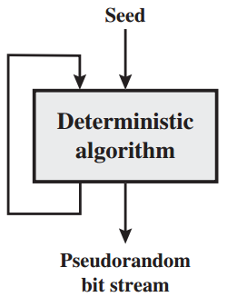
Random and pseudorandom numbers
True randomness is too expensive to obtain
Pseudorandom numbers: sequences of numbers that appear to be random generated by some algorithm
PRG: deterministic, not statistically random
But can pass many randomness test
Example:
glibc random():
r[i] ← ( r[i-3] + r[i-31] ) % 2³²
output r[i] >> 1
Q: How to determine if a PRG is
good or bad?
Notes:
Appear to be random, indistinguishable,
Statistical test: A(x) = 0 not random or 1 random
（1） A(x)=1 iff |#(0) - #(1)| <10*sqrt(n)
(2) A(x)=1 iff |#(00) – n/4| <10*sqrt(n)
A secure Prg should be unpredictable, meaning that given first I bit there is no way to predict i+1
In this sense, the glibc random function is bad, http://www.mscs.dal.ca/~selinger/random/

Slide 14
Group, Ring, Field
Algebraic Structure | Supported Typical Operations | Typical Sets of Integers
Group | (+,-) or (x,/) | Zn or Zn*
Ring | (+,-) or (x) | Z
Field | (+,-) and (x,/) | Zp
Zn : {0,1,…,n-1}
Zn*: {all elements in Zn that has a multiplicative reverse}
Zp : n is a prime number
Finite Fields: a filed with a finite number of elements

Slide 15
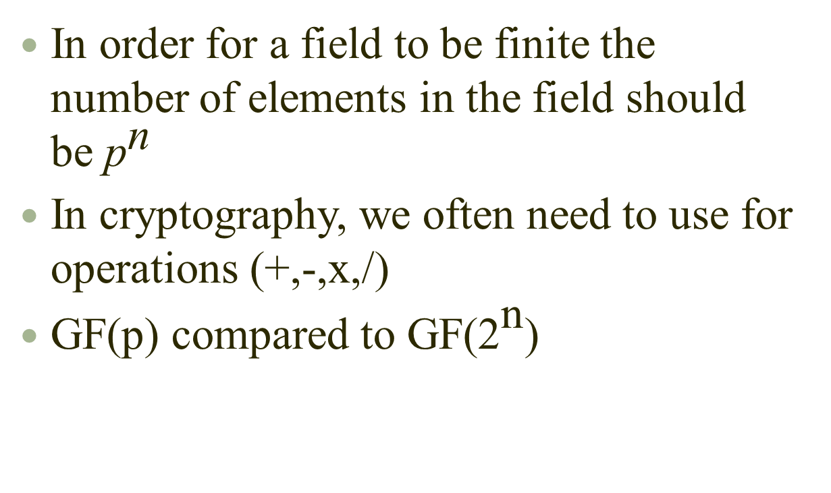

Galios fields and GF(${\text{2}}^{\text{n}}$) fields
In order for a field to be finite the number of elements in the field should be ${\text{p}}^{\text{n}}$
In cryptography, we often need to use for operations (+,-,x,/)
GF(p) compared to GF(${\text{2}}^{\text{n}}$)

Slide 16
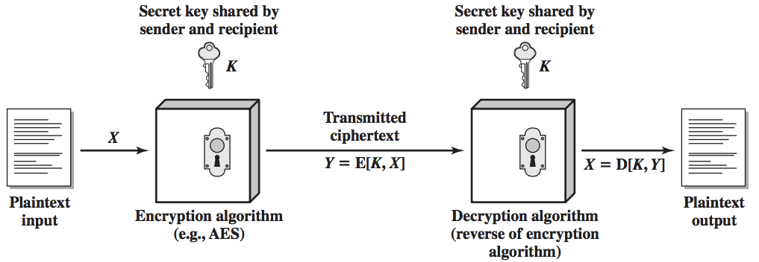
Symmetric encryption principles
5 tuple: {M, C, K, E_{k}, D_{k}}
Any k ∈ K, can be the key
D_{k}(E_{k}(m))=m, for each m∈M

Slide 17
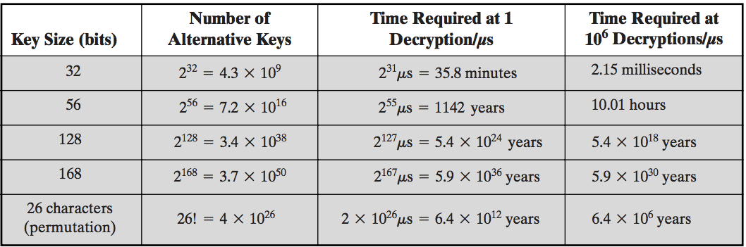
Symmetric encryption principles
Security depends on the secrecy of the key, not the algorithm
A good algorithm is a good trade-off between security and efficiency
Notes:
Efficiency: theoretically, polynomial time regarding to the input; practically, amount of time to carry out the algorithm

Slide 18
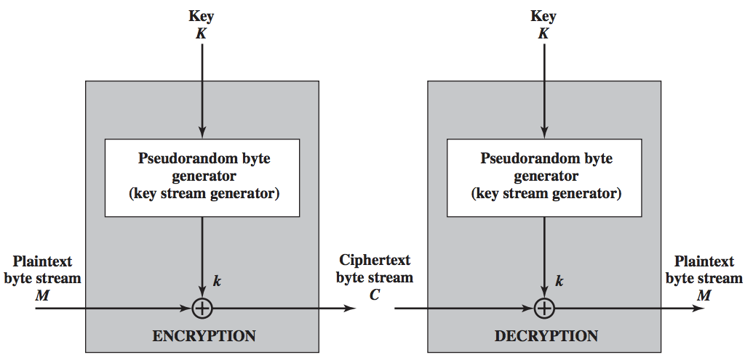
Stream ciphers
Key stream should appear to be as random as possible
Fast
Notes:
One time pad
Prove the decryption is effective
Given m and c, can u find out the key?
The key problem in stream cipher is how to generate the key stream
Perfect secrecy: len of key larger than len of message

Slide 19
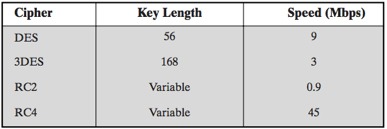
Stream ciphers: RC4
Designed by Ron Rivest, 1987
Variable key size, byte-oriented operation
Used in SSL, WEP, WPA etc.
Efficient to implement in software, relatively
Speed comparison on pentium II

Slide 20
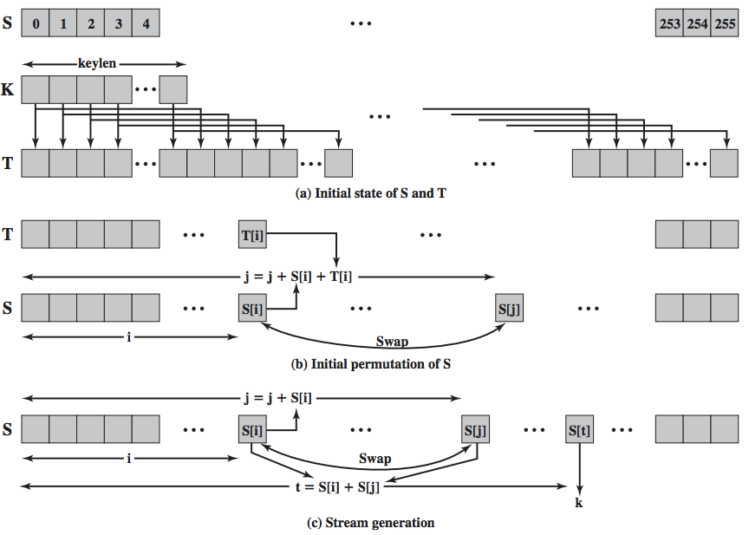
Stream ciphers: RC4

Slide 21
Stream ciphers: RC4
/* Initialization */
for i =0 to 255 do
S[i] = i;
T[i] = K[i mod keylen];
/* Initial Permutation of S */
j= 0;
for i= 0 to 255 do
j =(j + S[i] + T[i]) mod 256;
Swap (S[i], S[j]);
/* Stream Generation */
i, j = 0;
while (true)
i = (i + 1) mod 256;
j = (j + S[i]) mod 256;
Swap (S[i], S[j]);
t = (S[i] + S[j]) mod 256;
k = S[t];

Slide 22
Stream ciphers: RC4
Weaknesses:
Bias in initial output: Pr[ 2nd byte = 0 ] = 2/256
Prob. of (0,0) is 1/256² + 1/256³
Modern stream ciphers:
eStream: Salsa
Designed to be fast on x86 (SSE2), 5 times faster than RC4
E(k, m ; r) = m ⊕ PRG(k ; r)
Where r is a nonce that represents a non-repeating value for a given key

Slide 23
Stream ciphers: Attacks
Attack 1: use the key more than once
C₁ ← m₁ ⊕ PRG(k)
C₂ ← m₂ ⊕ PRG(k)
What an adversary can get is
C₁ ⊕ C₂ → m₁ ⊕ m₂
Redundancy in English and ASCII encoding
m₁ ⊕ m₂ → m₁ , m₂
Real world examples
World war II
Server – Client (MS PPTP)
WEP (802.11b)
Notes:
Don’ t use the same key for both direction when client talk to server

Slide 24
Stream ciphers: Attacks
Attack 2: integrity
Example：Email
enc ( ⊕k )
m
m⊕k
⊕
p
dec ( ⊕k )
m⊕p
(m⊕k)⊕p
Notes:
Bob = 42 6F 62
Eve = 45 76 65
Bob xor Eve = 07 19 07

Slide 25
Block ciphers
Overview
Feistel Network
DES
AES

Slide 26
Block ciphers: overview
A block cipher processes the plaintext input in fixed-sized blocks and produces a block of ciphertext of equal size for each plaintext block
n bits
n bits
E, D
PT Block
CT Block
Key
k bits

Slide 27
Block ciphers: overview
Components:
Block size
Key size
Number of rounds
Subkey generation algorithm
Round function
key k
key expansion
k₁
k₂
k₃
k_{n}
m
R(k₁, ⋅)
R(k₂, ⋅)
R(k₃, ⋅)
R(k_{n}, ⋅)
c

Slide 28
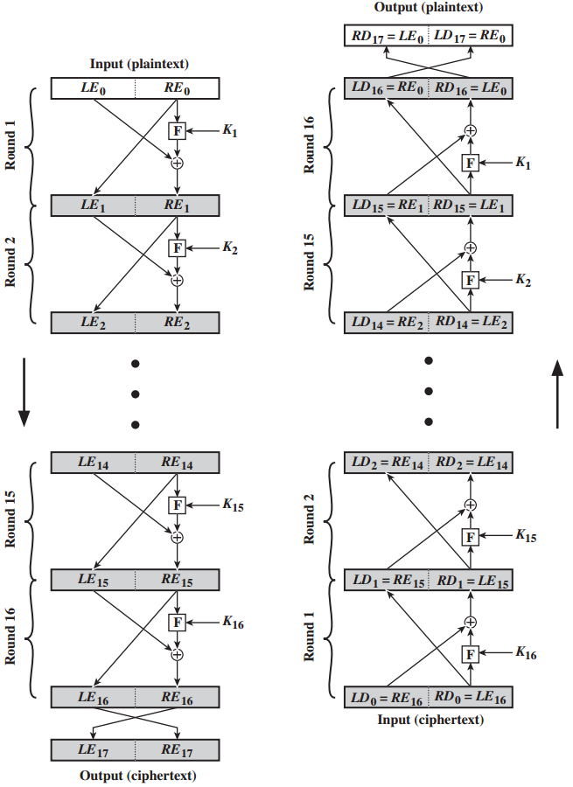
Block ciphers: feistel network
A particular example of general structure used by symmetric block ciphers
All rounds have the same structure
Decryption process is exactly the inverse of encryption. (Why?)
LE_{i}= RE_{i-1}
RE_{i}= ?

Slide 29
Block ciphers: DES
A 16 round feistel network
It is a “block’’ cipher with key length 56 bits.
It was designed by IBM in 1976 for the National Bureau of Standards (NBS), with approval from the National Security Agency (NSA).
It had been used as a standard for encryption until 2000.
A new encryption standard was adopted in 2000, as a replacement of DES.

Slide 30
Block ciphers: DES
The same 56-bit cipher key is used for both encryption and decryption
The origin 56-bit key is expanded into 16 48-bit round keys
DES takes 64-bit plaintext and creates a 64-bit ciphertext
Initial permutation and final permutation
k
key expansion
⋯
k₁
k₂
k₁₆
Permutation
Permutation
16 round Feistel network
64 bits
64 bits
input
To invert, use keys in reverse order
output

Slide 31
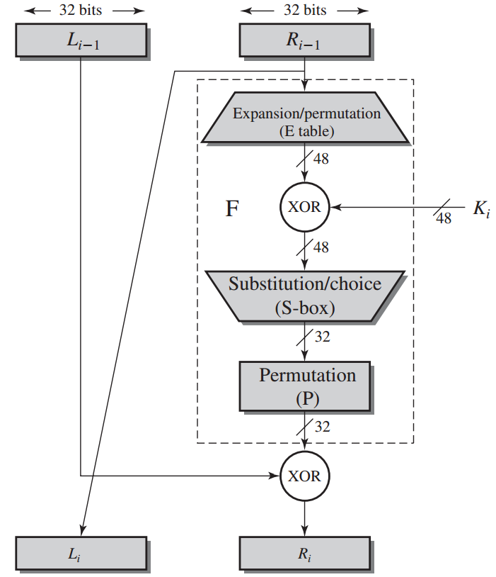
Block ciphers: DES
Rounds:
F, the function
Expansion
Key
S-box

Slide 32
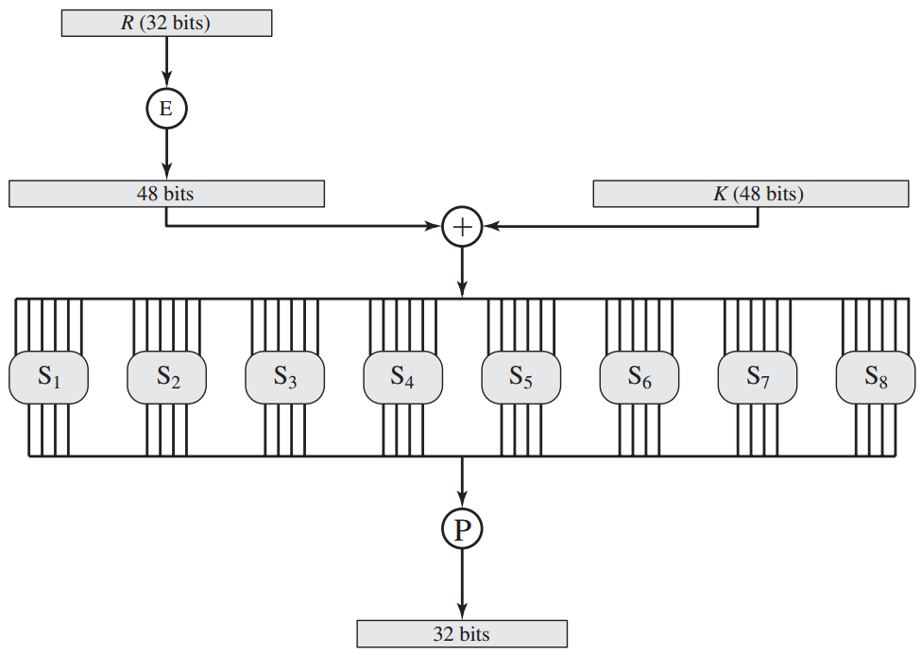
Block ciphers: DES
The F function

Slide 33
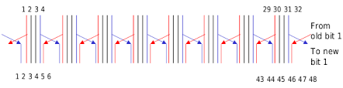
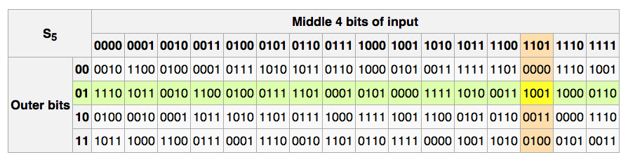
Block ciphers: DES
The expansion permutation
The S-box

Slide 34
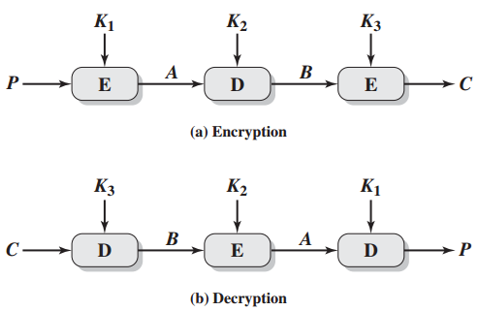
Block ciphers: 3DES
The analysis of security property of DES is out of the scope of this course, interested students are referred to the textbook.
1997: DES broken by exhaustive search
3DES was incorporated as part of the Data Encryption Standard in 1999 with the publication of FIPS 46-3

Slide 35
Block ciphers: AES
A replacement for DES was needed because DES is subject to exhaustive key search attacks.
US NIST issued call for ciphers in 1997
15 candidates accepted in Jun 98
5 were shortlisted in Aug-99
Rijndael was selected as the AES in Oct-2000
Issued as FIPS PUB 197 standard in Nov-2001

Slide 36
Block ciphers: AES
A private key symmetric block cipher
128-bit plaintext block, 128/192/256-bit keys
Stronger & faster than “Triple-DES”
Active life of 20-30 years
Efficient in both software and hardware implementations
Simple in design
Suitable for smart cards (memory requirement)

Slide 37
Block ciphers: AES
An initial round-key addition
9/11/13 rounds, corresponds to, 128/192/156 bit keys
A final round, similar to other round, but without mixed column operations
10 rounds
4
ByteSub
ShiftRow
MixColumn
ByteSub
ShiftRow
MixColumn
ByteSub
ShiftRow
4
input
⋯
⨁
⨁
⨁
⨁
k₀
invertible
k₁
k₂
k₉
⨁
key
k₁₀
key expansion:
4
output
16 bytes
16 bytes ⟶176 bytes
4

Slide 38
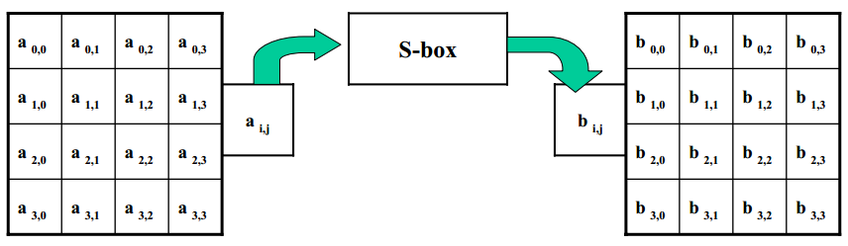
Block ciphers: AES
Round Function : ByteSub
Multiplicative inverse in GF(2⁸) is used

Slide 39
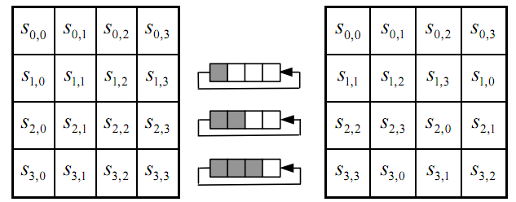
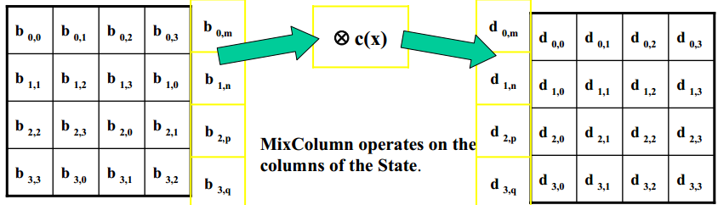
Block ciphers: AES
Round Function : Shift rows
Round Function : MixColumn

Slide 40
Block ciphers: AES
Simple
Symmetric and parallel structure
Flexible implementation
Secure against all known cryptanalytic attacks
Suitable modern processors (32-bit processor)
aesenc, aesenclast in intel, similar in AMD cpus
Suitable for smart cards (8-bit processor)
Trade off between space and speed

Slide 41
Performance: Crypto++ 5.6.0 [ Wei Dai ]
AMD Opteron, 2.2 GHz ( Linux)
Cipher Block/key size Speed (MB/sec)
RC4 126
Salsa20/12 643
Sosemanuk 727
3DES 64/168 13
AES-128 128/128 109
stream
block

Slide 42
Cipher block modes of operation
To apply block cipher in real encryption applications, five modes of operation are used:
Electronic codebook (ECB)
Cipher block chaining (CBC)
Cipher feedback (CFB)
Counter (CTR)

Slide 43
Modes of operation: ECB
Encryption: c_{i} = E_{k}(m_{i}) for each i.
Decryption: m_{i} = D_{k}(c_{i}) for each i.
Application:
secure transmission of single values (e.g., encryption key), not for lengthy message
Same plaintext block is always encrypted to the same ciphertext block.

Slide 44
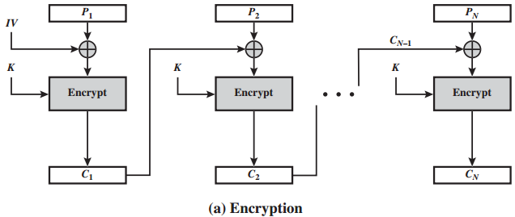
Modes of operation: CBC
Choose any n-bit vector IV as the initial value, and define c₀ = IV
Encryption: c_{i} = E_{k}(m_{i} ⊕ c_{i-1}) for each i ≥ 1.
Decryption: m_{i} = D_{k}(c_{i}) ⊕ c_{i-1} for each i ≥ 1
Application: general-purpose block-oriented transmission, authentication.

Slide 45
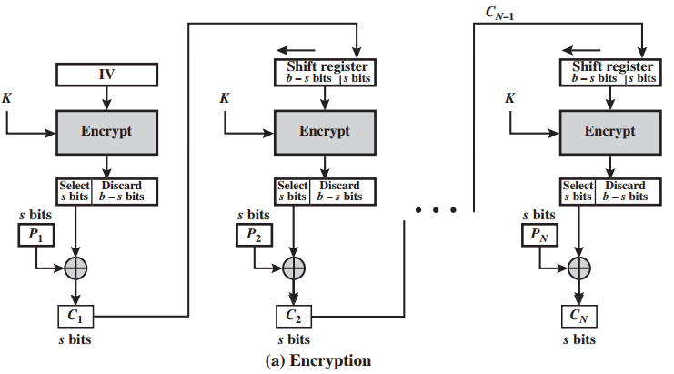
Modes of operation: CFB
Encryption: c_{i} = m_{i} ⊕ S_{s}[E_{k}(l_{i−1}||c_{i−1})]
Decryption: m_{i} = c_{i} ⊕ S_{s}[E_{k}(l_{i−1}||c_{i−1})]
l_{i−1} is the left most b-s bits of the shift register before c_{i} is encrypted
It is another way to convert a block cipher into a stream cipher.
OFB is very similar to CFB, but avoids error propagation

Slide 46
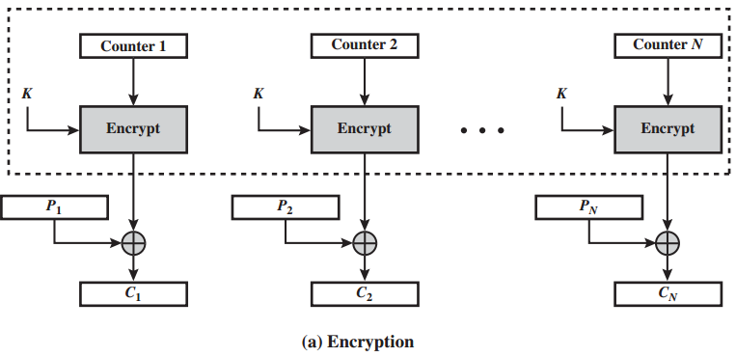
Modes of operation: CTR
No feedback
Counter is initialized to a pre-determined value (IV) and incremented based on a predefined rule (mod 2^{n})
The pseudorandomness in the key stream is achieved using a counter

Slide 47
Key management: requirements
For one key encryption schemes, the two parties must share the same key.
The key must be protected from access by others.
The key should be changed regularly (an adversary or enemy may learn the key in some way).
Key distribution: delivering a key to both parties, without allowing others to see the key.
Key agreement: agreeing on a key by parties involved, without allowing others to see the key.

Slide 48
Key distribution
A selects a key, and physically delivers it to B
A third party can select the key and physically deliver it to both A and B
If A and B have previously and recently used a key, one party can transmit the new key to the other, encrypted using the old key
If A and B each has an encrypted connection to a third party C, C can deliver a key on the encrypted links to A and B

Slide 49
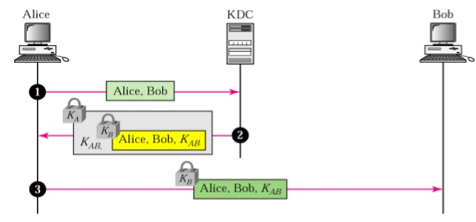
A Key Distribution Protocol: key distribution center
As an example of protocols for key distribution, we introduce a key distribution protocol using a key distribution center
Parties involved: A key distribution center (KDC), a group of people to communicate with each other.
Requirements: Whenever A wants to communicate with B, the KDC should generate a temporary key (called session key) and distribute it to A and B. Both confidentiality and authenticity must be achieved.
Q: Can KDC
send ticket to
Bob directly?
(synchronizing)

Slide 50
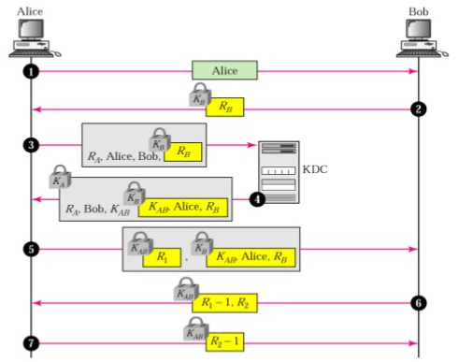
A Key Distribution Protocol: elaborated
Can step 1 and step 2 be omitted?

Slide 51
Key agreement: Merkle’s puzzle
Alice and Bob hoose any encryption method with key length = 128 bit
Alice Randomly pick an encryption key k_short_i with first 96 bits equal to 0
Alice Send the encrypted messages E(k_short_i, “puzzle x_i”||k_i) to Bob
Alice repeat step 2, 3 for n times
Bob randomly pick one such message j to decrypt and send x_j back to Alice

Slide 52
Key agreement: math
Can we exchange keys without third party involvement?
Discrete logarithms
Primitive roots: let p be a prime. An integer α is called a primitive root of p if each nonzero element a ∈ F_{p} （1 ≤ a ≤ p − 1）can be uniquely expressed as
a = α^{i} mod p
for some integer i, where 0 ≤ i ≤ p − 2
Discrete logarithm problem:
Given p, α, and a, find log_{α}a. This is in general very hard.

Slide 53
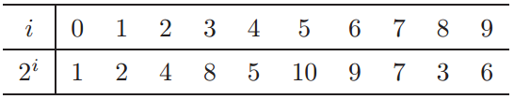
Key agreement: math
Example: 2 is a primitive root of the prime 11.
Theorem: Every prime p has at least one primitive root.

Slide 54

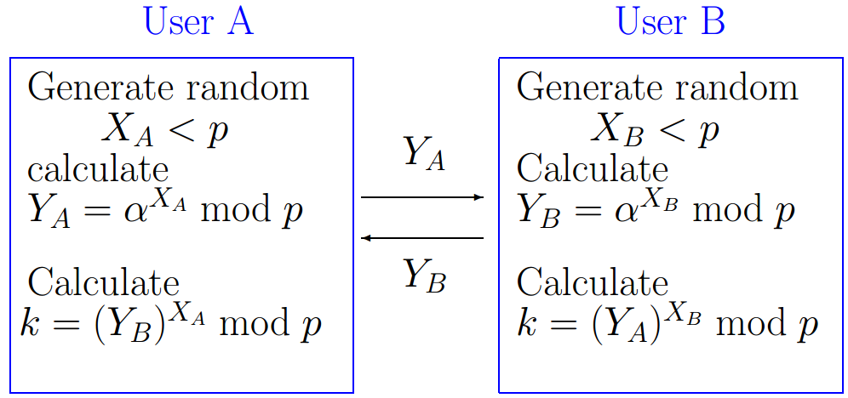
Diffie-Hellman Key Exchange Protocol
mod p. Also p and α are publicly known. But X_{A} and X_{B} must be kept secret.
The security with respect to passive attacks is based on the belief that solving the discrete logarithm problem is hard in general. It is vulnerable to an active attack if an adversary has control over the communication cannel.

Slide 55
How hard is to break DH?
Given Y_A and Y_B, how hard is it to compute the key k?
Suppose the prime p is n bits
Cipher key size (AES) | Prime number size
80 | 1024
128 | 3072
256 | 15360

Slide 56
Open problem
Facebook
Bob
Alice
David
Charlie

