Slide 1
MIE-311 Mobile Network Security
Zhe XuanYuan (轩辕哲)
xuanyuanz@mail.sysu.edu.cn

Slide 2
Lecture 3: Asymmetric encryption
Asymmetric encryption principles
Introduction to Public-Key Cryptography
The RSA Public-Key Cryptosystem
The ElGamal Public-Key Cryptosystem
Public Key Infrastructure (PKI)

Slide 3
Disadvantages of Symmetric-Key Cryptography
One-key crypto system: (M, C, K, E_{k}, D_{k}), where the encryption and decryption keys are the same.
The sender and receiver must share the same secret key. Key distribution is a must.
If n people want to communicate (two and two, in all possible ways), each must keep n-1 secret keys, and the system requires a total of
(n-1) · n/2
secret keys. This makes key management difficult.
For example: 1000*999/2 = 499500

Slide 4
Two-key Cryptosystems
A six-tuple
(M, C, K_{e}, K_{d}, E_{ke} , D_{kd} ),
Where M, C, K_{e}, K_{d} are respectively the plaintext space, ciphertext space, encryption key space, and decryption key space;
k_{e} ∈ K_{e} and k_{d} ∈ K_{d} are corresponding encryption and decryption keys respectively;
E_{ke} and D_{kd} are the encryption and decryption transformations, and
D_{kd} (E_{ke} (m)) = m,
for all m ∈ M (unique and correct decryption).

Slide 5
The Idea of Public-Key Cryptography
Idea: Suppose that I have a two-key crypto system (M, C, K_{e}, K_{d}, E_{ke} , D_{kd} )
Suppose further that given the encryption key k_{e}, the encryption algorithm and the decryption algorithm,
C1: it is “computationally infeasible” to derive the decryption key k_{d}; and
C2: it is “computationally infeasible” to derive the plaintext m if the corresponding ciphertext c is known.
Publish k_{e} together with the encryption algorithm in a public directory, in order for anybody else to encrypt a message and send it to me.

Slide 6
The Idea of Public-Key Cryptography
The conditions C1 and C2 are not rigorously defined in the mathematical sense, but this can be done. Usually, it is hard to prove that the two conditions are met.
In principle, any two-key crypto system may be called a public-key cipher. The point is whether it is secure if used as a public-key cipher

Slide 7
Requirements for Public-Key Cryptography
The C1 and C2 described before plus the following:
1. It is “computationally easy” for a party B to generate a pair (k_{e} , k_{d}).
2. It is “computationally easy” for a sender A, knowing the public key and the message to be encrypted, m, to generate the corresponding ciphertext c = E_{ke} (m).
3. It is “computationally easy” for the receiver B to recover the message m = D_{kd} (c).

Slide 8
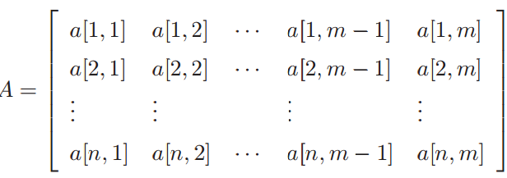
A Two-key Cipher not Satisfying C1 & C2
Matrix: An n × m matrix A = [a[i, j]] over {0, 1} is a 2-dimensional array
which has n rows and m columns, and each a[i, j] ∈ {0, 1}.

Slide 9
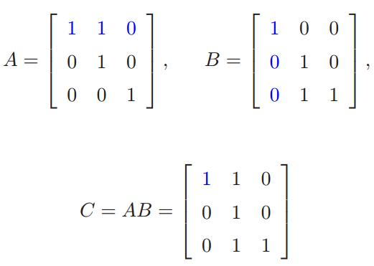
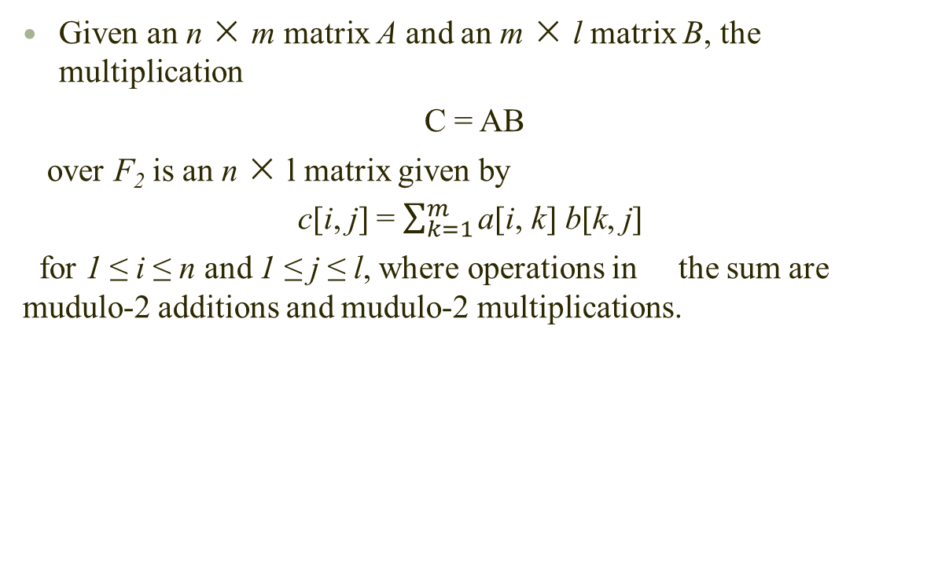
A Two-key Cipher not Satisfying C1 & C2
Given an n × m matrix A and an m × l matrix B, the multiplication
C = AB
over F₂ is an n × l matrix given by
c[i, j] = $\sum_{k=1}^{m}{\text{a}\text{[}\text{i}\text{, }\text{k}\text{]} \text{b}\text{[}\text{k}\text{, }\text{j}\text{] }}$
for 1 ≤ i ≤ n and 1 ≤ j ≤ l, where operations in the sum are mudulo-2 additions and mudulo-2 multiplications.

Slide 10
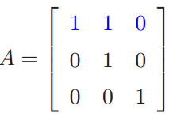
A Two-key Cipher not Satisfying C1 & C2
Definition: Let A be an n × n matrix over F₂. If there exists an n × n matrix B ∈ F₂ such that
A B = I_{n}
i.e., the n × n identity matrix, then A is said invertible, and B is the inverse matrix of A.
Example: A is the inverse of itself:

Slide 11
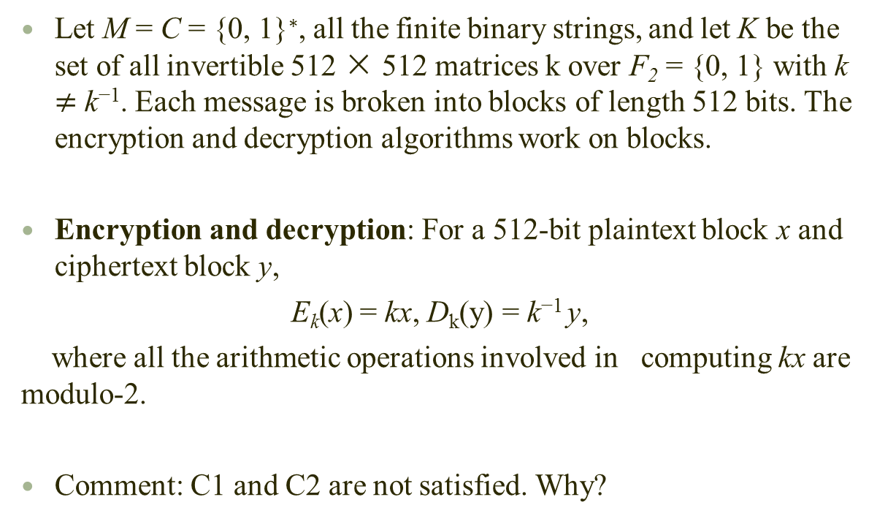
A Two-key Cipher not Satisfying C1 & C2
Let M = C = {0, 1}∗, all the finite binary strings, and let K be the set of all invertible 512 × 512 matrices k over F₂ = {0, 1} with k $≠$ k⁻¹. Each message is broken into blocks of length 512 bits. The encryption and decryption algorithms work on blocks.
Encryption and decryption: For a 512-bit plaintext block x and ciphertext block y,
E_{k}(x) = kx, D_{k}(y) = k⁻¹ y,
where all the arithmetic operations involved in computing kx are modulo-2.
Comment: C1 and C2 are not satisfied. Why?

Slide 12
Existence and Construction Problems
Question: Are there any public-key crypto systems meeting the five requirements described in the previous page?
Answer: Several are designed that are believed to meet these requirements. But there is no proof.
Main problem: The complexity of breaking the systems has not been determined (and it seems hard to do).
How to construct a public-key crypto system?
Using some problems that are believed to be hard to solve, for example instances of NP-hard problems, or one-way functions.

Slide 13
Advantages and Disadvantages
It is not necessary for a sender and a receiver to share a secret key for secure communications.
A person needs to have only one secret-key in order to have secure communications with a group of people.
Some public-key crypto system may be used for digital signature (nonrepudiation) and/or key exchange.
The main disadvantage is that known good public-key crypto systems are much slower than known good symmetric-key crypto systems.
So public-key crypto systems are not used for encrypting massive data, but for key management and signature applications.

Slide 14
History of Public-Key Cryptography
The idea of public-key cryptography was published by W. Diffie and M. Hellman, and independently by R. Merkle in 1976. It is regarded as a revolution in the history of cryptography!
Admiral Bobby Inman, while director of the NSA, claimed that public-key cryptography had been discovered at NSA in the mid-1960s.
The first documented introduction of these concepts was given in 1970 by the Communications-Electronics Security Group, Britain’s counterpart of NSA, in a classified report by James Ellis. This has become publicly known only in the last few years.

Slide 15
History of Public-Key Cryptography
The Knapsack public-key crypto system was developed by Ralph Merkle and Martin Hellman in 1978, but was broken in 1982 by Shamir and Zipple. It is for encryption only.
In the same year (1978), another system was invented by Ron Rivest, Adi Shamir, and Leonard Adleman. It is known as RSA. It is easy to understand and to implement, and is one of a few that are still regarded as secure. It can be used for both encryption and signature
ECC (Elliptic Curve Cryptography) which uses the same basic idea as RSA but more complicated mathematical structures.

Slide 16
Applications in Encryption
Given a public-key system (M, C, K_{e}, K_{d}, E_{ke} , D_{kd} )
Alice generates a key pair (k_{e} , k_{d}), keeps the decryption key k_{d} confidential, and publishes the encryption key k_{e} and the encryption algorithm in a public directory.
If Bob wants to send a message m to Alice, he finds Alice’s encryption key k_{e} and the encryption algorithm in the public directory, encrypts the message to get
c = E_{ke} (m),
and sends c to A.
After receiving c, Alice uses her decryption key and computes
D_{kd} (c) = D_{kd} (E_{ke}(m)) = m

Slide 17
Applications in Digital Signature
Suppose that the system has the further property
E_{ke} (D_{kd} (x)) = x, for all x ∈ C.
(In particular, this implies that M and C have the same size. Usually M = C). Then we can use such a system to sign messages.
To sign a message m, the sender applies a public hash function f to m obtaining f(m), which is called the message digest.
He then uses his private key to sign on the message digest, obtaining D_{kd} (f(m)). Then he sends the data
m|| D_{kd} (f(m))
to the receiver.
Question: Why do we need a hash function here?

Slide 18
Applications in Digital Signature
Checking the validity of signature :
To check the validity of the sender’s signature, the receiver breaks the received message c into two parts m′||c2, where c2 has a fixed length (i.e., the length of the signature).
Then he uses the sender’s public key to obtain E_{ke} (c2).
He computes f(m), (the hash function is public).
Finally, he compares f(m) with E_{ke} (c2)
If they match, he accepts m′||c2 as a valid message with signature from the sender. Otherwise he rejects it.

Slide 19
Applications in Key Exchange
Session key: Two parties want to communicate using a one-key cipher for encryption. They need a session key for each session of communication. Session key exchange/distribution
Two sides cooperate to exchange a session key.
Several different approaches are possible, involving the private key(s) of one or both parties.

Slide 20
The RSA Public-Key Cryptosystem
Euler’s Totient Function φ(n)
φ(n): The number of positive integers less than n that is relative prime to n.
Example:
φ(7) = 6 because {x : 1 ≤ x < 7, gcd(x, 7) = 1} = {1, 2, 3, 4, 5, 6}.
φ(6) = 2 because {x : 1 ≤ x < 6, gcd(x, 6) = 1} = {1, 5}.
Question: What is φ(8)?

Slide 21
Formula for Euler’s Totient Function
Theorem:
φ(p) = p − 1 for any prime number p.
φ(pq) = (p − 1)(q − 1) for any two distinct primes p and q.
Why?(Assignment)
Notes:
The value of phi(n) for large composite n can be found only if the number n can be factored into primes. In other words, the difficulty of finding phi(n) depends on the difficulty of finding the factorization of n

Slide 22
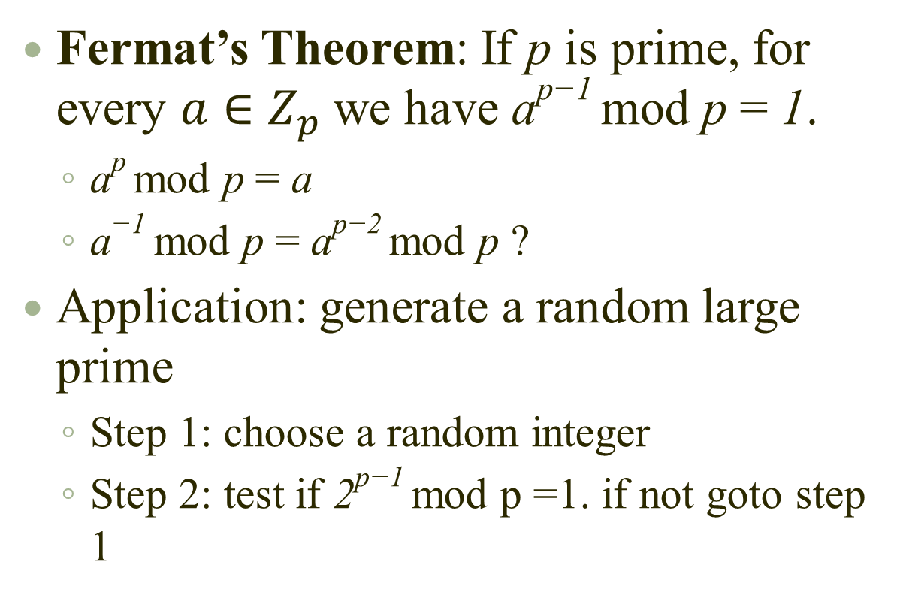
Fermat’s Theorem
Fermat’s Theorem: If p is prime, for every $a∈Z_{p}$we have a^{p−1} mod p = 1.
a^{p} mod p = a
a⁻¹ mod p = a^{p−2} mod p ?
Application: generate a random large prime
Step 1: choose a random integer
Step 2: test if 2^{p−1} mod p =1. if not goto step 1

Slide 23
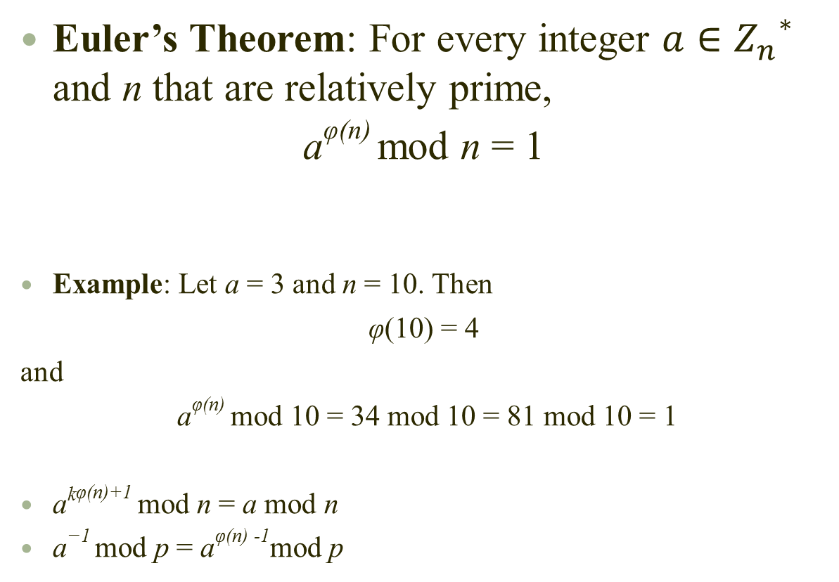
Euler’s Theorem
Euler’s Theorem: For every integer $a∈{Z_{n}^{}}^{∗}$ and n that are relatively prime,
a^{φ(n)} mod n = 1
Example: Let a = 3 and n = 10. Then
φ(10) = 4
and
a^{φ(n)} mod 10 = 34 mod 10 = 81 mod 10 = 1
a^{kφ(n)+1} mod n = a mod n
a⁻¹ mod p = a^{φ(n) -1}mod p

Slide 24
The RSA Public-Key Cryptosystem
Plaintext space: M = {0, 1}∗.
Ciphertext space: C = {0, 1}∗.
Binary representation and integers: A binary block
M = m₀m₁ · · · m_{k−1}
is identified with integer
m₀ + m₁2 + m₂2² + · · · + m_{k−1}2^{k−1}
which is in {0, 1, · · · , 2^{k} − 1}.

Slide 25
The RSA Public-Key Cryptosystem
Choose two distinct primes p and q.
Define n = pq.
Select d: 1 ≤ d < φ(n) with gcd(d, φ(n)) = 1.
Compute e: e = d⁻¹ mod φ(n).
Public key: (e, n)
Private key: d
Key spaces: K_{e} = Z_{φ(n)}* × {n}, K_{d} = Z_{φ(n)}∗
Z_{φ(n)}*: the set of positive integers that is less than φ(n) and has multiplicative inverse mod φ(n)

Slide 26
The RSA Public-Key Cryptosystem
Let 2^{k} < n < 2^{k+1}, i.e., k = ⌊log₂ n⌋. Plaintext is broken into blocks of length k.
Encryption: For each block M,
C = Me mod n.
Decryption:
M = C^{d} mod n.
Remark: Each message block M, when viewed as an integer, is at most 2^{k} ≤ n − 1.

Slide 27
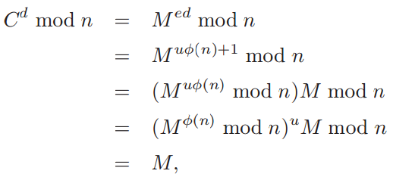
Correctness of Decryption
Proof: Case I: gcd(M, n) = 1
By Euler’s theorem,
where u is some integer.

Slide 28


Correctness of Decryption
Proof: Case II: gcd(M, n) = p
We have M = tp, 0 < t < q. So gcd(M, q) = 1. Since ed = uφ(n) + 1 for some u,
by Fermat’s
whence

Slide 29
Correctness of Decryption
Proof: Case III gcd(M, n) = q.
Similar to Case II.
Proof: Case IV gcd(M, n) = pq.
Trivial because M = 0 and C = 0.

Slide 30
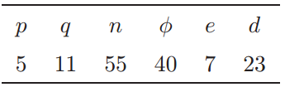
The RSA Public-Key Cryptosystem: Example
Parameters:
Public key: (7, 55)
Private key: 23
Encryption: M = 28, C = M⁷ mod 55 = 52.
Decryption: M = C²³ mod 55 = 28.

Slide 31

The Parameters of the RSA
Parameters:
Public key: (e, n)
Private key: d
Other parameters: p, q, φ(n) must be kept secret.
Question: Why?

Slide 32
The Security of the RSA
Brute force attack: Trying all possible private keys.
The number of decryption keys:
|{1 ≤ d < φ(n)| gcd(d, φ(n)) = 1}| = φ(φ(n)) = φ((p − 1)(q − 1)).
Comment: As long as p and q are large enough, this attack does not work as φ((p − 1)(q − 1)) − 1 will be large!
But the larger the n, the slower the system.
Attack: Factor n into pq. Thus φ(n) and d is known.
Attack: Determine φ(n) directly, without first determining p and q.
Attack: Determine d directly, without first determining φ(n).

Slide 33
RSA Security: Factoring
Security of RSA with respect to factoring depends on:
(1) development of algorithms for factorization;
(2) increase in computing power.
A number of algorithms for factorization. Most of them involve too much number theory and cannot be introduced here.
Computing power increases dramatically each year due to advances in hardware technology.
RSA can be used for both encryption and digital signature.

Slide 34
The ElGamal Public-Key Cryptosystem
The discrete logarithm problem.
The ElGamal public-key cryptosystem.

Slide 35
Recall of the Discrete Logarithm Problem
The discrete logarithm problem:
Let p be a prime, and let α be a primitive root of p. The discrete logarithm problem is to find log_{α}a for any 1 ≤ a ≤ p − 1, which is defined to be the unique integer 0 ≤ i ≤ p − 2 such that a = α^{i} (mod p).
Comment: In general, there is no polynomial-time algorithm for this problem (except for certain special primes p).
Comment: If p has 130 or more digits, the DLP is computationally infeasible to solve in general
Notes:
Recall that is rsa, we depend on the “hard” math problem of factoring a product of large primes.

Slide 36
Choosing Parameters for the ElGamal System
Choosing parameters:
Let p be a large prime, and let α be a primitive root of p.
Let u be a secret number in Z_{p−1}={0, · · · , p − 2}
Compute β = α^{u} mod p.
Building Blocks:
M = Z∗_{p} = {1, · · · , p − 1}
C = Z∗_{p} × Z∗_{p}
K_{e} = {p} × P × Z∗_{p} , where P is the set of all primitive roots of p. So
|K_{e}| = φ(p − 1) × (p − 1).
The public key k_{e} = (p, α, β).
K_{d} = Z_{p−1}. Thus | K_{d} | = p − 1.
The private key k_{d} = u such that β = α^{u} mod p

Slide 37
The Encryption and Decryption
Encryption:
For any public key k_{e} = (p, α, β), and for a (secret) random number v ∈ Z_{p−1}, E_{ke} (x, v) = (y1, y2), where
y1 = α^{v} mod p
y2 = xβ^{v} mod p.
Decryption:
For any (y1, y2) ∈ Z∗_{p} × Z∗_{p},
D_{kd} (y1, y2) = y2 (y1^{kd} )⁻¹ mod p.
Remark: Encryption is nondeterministic, and has data expansion.

Slide 38
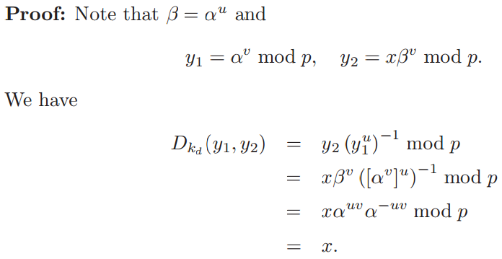
The Correctness of Decryption
Remark: For decryption, the receiver need not know the secret random number v
Remark: The system is not deterministic, since the ciphertext depends on both the plaintext x and the random number v chosen by Alice, the sender.
Remark: The ElGamal system cannot be used for signing messages, as the domain and range of the function E_{ke} are not the same. In fact, they are: Z∗_{p} and Z∗_{p} × Z∗_{p} .

Slide 39
An Example
Choose p = 2579, α = 2, and u = 765. Hence
β = 2⁷⁶⁵ mod 2579 = 949.
Public key k_{e} = (p, α, β) = (2579, 2, 949).
Private key k_{d} = u = 765.
Encryption: Let x = 1299 and choose a random v = 853,
E_{ke} (x, v) = (y1, y2) = (α^{v} mod p, xβ^{v} mod p)
= (2853 mod 2579, 1299 · 949⁸⁵³ mod 2579)
= (435, 2396).
Decryption:
D_{kd} (y1, y2) = y2 (y1^{kd} )⁻¹ mod p
= 2396 × (435⁷⁶⁵)⁻¹ mod 2579
= 1299.

Slide 40
Security of the ElGamal Cryptosystem
Question 1: Is it computationally feasible to derive the private key k_{d} from the public key k_{e}?
Question 2: Given a ciphertext (y1, y2), is it computationally feasible to derive its corresponding plaintext x?

Slide 41
Public-Key Infrastructure
Digital certificate
Certificate authority (CA)
Public key infrastructure (PKI)

Slide 42
What is a Digital Certificate?
Definition:
Digital certificates authenticate that their holders are truly who and what they claim to be.
Protect data exchanged online.
They are tamper-proof and cannot be forged.
Real world example: passport
Server certificates, and
Personal certificates (e.g., containing a public key).
Signing certificate
Encrypting certificate

Slide 43
Certificate Authority
It is a trusted third-party.
It is responsible for verifying the identities of cryptographic key holders.
It issues digital certificates.
Asserts that a public key is part of a key-pair held by an individual, organization, or other entity.
It publishes policy detailed in a Certification Practices
Statement (CPS).
Real World Example: HK Immigration Department.

Slide 44
Public Key Infrastructure
Public-key infrastructure (PKI) is the combination of software, encryption technologies, and services that enables enterprises to protect the security of their communications and business transactions on the Internet.
PKIs integrate digital certificates, public-key cryptography, and certificate authorities into a total, enterprise-wide network security architecture.

Slide 45
Elements of a Public Key Infrastructure
Certificate Authority (CA):
e.g., OpenSSL, Netscape, Verisign, Entrust, RSA Keon
Public/Private Key Pairs - key management
X.509 Identity Certificates - certificate management
LDAP servers (LDAP: Lightweight Directory Access Protocol)

Slide 46
Why Do We Need Public Key Infrastructures (I)
Authenticate identity:
Digital certificates issued as part of your PKI allow individual users, organizations, and web site operators to confidently validate the identity of each party in an Internet transaction.
Verify integrity:
A digital certificate ensures that the message or document the certificate “signs” has not been changed or corrupted in transit online.
Ensure privacy:
Digital certificates protect information from interception during Internet transmission.

Slide 47
Issues
Scalability: How many certificates can one CA manage?
Administration: How to revoke already issued certificates?
Trust: Why should I trust your CA?

Slide 48
Issues: PKI Scalability
A large PKI requires distributed CAs
Local, Regional, National CAs, International CAs
Certificate Hierarchy
Intermediate CA certificates are signed by the CA one-step up.
End-user certificates are part of a certificate chain.

Slide 49
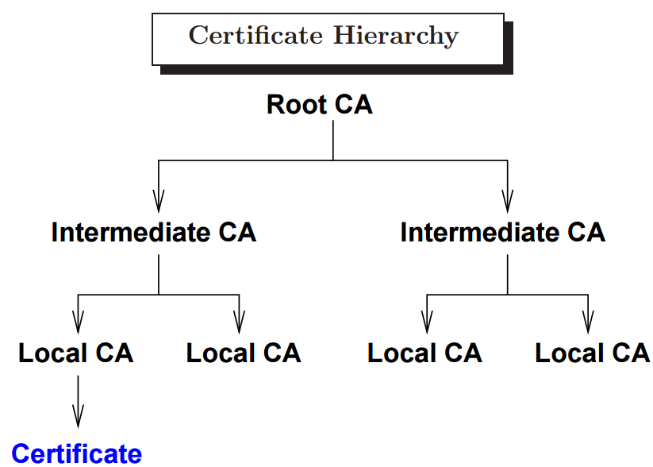
Issues: PKI Scalability

Slide 50
Methods of Publishing Digital Certificates
Without a 3rd party:
Own web page, via FTP file
With a 3rd party:
Dedicated key server, directory
Encrypt data for someone without prior contact.
You do not have to store all keys yourself.
Easier distribution of new keys and updates.

Slide 51
Implementing PKIs
PKI solutions, such as VeriSign OnSite, allow organizations to efficiently set up and maintain their own complete PKI, acting as a CA to issue certificates, while relying on expert services, technology, and practices for support.
Before your organization can begin implementing PKI and acting as a CA in issuing certificates, you need to be able to issue certificates that contain company-specific identifying information, and you must be able to control who is issued a certificate. There are two main PKI options: open and closed PKI.

Slide 52
Open and Closed PKIs
Closed PKI: With proprietary PKI software, you can issue digital certificates to a limited, controlled community of users. Applications - including those of extranet users and anyone else outside your enterprise with whom your employees need to communicate securely - need a special software interface from the PKI vendor to work with the certificates. Closed PKI systems require additional training, hardware, software, and maintenance.
Open PKI: Applications interface seamlessly with certificates issued under an open PKI, the roots of which are already embedded. Open PKI systems allow enterprises to become their own CA, while taking advantage of the PKI vendor’s service and support. Example, VeriSign OnSite.

Slide 53
Evaluating PKI Solutions
As the foundation for the security of your enterprise’s Internet transactions, the success of your PKI will have a major impact on your business. Before implementing PKI solutions for your enterprise, there are six critical questions to ask:
1. How experienced is your PKI solution provider? Full PKI functionality can include a full range of services, including certificate issuance, administration, records retention, and key management. Can you rely on your provider for time-tested experience?
2. Will your PKI integrate with your existing applications? Some PKI solutions are based on proprietary desktop software, while others provide digital certificates that integrate with standard web browsers, email clients, and enterprise applications.

Slide 54
Evaluating PKI Solutions
3. Can the PKI support all of your users? Information security is critical. Make sure your PKI will be available around the clock to employees, partners, and customers. Is it set up to handle disaster recovery? Hacker attacks? Unexpected peaks in demand?
4. Can your PKI grow with your business? As more and more users need digital certificates, can your PKI scale to accommodate demand?

Slide 55
Evaluating PKI Solutions
5. How secure is the PKI’s operating infrastructure? For most companies, operating a PKI presents a new and unique set of risk management challenges. CAs that support key applications use special cryptographic hardware to sign certificates. Is all of this hardware protected from theft?
6. Is your PKI ready for e-commerce? You may need your PKI to support an intranet at first, and then larger communities, such as an extranet for your suppliers and partners; VPNs for a worldwide network of offices, and even a world of e-commerce customers.

