Slide 1
MIE-311 Mobile Network Security
Zhe XuanYuan (轩辕哲)
xuanyuanz@mail.sysu.edu.cn

Slide 2
Lecture 4: Integrity & Authentication
Hash and Keyed Hash Functions
The Secure Hash Algorithm
Digital Signature

Slide 3
Authentication
Verify that the received message has not been altered
Verify that the alleged sender is the real one
Verify the timeliness of messages

Slide 4
A Basic Model of Authentication
A wants to send messages to B. They share a secret function f. A sends
c=m||f(m).
When B receives the message c, he partitions c into
c = c1||c2
and check whether f(c1) = c2. If yes, he conclude that c is indeed the message from A and it was not modified during transmission. The part f(m) is called the authenticator, while f is referred to as the authentication function. Usually the length of f(m) is fixed.
Natural Law: If you want to gain, you have to pay.
Question: What is the price paid in this system?

Slide 5
Authentication Functions
Encryption transformation: The ciphertext of the entire message serves as its authenticator.
Hash function: A public function h that maps a message of any length into a fixed-length hash value, which serves as the authenticator.
Keyed hash function: A secret function h_{k} that maps a message of any length into a fixed-length hash value, which serves as the authenticator, where k is a secret parameter.

Slide 6
Authentication with Conventional Encryption
Question: Suppose that Alice and Bob share a secret key k and no third party possesses k.
Does the following system provide authentication of message and sender? In other words, can Bob verify the sender and whether the message was altered?
Alice → E_{k}(m) → Bob
If yes, at the receiver end how can Bob verify the identity of sender and whether the data was modified during transmission?
Hint: The data E_{k}(m) has the same length as the plaintext m.

Slide 7
Authentication with Conventional Encryption
Case 1: Any finite string of characters is a possible message. In this case, the messages have no redundancy at all.
Answer: In this case, it does not provide authentication of sender and message.

Slide 8
Authentication with Conventional Encryption
Case 2: Some finite strings are not messages. In this case, the messages have redundancy. For example, natural languages.
Answer: In this case, it does provide authentication of both sender and message to some extent.
E.g., for natural languages, Bob decrypt the received data, obtaining D_{k}(c). Then he checks whether D_{k}(c) is meaningful. If yes, he concludes that the data was not altered and was from Alice, since no third person possesses the secret key. If no, Bob is absolutely sure that the message was forged or altered by a third party.
Comment: The probability that his conclusion is wrong depends on the redundancy of the natural language.

Slide 9
Hash Functions
Formal definition: A hash function h is a mapping from the set of all finite strings of characters from an alphabet A1 to a string of characters from an alphabet A2 with fixed length.
For any x, h(x) is called the hash value, hash code, or message digest.
Remark: For applications, a hash function h is always publicly known.

Slide 10
Authentication with Confidentiality
Protocol: Let h be a hash function. Assume that Alice and Bob share a secret key k of a one-key cipher. No third party possesses k.
Alice → E_{k}[m||h(m)] → Bob
When receiving the data c′, Bob decrypts c′, getting c, and partitions c into c1||c2, where c2 has the same length as h(m). Bob then computes h(c1) and compares it with c2.
Conclusion: It provides a certain degree of authentication of both sender and message, and also confidentiality.

Slide 11
Authentication with Confidentiality
Attacking the protocol: Without having k, an adversary picks up a random ciphertext c, and sends it to Bob.
Analysis: Assume that the messages have no redundancy. After decryption, Bob gets D_{k}(c) and partition it into D_{k}(c) = c1||c2, where c2 has the same length as the hash value. He finally compares h(c1) with c2. The probability of success is
Pr(h(c1) = c2).
Security requirements: The length of the hash value should be large enough (say, 256 bits). h(x) should be “uniformly distributed”.

Slide 12
Authentication without Confidentiality
Protocol: Let h be a hash function. Assume that Alice and Bob share a secret key k of a one-key cipher. No third party possesses k.
Alice −→ m||E_{k}[h(m)] −→ Bob
When receiving the data c, Bob partitions c into c1||c2, where c2 has the same length as E_{k}[h(m)]. Bob then compares h(c1) with D_{k}(c2).
Conclusion: It provides a certain degree of authentication of both sender and message, but no confidentiality for message.

Slide 13
Authentication without Confidentiality
Attacking the protocol: Observing m||E_{k}[h(m)], an enemy E then tries to find an m′ such that h(m) = h(m′). E then replaces m||E_{k}[h(m)] with a forged message m′||E_{k}[h(m)] and sends it to Bob.
Security requirement: For a given m, it should be computationally infeasible to find an m′ such that h(m) = h(m′)

Slide 14
Authentication with Nonrepudiation
Protocol: Let h be a hash function. Assume that Alice and Bob have exchanged their public keys.
Alice → m||D_{kdA} [h(m)] → Bob
When receiving the data c, Bob partitions c into c1||c2, where c2 has the same length as D_{kdA} [h(m)] . Bob then compares h(c1) with E_{keA} (c2).
Conclusion: It provides a certain degree of authentication & nonrepudiation, but no confidentiality.
Security requirement: For a given m, it should be computationally infeasible to find an m′ such that h(m) = h(m′). This is similar to the previous protocol!

Slide 15
Authentication + Nonrepudiation + Confidentiality
Protocol: Let h be a hash function. Assume that Alice and Bob share a secret key k of a one-key cipher, and have exchanged their public keys.
Alice → E_{k} (m|| D_{kdA}[h(m)]) → Bob
Bob verifies the sender, message, and signature similarly.
Conclusion: It provides a certain degree of authentication, nonrepudiation, and confidentiality.

Slide 16
Requirements for Hash Functions
h can be applied to a block of data of any size.
h produces a fixed-length output.
h(x) is easy to compute for any given x, making both hardware and software implementation practical.
For any given value v, it is computationally infeasible to find x such that h(x) = v. This is the one-way property.
For any given block x, it is computationally infeasible to find y such that h(x) = h(y). This is the weak collision resistance property.
It is computationally infeasible to find any pair (x, y) such that h(x) = h(y). This is the strong collision resistance property.

Slide 17
Requirements for Hash Functions
Implied by the previous ones:
The size of the hash value h(x) should be large enough (256 bits recommended), in order to thwart the brute-force attack.
h(x) should take on all the finite strings of fixed length as equally likely as possible.
Attacking Hash Functions
Finding the preimage: Given a hash value v, find an x such that h(x) = v. (One-way property required.)
Finding collision: Given a hash function h, find an x and y such that h(x) = h(y). (Strong collision resistance property required.)
Brute-force attack: The exhaustive search approach to finding the preimage and a collision.

Slide 18
Pigeonhole principle
If n pigeonholes are occupied by n+1 pigeons, then at least one pigeonhole is occupied by ____________ pigeons
If n pigeonholes are occupied by kn+1 pigeons, then at least one pigeonhole is occupied by ____________ pigeons
E.g. Message = 6 bits long, Hash code = 4 bit long

Slide 19
Birthday Problems
In a classroom with k students, what is the probability that at least two students have the same birthday?
In two classroom with k students each, what is the probability that at least two students, one from each class, have the same birthday?

Slide 20
Construction of Hash Functions
Using a Block Cipher
Building block: Given a one-key block cipher (M, C, K, E_{k}, D_{k}), where E_{k} maps a block of n bits into a block of n bits, and each key k has l bits
Construction 1: Given a message m, divide it into blocks of length l, m = m1m2m3 · · · mt
The hash value H is computed as follows:
H₀ = fixed initial value of n bits
H_{i} = E_{mi} (H_{i−1})
H = H_{t}
Comment: If n and l are large enough, and the block cipher is well designed, this hash function is expected to be secure

Slide 21
Construction of Hash Functions
Using a Block Cipher
Building block: Given a one-key block cipher (M, C, K, E_{k}, D_{k}), where E_{k} maps a block of n bits into a block of n bits, and each key k has l bits
Construction 2: Given a message m, divide it into blocks of length l, m = m1m2m3 · · · mt
The hash value H is computed as follows:
H₀ = fixed initial value of n bits
H_{i} = E_{mi} (H_{i−1}) ⊕ H_{i−1}
H = H_{t}
Comment: If n and l are large enough, and the block cipher is well designed, this hash function is expected to be secure

Slide 22
Some Hash Algorithms
Information: Many hash algorithms (functions) were designed during the last 10 years, and many of them were successfully attacked.
MD families of hash algorithms, named MDx, designed by Ron Rivest at MIT.
SHA and SHA-1, designed by the National Institute of Standards and Technology.
RIPEMD-160, developed under the European RACE Integrity Primitive Evaluation (RIPE) project.
We shall cover only SHA-1 in this course

Slide 23
Keyed Hash Functions
Formal definition:
A keyed hash function h_{k} is a mapping from the set of all finite strings of characters from an alphabet A to a string of characters from an alphabet B with fixed length, where k is a secret parameter from a space K.
For any x, h_{k}(x) is called the hash value or message authentication code (MAC).

Slide 24
Authentication without Confidentiality
Protocol: Let h_{k} be a keyed hash function. Assume that Alice and Bob share a secret key k. No third party possesses k.
Alice → m|| h_{k}(m) → Bob
When receiving the data c, Bob partitions c into c1||c2, where c2 has the same length as h_{k}(m). Bob then computes h_{k}(c1) and compares it with c2.
Conclusion: It provides a certain degree of authentication of both sender and message, but no confidentiality.

Slide 25
Authentication without Confidentiality
Attacking the protocol: Observing m||h_{k}(m), a third party tries to find another message m′ such that h_{k} (m) = h_{k}(m′). If this is possible, he can replace m||h_{k} (m) with m′||h_{k} (m′).
Question: How can an adversary find such an m′? Method : He randomly picks up an m′ and expects h_{k} (m) = h_{k} (m′).
Question: How should the keyed hash function h_{k} be designed so that this attack works with little chance?

Slide 26
Authentication without Confidentiality
Basic security requirement on h_{k} : With respect to the previous attack. If an opponent observes m and h_{k}(m), it should be computationally infeasible for the opponent to construct an m′ such that h_{k}(m′) = h_{k}(m).
Question: What does this basic requirement imply?
The size of the MAC h_{k} (x) should be ≥ 256 bits.
h_{k}(m) should be uniformly distributed in the sense that for randomly chosen messages, m and m′, the probability that h_{k} (m) = h_{k} (m′) is 2^{−n}, where n is the number of bits in the MAC.

Slide 27
Authentication with Confidentiality
Protocol: Let h_{k} be a keyed hash function. Assume that Alice and Bob share a secret key k1 for the keyed hash function and another one k2 for a one-key cipher. No third party possesses k1 or k2.
Alice → E_{k2} [m||h_{k1} (m)] → Bob
Bob verifies both the sender and message following the same procedure after decryption the data.
Conclusion: It provides a certain degree of authentication of both sender and message, and also confidentiality.

Slide 28
Authentication with Confidentiality
Protocol: Let h_{k} be a keyed hash function. Assume that Alice and Bob share a secret key k1 for the keyed hash function and another one k2 for a one-key cipher. No third party possesses k1 or k2.
Alice → E_{k2} (m)||h_{k1} [E_{k2} (m)] → Bob
Bob verifies both the sender and message following a similar procedure.
Conclusion: It provides a certain degree of authentication of both sender and message, and also confidentiality

Slide 29
Why to Use Message Authentication Codes
Recall: Conventional encryption does provide authentication when messages have redundancy.
Question: Why should we use MACs? (We need to pay for using MACs.)
Alice → E_{k2} [m||h_{k1} (m)] → Bob
Scenario 1: Encryption might be too expensive in certain applications due to time constraint.
Scenario 2: For some applications, confidentiality is not a concern, but message authentication is important. For example, the Simple Network Management Protocol Version 3.
Scenario 3: Separation of authentication and confidentiality functions affords architectural flexibility. For example, it may be desired to perform authentication at the application level, but to provide confidentiality at a lower level, such as the transport level.

Slide 30
Keyed Hash Functions using a Block Cipher
Building block: Given a one-key block cipher (M, C, K, E_{k}, D_{k}), where E_{k} maps a block of n bits into a block of n bits, and each key k has l bits
Construction 1: Given a message m, divide it into blocks of length l, m = m1m2m3 · · · mt
The hash value H is computed as follows:
H₀ = E_{k}(m1)
H_{i} = E_{k} (mi⊕H_{i−1})
H = H_{t}
Comment: If n and l are large enough, and the block cipher is well designed, this hash function is expected to be secure

Slide 31
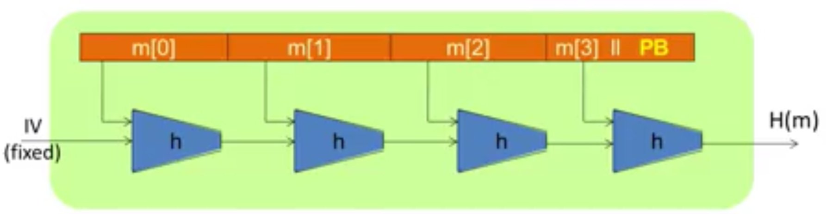
Building blocks of a secure hash algorithm
The Merkle-Damgard paradigm
Compression function
Collision resistance condition (proof…)
How to build a keyed hash function based on the merkle-damgard paradigm

Slide 32
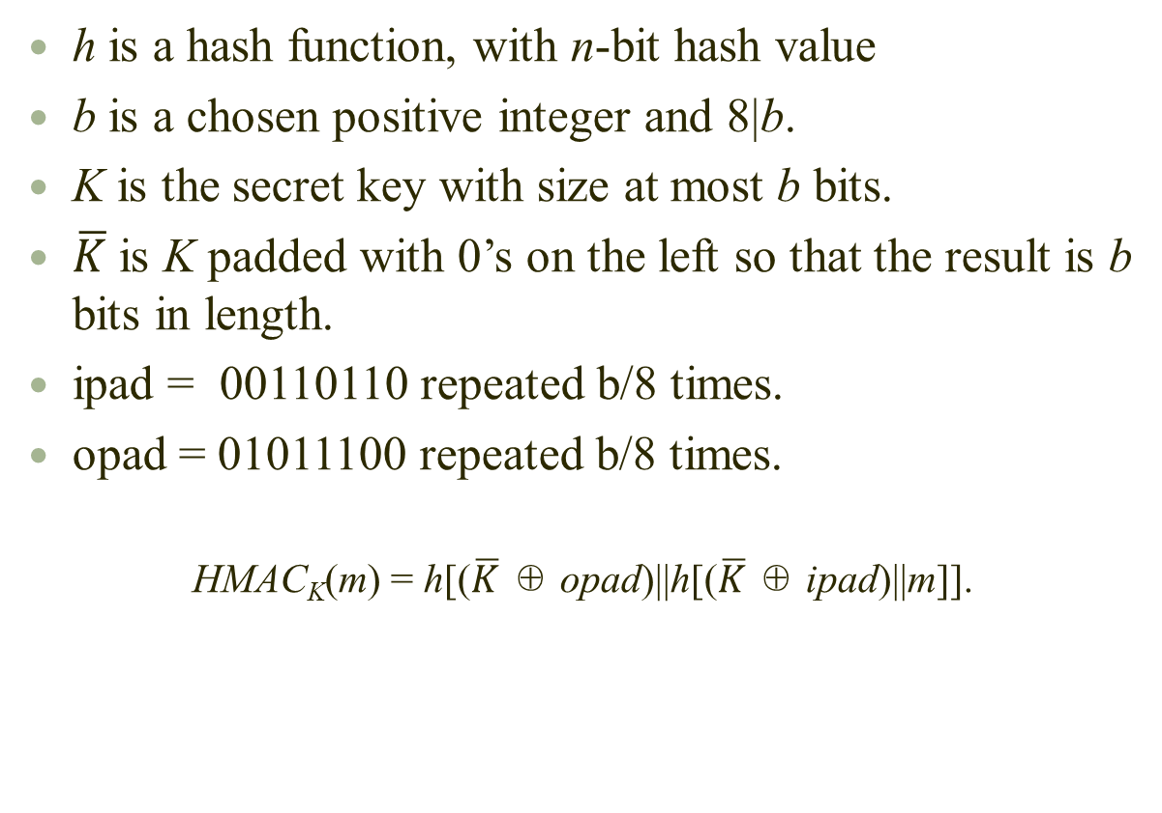
HMAC: A Specific Construction
h is a hash function, with n-bit hash value
b is a chosen positive integer and 8|b.
K is the secret key with size at most b bits.
$\overline{K}$ is K padded with 0’s on the left so that the result is b bits in length.
ipad = 00110110 repeated b/8 times.
opad = 01011100 repeated b/8 times.
HMAC_{K}(m) = h[($\overline{K}$ ⊕ opad)||h[($\overline{K}$ ⊕ ipad)||m]].

Slide 33
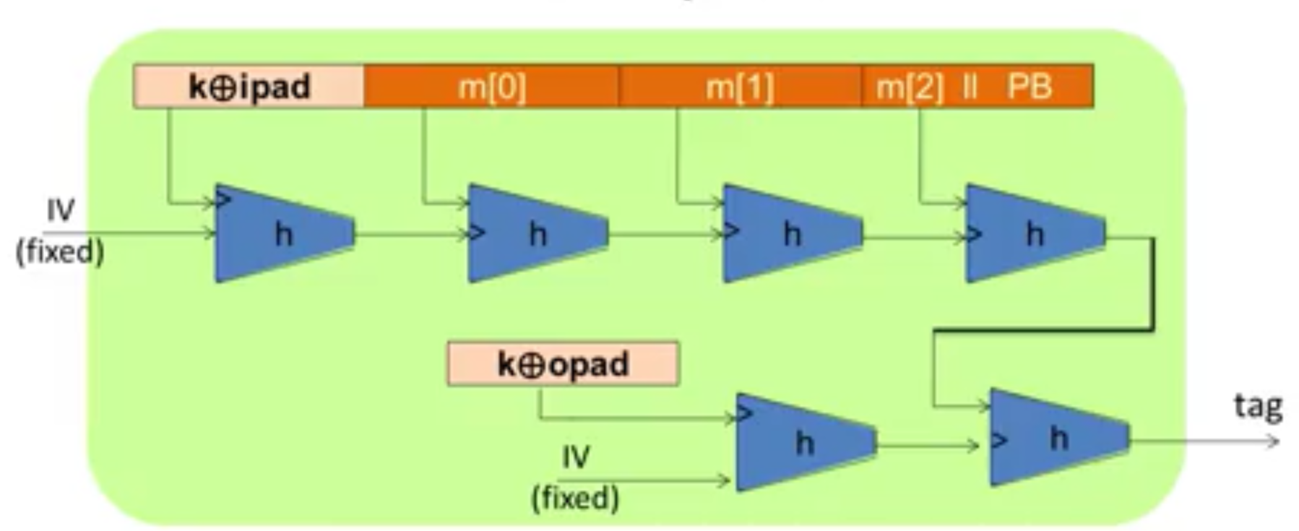
HMAC: A Specific Construction
Attack and defense on HMAC

Slide 34
The Secure Hash Algorithm
Brief Information on SHA-1
SHA was designed by the NIST, and published as a federal information processing standard in 1993
It is based on the MD4 algorithm, and its design closely models MD4.
SHA-1 is a revised version of SHA, and has a 160-bit hash value. The maximum input size is 2⁶⁴ bits, and the input is processed in 512-bit blocks.
It is used in the Digital Signature Standard (DSS), and Pretty Good Privacy (PGP), and other real systems.

Slide 35
Design Considerations: Security & Performance
It should be computationally infeasible to find a preimage given a hash value, and to find a collision.
Most hash algorithms are software-oriented and are implemented in general-purpose computers. Such a hash algorithm must make full use of the processor size.

Slide 36
Representation of numbers
Binary Representation of Numbers
1011 = 2³ + 2¹ + 2⁰ = 11
Decimal Representation of Numbers
7019 = 7 · 10³ + 1 · 10¹ + 9 · 10⁰
Hexadecimal Representation of Numbers
Define a = 10, b = 11, c = 12, d = 13, e = 14, f = 15
9ad1 = 9 × 16³ + a × 16² + d × 16 + 1 × 160 = 39633

Slide 37
SHA-1 Description
Step 1: Append padding bits
The message is padded so that its length ≡ 448 mod 512.
Padding is always added, even if the message is already of the desired length. Thus the number of padding bits is in the range of 1 to 512.
The padding rule: 1 followed by the number of necessary 0’s.
Remark: 448 is chosen here because another 64 bits will be appended in Step 2. Note that 448 + 64 = 512.

Slide 38
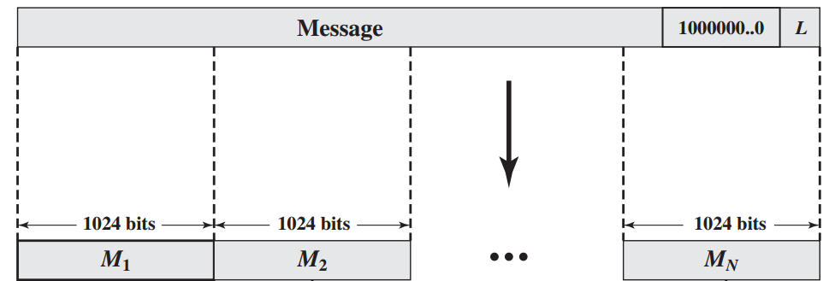
SHA-1 Description
Step 2: Append length of the original message
Since the length of the original message < 2⁶⁴, append the 64 bits of the binary representation of the length of the original message after Step 1.
This block of 64 bits is treated as an unsigned 64-bit integer (most significant byte first).
Remark: After the padding of Step 2, the length of the new message is a multiple of 512 bits.
448 bits
64 bits
512 bits
512 bits
512 bits

Slide 39
SHA-1 Description
Step 3: Initialize MD buffer
A 160-bit buffer is used to hold intermediate and final results of the hash function. The buffer can be represented as five 32-bit registers A, B, C, D, E.
These registers are initialized to the following 32-bit integers (hexadecimal values):
A = 67452301
B = efcdab89
C = 98badcfe
D = 10325476
E = c3d2e1f0

Slide 40
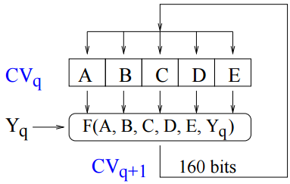
SHA-1 Description
Step 4: Process padded message in 512-bit blocks
Let Y₀Y₁ · · · Y_{L−1} be the message after the padding, where Y_{i} is a 512-bit block. Then SHA-1 computes the hash value as follows.
Where F(A, B, C, D, E, Y_{q}) is a function to be specified later, CV_{q} is the content of the buffer at time unit q, and CV_{q+1} is the new value for replacing CV_{q}. The final content of the buffer is the hash code.

Slide 41
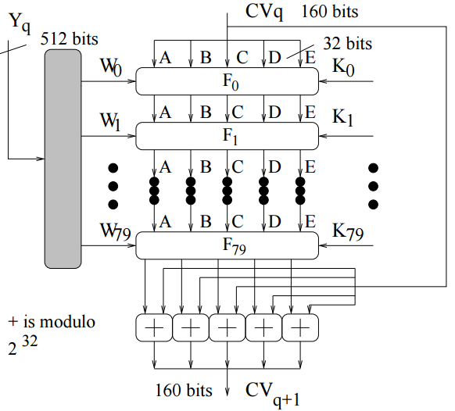
SHA-1 Description
Function F(A,B,C,D,E,Y_{q})

Slide 42
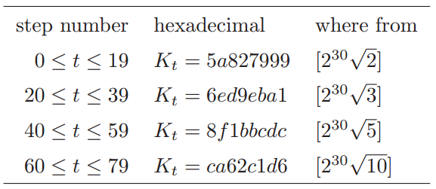
SHA-1 Description
Function F(A,B,C,D,E,Y_{q})
The constant K_{i}
Remark: These constants are needed inside the function F(A, B, C, D, E, Y_{q}), and are called magic numbers

Slide 43
SHA-1 Description
The W[0..79] computed from each block Y_{q}:
For each message block Y_{q}, 80 words W_{i} of 32 bits are computed:
Define
W₀||W₁|| · · · ||W₁₅ = Y_{q},
i.e., divide Y_{q} into 16 blocks of 32 bits.
For 16 ≤ t ≤ 79, W_{t} is computed by
W_{t} = S¹(W_{t−16} ⊕ W_{t−14} ⊕ W_{t−8} ⊕ W_{t−3})
recursively, where S^{i}(x) is the circular left shift of the 32-bit word x for i positions.

Slide 44
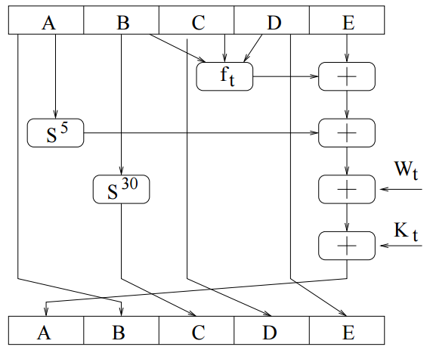
SHA-1 Description
Function F_{t}

Slide 45
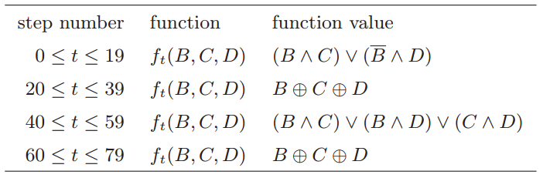
SHA-1 Description
The functions f_{t}
Remark: ∨ = OR, ∧ = AND, − = NOT, ⊕ = EXOR.
Remark: B ∧ C is the bitwise logical AND

Slide 46
Security and other Issues
It is derived from MD4 (one of the hash algorithms designed by Ron Rivest). But no design criteria are publically known.
It is simple to describe and simple to implement and do not require large programs or substitution tables.
Collisions of SHA-1 and MD5 were found. But for any message x, it is not known how to find a y such that H(x) = H(y). So it is not really a threat for real applications. But it is time to design new hash functions.

Slide 47
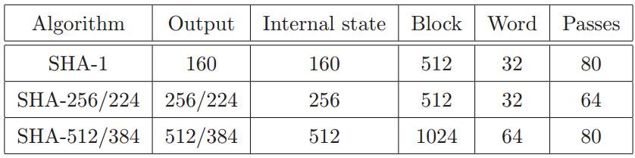
Other Variants of SHA
In 2002, NIST published three additional hash functions in the SHA family, each with longer digests, collectively known as SHA-2. The individual variants are named after their digest lengths (in bits): ”SHA-256”, ”SHA-384”, and ”SHA-512”.
In February 2004, NIST published an additional variant, ”SHA-224”, defined to match the key length of two-key Triple DES.
The operations in SHA-256 and SHA-512 work on 32-bit and 64-bit words, respectively.
SHA-256 and SHA-512 use different shift amounts and additive constants, but their structures are otherwise virtually identical, differing only in the number of rounds.
SHA-224 and SHA-384 are simply truncated versions of the first two, computed with different initial values.

Slide 48
Digital Signature Standard
Scenario: Assume that Alice and Bob share a secret key k1 for the keyed hash function and another one k2 for a one-key cipher. Consider the following authentication protocol.
Alice → E_{k2} [m||h_{k1} (m)] → Bob
Problems: Assume that Alice sends an authenticated message to Bob.
Bob may forge a message and claim that it came from Alice.
Alice can deny sending the message.
Solution: Digital signature, analogous to handwritten signature.

Slide 49
Digital Signature Standard
Comparison with conventional signatures
Inclusion
Verification Method
Relationship
Duplicity

Slide 50
Basic Requirements
The signature must depend on the message being signed.
The signature must use some information unique to the sender, to prevent both forgery and denial.
It must be relatively easy to produce the digital signature
It must be relatively easy to recognize and verify the digital signature.
It must be computationally infeasible to forge a digital signature,
either by constructing a new message for an existing digital signature
or by constructing a fraudulent digital signature for a given message.
It must be practical to retain a copy of the digital signature in storage.

Slide 51
Digital Signature with Public-Key Cryptosystems
Protocol: Let h be a hash function. Assume that Alice and Bob share a secret key k of a one-key cipher, and have exchanged their public keys.
Alice → E_{k} (m|| D_{kdA}[h(m)]) → Bob
Question: Which of the basic requirements for digital signature are met?
For example, we can use RSA cryptosystem to implement the digital signature system

Slide 52
Recall the ElGamal cryptosystem
Encryption:
For any public key k_{e} = (p, α, β), and for a (secret) random number v ∈ Z_{p−1}, E_{ke} (x, v) = (y1, y2), where
y1 = α^{v} mod p
y2 = xβ^{v} mod p.
Decryption:
For any (y1, y2) ∈ Z∗_{p} × Z∗_{p},
D_{kd} (y1, y2) = y2 (y1^{kd} )⁻¹ mod p.
Remark: The ElGamal system cannot be used for signing messages, as the domain and range of the function E_{ke} are not the same. In fact, they are: Z∗_{p} and Z∗_{p} × Z∗_{p} .

Slide 53
ElGamal Digital Signature Scheme
Choosing parameters:
Let p be a large prime, and let α be a primitive root of p.
Let u be a secret number in Z_{p−1}={0, · · · , p − 2}
Compute β = α^{u} mod p.
The public key k_{e} = (p, α, β)
The private key k_{d} = u such that β = α^{u} mod p
Signing process, suppose the original message is x:
Alice choose a secret random number r and calculate
S₁= α^{r} mod p
S₂= (x - u* S₁ )* r⁻¹ mod (p-1)
Where r⁻¹ is the multiplicative inverse of r modulo p
Alice sends x, S_{1,} S₂ to Bob

Slide 54
ElGamal Digital Signature Scheme
Verifying process
Calculate V₁= α^{x} mod p
Calculate V₂= β ^{S1} * S₁ ^{S2} mod p
If V₁ = V₂ (mod p), the message is accepted, otherwise it is rejected.
Proof:
V₁ = V₂ (mod p) → α^{x} = β ^{S1} * S₁ ^{S2} (mod p)
= (α^{u} )^{S1} * (α^{r} ) ^{S2} (mod p)
= α^{u} ^{S1} ⁺ ^{r S2} (mod p)
Because α is a primitive root, therefore the above holds iff
x=(u S₁ + r S₂) mod (p-1)
Because by definition S₂= (x - u* S₁ )* r⁻¹ mod (p-1) , the above equation holds.

Slide 55
Example
Alice choose p=3119, α = 2, u =127 and calculate β = 2¹²⁷ mod 3119 = 1702.
For a give message x=320, Alice choose r=307,
S₁ = α^{r} = 2³⁰⁷ mod 3119 =2083 mod 3119
S₂= (x - u* S₁ )* r⁻¹ mod (p-1) = 2105 mod 3118
Alice sends (320, 2083, 2105) to Bob
Bob calculate
V₁= α^{x} mod p = 3006 mod 3119
V₂= β ^{S1} * S₁ ^{S2} mod p = 3006 mod 3119
Bob accepts the message and assumes that the message has been signed by Alice.

