Slide 1
MIE-311 Mobile Network Security
Zhe XuanYuan (轩辕哲)
xuanyuanz@mail.sysu.edu.cn

Slide 2
Lecture 5: Electronic Mail Security
Email security issues
Detailed introduction of PGP

Slide 3
About Electronic Mail
In virtually all distributed environment, electronic mail is the most heavily-used network-based application
It is also one of the most widely used distributed application that is widely used across all architectures and platforms (PC, UNIX, Macintosh, etc)
With the explosively growing reliance on electronic mail, there is a growing demand for authentication and confidentiality services

Slide 4
Developing a System for Electronic Mail Security
Having learned the basics of ciphers, digital signature, and authentication, you are asked to design a system to support the following for electronic email communication:
confidentiality of message;
nonrepudiation of the sender; and
authentication of message.
Question: How do you design your system?

Slide 5
Developing a System for Electronic Mail Security
You need to carry out the following:
Select the best available cryptographic algorithms as building blocks;
Integrate these algorithms into a general-purpose application that is independent of operating system and processor and that is based on a small set of easy-to-use commands.
This is how PGP and S/MIME were developed.
PGP: Pretty Good Privacy
S/MIME: Secure/Multipurpose Internet Mail Extension

Slide 6
PGP: Pretty Good Privacy
It is a program for email communication security.
Phil Zimmermann started writing PGP in the mid 1980s and finished the first version in 1991.
It is available free worldwide in versions than runs on a variety of platforms, including DOS/Windows, UNIX, Macintosh, and many more.
It is based on cryptographic algorithms that have survived extensive public review.
It has a wide range of applicability: within corporations and for individuals within themselves.

Slide 7
A Summary of PGP Services
Nonrepudiation and authentication (Digital signature using DSS/SHA or RSA/SHA).
Message confidentiality (encryption with CAST or IDEA or 3DES, and session key encryption with ElGamal or RSA).
Compression (using ZIP) – A message may be compressed, for storage or transmission.
Email compatibility (using radix-64 conversion): To provide transparency for email applications, an encrypted message may be converted to an ASCII string using radix-64 conversion.
Segmentation – to accommodate maximum message size limitations, PGP performs segmentation and reassembly.

Slide 8
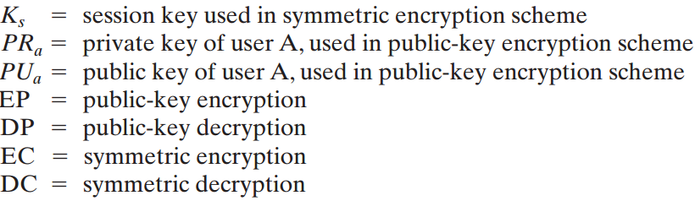
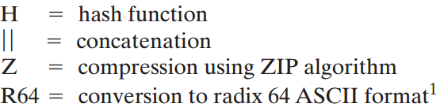
Authentication, Confidentiality, Nonrepudiation in PGP

Slide 9
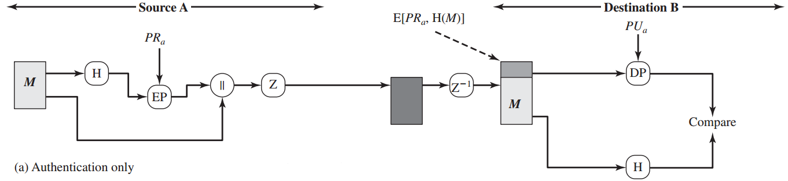
Authentication and Nonrepudiation
The sender creates a message.
SHA-1 is used to generate a 160-bit hash code of the message.
The hash code is encrypted with RSA using the sender’s private key, and the result is prepended to the message.
The receiver uses RSA with the sender’s public key to decrypt and recover the hash code.
The receiver generates a new hash code for the message and compares it with the decrypted hash code. If the two match, the message is accepted as authentic.

Slide 10
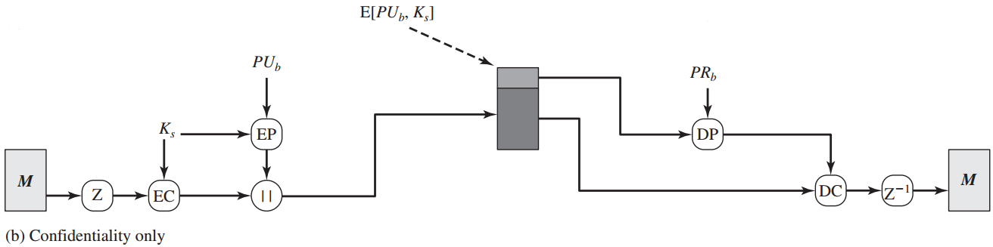
Confidentiality
The sender generates a message and a random 128-bit number to be used as a session key for this message only.
The message is encrypted using CAST-128 (or IDEA or 3DES) with the session key.
The session key is encrypted with RSA using the recipient’s public key and is prepended to the message.
The receiver uses RSA with its private key to decrypt and recover the session key.
The session key is used to decrypt the message.

Slide 11
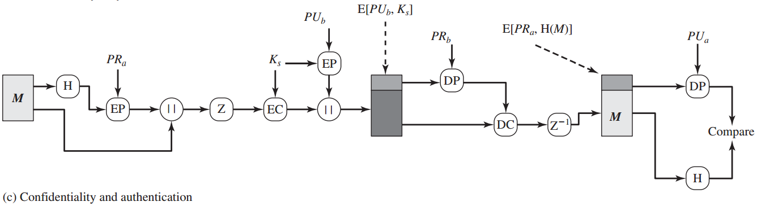
Authentication with Confidentiality

Slide 12
Compression
Why compression?
Save space both for email transmission and for file storage.
PGP compresses the message after applying the signature but before encryption
It is preferable to sign an uncompressed message so that one can store only the uncompressed message together with the signature for future verification
Message encryption is applied after compression to strengthen cryptographic security. Because the compressed message has less redundancy than the original plaintext, cryptanalysis is more difficult.
Finding the right placement of a building block is quite important for the whole system!

Slide 13
Email Compatibility
The problem: When PGP is used, at least part of the block to be transmitted is encrypted, consists of a stream of arbitrary 8-bit octets. However, many electronic mail systems only permits the use of blocks consisting of ASCII text.
Solution: To accommodate this restriction, PGP provides the service of converting the raw 8-bit binary stream to a stream of printable ASCII characters. The scheme used is the “radix-64 conversion”.
Comment: The use of radix-64 conversion expands a message by 33%. Fortunately, the compression should be more than enough to compensate for the radix-64 conversion.

Slide 14
Segmentation and Reassembly
The problem: Email facilities often are restricted to a maximum message length (e.g., 50, 000 octets). Any message longer than that must be broken into smaller segments, each of which is mailed separately.
Solution: To accommodate this restriction, PGP automatically subdivides a message that is too large into segments that are small enough to send via email. When is segmentation done? After all of the other processing, including the radix-64 conversion.
The session key component and signature component appear only once, at the beginning of the first segment. At the receiving end, PGP must strip off all email headers and reassemble the entire original block before performing the steps illustrated in the figure of the previous page.

Slide 15
Keys used in PGP
One-time session conventional keys.
Public and private keys.
Passphrase-based conventional keys.

Slide 16
Key Requirements in PGP
A means of generating unpredictable session keys is needed.
A user is allowed to have multiple public/private key pairs. (A user may wish to have multiple key pairs at a given time to interact with different groups of correspondents or simply to enhance security by limiting the amount of material encrypted with any one key.) Hence there is not a one-to-one correspondence between users and their public keys.
Each PGP entity must maintain a file of its own public/private key pairs as well as a file of public keys of correspondents.

Slide 17
Session Key Generation
Definition: Each is associated with a single message and is used only for encrypting and decrypting that message using a symmetric cipher. Symmetric ciphers: CAST-128, IDEA (with 128-bit key), 3DES (with 168-bit key).
Session Key Generation: Using CAST-128 (block size 64) as example
ks = CAST-128_{CFB}(k, N),
where k is a 128-bit key for CAST-128, and N = N2||N1 are two 64-bit blocks. All three (k, N1, N2) are based on a keystroke input from the user. N is encrypted using CAST-128 in CFB mode.

Slide 18
Key Identifiers (1)
Problem: Recall that A sends E_{keB} [ks]||E_{ks} [x] to B if encryption is needed. But in the system B could have more than one private/public key pairs. How could B know which of his public key was used by A?
Solution 1: Transmit the public key k_{eB} together with that message. Then B could check that it is indeed one of his public keys.
Disadvantages: But it is a waste of resource, as a public key could have hundreds of digits in length.

Slide 19
Key Identifiers (2)
Problem: Recall that A sends E_{keB} [ks]||E_{ks} [x] to B if encryption is needed. But in the system B could have more than one private/public key pairs. How could B know which of his public key was used by A?
Solution 2: Associate an identifier with each public key that is unique at least within each one user. That is, user ID plus key ID would be sufficient to identify a key uniquely.
Disadvantages: It leads to a management and overhead problem: Key IDs must be assigned and stored so that both sender and recipient could map from key ID to public key.

Slide 20
Key Identifiers (3)
Problem: Recall that A sends E_{keB} [ks]||E_{ks} [x] to B if encryption is needed. But in the system B could have more than one private/public key pairs. How could B know which of his public key was used by A?
Solution adopted in PGP: ID of a public key k_{eB} is defined to be k_{eB} mod 2⁶⁴.
Comments:
Hence with very high probability that the IDs of a user’s public keys are unique.
Is key ID needed for PGP signature? Yes. Key ID is also included in the component of PGP signature.

Slide 21
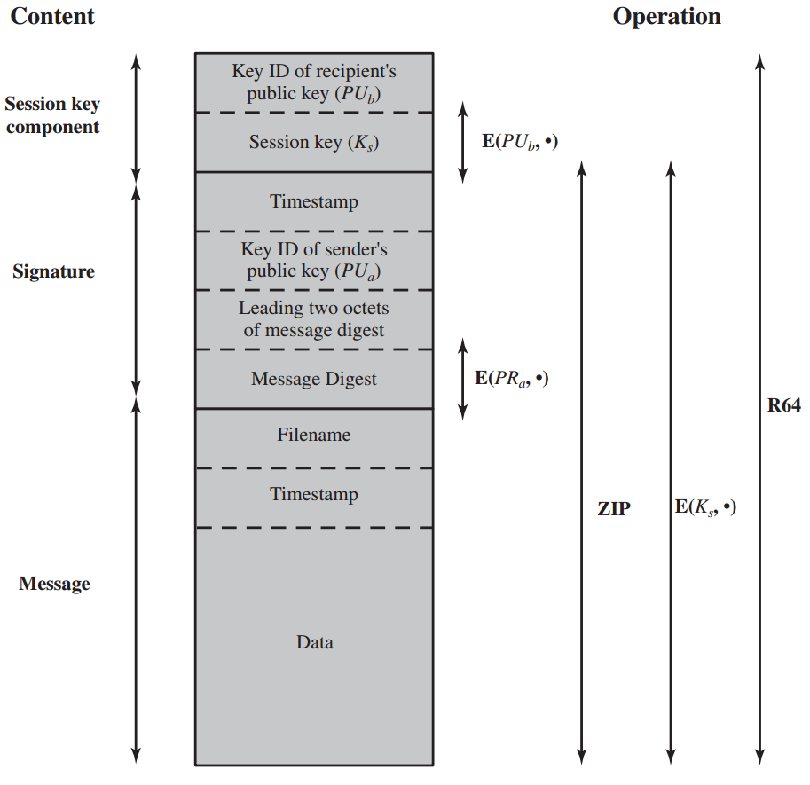
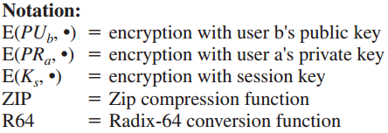
General Format PGP Message (from A to B)

Slide 22
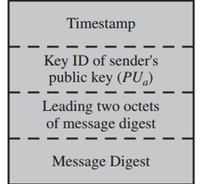
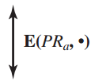
Format of Transmitted Messages in PGP
Signature Component (1):
Timestamp: T2, the time at which the signature was made.
Message digest: SHA-1(M||T2)
Leading two octets of message digest: L
Key ID of sender’s public key

Slide 23
Signature Component (2)
Roles of the building blocks:
Message digest: SHA-1(M||T2)
Why should T2 be involved here?
Against replay types of attacks.
Leading two octets of message digest
Enables the recipient to determine if the correct public key was used to decrypt the message digest for authentication by comparing this plaintext copy of the first two octets with the first two octets of the decrypted digest

Slide 24
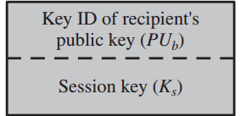

Format of Transmitted Messages in PGP
session key component
Includes the session key and the identifier of the recipient’s public key that was used by the sender to encrypt the session key

Slide 25
Key Rings
Observation: Two key IDs ID(k_{eA} ) and ID(k_{eB}) are included in any PGP message that provides both confidentiality and authentication.
Question: How to store and organize them in a systematic way for efficient and effective use by all parties?
Scheme used in PGP: It provides a pair of data structure at each node, one to store the public/private key pairs owned by that node and one to store the public keys of other users known at this node. The data structures are referred to, respectively, as the private-key ring and public-key ring.

Slide 26
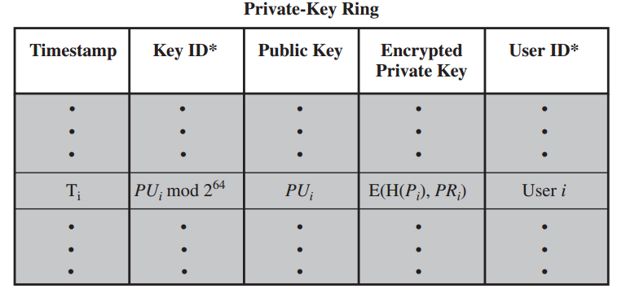
Private Key Ring: 1-Row 1-Key Pair
* indicates the fields to index the table. The private-key ring can be indexed by either User ID or Key ID.
The private-key ring is stored only on the machine of the user that created and owns the key pair, and is accessible only to that user.
The user selects a passphrase P_{i}, computes H(P_{i}) = SHA-1(P_{i}). The private key is encrypted with CSAT-128 or IDEA or 3DES, using part of H[P_{i}] as the key. The encrypted private key is stored.

Slide 27
Private Key Ring
More about the passphrase:
When a user accesses his/her private key, he/she must supply the passphrase. PGP will retrieve the encrypted private key.
When the system generates a new public/private key pair, it also asks the user for the passphrase.
Hence the security of the system depends on that of the password

Slide 28
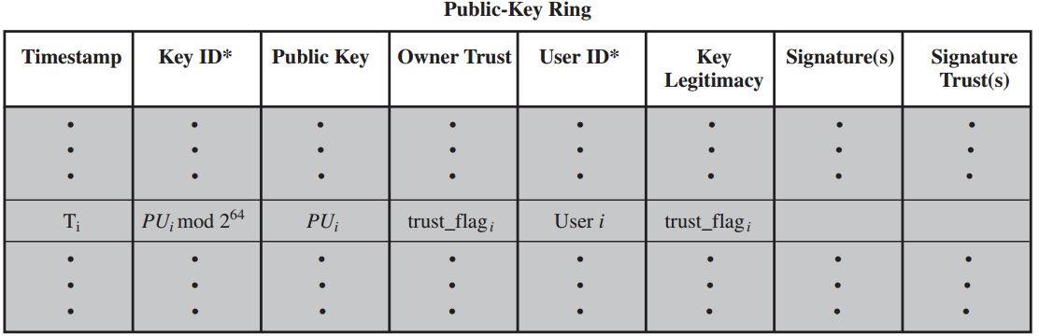
Public Key Ring:
Definition: It is used to store public keys of other users that are known to this user.
Remark: The public-key ring can be indexed by either User ID or Key ID. We will see the need for both means of indexing later.

Slide 29
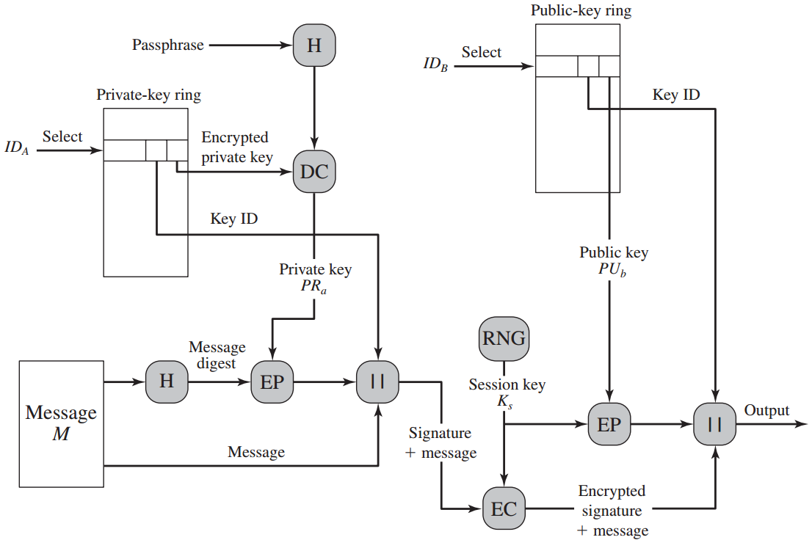
PGP Message Generation
*we ignore compression and radix-64 conversion

Slide 30
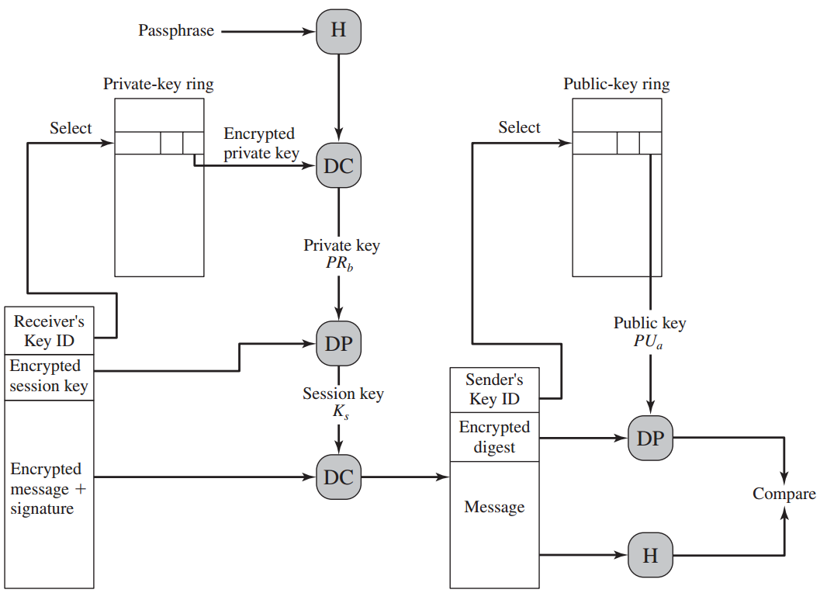
PGP Message Generation
*we ignore compression and radix-64 conversion

Slide 31
Key revocation
Why key revocation?
Because compromise is suspected or a user wants to avoid the use of the same key for an extended period.
How to do this?
The owner issues a key revocation certificate, signed by the owner. This certificate has the same form as a normal signature certificate, but includes an indicator that purpose of this certificate is to revoke the use of this public key.
Remark: The corresponding private key must be used to sign a certificate that revokes a public key.
Comments: An opponent who has compromised the private key of an owner can also issues such a certificate. However, this would deny the opponent as well as the legitimate owner the use of the public key.

