Slide 1
MIE-311 Mobile Network Security
Zhe XuanYuan (轩辕哲)
xuanyuanz@mail.sysu.edu.cn

Slide 2
Lecture 6: SSL and TLS
Brief Information on SSL and TLS
Secure Socket Layer (SSL)
Transport Layer Security (TLS)
Recommended Reading

Slide 3
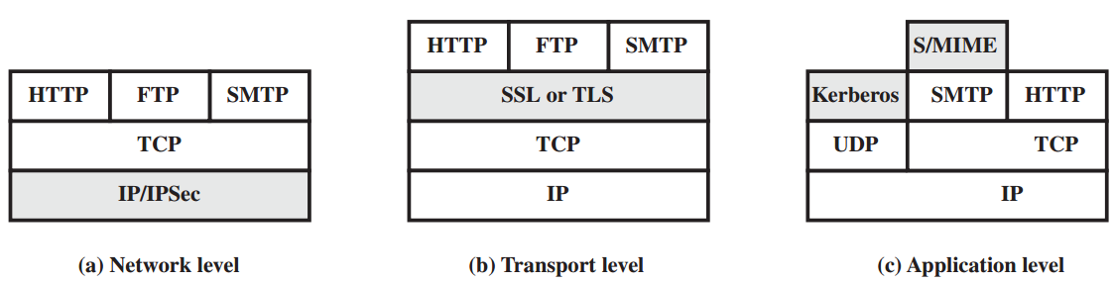
Security Facilities in the TCP/IP Protocol Stack
Connectionless and connection-oriented transport layer service:
Security Protocol 4 (SP4) – NSA, NIST
Transport Layer Security Protocol (TLSP) – ISO
Connection-oriented transport layer service:
Encrypted Session Manager (ESM) – AT&T Bell Labs.
Secure Socket Layer (SSL) – Netscape Communications,
Transport Layer Security (TLS) – IETF TLS WG Most popular transport layer security protocols,

Slide 4
SSL and TLS: Information
SSL was originated by Netscape, Version 2, 3
TLS working group was formed within IETF
First version of TLS can be viewed as an SSLv3.1

Slide 5
SSL: Brief Introduction
Based on connection-oriented and reliable service (e.g., TCP)
Able to provide security services for any TCP-based application protocol, e.g., HTTP, FTP, TELNET, etc. – Application independent

Slide 6
SSL Services
Client- server authentication
Data confidentiality
Data origin authentication
Data integrity

Slide 7
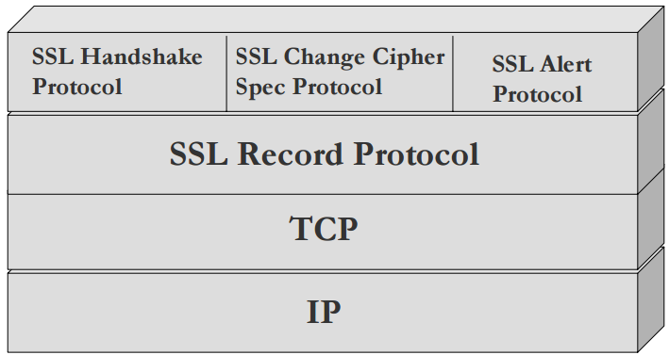
SSL Architecture

Slide 8
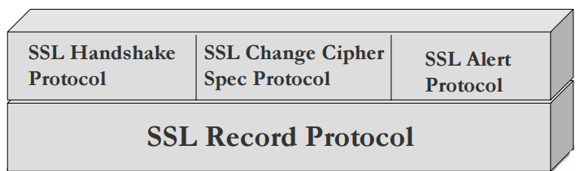
SSL Protocol Structure
It makes use of TCP to provide a reliable end-to-end secure service.
It consist of two layers of protocols:
[provides support for SSL session & connection establishment]
Auth. & encryption algorithms, keys, random numbers, alert messages
[message origin authentication, data confidentiality, data integrity]

Slide 9
SSL Protocol
Components:
SSL Record Protocol
Layered on top of a connection-oriented and reliable transport layer service
Provides message origin authentication, data confidentiality, and data integrity
SSL sub-protocols
Layered on top of the SSL Record Protocol
Provides support for SSL “session” and “connection” establishment

Slide 10
SSL Connection and Session
Connection:
A transport (in the OSI layering model definition) that provides a suitable service.
For SSL, such connections are peer-to-peer relationships.
Every connection is associated with one “session”.
Session:
An association between a client and a server.
Created by handshake protocol
Defines a set of cryptographic parameters, which can be shared among multiple connections.
Is used to avoid the expensive negotiation of new security parameters for each connection.

Slide 11
SSL State Information
SSL session is stateful
SSL protocol must initialize and maintain session state information on either side of the session
SSL session can be used for a number of connections
connection state information

Slide 12
SSL Session State Information Element
Session ID: An arbitrary byte sequence chosen by the server to identify an active or resumable session state.
Peer certificate: X509.v3 certificate of the peer
Compression method: algorithm to compress data before encryption
Cipher spec: specification of data encryption and Message Authentication Code (MAC) algorithms
Master secret: 48-byte secret shared between client and server
Is resumable: flag that indicates whether the session can be used to initiate new connections

Slide 13
More on SSL Session State
A previous session may be resumed (use Session ID and its session cache)
A new session may be negotiated (use Session ID and the Handshake Protocol)

Slide 14
SSL Connection State Information Elements
Server and client random: byte sequences that are chosen by server and client for each connection (in order to make cryptanalysis harder).
Server write MAC secret: secret used for MAC on data written by server
Client write MAC secret: secret used for MAC on data written by client
Server write key: key used for data encryption by server and decryption by client
Client write key: key used for encryption by client and decryption by server
Initialization vector: for CBC block ciphers
Sequence number: for both transmitted and received messages for each connection, maintained by each party. (Anti-replay purpose)

Slide 15
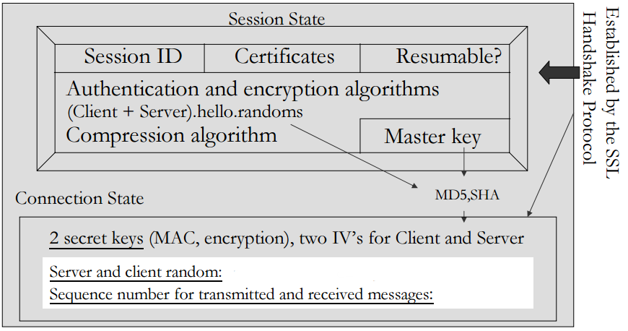
Session & Connection State: Pictorial Description

Slide 16
Current and Pending State
Current state: There is a current operating state for both read and write (i.e., receive and send).
Pending state: In addition, during the Handshake Protocol, pending read and write states are created.
Updating: Upon successful conclusion of the Handshake protocol, the pending states become the current states.

Slide 17
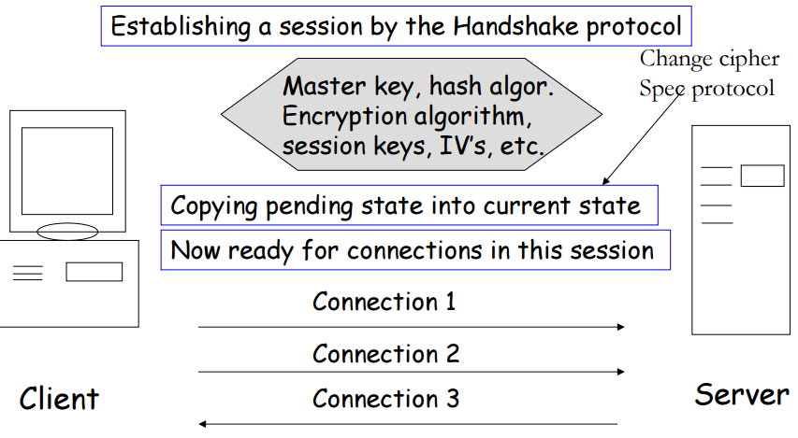
Connection and Session

Slide 18
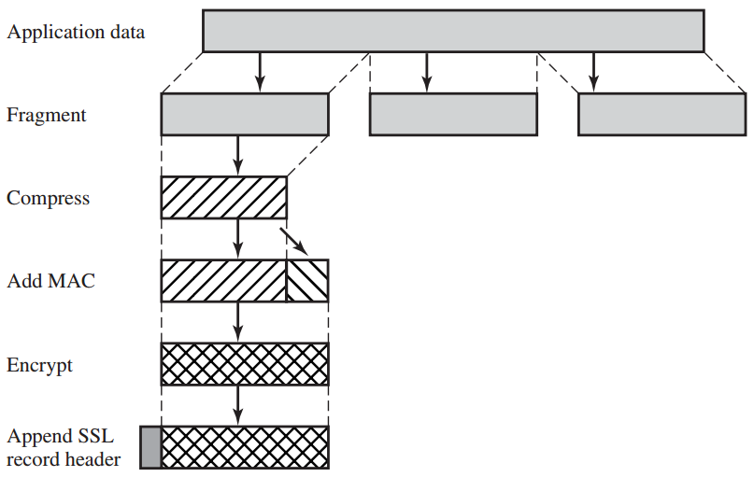
SSL Record Protocol

Slide 19
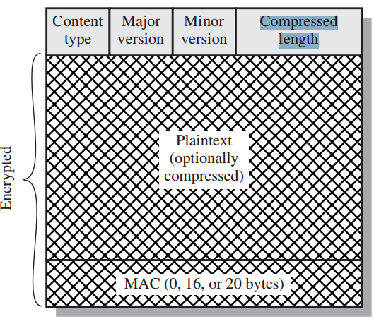
SSL Record Format
Content Type (8 bits): The higher-layer protocol used to process the enclosed fragment.
Major Version (8 bits): Indicates major version of SSL in use. For SSLv3, the value is 3.
Minor Version (8 bits): Indicates minor version in use. For SSLv3, the value is 0.
Compressed Length (16 bits): The length in bytes of the plaintext fragment (or compressed fragment if compression is used). The maximum value is 2^16 bytes.

Slide 20
SSL Record Content
Content type (8 bits) – Defines higher layer protocol that must be used to process the payload data (which may be handshake, alert, or change_cipher_spec messages).
Protocol version number (major & Minor) (8 bits)
Defines SSL version in use. (3, 0) for SSLv3
Length (16 bits): length in bytes of (compressed) plaint.
Data payload
Optionally compressed and encrypted
Encryption and compression requirements are defined during SSL handshake
MAC (0, 16, or 20 bytes)
Appended for each record for message origin authentication and data integrity verification

Slide 21
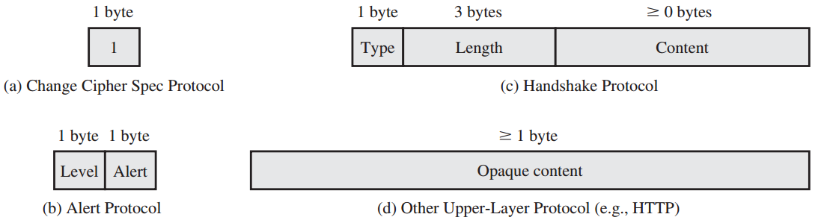
Change Cipher Spec Protocol
It is one of the three SSL-specific protocols that use the SSL Record Protocol.
It consists of a single message, which consists of a single byte with value 1.
The sole purpose of this message is to cause the pending state to be copied into the current state, which updates the cipher suite to be used on this connection.

Slide 22

Alert Protocol
Used to transmit alerts via SSL Record Protocol to peer entity.
Alert message: (alert level, alert description)
Alert messages are compressed and encrypted, as specified by the current state.
Format of the message in this protocol:
unexpected_message: An inappropriate message was received.
bad_record_mac: An incorrect MAC was received.
decompression_failure: The decompression function received improper input (e.g., unable to decompress or decompress to greater than maximum allowable length).
handshake_failure: Sender was unable to negotiate an acceptable set of security parameters given the options available.
illegal_parameter: A field in a handshake message was out of range or inconsistent with other fields.
warning
fatal

Slide 23
Handshake Protocol
The most complex part of SSL.
Allows the server and client to authenticate each other.
Negotiate encryption, MAC algorithm and cryptographic keys.
Used before any application data is transmitted.

Slide 24

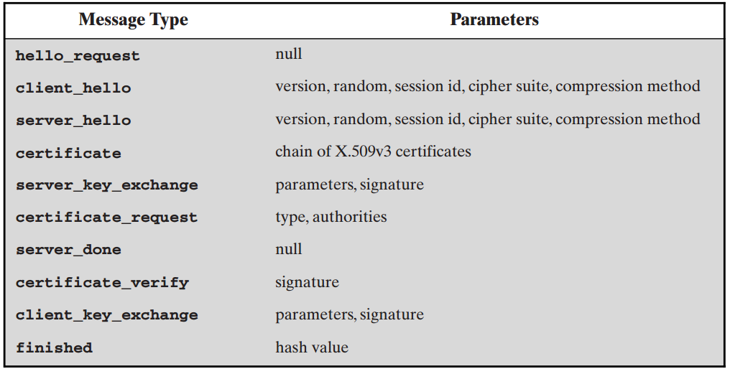
Handshake Protocol
Type (1 byte): Indicates one of 10 messages.
Length (3 bytes): The length of the message in bytes.
Content ( bytes): The parameters associated with this message

Slide 25
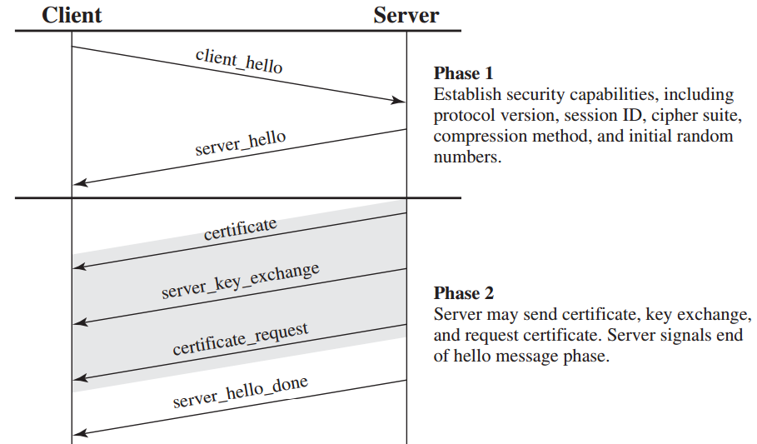
SSL Handshake

Slide 26
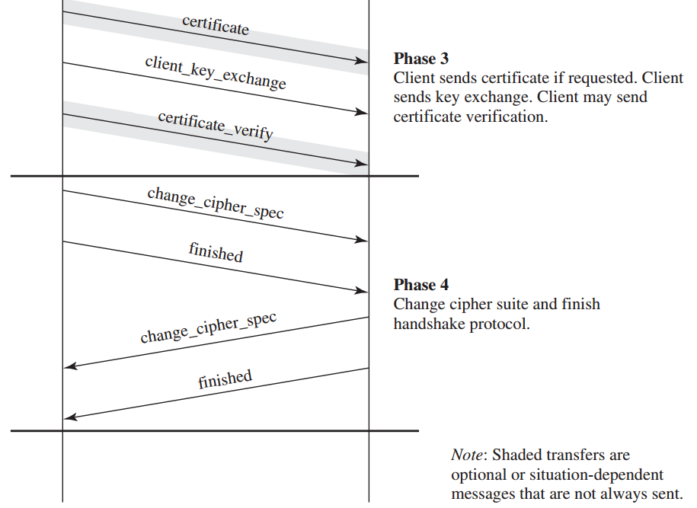
SSL Handshake

Slide 27
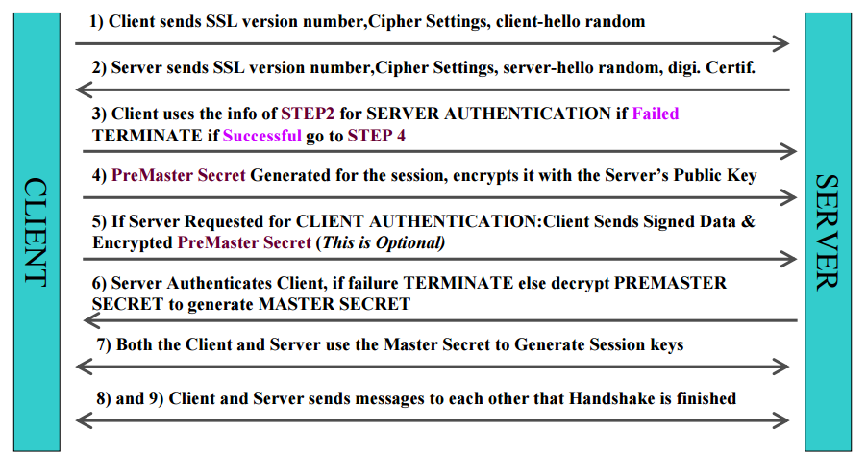
SSL Handshake

Slide 28
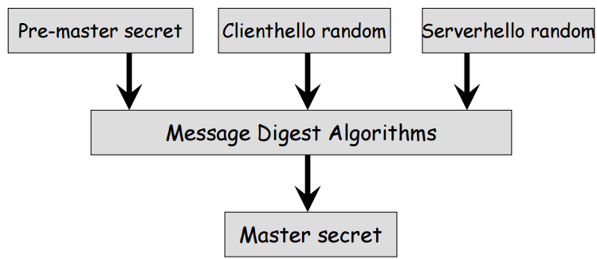
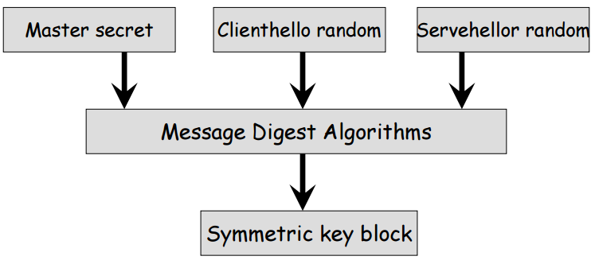
SSL Handshake
Symmetric key block = client write MAC secret, server write MAC secret, client write key, server write key, client write IV, and server write IV

Slide 29
SSL Handshake

Slide 30
Transport Layer Security (Protocol)
Revised version of SSLv3. (RFC5246)
Differences in the:
version number (v3.3)
message authentication code (HMAC)
pseudorandom function (Key generation)
alert codes
cipher suites
client certificate types
certificate_verify and finished message
cryptographic computations
padding

Slide 31
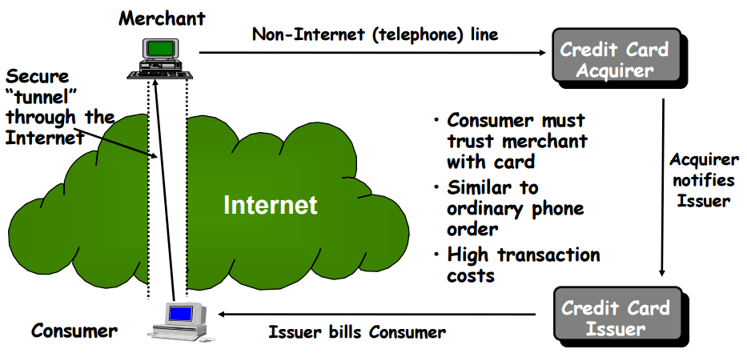
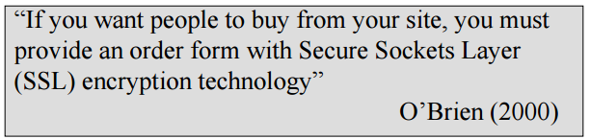
SSL Applications

Slide 32
SSL Applications
https
(HTTP over SSL)
Port 443
Encrypt: URL of the requested document, content of the document, contents of the browser forms, cookies, contents of http hearder
Establish SSL/TLS session before http session

Slide 33
SSL and SSH
Secure shell (SSH)
Secure logon to replace TELNET
SSH (Secure Shell) and SSL (Secure Sockets Layer) can both be used to secure communications across the Internet.
SSL can be bundled with any applications based on TCP, such as SSL+HTTP=HTTPS. Same thing can be done for your own application.
SSH itself is designed as an application that can do a lot of things, e.g. console login, secure file transfers, setting up a secure tunnel between hosts.

Slide 34
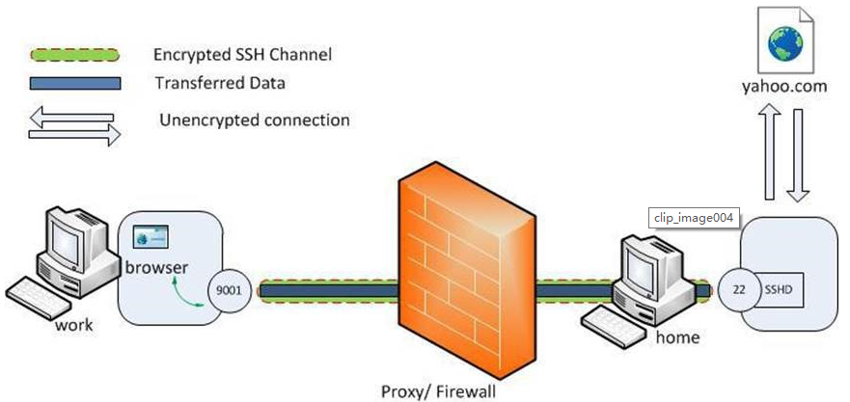
SSH tunneling
Local port forwarding
ssh -L 9001:yahoo.com:80 home
ssh -L <local-port-to-listen>:<remote-host>:<remote-port> <gateway>

Slide 35
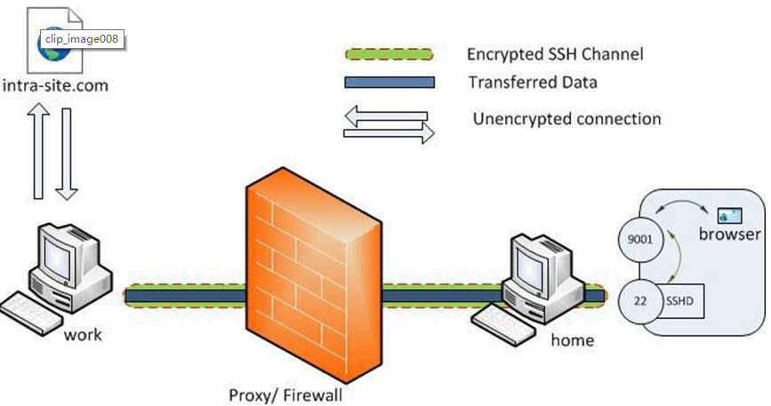
SSH tunneling
Remote port forwarding
ssh -R 9001:intra-site.com:80 home
(Executed from 'work')

Slide 36
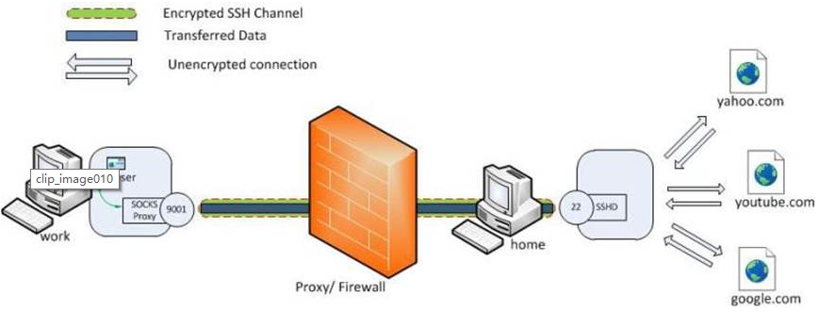
SSH tunneling
Dynamic port forwarding
ssh -D 9001 home
(Executed from 'work')

Slide 37
Recommended Reading
W. Stallings, Cryptography and Network Security, 2nd, 3rd Edition, Prentice Hall
Garfinkel, S., and Spafford, G. Web Security & Commerce. O’Reilly and Associates, 1997
The SSL Protocol Version 3.0 Transport Layer Security Working Group RFC-2246
OpenSSL website: www.openssl.org

