Slide 1
MIE-311 Mobile Network Security
Zhe XuanYuan (轩辕哲)
xuanyuanz@mail.sysu.edu.cn

Slide 2
Lecture 7: IPSec
Network layer security
Brief introduction of IPSec
IPSec building blocks
Security associations
Security policy database
Sub-protocols
AH and ESP
Two modes of AH and ESP
The outline of the key management (IKE)
IPSec workflow
Anti-replay in IPSec

Slide 3
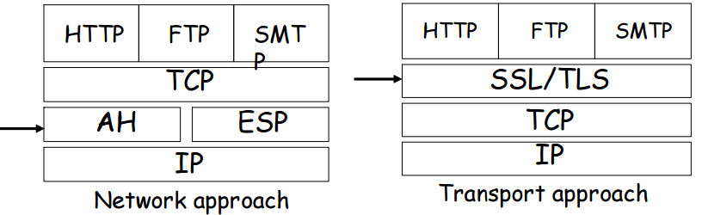
Where can we put security

Slide 4
Network Layer
Provides connectionless service
Routing (routers): determine the path:
a packet has to traverse to reach its destination
Defines addressing mechanism
Hosts should conform to the addressing mechanism

Slide 5
Network Layer and Security
In most network architecture and corresponding communication protocol stack: network layer protocol data units are transmitted in the clear:
Easy to inspect the data content
Easy to forge source or destination address
Easy to modify content
Easy to replay data
Need network layer security protocol
IPSec is designed for this purpose

Slide 6
Internet Engineering Task Force Standardization
1992: IPSEC WG (IETF) – Define security architecture – Standardize IP Security Protocol and Internet Key Management Protocol
1998: revised version of IPSec Architecture
IPsec protocols (two sub-protocols AH & ESP)
Internet Key Exchange (IKE)
2005: updated version (RFC4301-4306)

Slide 7
IP Security Overview
IPSec provides the following:
Data origin authentication
Connectionless data integrity
Data content confidentiality
Anti-replay protection
Limited traffic flow confidentiality

Slide 8
Building Blocks: Security Association
It is a one-way relationship between a sender and a receiver, stored in the SAD.
It associates security services and keys with the traffic to be protected.
It is uniquely identified by three parameters:
Security Parameter Index (SPI)
A bit string assigned to this SA
The SPI is carried in AH or ESP headers to enable the receiving system to select the SA under which a receiving packet will be processed.
IPSec protocol identifier (AH or ESP)
Destination address (direction, firewall, router)

Slide 9
Security Association
Defines security services and mechanisms between two end points (or IPsec modules):
Hosts
Network security gateways (e.g., routers, application gateways)
Hosts and security gateways
Defines parameters, mode of operation, and initialization vector
e.g., Confidentiality using ESP with DES in CBC mode with IV initialization vector
May use either Authentication Header (AH) or Encapsulating Security Payload (ESP).

Slide 10
Security Association
Host A Security Association:
# ipsecadm new esp ­spi 1000 ­src HostA \ ­dst HostB ­forcetunnel ­enc 3des ­auth sha1 \
key 7762d8707255d974168cbb1d274f8bed4cbd3364 \
authkey 6a20367e21c66e5a40739db293cf2ef2a4e6659f
Host B Security Association:
# ipsecadm new esp ­spi 1001 ­src HostB \ ­dst HostA ­forcetunnel ­enc 3des ­auth sha1 \ key 7762d8707255d974168cbb1d274f8bed4cbd3364 \­authkey 6a20367e21c66e5a40739db293cf2ef2a4e6659f

Slide 11
SA Parameters
Sequence Number counter (defined later)
Sequence Counter Overflow (defined later)
Anti-replay Window (defined later)
AH information (defined later)
ESP information (defined later)
Lifetime of this SA
IPSec Protocol Mode (Tunnel, Transport)
Path MTU: maximum size of a packet that can be transmitted without fragmentation

Slide 12
SA -- Lifetime
Amount of traffic protected by a key and time frame the same key is used
Manual creation: no lifetime
Dynamic creation: may have a lifetime

Slide 13
SA -- Security Granularity
User specified
Host-oriented keying
All users on one host share the same session key
Not recommended!
User-oriented keying
Each user on one host has one or more unique session keys
Session-unique keying
Single session key is assigned to a give IP address, upper-layer protocol, and port number

Slide 14
Building Blocks: Security Policy Database(SPD)
Defines:
What traffic to be protected
How to protect
With whom the protection is shared
For each packet entering or leaving an IPsec implementation, SPD is used to determine security mechanism to be applied
Actions:
Discard: do not let packet in or out
Bypass: do not apply or expect security services
Protect: apply/expect security services on packets

Slide 15
Building Blocks: IPSec Protocols
Encapsulating Security Payload (ESP)
Data confidentiality and limited traffic flow confidentiality
Anti-replay protection
Proof of data origin, data integrity (optional)
Authentication Header (AH)
Proof of data origin, data integrity
Anti-replay protection

Slide 16
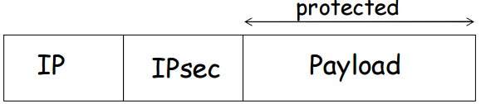
Transport Mode: AH & ESP
Usage: protect upper layer protocols
IPSec header is inserted between the IP header and the upper-layer protocol header
Communication endpoints must be cryptographic endpoints (for end-to-end authentication)

Slide 17
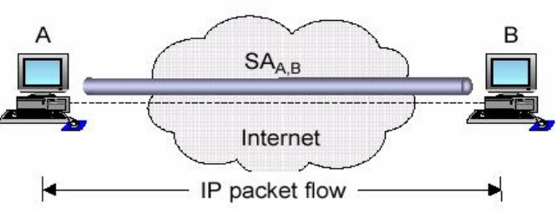
When is Transport Mode Used
Both endpoints are cryptographic endpoints, i.e. they generate / process an IPSec header (AH or ESP)

Slide 18
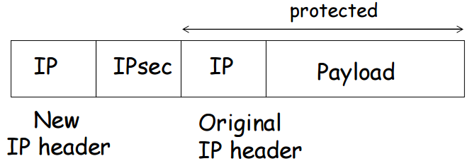
Tunnel Mode: AH & ESP
Usage: protect entire IP datagram
Entire IP packet to be protected is encapsulated in another IP datagram and an IPsec header is inserted between the outer and inner IP headers

Slide 19
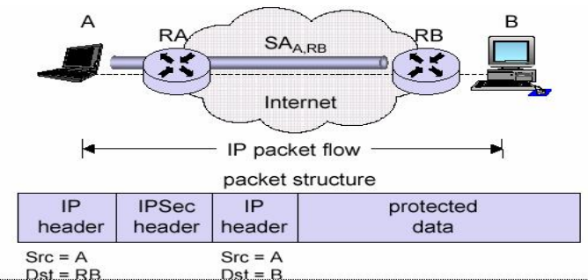
When Is Tunnel Mode Used
Tunnel mode is used when at least one cryptographic endpoint is not a communication endpoint of the secured IP packets.
Outer IP Header – Destination for the router
Inner IP Header – Ultimate Destination

Slide 20
Authentication Header (AH)
Does NOT provide confidentiality
Provides:
Data origin authentication
Connectionless data integrity
May provide:
Non-repudiation (depends on cryptographic alg.)
Anti-replay protection

Slide 21
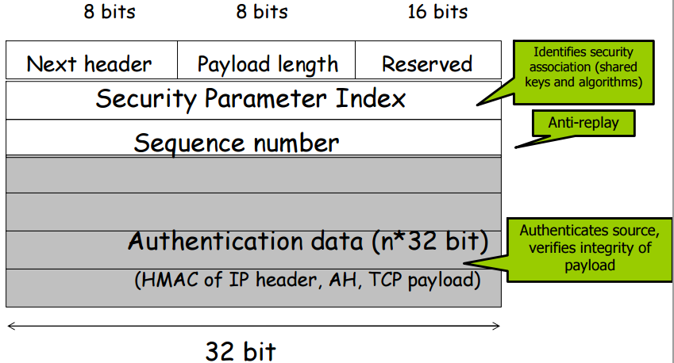
AH Header Format

Slide 22
AH Header Format
Next Header (8 bits): identifies the type of header immediately following this head.
Payload Length (8 bits): Length of Authentication Header in 32-bit words.
Reserved (16 bits): For future use.
Security Parameters Index (32 bits): identifies a security association.
Sequence Number (32 bits): A monotonically increasing counter value, discussed earlier.
Authentication Data (variable): 32*n, contains MAC for this packet.

Slide 23
Authentication Data
Computed by using
authentication algorithm (MD5, SHA-1)
cryptographic key (secret key)
Sender: computes authentication data
Recipient: verifies data

Slide 24
Encapsulating Security Payload (ESP)
Provides:
Confidentiality
Authentication
Optional, not as strong as AH
Limited traffic flow confidentiality (in tunnel mode only)
Anti-replay protection

Slide 25
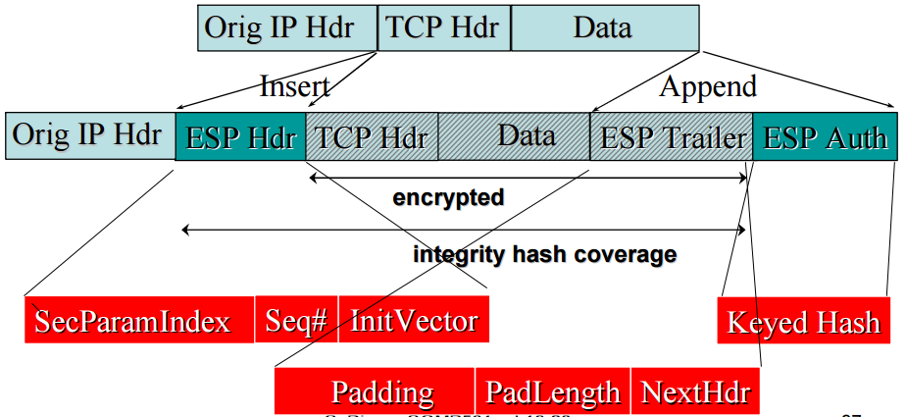
IPSec ESP in Transport Mode

Slide 26
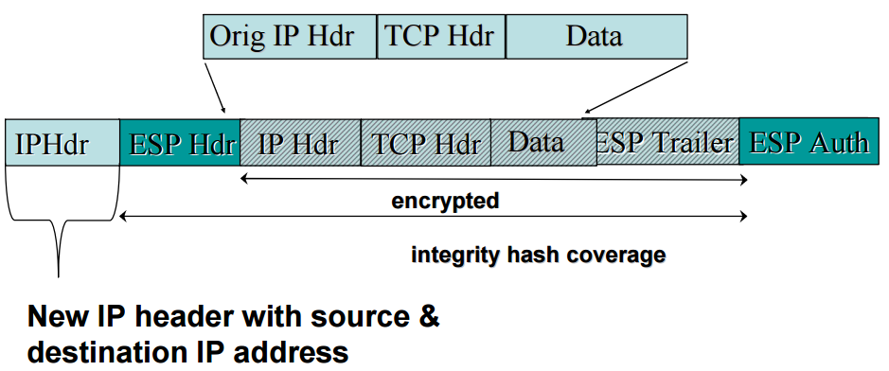
IPSec ESP Tunnel Mode

Slide 27
ESP header and trailer
ESP packet processing:
1. Verify sequence number
2. Verify integrity
3. Decrypt
ESP header: not encrypted (why?)
Contains: SPI and sequence number
ESP trailer: usually encrypted
Contains: padding, length of padding, next protocol

Slide 28
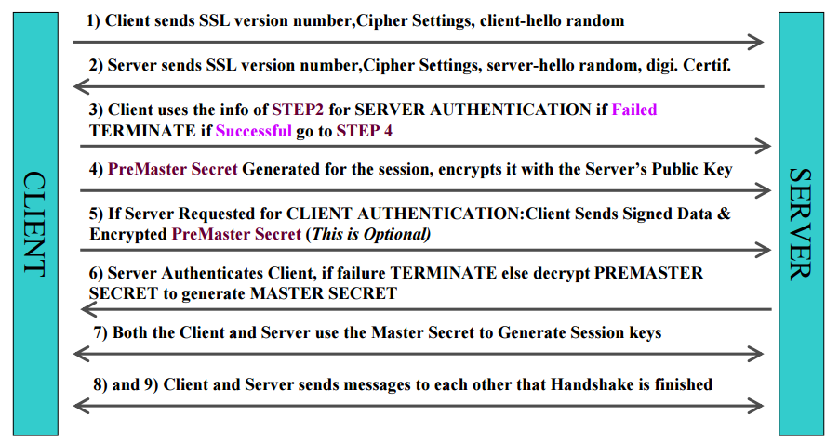
SSL Handshake

Slide 29
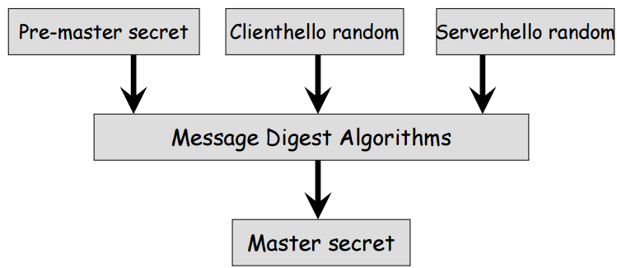
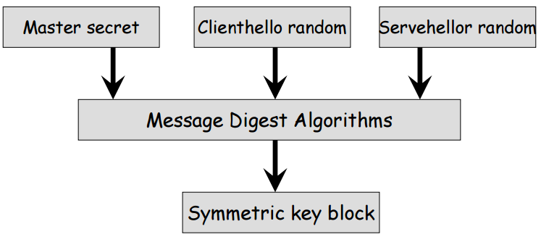
SSL Handshake
Symmetric key block = client write MAC secret, server write MAC secret, client write key, server write key, client write IV, and server write IV

Slide 30
SSL Handshake

Slide 31
Transport Layer Security (Protocol)
Revised version of SSLv3. (RFC5246)
Differences in the:
version number (v3.3)
message authentication code (HMAC)
pseudorandom function (Key generation)
alert codes
cipher suites
client certificate types
certificate_verify and finished message
cryptographic computations
padding

Slide 32
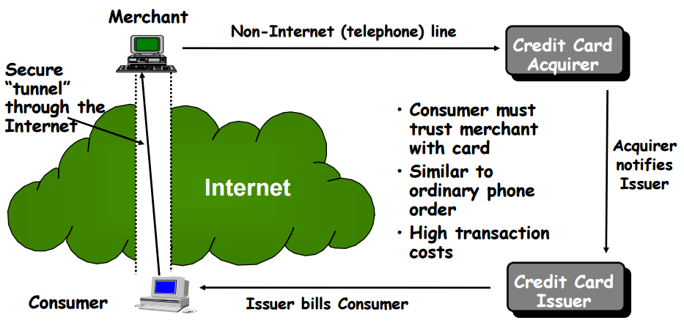
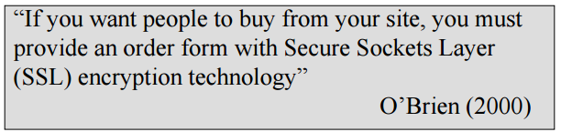
SSL Applications

Slide 33
SSL Applications
https
(HTTP over SSL)
Port 443
Encrypt: URL of the requested document, content of the document, contents of the browser forms, cookies, contents of http hearder
Establish SSL/TLS session before http session

Slide 34
SSL and SSH
Secure shell (SSH)
Secure logon to replace TELNET
SSH (Secure Shell) and SSL (Secure Sockets Layer) can both be used to secure communications across the Internet.
SSL can be bundled with any applications based on TCP, such as SSL+HTTP=HTTPS. Same thing can be done for your own application.
SSH itself is designed as an application that can do a lot of things, e.g. console login, secure file transfers, setting up a secure tunnel between hosts.

Slide 35
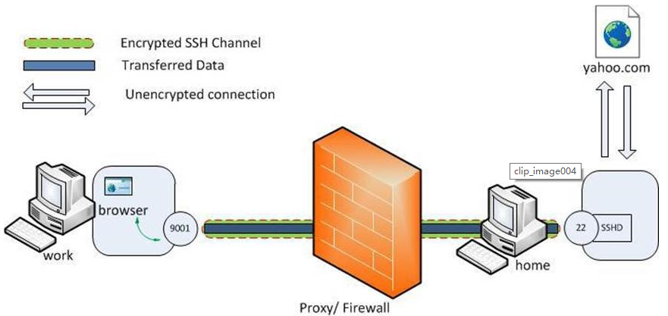
SSH tunneling
Local port forwarding
ssh -L 9001:yahoo.com:80 home
ssh -L <local-port-to-listen>:<remote-host>:<remote-port> <gateway>

Slide 36
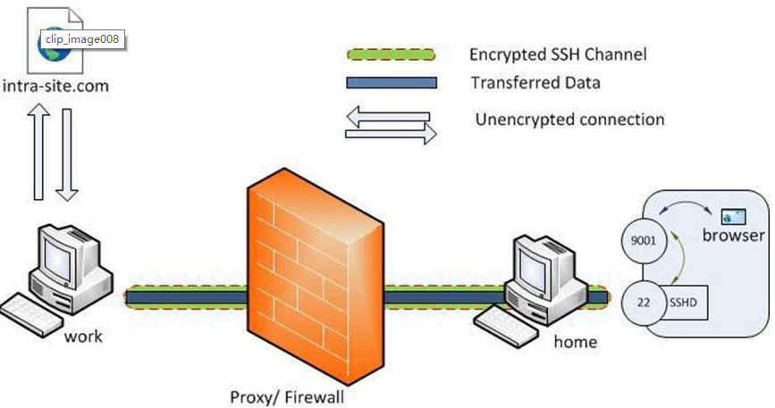
SSH tunneling
Remote port forwarding
ssh -R 9001:intra-site.com:80 home
(Executed from 'work')

Slide 37
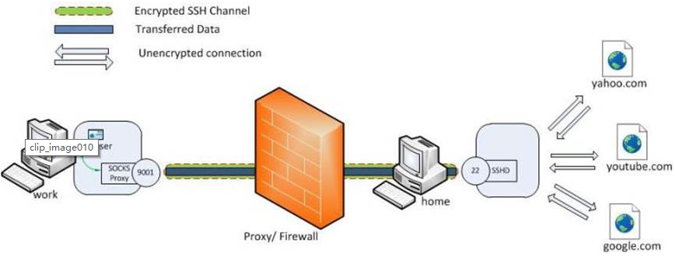
SSH tunneling
Dynamic port forwarding
ssh -D 9001 home
(Executed from 'work')

Slide 38
Recommended Reading
W. Stallings, Cryptography and Network Security, 2nd, 3rd Edition, Prentice Hall
Garfinkel, S., and Spafford, G. Web Security & Commerce. O’Reilly and Associates, 1997
The SSL Protocol Version 3.0 Transport Layer Security Working Group RFC-2246
OpenSSL website: www.openssl.org

