Slide 1
Machine learning 101 Perceptron learning algorithm
Han Xiao
hxiao29@wisc.edu
CEE department

Slide 2
PLA
Your first Machine Learning algorithm!
Objective:
- Understand how to apply PLA in binary classification problem
- Why PLA works

Slide 3
Learn to answer yes/no
Badger football game on next Saturday
Can I ask someone to go with me?
Called binary classification problem in ML

Slide 4
Learn to answer yes/no
Can I date someone on this Saturday?
Unknown target function
f : X → Y
Training examples
(x₁,y₁), (x₂,y₂),…, (x_{n},y_{n})
Final hypothesis
g ≈ f
Algorithm
A
Hypothesis
H
Learning from data, page 4

Slide 5
Learn to answer yes/no
Let me make some analysis!
Based on my previous experience:
- good weather is important
- the temperature should not be too low
- I must feel good to go out
- she/he must agree to go(most important!)

Slide 6
Learn to answer yes/no
Can I date someone on this Saturday?
Weather | Sunny
Temperature | 75 F
Emotion | Good
Does she/he wants to go with me | No ☹
Unknown target function
f : X → Y
Training examples
(x₁,y₁), (x₂,y₂),…, (x_{n},y_{n})
Final hypothesis
g ≈ f
Algorithm
A
Hypothesis
H
Learning from data, page 4

Slide 7
Learn to answer yes/no
Can I date someone on this Saturday?
Weather | Rainy
Temperature | 70 F
Emotion | OK
Does she/he wants to go with me | Yes ☺
Unknown target function
f : X → Y
Training examples
(x₁,y₁), (x₂,y₂),…, (x_{n},y_{n})
Final hypothesis
g ≈ f
Algorithm
A
Hypothesis
H
Learning from data, page 4

Slide 8
Learn to answer yes/no
Can I date someone on this Saturday?
Weather | Snowy
Temperature | -100 F
Emotion | Good
Does she/he wants to go with me | Yes (but I’ll not go…)
Unknown target function
f : X → Y
Training examples
(x₁,y₁), (x₂,y₂),…, (x_{n},y_{n})
Final hypothesis
g ≈ f
Algorithm
A
Hypothesis
H
Learning from data, page 4

Slide 9
Learn to answer yes/no
Which one is important?
Weather/temperature/emotion: have some importance
His/her opinion: very important

Slide 10

Learn to answer yes/no
Try to analyze with -1/+1 to represent good/bad
Use weight factor to represent the importance
weather
$$\sum_{i}{w_{i}x_{i}}+b>0$$
0.9
threshold
temperature
1.2
+
Y = +1 go
-1 not go
1.0
Emotion
3.0
Other’s opinion

Slide 11
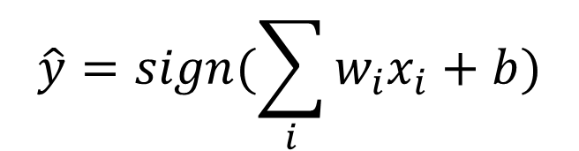
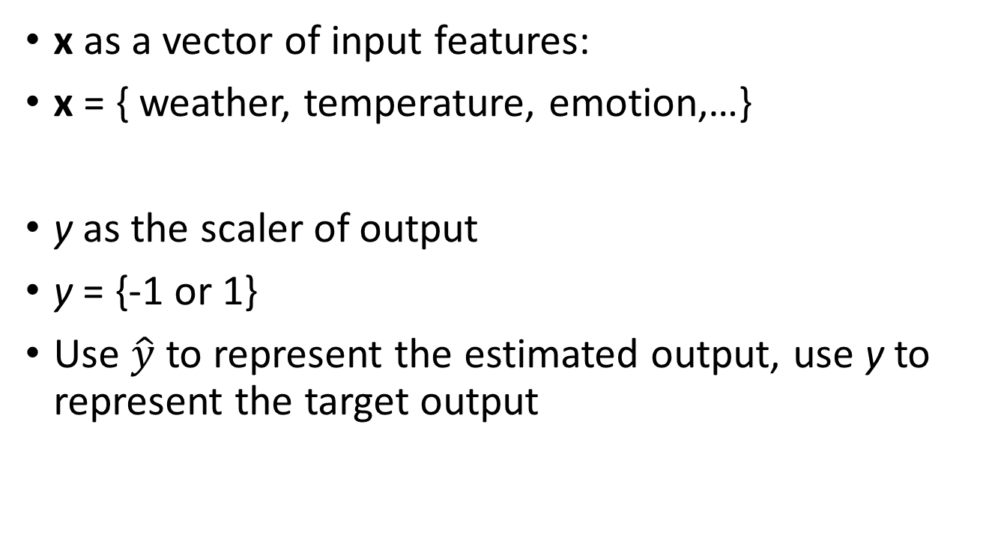
Perceptron
x as a vector of input features:
x = { weather, temperature, emotion,…}
y as the scaler of output
y = {-1 or 1}
Use $\hat{y}$ to represent the estimated output, use y to represent the target output
$$\hat{y}=sign(\sum_{i}{w_{i}x_{i}}+b)$$

Slide 12
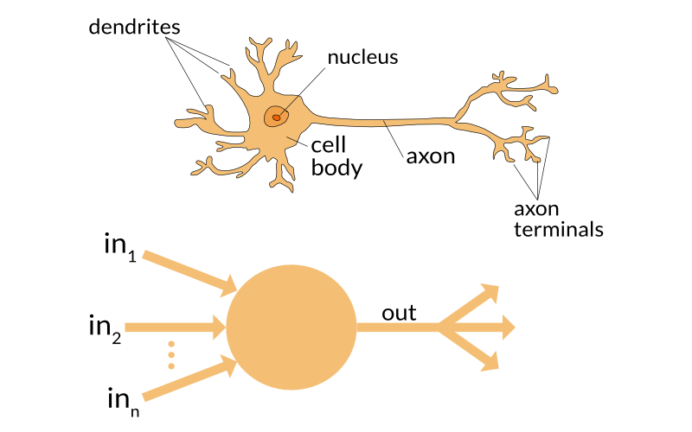





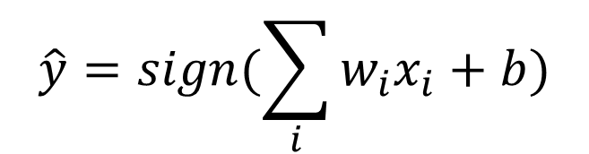


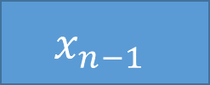

Perceptron
https://appliedgo.net/perceptron/
$$x_{1}$$
$$w_{1}$$
$$x_{2}$$
$$w_{2}$$
b
.
.
.
+
$$\hat{y}$$
$$w_{n−1}$$
$$x_{n−1}$$
$$w_{n}$$
$$\hat{y}=sign(\sum_{i}{w_{i}x_{i}}+b)$$
$$x_{n}$$

Slide 13
Perceptron
-1
+1

Slide 14
Perceptron
Can I date someone on this Saturday?
Unknown target function
f : X → Y
Training examples
(x₁,y₁), (x₂,y₂),…, (x_{n},y_{n})
Final hypothesis
g ≈ f
?
PLA
Previous dating experience
Algorithm
A
Minimize the error in training set
Hypothesis
H
Learning from data, page 4
Perceptron

Slide 15

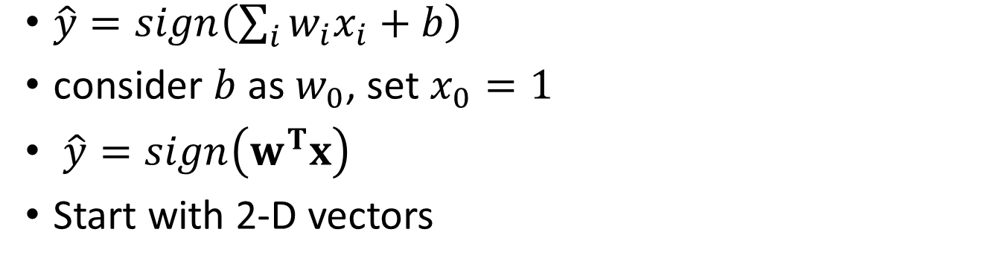

How?
$\hat{y}=sign\left(\sum_{i}{w_{i}x_{i}}+b\right)$
consider $b$ as $w_{0}$, set $x_{0}=1$
$\hat{y}=sign\left(w^{T}x\right)$
Start with 2-D vectors
$$\hat{y}=−1$$
$$\hat{y}=+1$$
w
w
x
x
How to correct the result?

Slide 16
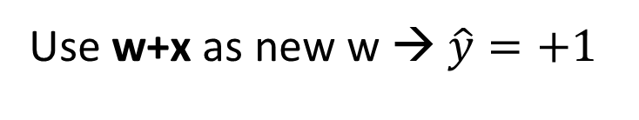
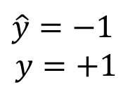

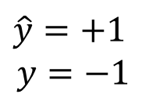
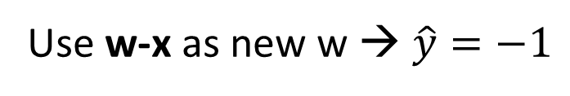
PLA
w + x
$$\hat{y}=−1$$
$$y=+1$$
w
x
Use w+x as new w → $\hat{y}=+1$
w - x
$$\hat{y}=+1$$
$$y=−1$$
w
x
Use w-x as new w → $\hat{y}=−1$
$$w_{t+1}←w_{t}+y_{n}x_{n}$$

Slide 17

PLA
Training PLA:
Step1: initiate a random w₀
Step2:
- Run ${\hat{y}}_{n}=sign\left(w^{T}x_{n}\right)$ for every training data
- Randomly choose one data which ${\hat{y}}_{n}≠y_{n}$
- Update the weight with $w_{t+1}←w_{t}+y_{n}x_{n}$
Step3: run the algorithm until no error exists

Slide 18

PLA
W₀ = 0 , set sign(0) = +1
+
$$x=[1,−0.5,−0.5]$$

Slide 19


PLA
$w_{1}←w_{0}+y_{n}x_{n}$
$w_{1}=[−1, 0.5, 0.5]$
$$x=[1,−0.1,1]$$
-
+

Slide 20


PLA
$w_{2}←w_{1}+y_{n}x_{n}$
$w_{2}=[0, 0.4, 1.5]$
+
$$x=[1,−0.5,0.5]$$
-

Slide 21


PLA
$w_{3}←w_{2}+y_{n}x_{n}$
$w_{3}=[−1, 0.9, 1]$
+
-
$$x=[1,0.3,−0.5]$$

Slide 22

PLA
$w_{4}←w_{3}+y_{n}x_{n}$
$w_{4}=[0, 1.2, 0.5]$
+
DONE!
-

Slide 23
Why PLA works?
MATH ALERT!
For linearly separable data sets, PLA can always find a correct classification hyperplane

Slide 24
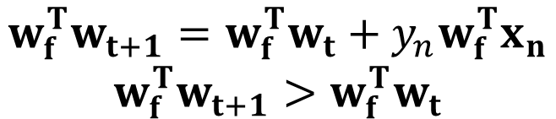
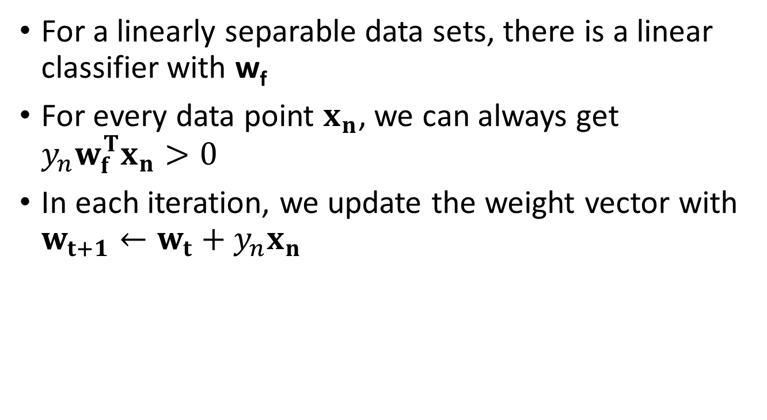
Why PLA works?
For a linearly separable data sets, there is a linear classifier with w_{f}
For every data point $x_{n}$, we can always get $y_{n}w_{f}^{T}x_{n}>0$
In each iteration, we update the weight vector with $w_{t+1}←w_{t}+y_{n}x_{n}$
$$w_{f}^{T}w_{t+1}=w_{f}^{T}w_{t}+y_{n}w_{f}^{T}x_{n}$$
$$w_{f}^{T}w_{t+1}>w_{f}^{T}w_{t}$$

Slide 25
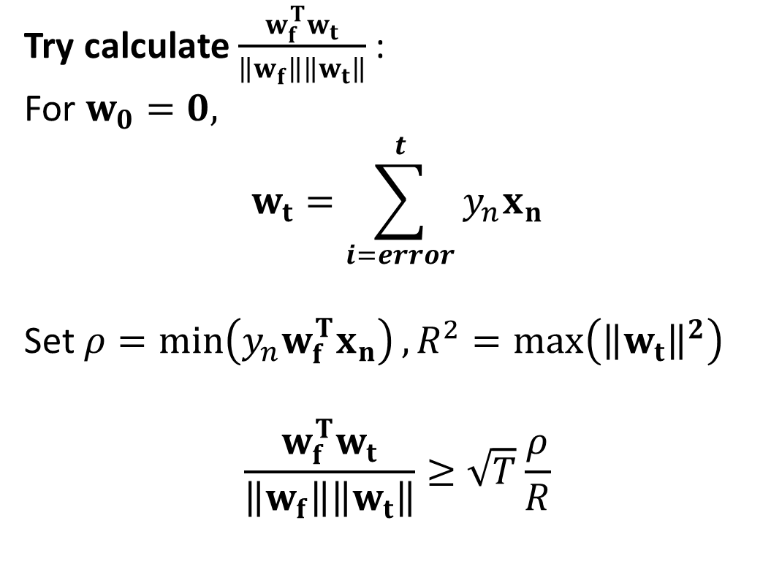
Why PLA works?
Try calculate $\frac{w_{f}^{T}w_{t}}{\left\|w_{f}\right\|\left\|w_{t}\right\|}$ :
For $w_{0}=0,$
$$w_{t}=\sum_{i=error}^{t}{y_{n}x_{n}}$$
Set $ρ=\min\left(y_{n}w_{f}^{T}x_{n}\right), R^{2}=\max\left({\left\|w_{t}\right\|}^{2}\right)$
$$\frac{w_{f}^{T}w_{t}}{\left\|w_{f}\right\|\left\|w_{t}\right\|}≥\sqrt{T}\frac{ρ}{R}$$

Slide 26
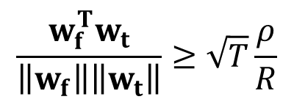
Why PLA works?
$$\frac{w_{f}^{T}w_{t}}{\left\|w_{f}\right\|\left\|w_{t}\right\|}≥\sqrt{T}\frac{ρ}{R}$$
MATH ALERT ENDS
For linearly separable data sets, PLA can always find a correct classification hyperplane

Slide 27
Perceptron
Answer Yes/No
Unknown target function
f : X → Y
Hyperplane as a linear classifier
Training examples
(x₁,y₁), (x₂,y₂),…, (x_{n},y_{n})
Final hypothesis
g ≈ f
PLA
Linear separable data
Algorithm
A
Hypothesis
H
Learning from data, page 4
Perceptron

Slide 28
PLA
Linearly update the weight vector in every loop
Advantage: easy to apply, compute efficiently
Disadvantage: What if our data set is not linearly separable?
+

Slide 29
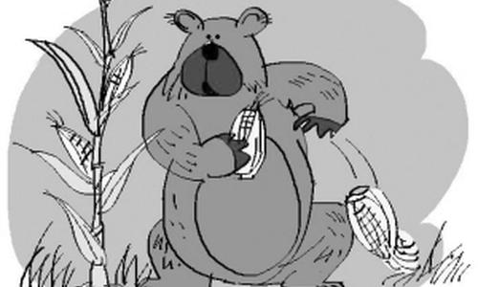
Pocket PLA
Like a bear picking corns: find the best one!
Run PLA for t iterations: remember the minimum amount of error
Repeat the procedure k times: choose the hyperplane with smallest error!

Slide 30

Questions?
Topic of next lecture: linear regression, probabilistic binary classifier

