Slide 1
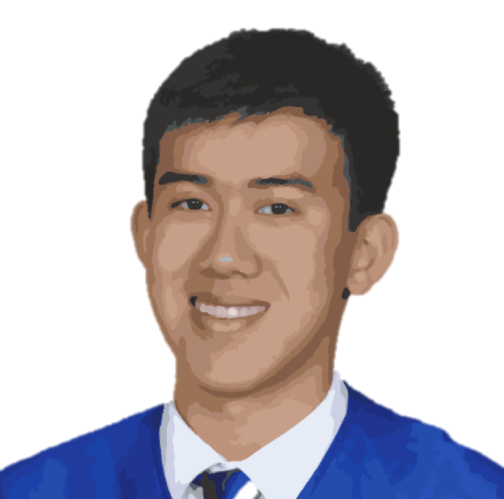
ABOUT ME
I am a first year undergraduate at UC Berkeley looking for a position in front end web development. I am interested in creating and designing a friendly and impactful user experience. I have previous experience working in medium to large groups on planning and executing long term, detail oriented projects.
EDUCATION
UC Berkeley, Class of 2020
B.S. Electrical Engineering and Computer Science
Relevant Courses: CS 61A SCIP, CS 198 Web Design Decal, CS 61B Data Structures (IP)
CSU Dominguez Hills
High School Concurrent Enrollment
Relevant Courses: CS 116 Intro to Computer Hardware & Tools, FIN 360 Business Finance
WILL
WANG
EXPERIENCE
Front End Developer
Gulfstream Aerospace
High School Apprentice, Aug 2015 – June 2016
Worked with the mechanical engineering teams on interior design drawings of G550 and G650 aircraft. Responsibilities included intensive use of AutoCAD, CATIA, and Excel.
Honors: Mach 3 Excellence Award
Experium Science Academy
Laboratory Technician, June 2014 – Aug 2015
SKILLS
Python
Java
HTML / CSS
Javascript
Scheme
Node.JS
Bootstrap
MySQL
Ruby
AutoCAD
Solidworks
inventor
Final Cut Pro
★★★
★★★
★★★
★★★
★★★
★★
★★
★
★
★★★
★★★
★★
★
PROJECTS
Scheme Interpreter
Interactive Interpreter that reads and executes user input in Scheme, a dialect of Lisp. Project is written in Python and focuses on Object Orientated Programming and environments.
pyCalc
Python based graphing calculator that reads, evaluates, and graphs user input. Emphasis on Read-Evalv-Print Loops (REPL) and tree objects.
hantaowang.me
Personal website written in HTML, CSS, and Javascript. Currently in the process of migrating to a server built with Express in Node.JS.
CONTACT
hantaowang.me
hwang97@berkeley.edu
github.com/hantaowang
(310) 293 - 4575
Facebook Analyzer
Python tool that downloads JSON data of a Facebook group and analyzes data trends regarding posters, commenters, likers, and content.

