Slide 1
HANTAO
(WILL) WANG
website: hantaowang.me
github: github.com/hantaowang
email: hwang97@berkeley.edu
cell: (310)-293-4575
Education
UC Berkeley B.S. Electrical Engineering & Computer Science
Aug 2016 – May 2020 Overall GPA: 3.528 Technical GPA: 3.740
Relevant Courses:
CS 61A The Structure and Interpretation of Computer Programs (Python) A
MATH 53 Multivariable Calculus A-
CS 98 Directed Group Studies for Advanced Undergraduates (HTML/CSS/JS) Pass
CS 61B Data Structures (Java) In Progress
MATH 54 Linear Algebra and Differential Equations In Progress
CSU Dominguez Hills Concurrent Enrollment
Jun 2013 – May 2016 Overall GPA: 3.978
Skills
Programming
Applications Languages
Experience
Gulfstream Aerospace High School Intern
Aug 2015 – May 2016
Worked with the mechanical engineering teams on interior design drawings of G550 and G650 aircraft. Responsibilities included intensive use of AutoCAD, CATIA, and Excel.
Lab Technician Experium Science Academy
Jun 2014 – Aug 2014
Python
HTML
CSS
JQuery
Java
Ruby
Scheme
SQL
AutoCAD
Inventor
Solidworks
Final Cut Pro
English
Chinese (Mandarin)
Spanish
Projects
Scheme Interpreter CS 61A, Fall 2016
Interactive Interpreter that reads and executes user input in Scheme, a dialect of Lisp. Project is written in Python and focuses on Object Orientated Programming and environments.
hantaowang.me Personal, Winter 2016
Professional website written in HTML, CSS, and JQuery.
Ruby Blackjack Personal, Winter 2016
Object orientation blackjack game written in Ruby and run in a terminal, complete with a simple AI dealer. Card drawing implementation designed to allow card counting.
pyCalc Personal, Fall 2016
Python based graphing calculator that reads, evaluates, and graphs user input. Emphasis on Read-Evalv-Print Loops (REPL) and tree objects.

Slide 2
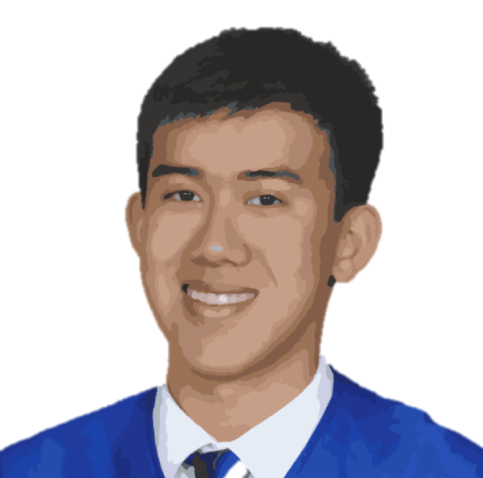
ABOUT ME
I am a first year undergraduate at UC Berkeley looking for a position in front end web development. I am interested in creating and designing a friendly and impactful user experience. I have previous experience working in medium to large groups on planning and executing long term, detail oriented projects.
EDUCATION
UC Berkeley, Class of 2020
B.S. Electrical Engineering and Computer Science
Relevant Courses: CS 61A SCIP, CS 198 Web Design Decal, CS 61B Data Structures (IP)
CSU Dominguez Hills
High School Concurrent Enrollment
Relevant Courses: CS 116 Intro to Computer Hardware & Tools, FIN 360 Business Finance
WILL
WANG
EXPERIENCE
Front End Developer
Gulfstream Aerospace
High School Apprentice, Aug 2015 – June 2016
Worked with the mechanical engineering teams on interior design drawings of G550 and G650 aircraft. Responsibilities included intensive use of AutoCAD, CATIA, and Excel.
Honors: Mach 3 Excellence Award
Experium Science Academy
Laboratory Technician, June 2014 – Aug 2015
SKILLS
Python
Java
HTML / CSS
Javascript
Scheme
Node.JS
Bootstrap
MySQL
Ruby
AutoCAD
Inventor
Solidworks
Final Cut Pro
☆☆☆
☆☆☆
☆☆☆
☆☆☆
☆☆☆
☆☆
☆☆
☆☆
☆
☆☆☆
☆☆☆
☆☆☆
☆
PROJECTS
Scheme Interpreter
Interactive Interpreter that reads and executes user input in Scheme, a dialect of Lisp. Project is written in Python and focuses on Object Orientated Programming and environments.
pyCalc
Python based graphing calculator that reads, evaluates, and graphs user input. Emphasis on Read-Evalv-Print Loops (REPL) and tree objects.
hantaowang.me
Personal website written in HTML, CSS, and Javascript. Currently in the process of migrating to a server built with Express in Node.JS.
CONTACT
hantaowang.me
hwang97@berkeley.edu
github.com/hantaowang
(310) 293 - 4575
ucbmft.com
Analysis of the posts, users, and trends of the cultural phenomenon that is UC Berkeley Memes of Edgy Teens. Uses Facebook’s Graph API and written in Python. Website current in progress with a backend built with Node.JS.

