Slide 1
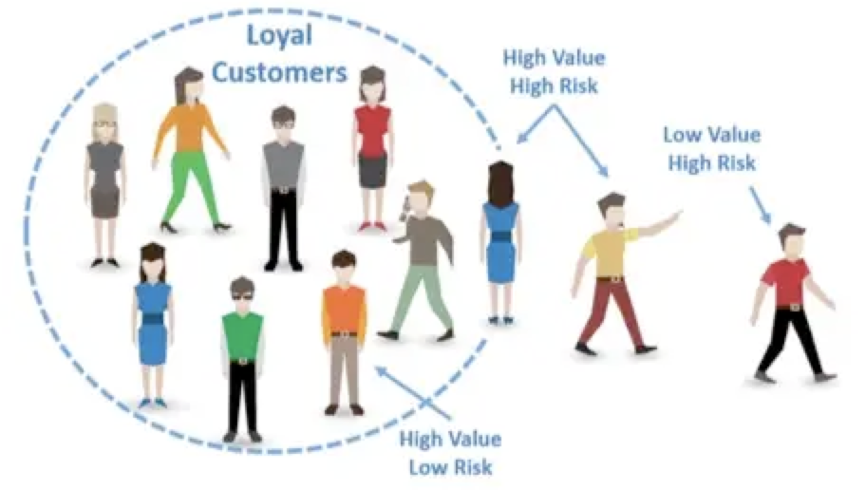
Customer Churn Prediction
MACS30100 Project I
Hantao Xiao, Zihan Zhao, Chunyang Zhang
Video_Link

Slide 2
Overview
Task:
This task is a classification task that aims to predict wether a customer will change their telecommunication provider (a behavior known as churn) given 19 input features
Dataset:
4250 samples
19 features (4 categorical, 15 numerical)
1 labeled target variable "churn" (yes/no)
https://www.kaggle.com/competitions/customer-churn-prediction-2020/overview
Method:
labeled data
filanl goal--to predict whether the cutomer churn or not
Supervised Binary Classification task.
LinearSVC, Decision Tree, Random Forest

Slide 3
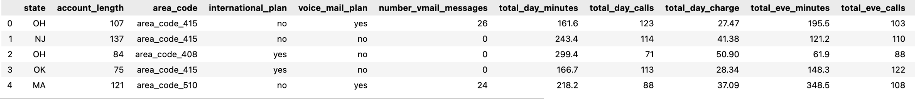
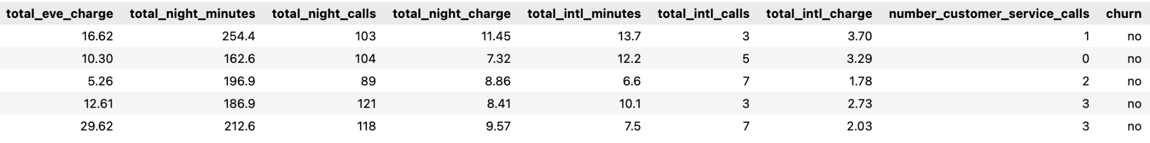
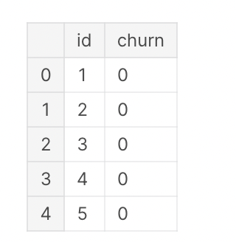
Data Overview:
Input:
Output:

Slide 4
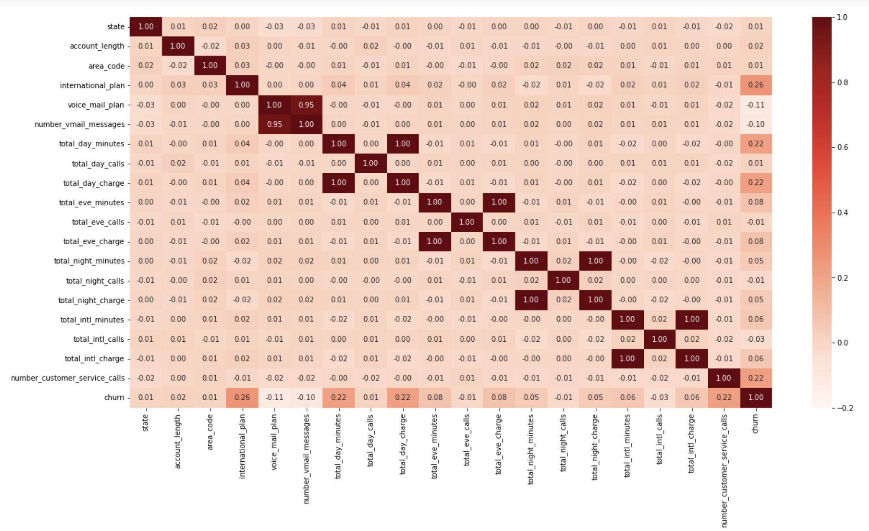
Heatmap

Slide 5
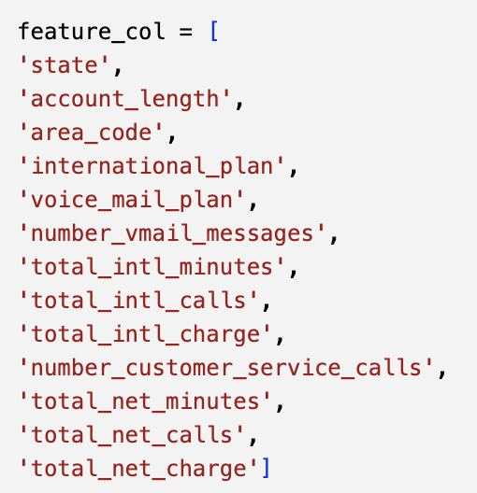
Feature Engineering
Total minutes = day minutes + evening minutes + night minutes
Total calls = day calls + evening calls + night calls
Total charge = day charge + evening charge + night charge

Slide 6
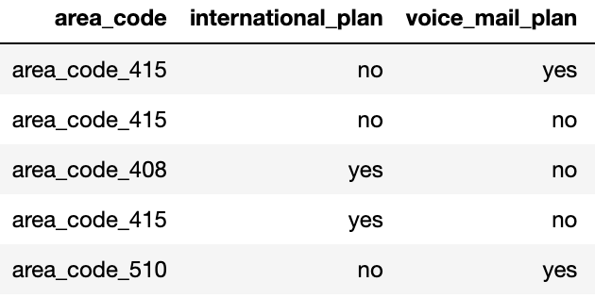
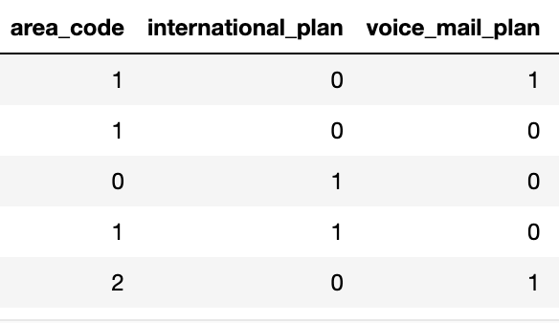
Data Pre-processing
Transformation

Slide 7
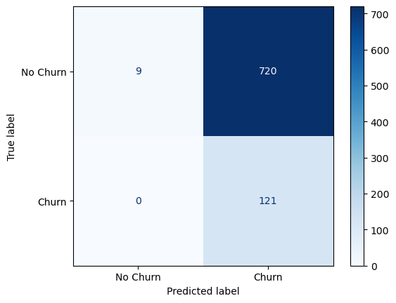
Model
LinearSVC
GridSearchCV function--to find the best parameter in model
accuracy: 0.15
inplement a matrix function to display the accuracy of our model
Notes:
classification task
dataset example is less than linearSVC
A confusion matrix is a table that is used to evaluate the performance of a classifier, by comparing the predicted class labels with the true class labels.
The diagonal cells represent the number of instances that were correctly classified, while the off-diagonal cells represent the number of instances that were misclassified.

Slide 8
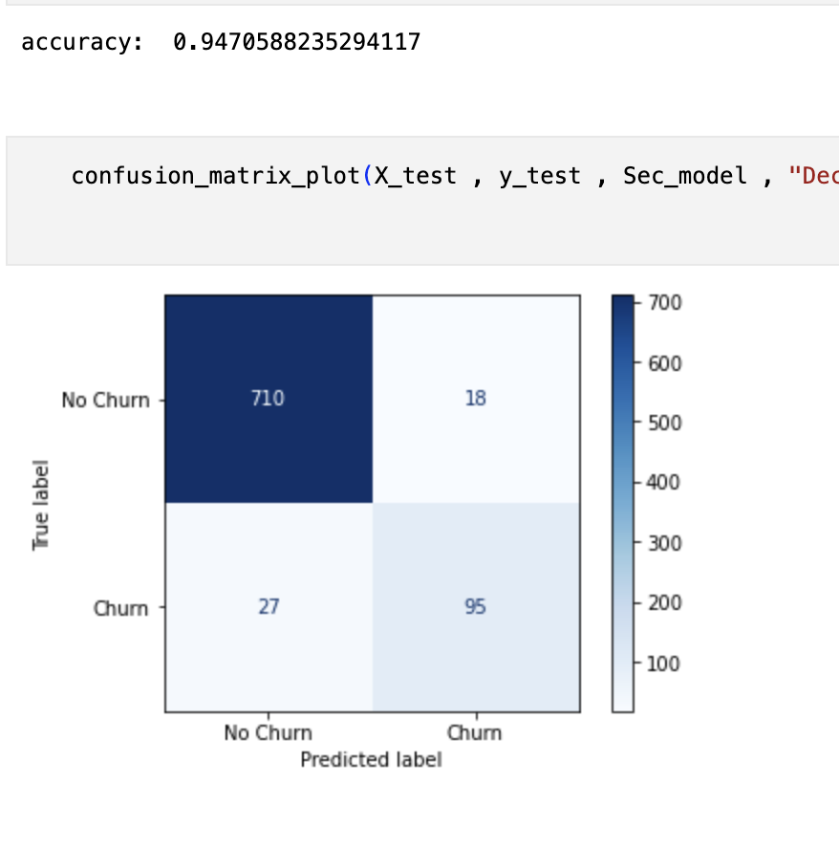
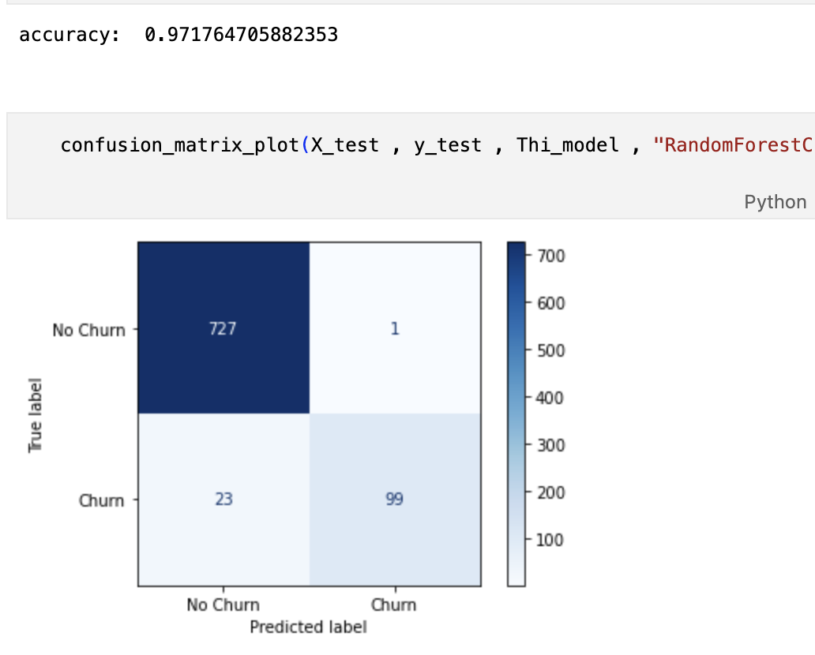
Model
Decision tree
GridSearchCV function
accuracy: 0.95
inplement a matrix function to display the accuracy of our model
Random Forest
GridSearchCV function
accuracy: 0.97
inplement a matrix function to display the accuracy of our model

Slide 9
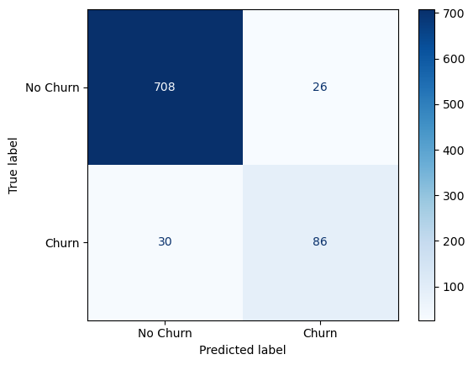
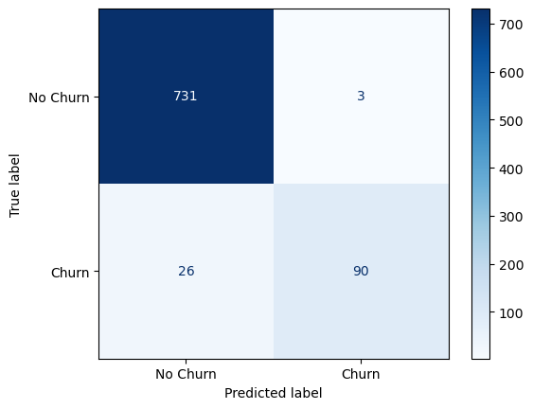
REPLACING THE OUTLIERS
Here is the comparation of the effect of replacing outliner from the dataset, from which we can realize that the accuracy actually decrease 5%. From our standpoint, we believe that it may result from the following reasons:
1. The median value may not accurately represent the underlying data distribution, especially if the data is skewed or has multiple modes.
2. Replacing outliers with the median value can result in loss of important information or patterns in the data that can affect the model's performance.
3. If the outliers are significant, they might be an indicator of important trends or relationships in the data. Replacing them with the median can alter or mask these relationships, leading to less accurate predictions.
ACCURACY: 0.971
ACCURACY: 0.935

Slide 10
Conclusion Future Improvement
LinearSVC, Decison Tree and Random Foreset to train the model first.
Accuracy: Random Foreset > Decison Tree > LinearSVC
The accuracy gets improved without removing outliers.
Use better algorithms. For example, GradientBoostingClassifier.
Add more qulified data
More related features
Ask for professionals suggestions

