Slide 1
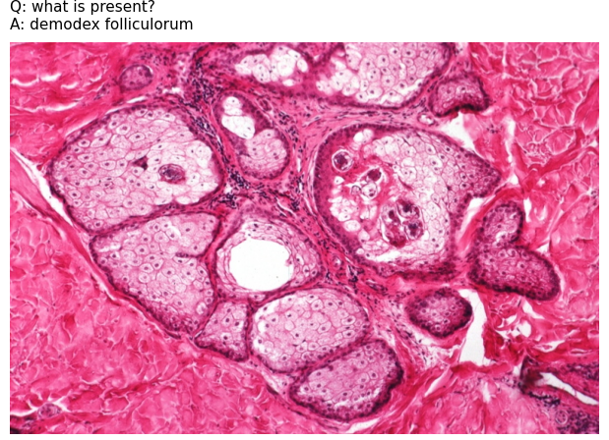

VQA DATA
Question: What is present
Accept
Answer Quality
Anwser:demodex folliculorum
Multimodal LLMs
BLEU-1
ROUGE-L
METEOR
Qwen-2.5
Answer Generation
Rejection threshold
LLaVa
Greedy Answer
Reliability Analysis
K Sampled Answer
ADF Frequency
AUROC
AUPRC
Risk-Coverage
Reject
Prompt Control
MedGemma
Semantic AFD
Q-Aligned Entropy

