Slide 1
Lakelet
Your data fits on your laptop.
Pre-flight check
Memory
Est. time
A local-first lakehouse anyone can ask questions of. It borrows a bigger computer only for the runs that need one.
Runs here
Fits in memory. Costs nothing.
Pre-seed · September 2026
Notes:
Opener. The one-liner is the product: local by default, burst only when needed, on the customer's own cloud account.

Slide 2
Most teams pay by the second for a computer they already own.
A cloud warehouse makes sense at a petabyte. Below a terabyte, a laptop is usually faster, and it doesn't tick.
$745K
$59K–185K
$1,200
average annual Snowflake spend at enterprise tier; $500K for Databricks
what even SMB tiers cost per year, before egress or governance tooling
burned in three weeks by one engineer learning lakehouse patterns on trial credits
The pattern
A team of five with 38 GB of data runs an X-Small warehouse nine hours a day, forgets auto-suspend twice, and pays $4,212 for a month of queries a MacBook would finish in seconds. The bill is not for the data. It is for the meter.
Lakelet
2
Notes:
Cost figures from industry reporting (DataExpert, Medium, Sep 2026). The $4,212 example is illustrative; replace with a design-partner bill before investor meetings.

Slide 3



Three tools hit production maturity within months of each other.
Any two existed before spring 2026. All three together make a laptop lakehouse real, not a demo.
Feb–Apr 2026
May 29, 2026
Aug 26, 2026
Catalogs get simple
DuckDB 1.5.3 ships Iceberg write support
AWS acquires the DuckLabs team
Apache Polaris graduates to a top-level project (Feb 19). DuckLake 1.0 embeds the catalog in SQLite or Postgres (Apr 13). The "which catalog" blocker is gone.
MERGE INTO, ALTER TABLE, partition transforms. Writing Iceberg no longer needs a Spark cluster, which 96% of Iceberg users were running just to write.
DuckDB is now credible enterprise infrastructure, with one million daily downloads. The project stays MIT under the DuckDB Foundation.
Plus dbt Core: Apache 2.0, no seat limits, required in 61% of data engineering job postings. The transformation layer is already standard.
Lakelet
3
Notes:
The timing argument. Investors will ask "why hasn't MotherDuck done this" — the answer is that Iceberg write support only landed in May, and MotherDuck's model is their cloud, not yours.

Slide 4
The computer on your desk is growing faster than your data.
Why rent a warehouse when a laptop holds the whole dataset in memory? Lakelet turns that question into a per-query decision.
Unified memory you can buy for a desk, GB
614 GB/s
memory bandwidth on M5 Max; 1.2 TB/s on M5 Ultra. DuckDB is bandwidth-bound, so this is the number that matters.
MacBook Pro M1 Max · 2021
64 GB
$1,699
Mac mini with M5 Pro and 64 GB. Less than half of one month of the warehouse bill on slide 2.
MacBook Pro M5 Max · 2026
128 GB
NVIDIA DGX Spark · 2025
128 GB
$4,699
DGX Spark: 128 GB unified memory and a petaflop of AI compute in a 1.2 kg box. Local is no longer the small option.
Mac Studio M5 Ultra · 2026
512 GB
10–100 GB
the range where a laptop already beats an X-Small warehouse on latency, per the DataExpert analysis. Most teams under a terabyte live here.
Memory you can buy for a desk, in GB. A 38 GB dataset (the team on slide 2) fits in RAM on the second bar.
Lakelet
4
Notes:
Sources: Apple newsroom (M5 Pro/Max, Mar 2026; Mac Studio M5 Ultra, Aug 2026); NVIDIA DGX Spark price notice (Feb 2026); DataExpert (Sep 2026). The point is not that laptops replace warehouses at a petabyte; it is that below a terabyte the local machine is the faster, cheaper default, and the gauge is what lets a team act on that without guessing.

Slide 5
A $15B market that prices the small team like a large one.
Top-down from analyst reports; bottom-up from what small teams actually pay. Both land in the same place. All figures rounded; estimates marked.
TAM
$15B
Who has the money today
Cloud data warehouse spend, 2026. Three analyst estimates cluster at $14.5–16.5B, growing 21–27% a year to $32–49B by 2030–31.
Snowflake
$4.7B revenue FY26 (+29%), 733 customers over $1M, ~11,000 customers in total. The ~10,000 below $1M are the long tail Lakelet targets.
SAM
~$3B
Databricks
Small and mid-size teams (39% of the market) on workloads under a terabyte (est. half of their spend). Bottom-up: ~100K small data teams × $500–5K/month ⇒ $0.6–6B.
$4.8B run rate (Sep 2025, +55%), expected to pass Snowflake in 2026. Retired its Standard tier in April 2026; entry price went up 20–30%.
SOM
$1.35M → $7M
MotherDuck
Base case 2029 ARR (750 paying teams) to bull case. Under 0.3% of SAM; the plan does not need share to work, it needs the funnel to work.
~$133M raised at ~$496M. Removed the $25 tier in early 2026; free is 10 GB, next step $250/month per org.
The gap: every incumbent has raised its floor in the last 18 months. Lakelet's floor is a laptop.
Lakelet
5
Notes:
TAM sources: Research and Markets ($14.53B 2026 → $31.7B 2030), Mordor ($14.94B → $49.12B 2031), Fortune Business Insights ($16.53B 2026). SME share 39% and 31% SME CAGR from Mordor. Snowflake from the FY2026 10-K and Q4 8-K. Databricks from Sacra. SAM sub-terabyte share is an estimate; say so if asked.

Slide 6



One box. Ask in English or write SQL. The gauge runs first.
Engineers ignore the English; founders ignore the SQL; agents call the same tools over MCP. Nobody is asked which one they are, and nothing runs before the verdict.
Runs here
Ask
daily active users by country, last 90 days
Fits in memory, seconds. Most queries on most teams' data. Free.
SQL · editable
select event_date, country, count(distinct user_id) as dau
from events
where event_date >= current_date - interval 90 day
group by 1, 2 order by 1, 3 desc
Runs here, slowly
Spills to disk or takes minutes. You see the estimate and decide.
Needs more machine
Needs more machine
· 48 GB from s3://acme-data, ~34 min at your 190 Mbps · burst ~1.5 min
One click, a worker in your cloud account, cap shown first.
Burst · ≤ $0.41
Run locally anyway (~34 min)
Simple / Technical switch
The bill for a burst cannot exceed the number on the button. The worker enforces the cap.
Every project is a dbt project under git from the first save. Simple mode calls models "questions," tests "checks," commits "versions." Technical mode shows the DAG, the SQL and the diff. Same files either way.
Lakelet
6
Notes:
Demo the four-minute flow here: drop a CSV, ask, Green, change the question, Red, click, watch the cost. Then flip Simple→Technical to show the dbt model and commit that the non-developer never saw.

Slide 7
Built for people. Agents need it more.
Supabase became the default backend because AI tools provision it on the user's behalf. Lakelet is built to be provisioned the same way, with the guardrail the incumbents lack.
What pulled Supabase to $10.5B
lakelet mcp · one line in Claude Code, Cursor, Codex
Estimate before run
"lakelet": { "command": "lakelet", "args": ["mcp"],
"env": { "LAKELET_AGENT_CAP_USD": "2.00" } }
An agent asks the gauge first. Red comes back as a cost and a time it can reason about, not a bill.
60%+
of new Supabase databases are launched by an AI tool, not a person (June 2026)
tools list_tables · describe · estimate · query · burst(cap) · save_question · lineage
A cap per agent, per day
6×
year-over-year growth in databases, with agents the leading source of new projects
The worker enforces it; the control plane refuses calls past it. A loop cannot overspend.
agent:claude estimate dau_by_country
Red · burst offered · cap $0.41
100K+
apps a day created on Lovable alone, each with a Supabase project owned by the user
Everything in git
agent:claude burst dau_by_country
done · 1 min 12 s · $0.19
Agent-saved questions become dbt models with tests and a commit naming the agent. Review the diff.
agent:claude query top_customers
Green · 1.8 s · $0.00
MCP + API
an MCP server for agents in the loop; a platforms API so builders provision on the user's behalf
Local means local
budget today
$0.19 of $2.00 · 3 calls · 0 refused
Local model + local project: nothing leaves the laptop. The same privacy posture people get.
Then the platforms move: a provisioning API so AI app builders, whose users outgrow their app database and have no warehouse, spin up a lakehouse on the user's laptop with one call and never host it.
Lakelet
7
Notes:
Sources: Supabase "Introducing Supabase for Platforms" (Dec 2025), "Lovable Cloud + Supabase" (Sep 2025), Supabase for Agents page, and June 2026 Series F coverage (60%+ of launches by AI tools, 6x YoY). Lakelet's mcp server is a thin wrapper over the same core: about a week of work in Day 0. The differentiator is not the MCP server, which everyone will have; it is that the gauge and the cap already exist.

Slide 8
Data stays in your bucket. Lakelet's cloud holds metadata only.
One rule from one laptop to a company: files stay in your bucket, the catalog is the only thing that moves, and anything that leaves your machine is something you turned on.
Solo · free
Team · $24 / seat
Self-hosted · from $25K
App, DuckDB, gauge on the laptop
SQLite catalog in the project
Optional: your own S3 bucket
Burst: job spec to Lakelet, worker in your region
Zero network calls until you add a bucket or key
Same catalog, hosted on Postgres
Holds table metadata and roles; vends 15-min prefix-scoped credentials
SQL and dbt models in your git remote
Scheduled runs and compaction on workers in your account
Laptops still run most queries locally
Catalog and control plane in your VPC
SSO from your IdP; audit to your SIEM
Prompts to your own model endpoint
Workers launch in each bucket's region
Lakelet sees a licence and a version
Green: your device or your cloud account. Blue: Lakelet-hosted, metadata only. Your data files are in the green column in every setup.
Lakelet
8
Notes:
This is the MotherDuck contrast and the enterprise answer on one slide. The only row that moves as a customer grows is catalog metadata: laptop → Lakelet → their VPC.

Slide 9
Priced like a tool, not like a meter.
Free locally. Revenue from shared catalogs and from compute customers borrow, with a hard cap per run.
Local
$0
Desktop app and CLI. Editor, dbt runner, lineage, pre-flight check. Bring your own bucket. Open source, forever.
Monthly cost, team of five, 38 GB, 1,240 dbt runs
$4,212
Team
$24 / seat / mo
Shared catalog across laptops. Scheduled runs, compaction, snapshot expiry, freshness and test alerts.
$124
Burst
Cost + 15%
Spot workers sized to the run, on the customer's cloud account. Never idle. Cap agreed before it starts.
Cloud warehouse
Lakelet
Lakelet: $120 Team seats, $3.40 for 9 burst runs, $0.87 of S3.
Lakelet
9
Notes:
Two revenue lines: seats (predictable) and burst margin (scales with data). The bar chart is the receipt from the landing page; swap in a real design-partner bill.

Slide 10
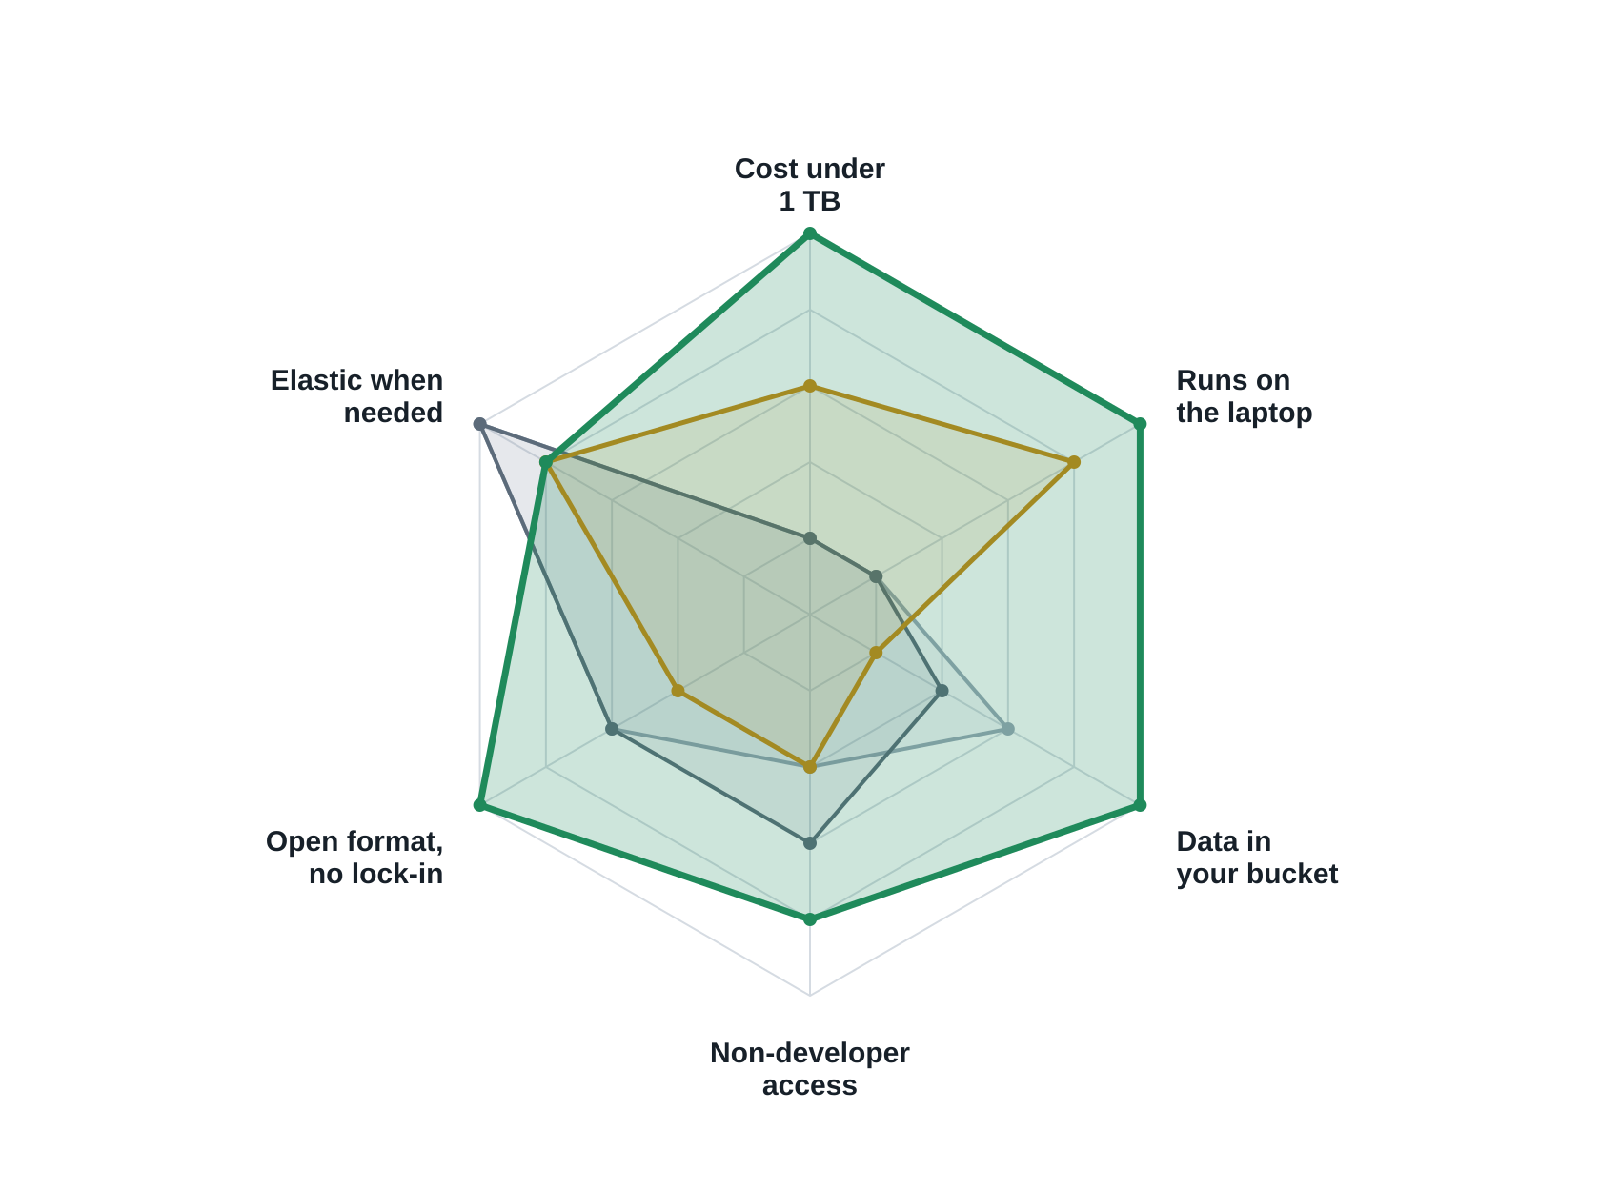
Where the incumbents are weak is exactly where small teams live.
Scored 1–5 by the founding team on six axes a sub-terabyte team cares about. Directional, not measured; the receipt on slide 2 is the measured version of the first axis.
Cost under 1 TB
Lakelet
Warehouses bill by the second whether the data is 38 GB or 38 TB. Lakelet is free at 38 GB.
MotherDuck
Snowflake
Runs on the laptop
Only MotherDuck has a local story, and its hybrid execution decides for you on their cloud.
Databricks
Outer ring = 5. Snowflake and Databricks overlap almost entirely.
Data in your bucket
Iceberg opt-in on Snowflake and Databricks; MotherDuck stores on their side. Lakelet has no other mode.
Non-developer access
Cortex and Genie exist, behind a warehouse contract. Lakelet's ask box ships in the free tier.
Elastic when needed
The one axis the incumbents win outright. Burst narrows it for the runs that matter.
Lakelet
10
Notes:
Who buys: solo DEs and 2–10 person teams under 1 TB paying $3–5K/month first; learners on the free tier second. Biggest risk remains AWS shipping "DuckDB serverless"; moat is the catalog, the calibration data and multi-cloud, not the engine. Scores are the founding team's; invite the investor to move any of them.

Slide 11
Supabase did this for Postgres. Lakelet does it for the warehouse.
Same playbook: an open-source core on a boring standard, free to start, priced like a tool, growing through the developers who learn it first.
 | Supabase | Lakelet
Open standard underneath | Postgres | DuckDB + Apache Iceberg + dbt Core
Closed incumbent it replaces | Firebase | Snowflake and Databricks, below a terabyte
Where your data lives | Your Postgres, exportable any time | Your S3 bucket, readable by any Iceberg engine
Entry price | Free, then $25/mo plus usage | Free, then $24/seat plus burst compute
How it spreads | AI builders provision it for their users; 60%+ of new databases | Agents and app builders provision it via MCP and a platforms API
Where the playbook led
$10.5B
Series F valuation, June 2026, seven months after the Series E
$170M
ARR in May 2026, up from about $101M at end of 2025
250K+
customers on the same free-then-$25 ladder
Nearest in-category comp: MotherDuck, DuckDB on their cloud, ~$133M raised at a ~$496M valuation (May 2025). Lakelet is DuckDB on your bucket, the Supabase-versus-Firebase distinction.
Lakelet
11
Notes:
Supabase figures: $500M Series F at $10.5B post-money led by GIC (June 2026); ARR $170M in May 2026; 250,000+ customers; pricing Free / Pro $25 / Team $599 with compute billed separately. MotherDuck: ~$133M raised, ~$496M valuation at May 2025 extension, no priced Series C announced as of June 2026. Investors will map Lakelet onto Supabase instantly; let them, then point at MotherDuck as proof the category funds and at "your bucket" as the reason we are not MotherDuck.

Slide 12
Four phases. Each one produces the evidence for the next round.
Free is the funnel; seats and burst keep the company alive; the catalog and the calibration data are what compounds.
Day 0 · Sep–Dec 2026
Day 1 · H1 2027
Day 2 · Jul 2027 – Jun 2028
Day 3 · Jul 2028 – Dec 2029
Prove it works
Open-source launch
Team product
Company product
Desktop app + CLI, gauge, local Iceberg, ask box, burst on AWS, MCP server for agents. Ten design partners on real workloads.
One-command install, Apache 2.0 repo, bill calculator, dbt DAG by verdict, Lambda backend.
Hosted catalog, billing, scheduling, split dbt runs, GCP and R2, remote MCP and the platforms API. Revenue starts.
Self-hosted control plane, SSO, audit, SOC 2, connectors, lineage, Rust core.
Pre-seed raised on this
2,000 MAU · 30 teams waitlisted
Seed on ~200 teams, ~$300K ARR
Series A on $1–3M ARR
Base case ARR: $49K end-2027 · $326K end-2028 · $1.35M end-2029, on 1.5–2.5% seat conversion from 8K → 40K → 120K monthly actives. Full assumptions and sources in the financial plan.
Lakelet
12
Notes:
Rounds and phases are the same thing from two sides. Pre-seed is raised on Day 0 evidence: the demo, ten partners, spikes passed, $0 revenue said out loud.

Slide 13
The ask
$1.5M pre-seed to launch Lakelet open source and reach the team product in 18 months.
Dec 2026 · Day 0 done
Jun 2027 · Day 1 done
Jun 2028 · Day 2 done
Ten design partners on real workloads. Gauge within 2× on 80% of runs. Ten bursts under cap. Agents connected over MCP.
Open-source launch. 2,000 monthly actives, 30 teams waitlisted with a real bill.
Team catalog and billing live. ~200 paying teams. First platform provisioning projects. Seed raised.
Use of funds: two engineers now, a third plus developer relations in 2027, cloud credits for burst and calibration, the open-source launch. No sales hire before 2029.
hello@lakelet.dev
Lakelet
13
Notes:
Round size and milestones are placeholders to pressure-test; adjust to actual hiring plan and runway.

