Slide 1
Python Mini Series
🐍

Slide 2
Objectives
Learn some new programming skills over the next 5 weeks
Some potential goals:
Become comfortable, not an expert in Python and its coding environments
Learn what you want to become more fluent in, then explore it on your own or with others
Acquire basic skills to read programmer documentation

Slide 3
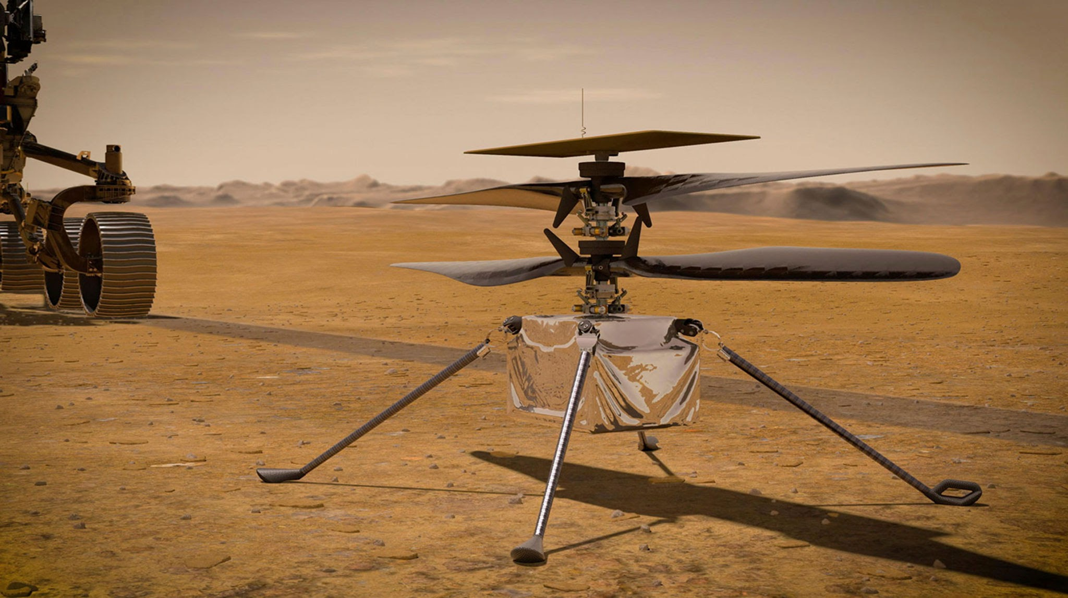
Python and X
Fill in the blank
Python has been there and done it
https://github.com/readme/featured/nasa-ingenuity-helicopter

Slide 4
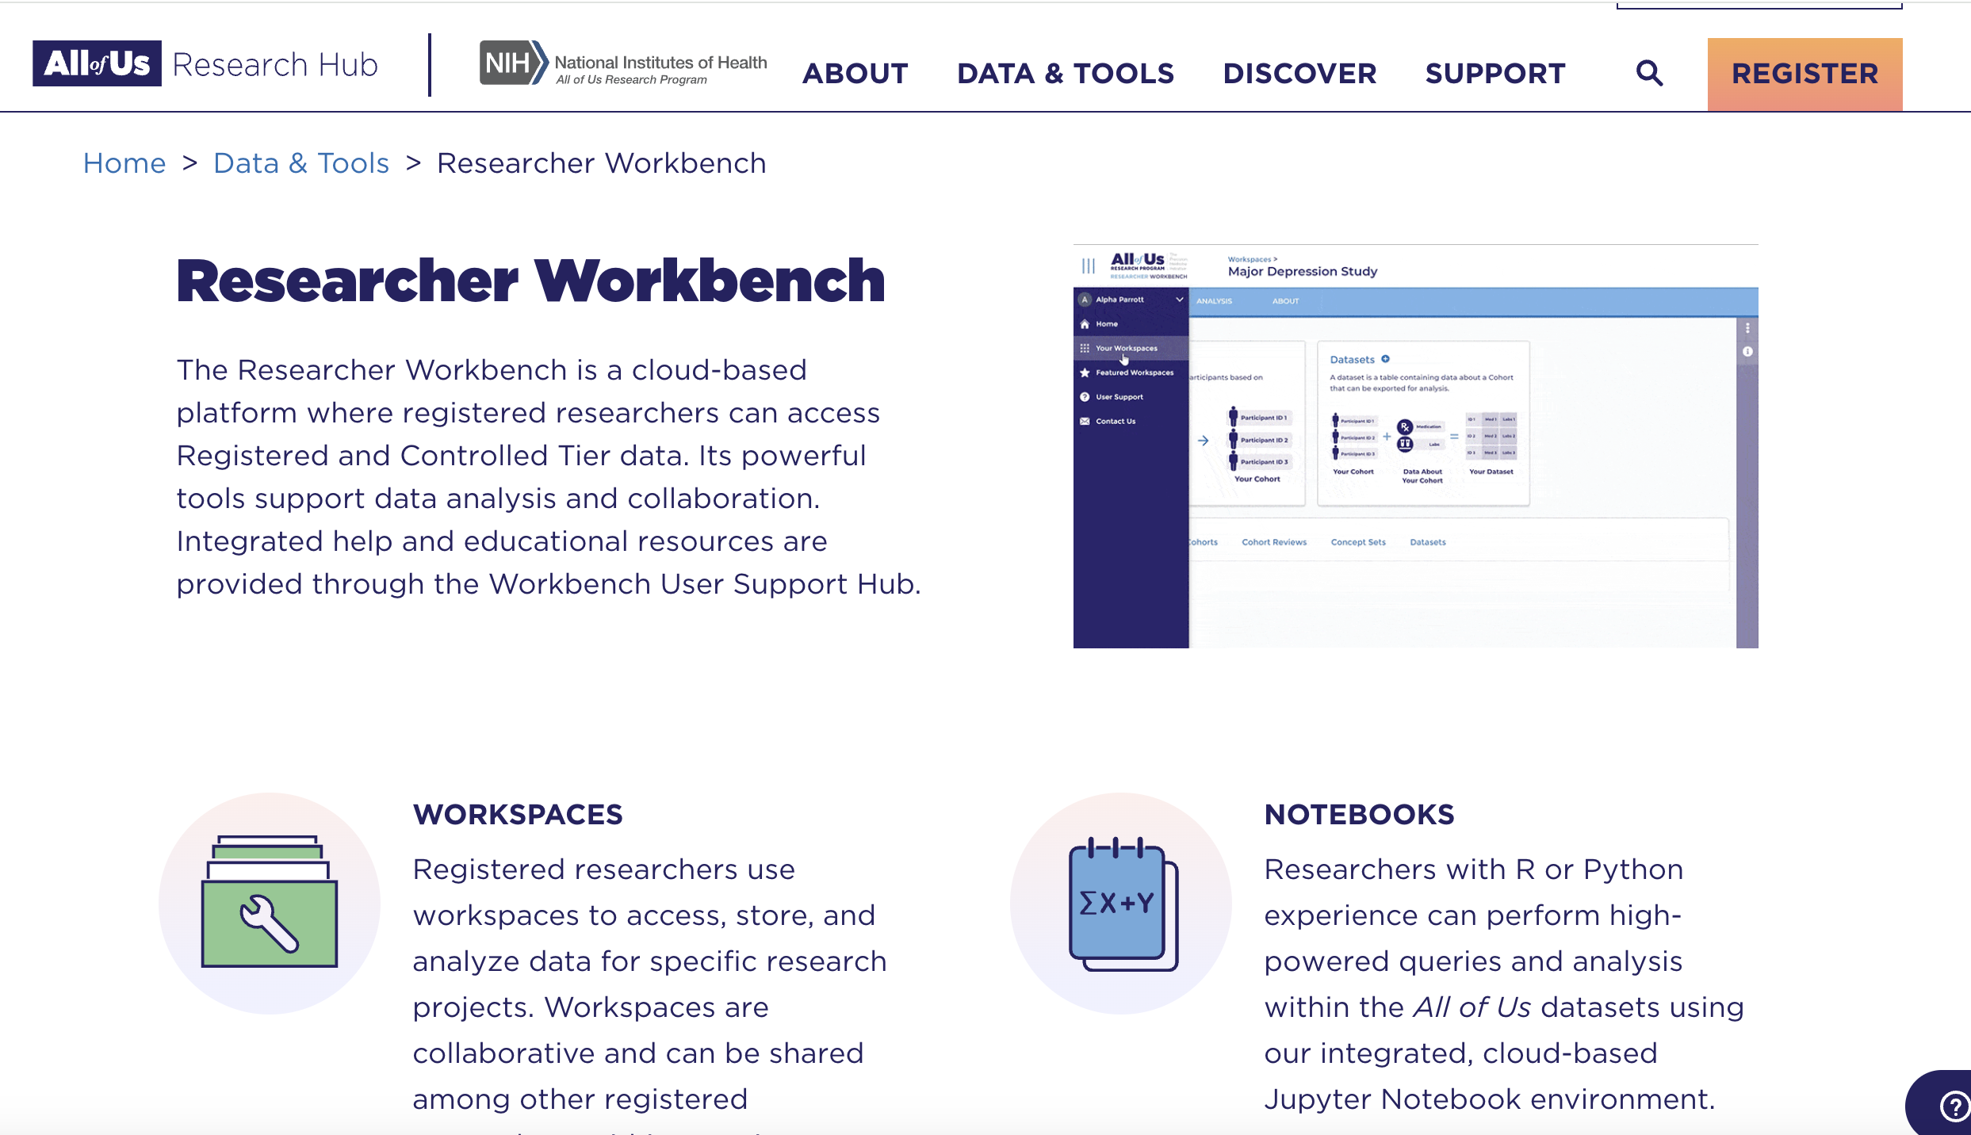
NIH buy in: all-of-us

Slide 5

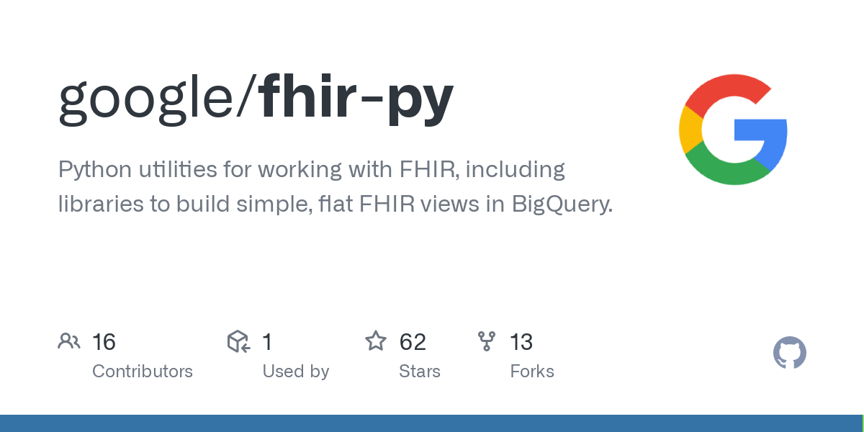

Interoperability / Machine Learning (Ai)

Slide 6



Bioinformatics and Adv. Imaging Analysis

Slide 7

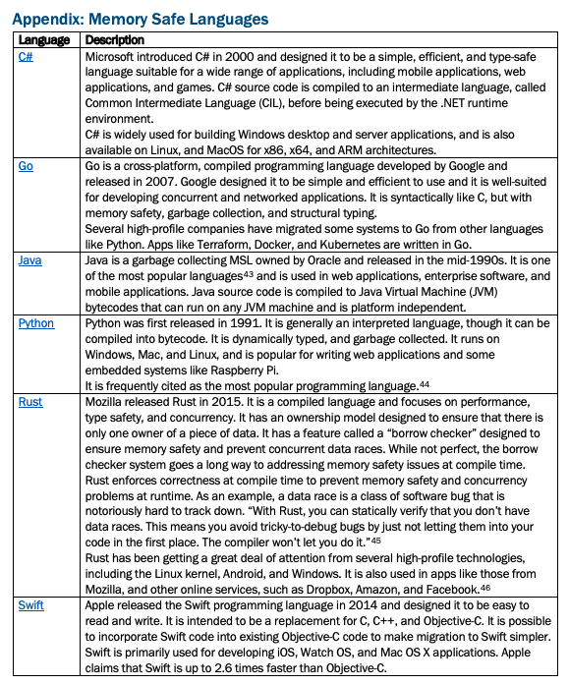
US Government / C-Suite Executives: Memory Safe Language: Recommended by NSA
https://www.cisa.gov/sites/default/files/2023-12/The-Case-for-Memory-Safe-Roadmaps-508c.pdf
https://www.whitehouse.gov/wp-content/uploads/2024/02/Final-ONCD-Technical-Report.pdf

Slide 8
What you get.....independence as a medical research
Superpower = clinical/care provider + some compute
Since gaining knowledge in Python/R/SQL/SAS/Javascript → higher degree of autonomy in the clinical research and non-research questions that I can ask and answer
No need to wait on a biostatistician
Get a quick ‘preliminary’ answer, then work with a biostatistician after to see if you did it correctly

Slide 9
Todays for today (Python + Google)
Python and Linux
Google Colab – Jupyter Notebook (https://colab.research.google.com/)
Google Shell (https://shell.cloud.google.com/ - VS Code + Terminal + Python 3.10
Local (if time) – GitKraken, Python 3.11/12, VS Code

