Slide 1
The Write Stuff: Can Ai Judge Seed Grant Applications
A Comparative Study of LLMs and Prompt Engineering Strategies
Team: Hants Williams, Jack Lamberg, and Eric Lamberg
Institution: Stony Brook University, School of Health Professions
Date: October 14, 2025
Funding: SBU Seed Grant Program
Can LLMs Replace Human Grant Reviewers? | SBU School of Health Professions

Slide 2
Background & Motivation
The Challenge of Grant Review
Grant review is time-intensive and resource-demanding
Requires expertise across multiple evaluation criteria
Inter-rater reliability varies among human reviewers
Growing interest in AI-assisted academic workflows
Research Question:
Can Large Language Models (LLMs) provide reliable grant reviews comparable to human experts?
Can LLMs Replace Human Grant Reviewers? | SBU School of Health Professions
2

Slide 3
Study Design
Dataset:
4 grant applications originally submitted to SBU School of Health Professions Research Seed Grant
Program
1 applicant excluded - withdrew consent for LLM processing (remote or local)
Final dataset: 3 grant applications analyzed
4 human reviewers per application (12 total human reviews)
Multiple LLM models tested (OpenAI GPT, Google Gemini, xAI Grok)
IRB Status:
IRB2025-00534 - Exempt, Non-Human Subjects Research (Stony Brook University)
Can LLMs Replace Human Grant Reviewers? | SBU School of Health Professions
3

Slide 4
Study Design (continued)
Evaluation Criteria (100 points total):
1. Innovation & Impact (30 pts)
2. Methodological Approach & Feasibility (30 pts)
3. Research Team Strength (10 pts)
4. External Funding Potential (10 pts)
5. Budget Clarity (10 pts)
6. Presentation Quality (10 pts)
Can LLMs Replace Human Grant Reviewers? | SBU School of Health Professions
4

Slide 5
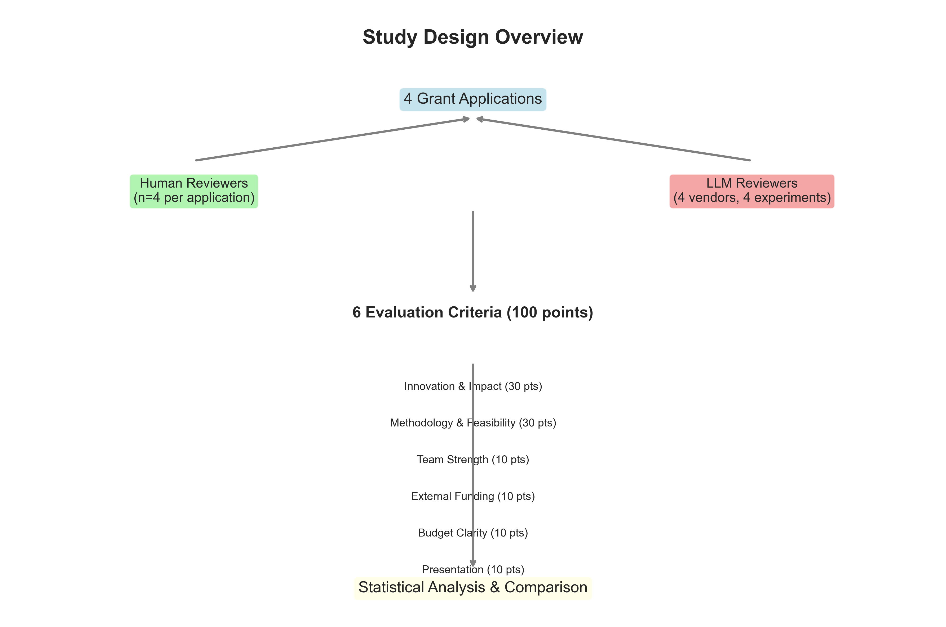
Study Design (continued)
Can LLMs Replace Human Grant Reviewers? | SBU School of Health Professions
5

Slide 6
Prompt Engineering Experiments
Four Experimental Conditions:
1. baseline_v1 - Standard instructions without examples
2. with_training_data_v1 - Single training example (1 complete human review)
3. multi_examples_v1 - Multiple training examples (4 human reviews showing score variance)
4. strict_scoring_v1 - Emphasis on conservative/critical evaluation
Important: Experiments using training data exclude that applicant from analysis to prevent data leakage
Can LLMs Replace Human Grant Reviewers? | SBU School of Health Professions
6

Slide 7
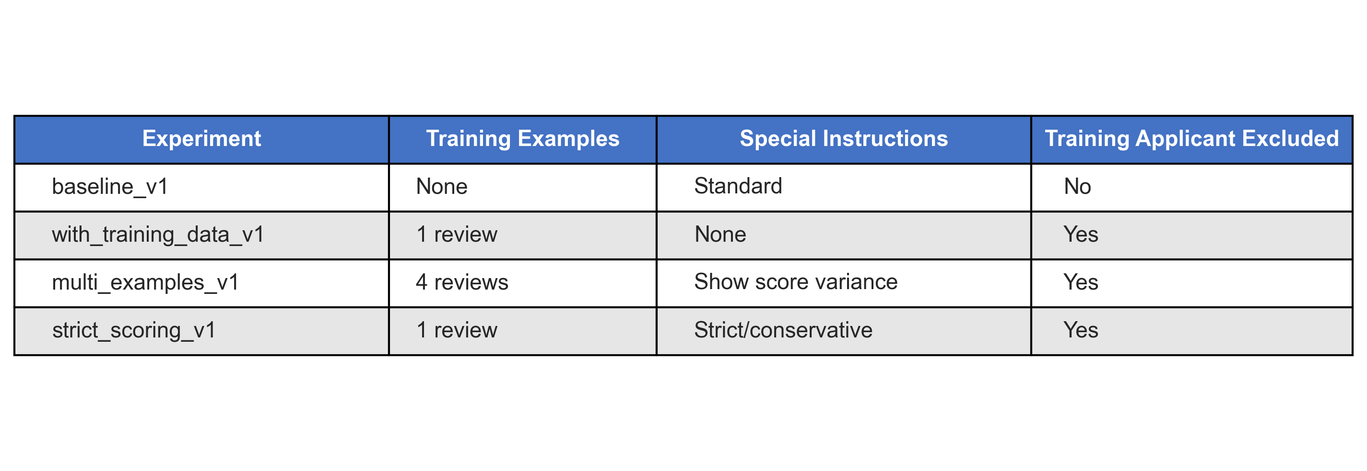
Prompt Engineering Experiments (continued)
Can LLMs Replace Human Grant Reviewers? | SBU School of Health Professions
7

Slide 8
Human vs. LLM Performance Overview
Overall Score Comparison:
Human reviewers (n=12): 79.08 ± 13.32 points
Range: 61-99 points
Median (IQR): 78.5 (24.5)
LLM reviewers (n=108): 79.56 ± 7.14 points
Range: 62-97 points
Median (IQR): 79.0 (10.0)
Can LLMs Replace Human Grant Reviewers? | SBU School of Health Professions
8

Slide 9
Human vs. LLM Performance Overview (continued)
Key Findings:
No significant difference in overall scores (t=-0.196, p=0.845)
Difference: +0.47 points (Cohen's d = 0.04, small effect)
LLMs show lower variability (SD: 7.14 vs 13.32)
Strong rank-order agreement (Spearman ρ=1.0, p<0.001)
Can LLMs Replace Human Grant Reviewers? | SBU School of Health Professions
9

Slide 10
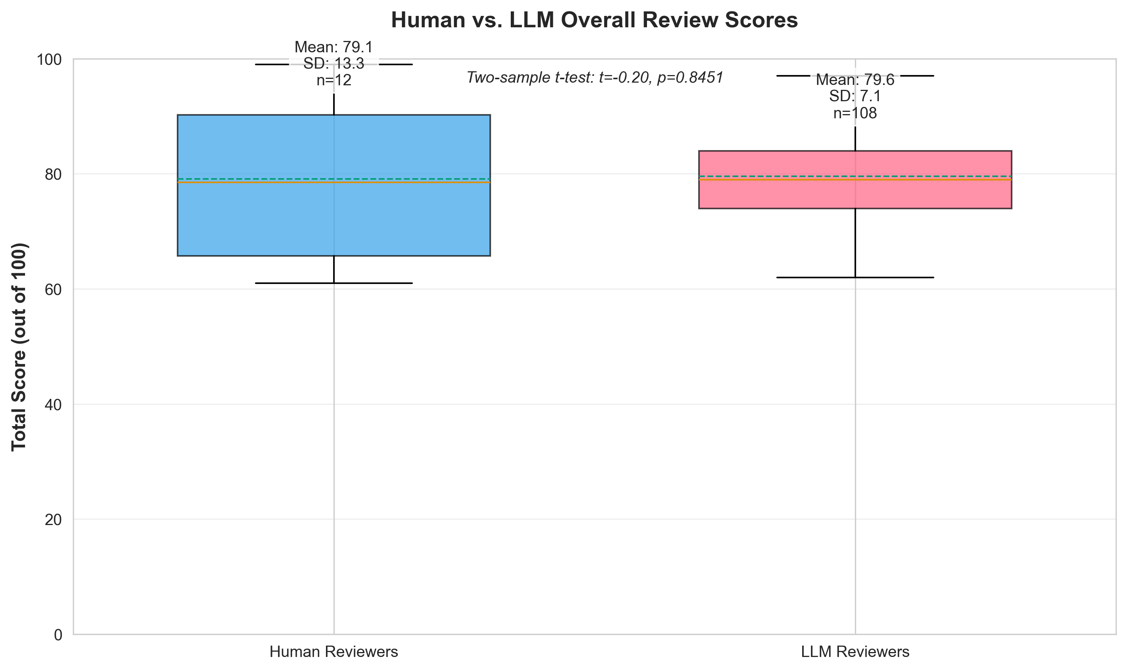
10

Slide 11
Performance by Evaluation Criteria
Criterion
Human %
LLM %
Difference
p-value
Innovation & Impact
84.7%
83.5%
-0.37 pts
ns
Methodology
72.2%
75.4%
+0.96 pts
ns
Team Strength
85.8%
83.1%
-0.27 pts
ns
External Funding
76.7%
83.5%
+0.69 pts
p=0.022
Budget Clarity
83.3%
80.7%
-0.26 pts
ns
Presentation
74.2%
72.2%
-0.19 pts
ns
Key Insights:
Minimal differences across most criteria
LLMs score significantly higher on External Funding potential (p=0.022)
LLMs also score higher on Methodology (+0.96 pts, ns)
No evidence of systematic "LLM optimism" - scores closely match humans
11

Slide 12
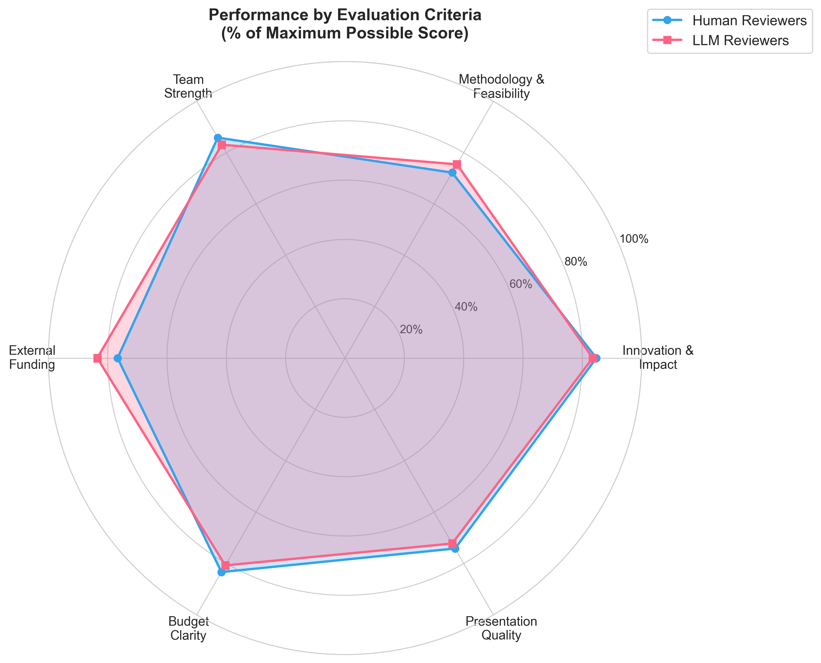
12

Slide 13
Impact of Prompt Engineering
Experiment
Mean ± SD
Diff from Human
n
Baseline (no examples)
83.63 ± 5.75
+4.55 pts
27
Single Example
84.94 ± 6.19
+5.86 pts
18
Multiple Examples (4)
80.56 ± 5.36
+1.47 pts
18
Strict Instructions
72.44 ± 5.34
-6.64 pts
18
Key Findings:
Experiments differ significantly (F=18.44, p<0.001)
Multiple examples achieved best alignment with humans (1.47 pt difference)
Strict instructions led to under-scoring (-6.64 pts)
More examples > single example for calibration
Answer: Yes - training examples (especially multiple) improve LLM-human alignment
Can LLMs Replace Human Grant Reviewers? | SBU School of Health Professions
13

Slide 14
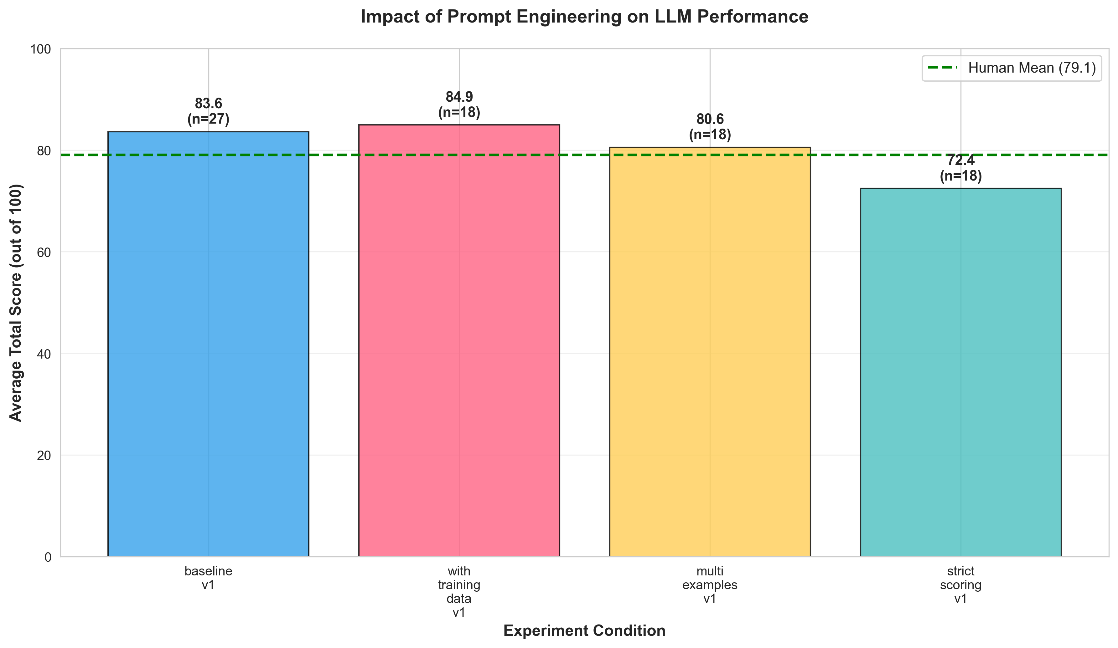
14

Slide 15
Model-Specific Performance
Vendor Comparison (n=48 each):
Rank
Vendor
Mean ± SD
Diff from Human
n
1
xAI (Grok)
79.72 ± 6.54
+0.64 pts
36
2
OpenAI (GPT)
75.44 ± 4.98
-3.64 pts
36
3
Google (Gemini)
83.50 ± 7.41
+4.42 pts
36
Key Insights:
xAI Grok shows best alignment with human reviewers (0.64 pt difference)
Google Gemini tends to score higher than humans (+4.42 pts)
OpenAI GPT scores more conservatively (-3.64 pts)
All models maintain reasonable consistency (SD: 4.98-7.41)
Implication: Model choice matters - xAI Grok most suitable for this application
Can LLMs Replace Human Grant Reviewers? | SBU School of Health Professions
15

Slide 16
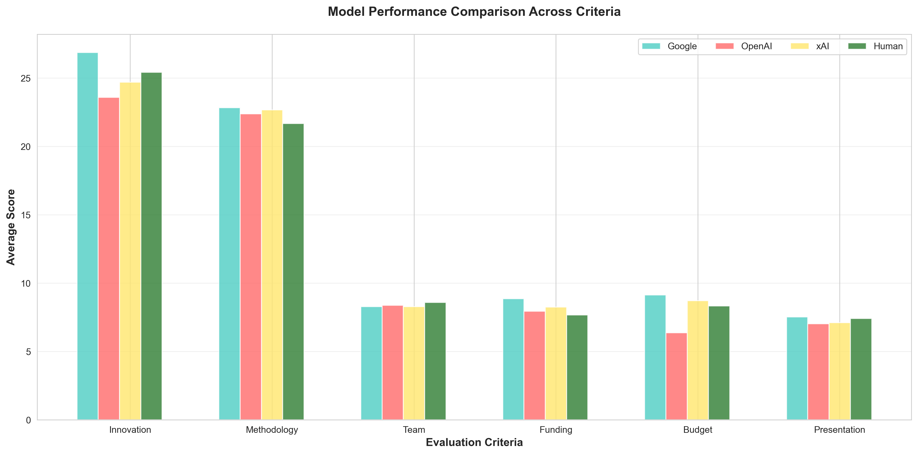
16

Slide 17
Inter-Rater Reliability & Agreement
Consistency Analysis:
Variability (Average SD across applicants):
Human reviewers: 11.37 points; LLM reviewers: 6.94 points
LLMs are 39% more consistent than humans
Human-LLM Score Agreement:
Pearson correlation: r = 0.90 (p=0.283); Spearman correlation: ρ = 1.00 (p<0.001)
Perfect rank-order agreement on applicant scoring
Recommendation Agreement:
LLMs prefer "Fund with Revisions" (61%) vs Human split (42% Do Not Fund, 33% Fund, 25% Revisions)
LLMs more optimistic about revision potential
Can LLMs Replace Human Grant Reviewers? | SBU School of Health Professions
17

Slide 18
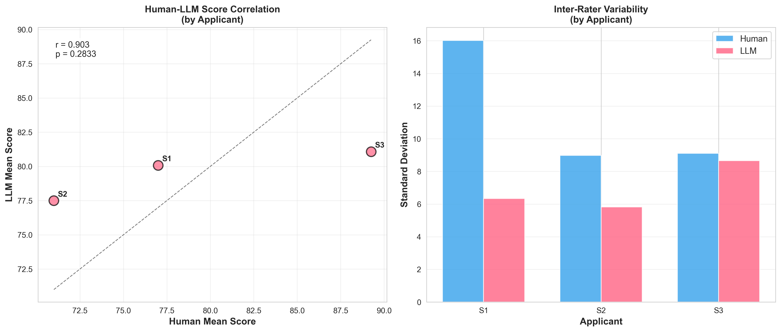
Critical Finding: Strong numerical agreement doesn't guarantee decision alignment
18
Note: Applicants anonymized as S1-S3 to maintain blinding

Slide 19
Conclusions & Implications
Key Takeaways:
1. LLMs can match human scoring accuracy (no significant difference, r=0.91)
But more conservative in recommendations
2. Prompt engineering significantly impacts performance
Multiple training examples optimal for calibration
Strict instructions led to under-scoring
Can LLMs Replace Human Grant Reviewers? | SBU School of Health Professions
19

Slide 20
Conclusions & Implications (continued)
3. Model selection matters
xAI Grok showed best human alignment
5-point spread between best and worst models
4. LLMs offer advantages in consistency
39% lower variability than humans
Reduced inter-rater reliability concerns
Can LLMs Replace Human Grant Reviewers? | SBU School of Health Professions
20

Slide 21
Conclusions & Implications (continued)
Practical Implications:
Where LLMs Can Help:
Initial screening and ranking
Generating detailed feedback
Calibration/norming exercises
Reducing reviewer burden
Where Humans Remain Essential:
Final funding decisions
Nuanced judgment calls
Handling edge cases
Accountability and transparency
Can LLMs Replace Human Grant Reviewers? | SBU School of Health Professions
21

Slide 22
Recommended Approach:
Hybrid system with LLM pre-screening + human final decisions
Can LLMs Replace Human Grant Reviewers? | SBU School of Health Professions
22

Slide 23
Future Directions & Acknowledgments
Next Steps for Research:
1. Expand sample size - Test across multiple grant programs and cycles
2. Hybrid system testing - Evaluate LLM pre-screen + human review workflows
3. Longitudinal validation - Track prediction accuracy for funded projects
4. Bias analysis - Assess for demographic or institutional biases
5. Qualitative analysis - Compare rationale quality and feedback utility
Broader Implications:
Potential for democratizing access to expert review
Reducing time-to-decision in grant administration
Standardization of evaluation criteria
Cost reduction for funding agencies
Can LLMs Replace Human Grant Reviewers? | SBU School of Health Professions
23

Slide 24
Thank You!
Acknowledgments:
SBU School of Health Professions
Human reviewers who participated in this study
Contact & Code:
Email: hants.williams@stonybrook.edu
Can LLMs Replace Human Grant Reviewers? | SBU School of Health Professions
24

Slide 25
Supplementary Slides
Can LLMs Replace Human Grant Reviewers? | SBU School of Health Professions

Slide 26
S1: Detailed Methodology
Database Schema:
Combined reviews table with human and LLM data
Experiment tracking with prompt versions
Criteria-level scoring breakdown
Can LLMs Replace Human Grant Reviewers? | SBU School of Health Professions
26

Slide 27
S1: Detailed Methodology (continued)
LLM API Configurations:
OpenAI: GPT-5-nano (default)
Google: Gemini 2.5 Flash
xAI: Grok-4-fast-reasoning
Statistical Analysis Methods:
Two-sample t-tests for group comparisons
Pearson and Spearman correlations
One-way ANOVA for experiment comparison
Effect sizes (Cohen's d) reported
Can LLMs Replace Human Grant Reviewers? | SBU School of Health Professions
27

Slide 28
S2: Example Review Comparison
Human Review Excerpt (Applicant S1):
"The proposal addresses an important gap in physical therapy education regarding Lyme disease
differential diagnosis. The methodology is sound but lacks detail on sampling strategy. Budget is well-
justified. Recommend funding with minor revisions to strengthen the timeline section."
LLM Review Excerpt (Same Applicant):
"This proposal demonstrates strong innovation in addressing Lyme disease education gaps for physical
therapists. The methodological approach shows promise, though the convenience sampling limits
generalizability. Budget allocation is appropriate and clearly justified. The absence of a detailed timeline is a
significant weakness. Recommendation: Fund with Revisions to address timeline and sampling concerns."
Similarity: Both identify timeline weakness; LLM more detailed
Difference: Human more concise; LLM more structured
Can LLMs Replace Human Grant Reviewers? | SBU School of Health Professions
28

Slide 29
S3: Limitations
Sample Size:
Limited to 3 grant applications (originally 4)
Single institution and program
May not generalize to other grant types or disciplines
Generalizability:
Seed grants may differ from larger federal grants (NIH, NSF)
Health professions context may not extend to other fields
English-only applications
Can LLMs Replace Human Grant Reviewers? | SBU School of Health Professions
29

Slide 30
S3: Limitations (continued)
Technical Limitations:
API costs and access restrictions
Token limits for very long proposals
Model versions subject to change
Design Limitations:
No real-time feedback incorporation
Human reviewers not calibrated using training examples
Recommendation categories may be institution-specific
Can LLMs Replace Human Grant Reviewers? | SBU School of Health Professions
30

Slide 31
S4: Ethical Considerations
Data Privacy & Anonymization:
All applicant data de-identified in public presentations
Grant applications stored securely
IRB approval obtained (not human subject research)
Bias Detection & Mitigation:
No demographic information provided to LLMs
Multiple models tested to identify vendor-specific biases
Training examples selected to represent score range diversity
Can LLMs Replace Human Grant Reviewers? | SBU School of Health Professions
31

Slide 32
S4: Ethical Considerations (continued)
Transparency:
Full prompt disclosure in supplementary materials
Reproducible methodology with open-source code
Clear communication of limitations to stakeholders
Implementation Guidelines:
Recommend human oversight for final decisions
Regular auditing of LLM outputs
Explicit disclosure to applicants if LLMs used in review
Can LLMs Replace Human Grant Reviewers? | SBU School of Health Professions
32

