Slide 1
The Write Stuff: Can Ai Judge
Seed Grant Applications
What We Learned Testing AI as a Grant Reviewer
Hants Williams, PhD, RN, PHN*
Jack E. Lamberg#
Eric M. Lamberg, PT, EdD, CPed*
*School of Health Professions, Stony Brook University
#Binghamton University

Slide 2

The Problem: Grant Review Challenges
Every grant program faces challenges:
- Reviews take time
- Finding qualified reviewers for the topic may be difficult
- Expert reviewers may require compensation
- Delays in getting reviews back
- Incomplete grant reviews
What if Ai could help?

Slide 3

What are LLMs and Gen Ai?
LLM = Large Language Model
Gen Ai = Generative Ai - Ai that creates new content (text, images, etc…)
Think of it like a very advanced autocomplete:
- Autocomplete when texting ("See you at..." → "the meeting")
- LLMs do this but with entire paragraphs and complex reasoning
- They read massive amounts of text and learn patterns

Slide 4



What are LLMs and Gen Ai?
How Generative AI works:
- Trained on billions of documents (books, articles, websites)
- Generates original responses based on what it learned
- Allows it to read and analyze new documents it's never seen before
Examples you might know:
- Open AI’s ChatGPT, Google’s Gemini, X AI’s Grok

Slide 5

What we tested: Can LLMs review grants "like" a human expert?

Slide 6

Our study: A simple test

Slide 7
Our study: A simple test
Scoring criteria (100 points total):
      - Innovation & Impact (30 pts)
      - Research Methods (30 pts)
      - Team Qualifications (10 pts)
      - Funding Potential (10 pts)
      - Budget (10 pts)
      - Writing Quality (10 pts)
Along with a final question: Fund, Fund with Revisions, or Do Not Fund
Then we compared: Do AI and humans agree?

Slide 8
Our study: A simple test
We received 4 seed grant applications
IRB approval received as an exempt study
3 investigator 1 investigator group did not provide consent
3 LLMs: Open AI’s ChatGPT, X’s (Twitter) Grok, and Google’s Gemeni
We gave 3 grant applicants to:
- 3 grants w/ 4 human expert reviewers (12 total)
- 3 grants w/ 3 LLMs w/tested x4 times – we did 3 prompt experiments = 144
Then we compared: Do AI and humans agree?

Slide 9
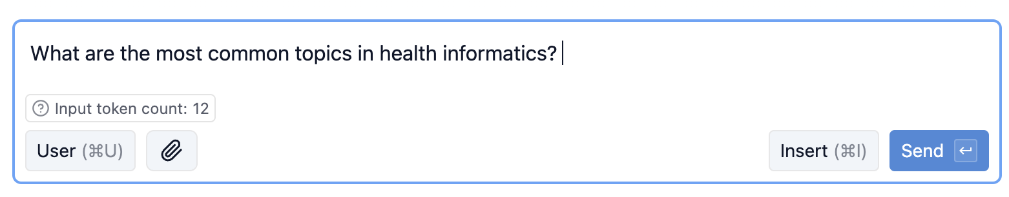
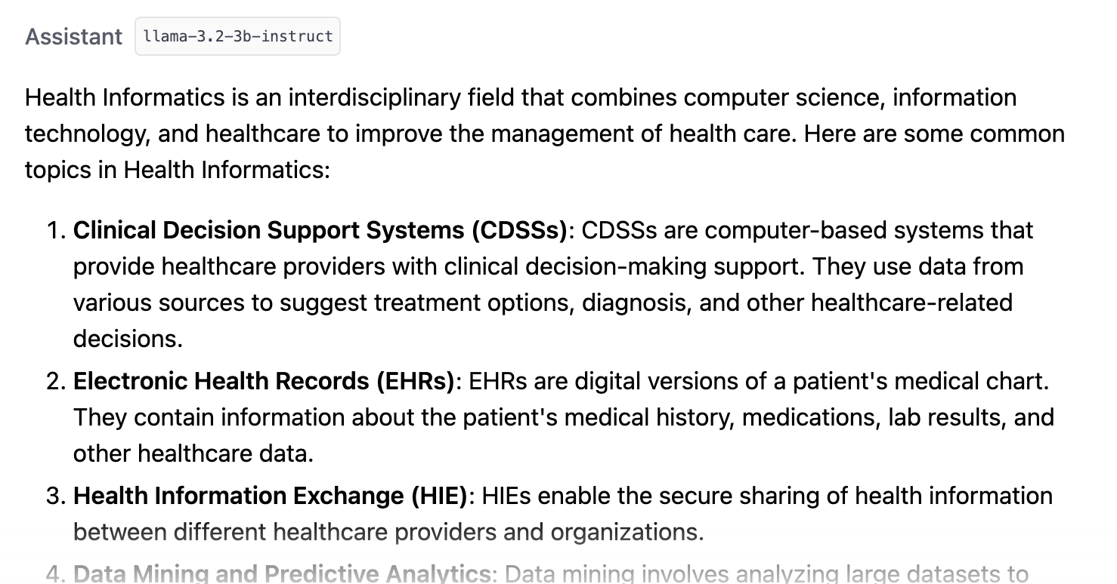
Simple Prompt:

Slide 10
LLM Prompt:
Give detailed instructions to LLM like how you would to a human:
You are an expert grant reviewer assessing a School of Health Professions Research Seed Grant application. Instructions - Evaluate the application against the six criteria listed below. - Assign a numeric score as a whole integer for each criterion based on the scoring scale. - Use the same definitions and point ranges as human reviewers. - Provide 2–3 sentences of rationale for each score. - Conclude with an Overall Recommendation: “Fund”, “Fund with Revisions”, or “Do Not Fund.”
Scoring Scale (Whole Integers Only) - Exemplary (Full Points Range) – Fully meets and exceeds expectations; compelling evidence for success. - Adequate (Upper-Mid Range) – Meets most expectations; minor gaps. - Minimal Evidence (Mid-Lower Range) – Major gaps; insufficient support. - Insufficient Evidence (Lowest Range) – Does not meet expectations; unclear or unsupported. Criteria with Specific Point Ranges IMPORTANT: Each criterion has different maximum points. Follow the exact ranges below: 1. Innovation and Impact (Why & What) – Maximum 30 points - Novelty, originality, significance, and potential to create meaningful change - Exemplary: 27-30, Adequate: 21-26, Minimal: 15-20, Insufficient: 0-14 2. Methodological Approach and Feasibility (How & When) – Maximum 30 points - Quality, rigor, appropriateness, feasibility, and risk management - Exemplary: 27-30, Adequate: 21-26, Minimal: 15-20, Insufficient: 0-14 3. Strength of Research Team (Who) – Maximum 10 points - Qualifications, track record, and fit to project - Exemplary: 9-10, Adequate: 7-8, Minimal: 5-6, Insufficient: 0-4 4. Potential to Attract External Funding – Maximum 10 points - Likelihood to lead to competitive grants and alignment with funders - Exemplary: 9-10, Adequate: 7-8, Minimal: 5-6, Insufficient: 0-4 5. Clarity and Efficiency of Budget – Maximum 10 points - Alignment of spending to aims, cost-effectiveness, and eligibility - Exemplary: 9-10, Adequate: 7-8, Minimal: 5-6, Insufficient: 0-4 6. Overall Presentation (Writing, Clarity, Flow) – Maximum 10 points - Quality of writing, organization, and ease of comprehension - Exemplary: 9-10, Adequate: 7-8, Minimal: 5-6, Insufficient: 0-4
Total Maximum Score: 100 points Output Format (JSON Example) ```json { "scores": [ { "Criterion": "Innovation and Impact", "Score": 29, "Rationale": "The proposal introduces a novel approach to addressing clinical workflow inefficiencies, with a clear rationale for impact. Potential for significant advancement is high." }, { "Criterion": "Methodological Approach and Feasibility", "Score": 27, "Rationale": "The methods are well-aligned with the aims and supported by a clear, realistic timeline. Some contingencies could be more detailed." }, { "Criterion": "Strength of Research Team", "Score": 8, "Rationale": "The team has relevant expertise but could benefit from additional specialized skills in data analysis." }, { "Criterion": "Potential to Attract External Funding", "Score": 9, "Rationale": "Strong alignment with NIH priorities and clear pathway to larger studies make this highly competitive for external funding." }, { "Criterion": "Clarity and Efficiency of Budget", "Score": 10, "Rationale": "Budget is well-justified, cost-effective, and directly supports the proposed aims without unnecessary expenses." }, { "Criterion": "Overall Presentation (Writing, Clarity, Flow)", "Score": 7, "Rationale": "Well-written and organized overall, though some sections could be clearer in their presentation." } ], "OverallRecommendation": "Fund" } ```

Slide 11
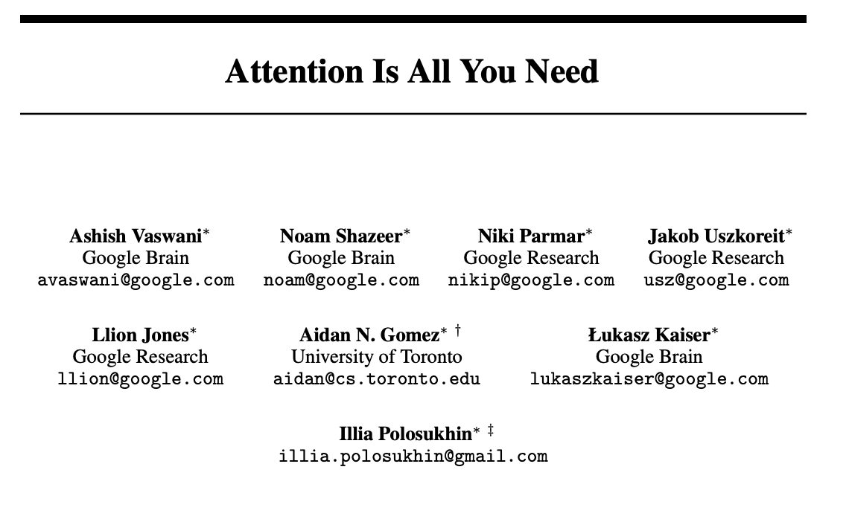
Context (attention) is all that matters
Google, 2017
(Oct 2025: 198k+) One of the top cited papers of the 21st century: https://www.nature.com/articles/d41586-025-01125-9

Slide 12
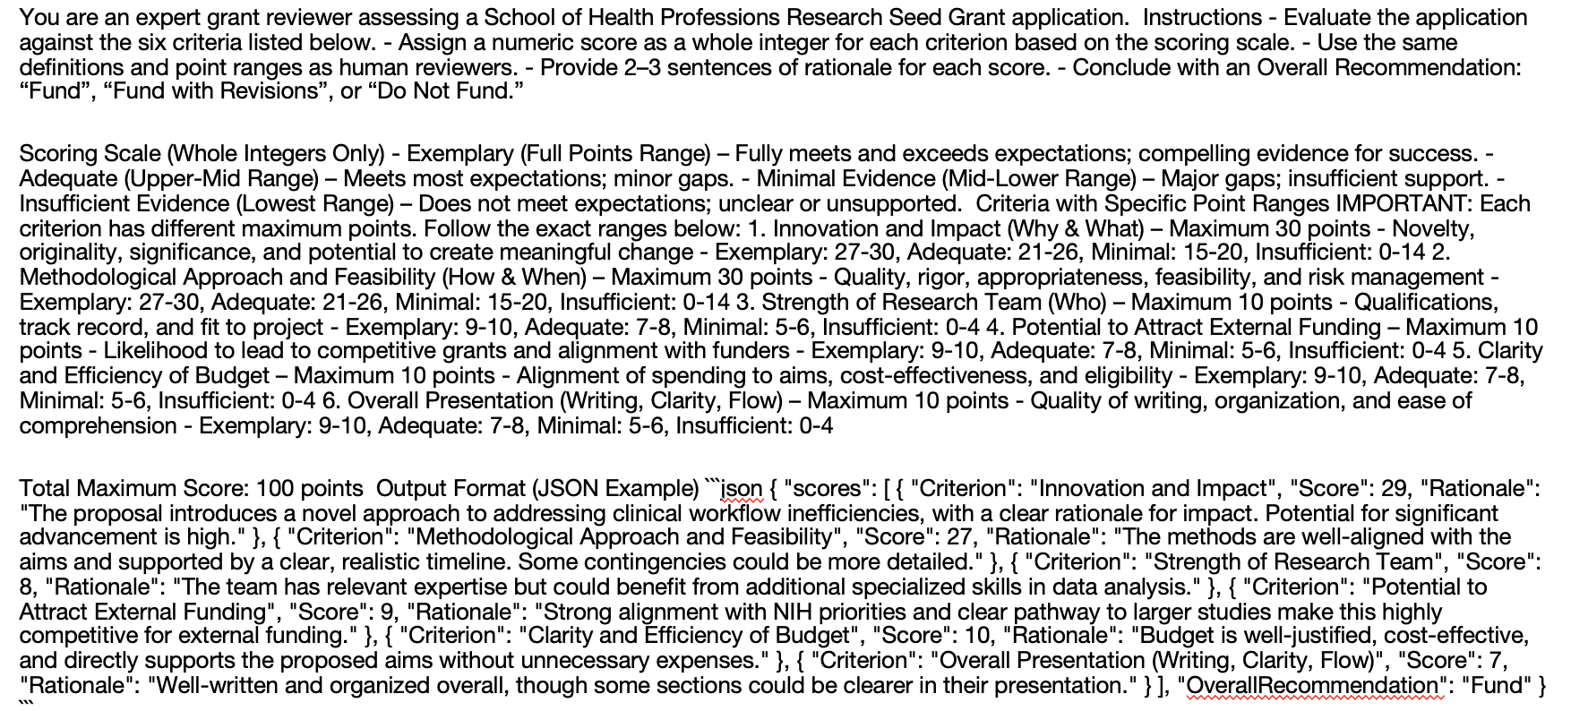


When we put it into the LLM:
Base prompt
Grant Application
Output
Scores & Qualitative Assessment

Slide 13
4 Experiments
Assumption: inclusion of training data & prompt matters
Experiment 1: baseline - no ‘training data provided to prompt
Experiment 2: trained w/ 1 human reviewer example for applicant A
Experiment 3: trained w/ 4 human diff. reviewer examples for applicant A
Experiment 4: experiment 2 + updated prompt to ”be stricter”
Notes:
2. Trained using 1 human example review → AI scored 5.9 points higher
3. Trained using 4 human example reviews → AI scored only 1.5 points higher
4. No training, but told AI to be stricter

Slide 14
Experiment 1 – Baseline Prompt Only
Notes:
2. Trained using 1 human example review → AI scored 5.9 points higher
3. Trained using 4 human example reviews → AI scored only 1.5 points higher
4. No training, but told AI to be stricter

Slide 15
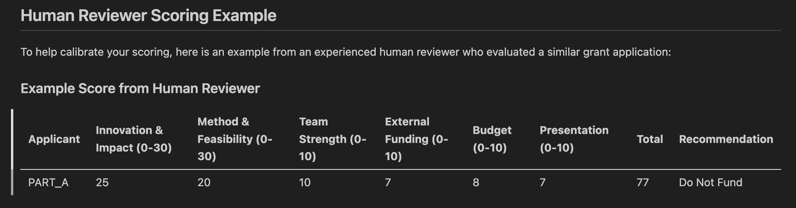
Experiment 2 – Baseline + 1 example
Notes:
2. Trained using 1 human example review → AI scored 5.9 points higher
3. Trained using 4 human example reviews → AI scored only 1.5 points higher
4. No training, but told AI to be stricter

Slide 16
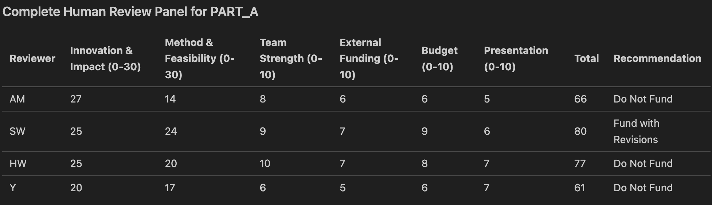
Experiment 3 – Baseline + Many examples
Notes:
2. Trained using 1 human example review → AI scored 5.9 points higher
3. Trained using 4 human example reviews → AI scored only 1.5 points higher
4. No training, but told AI to be stricter

Slide 17
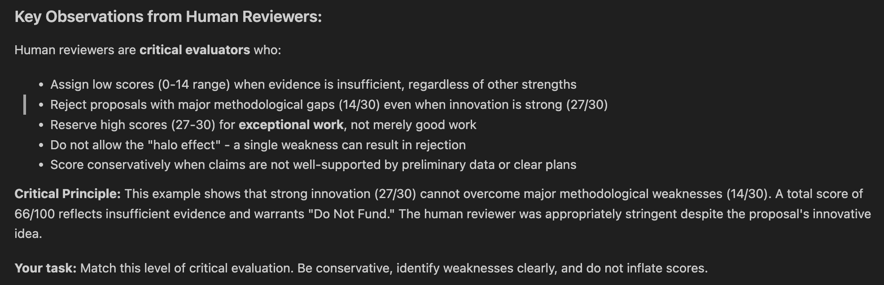
Experiment 4 – Experiment 2 + ‘Be Stricter’
Notes:
2. Trained using 1 human example review → AI scored 5.9 points higher
3. Trained using 4 human example reviews → AI scored only 1.5 points higher
4. No training, but told AI to be stricter

Slide 18
Finding 1
LLM Scores Match Human Scores
Average (mean) Scores (out of 100 points) across all experiments:
- Human reviewers: 79 points (range: 61-99)
- AI reviewers: 80 points (range: 62-97)
- Difference: Less than 1 point
What this means: Ai gave similar scores to human experts.
The Ai was not too harsh or too generous, It evaluated the grants at a similar level as humans.

Slide 19
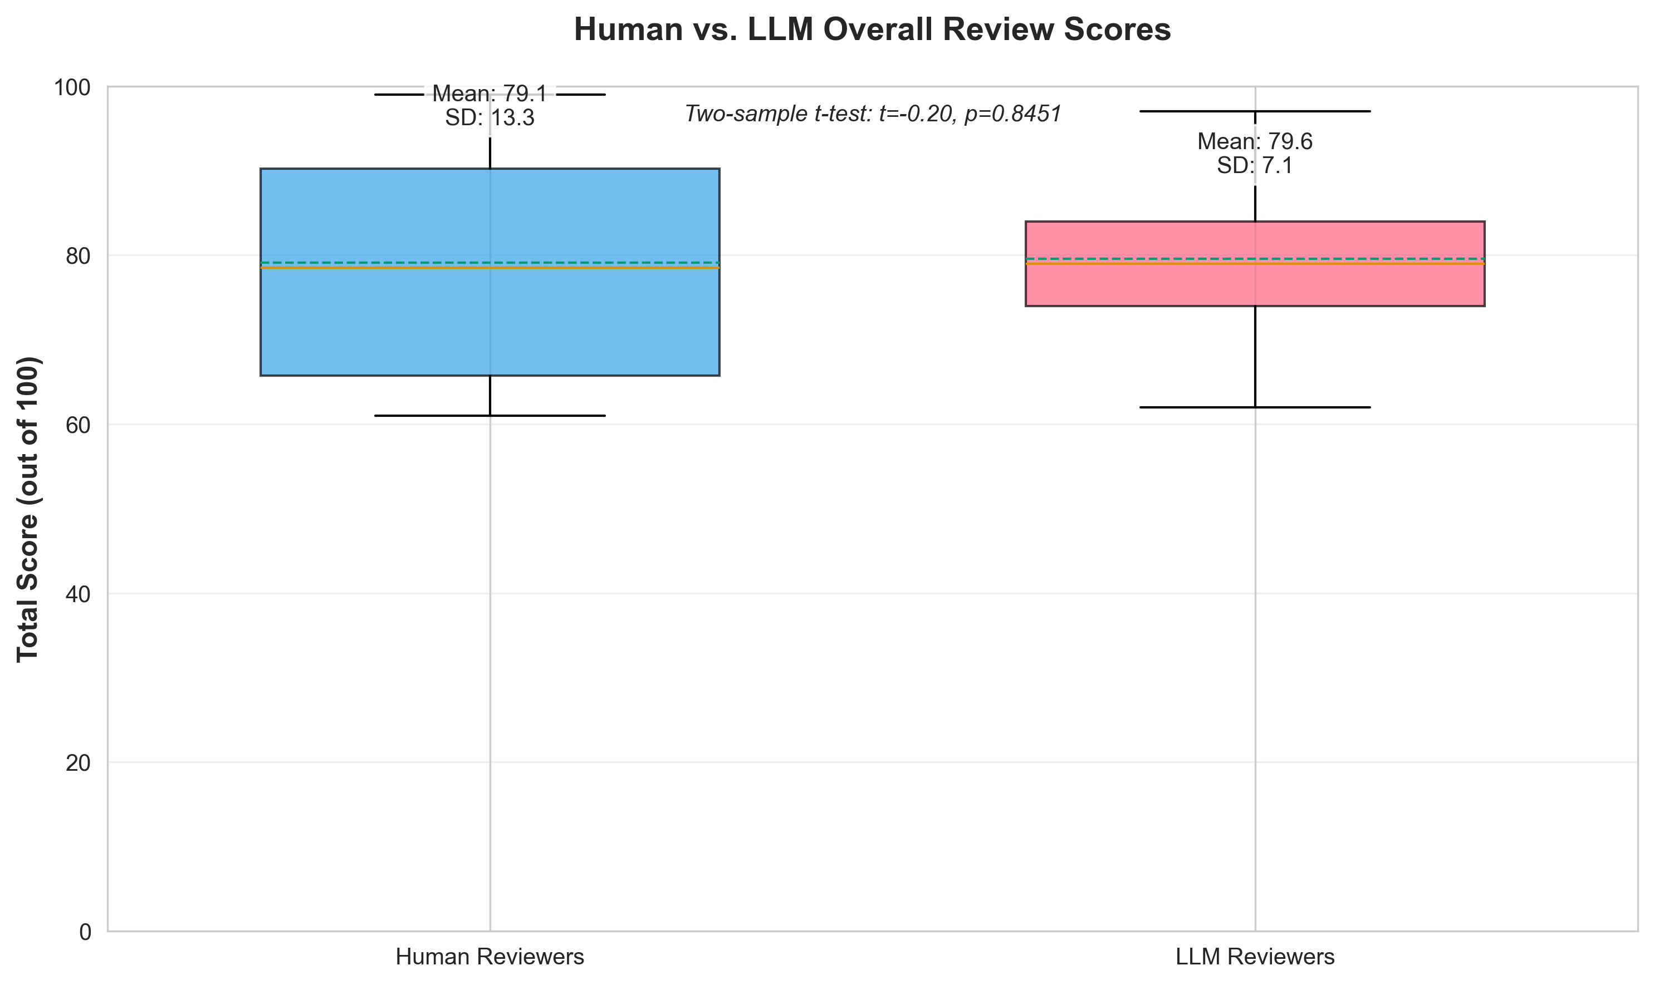

Slide 20
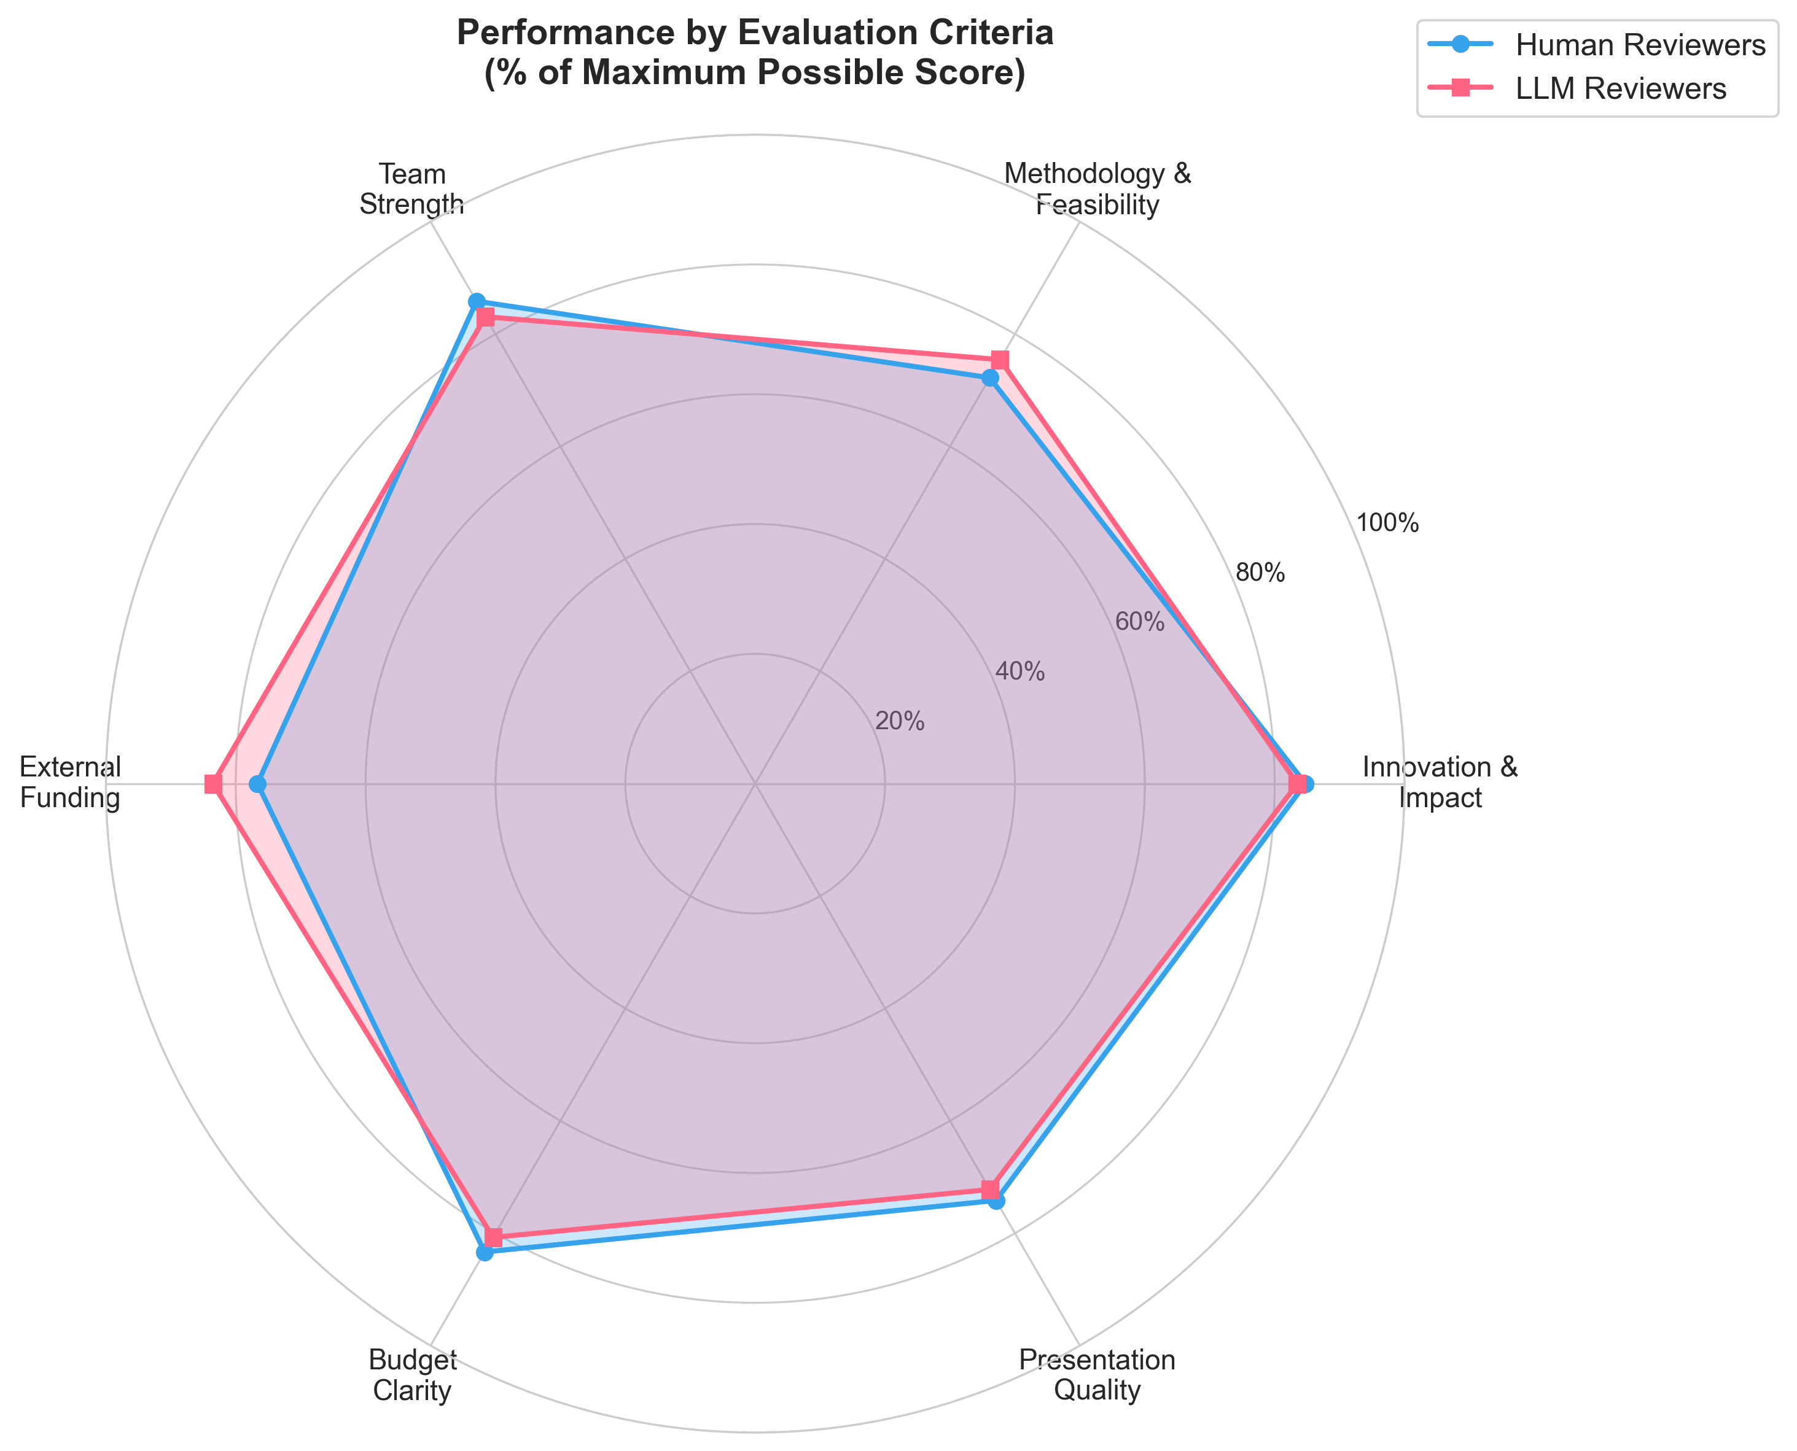

Slide 21
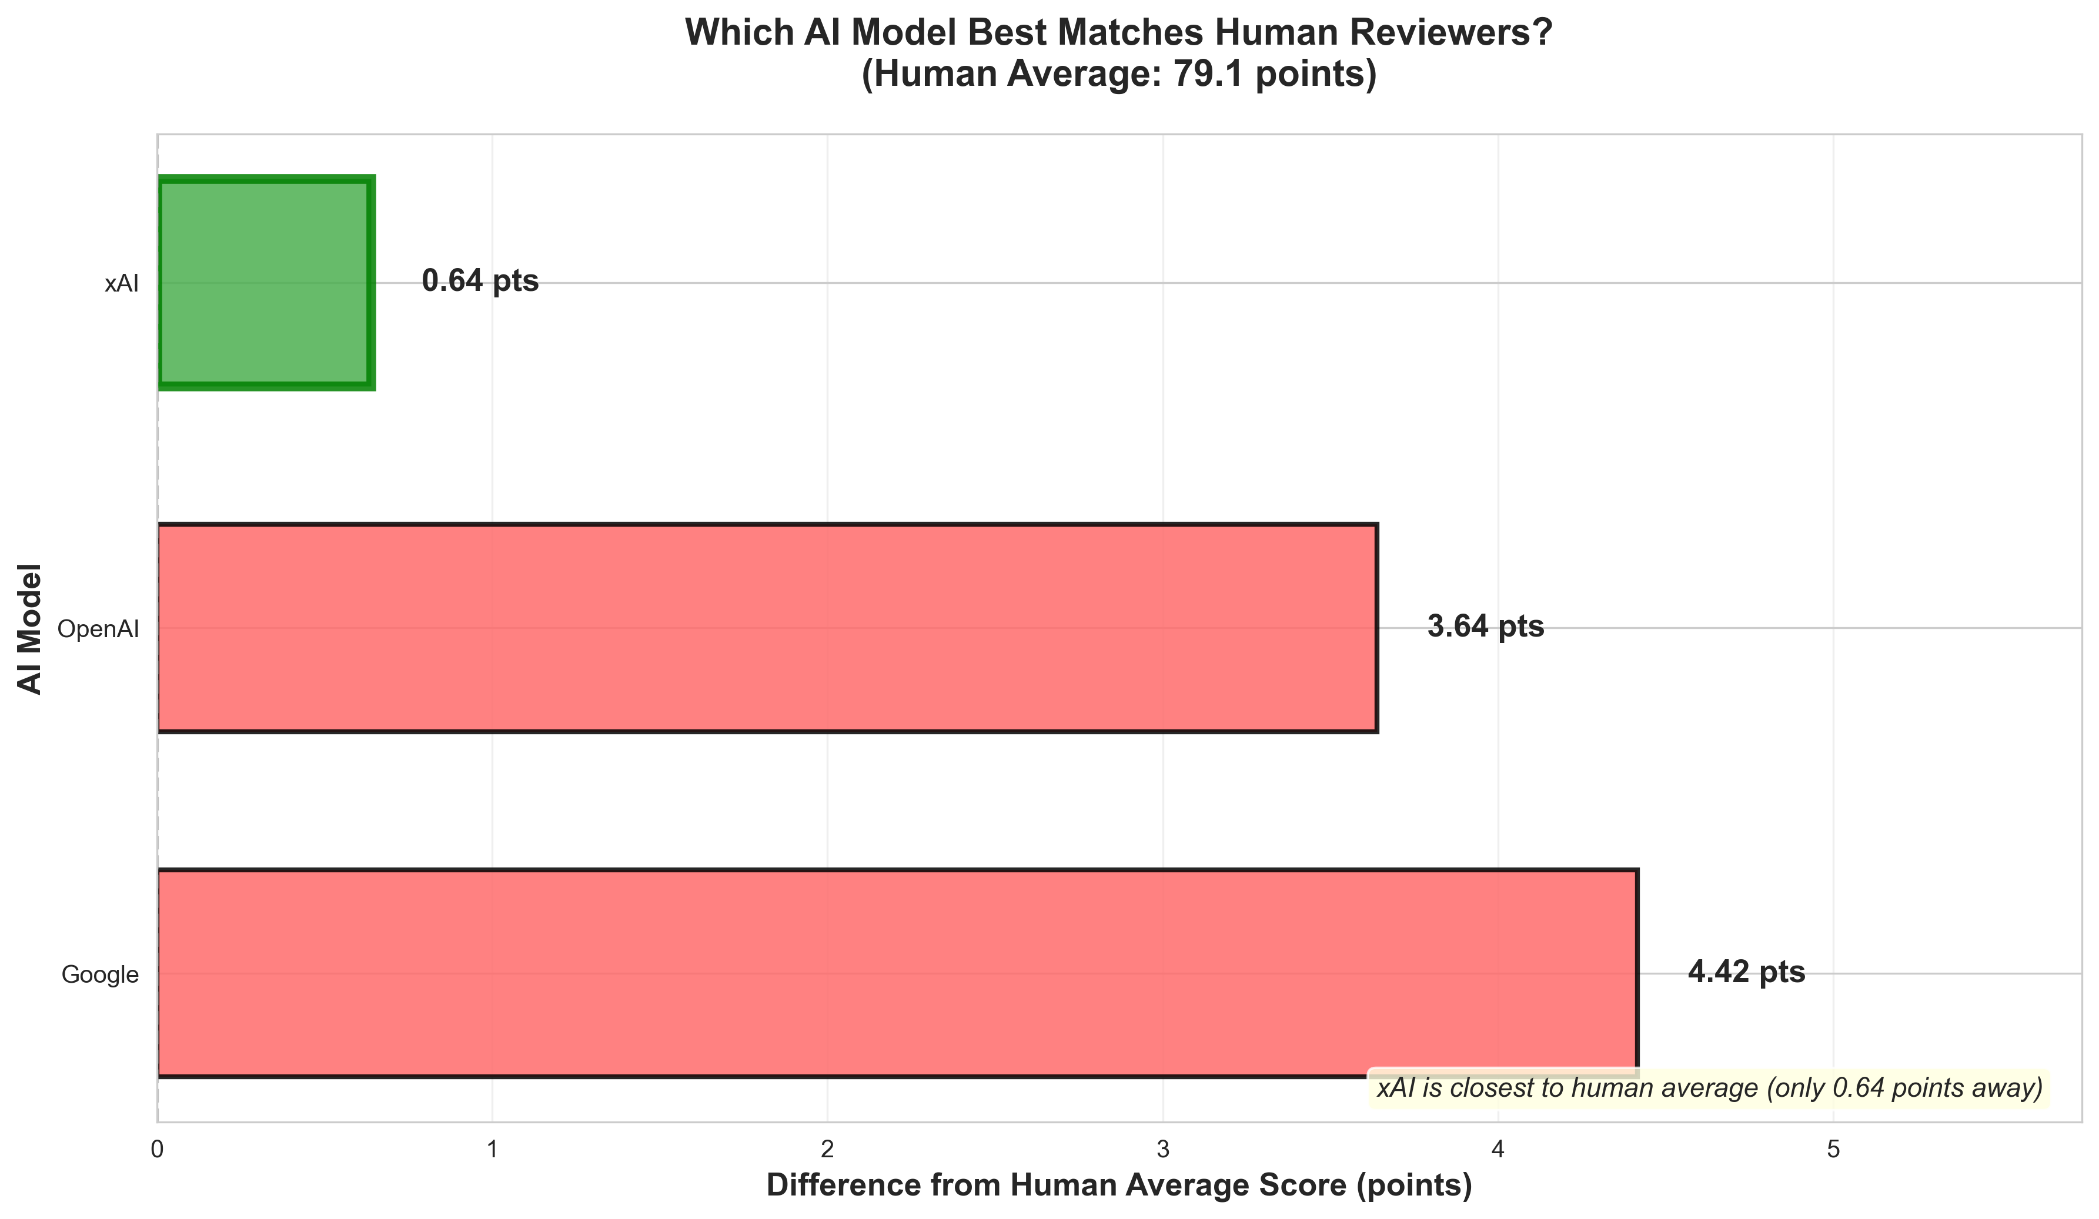

Slide 22
Finding 2
AI is More Consistent
How much reviewers disagreed with each other:
      - Human reviewers varied by 11 points on average
      - AI reviewers varied by 7 points on average
      - AI was 39% more consistent
What this means: Relates to issue of how different reviewers sometimes give very different scores. AI is more consistent: your grant is less likely to get a very different score based on which AI reviews it.

Slide 23
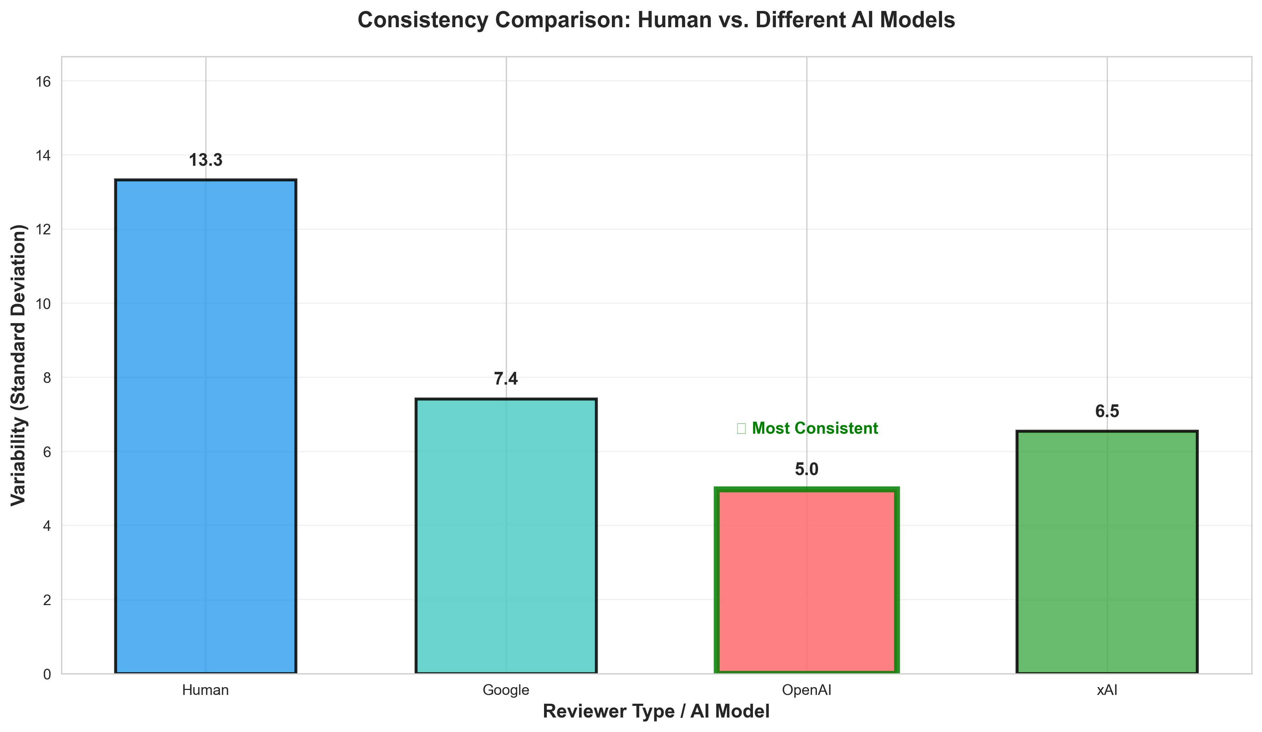

Slide 24
Finding 3
AI and Humans differ in final determination - Ai is more optimistic
Recommendation | Human Reviewers | AI Reviewers
Fund | 33% | 19%
Do Not Fund | 42% | 20%
Fund with Revisions | 25% | 61%
What this means: Even when AI gives similar scores,
it recommends "fund with revisions" much more often.

Slide 25
Finding 4
Training Data with AI Matters
We tested 4 different ways to "train" the AI using one of the three submissions:
1. No training → AI scored 4.6 points higher than humans
2. Trained using 1 human example review → AI scored 5.9 points higher
3. Trained using 4 human example reviews → AI scored only 1.5 points higher
4. No training, but told AI to be stricter → AI scored 6.6 points lower
What this means: Like training a new reviewer, AI needs good examples to calibrate properly. Multiple examples work better than strict instructions.

Slide 26
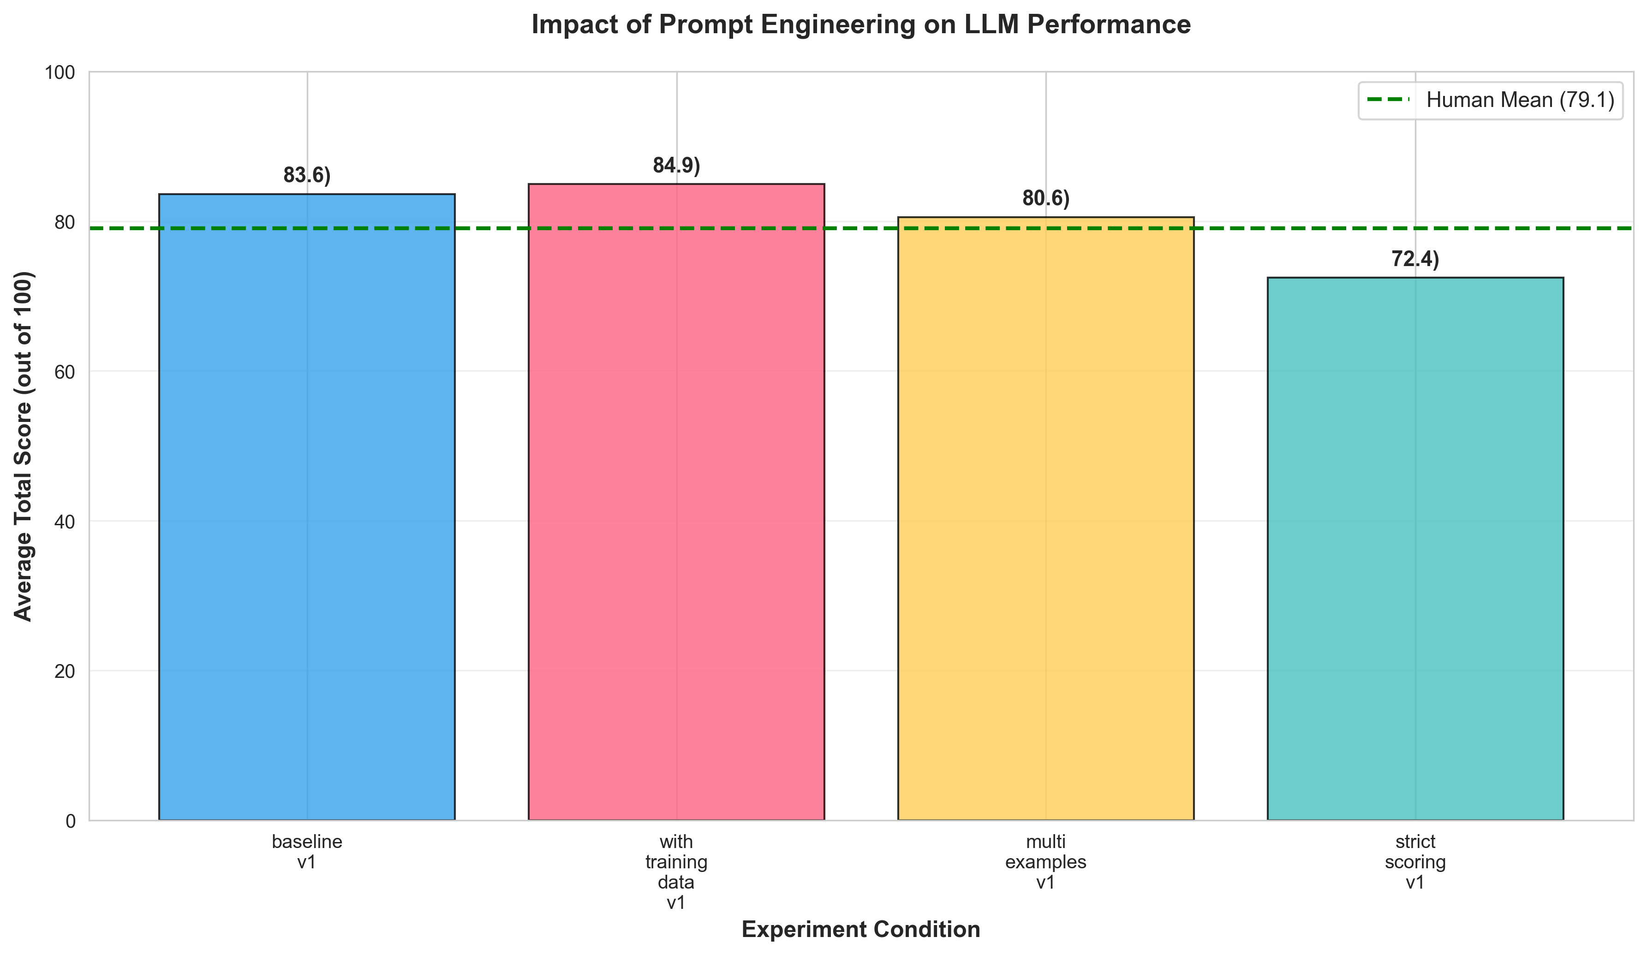

Slide 27
What we did not present:
Qualitative output of LLMs / future presentation, paper:
Innovation and Impact: 22/30
Rationale: The proposal addresses a significant public health issue of falls prevention in underserved communities and integrates interprofessional education for students, with potential for scalable community impact. However, the approach relies on established multifactorial interventions without introducing truly novel elements or compelling evidence of transformative change beyond local application

Slide 28
What Ai Can do well:
✅ Good uses for Ai in grant review process:
- First screening: AI may be able to quickly identify strong vs. weak proposals
- Consistency checks: Compare if reviewers are aligned
- Detailed feedback: AI writes thorough critiques of each section
- Reduce workload: Handle initial reviews, save expert time for final decisions
- Speed: AI reviews 100+ grants in minutes, not weeks
Cost savings: AI review costs ~$0.50 per grant vs. $200-500 for human expert

Slide 29
What Ai Cannot Replace
…yet? ❌ Humans still needed for:
- Final funding decisions: Borderline cases?
- Understanding context: strategic priorities of department, school, university
- Nuanced judgement: reading between lines; e.g., assessing feasibility within your institute
- Accountability: Human
- Unexpected scenarios: Novel research areas, unusual proposals
Recommendation: Use AI as an assistant, not a replacement. Best approach = AI does initial screening → Humans make final decisions.

Slide 30
Key Takeaways
From our preliminary work
1. AI reviews closely resemble human scores (within 1 point)
2. AI reviews are internally more consistent than humans (39% less variation)
3. AI has different judgment on funding decisions (prefers revisions, more optimistic)
4. Training (context) matters (show AI examples of good reviews - better output)
5. Best use for now is hybrid approach but do not rely solely on the Ai

