Slide 1
The Write Stuff: Can Ai Judge Seed Grant Applications
What We Learned Testing AI as a Grant Reviewer
Hants Williams, Jack Lamberg, Eric Lamberg

Slide 2
The Problem: Grant Review Takes Time
Every grant program faces these challenges:
- Each review takes 2-4 hours of expert time
- Finding qualified reviewers is difficult
- Expert reviewers are expensive (or volunteer their time)
- Delays in getting reviews back
- Reviewers sometimes disagree significantly
What if Ai could help?

Slide 3
What are LLMs and Gen Ai?
LLM = Large Language Model
Gen Ai = Generative Ai - Ai that creates new content (text, images, etc…)
Think of it like a very advanced autocomplete:
- You've used autocomplete when texting ("See you at..." → "the meeting")
- LLMs do this but with entire paragraphs and complex reasoning
- They read massive amounts of text and learn patterns

Slide 4
What are LLMs and Gen Ai?
How Generative AI works:
- Trained on billions of documents (books, articles, websites)
- Generates original responses based on what it learned
- Can read and analyze new documents it's never seen before
Examples you might know:
- ChatGPT (OpenAI), Google Gemini, Claude (Anthropic)

Slide 5
What we tested: Can LLMs review grants like a human expert?

Slide 6
Our study: A simple test
We gave the same 3 grant applications to:
- 4 human expert reviewers (12 total reviews)
- 3 different AI systems, each tested 4 different ways (108 AI reviews)
Same scoring criteria for everyone (100 points total):
- Innovation & Impact (30 pts)
- Research Methods (30 pts)
- Team Qualifications (10 pts)
- Funding Potential (10 pts)
- Budget (10 pts)
- Writing Quality (10 pts)
Along with a final question: fund, fund with revisions, or do not fund
Then we compared: Do AI and humans agree?

Slide 7
LLM Prompt:
To give detailed instructions to LLM like how you would to a human
You are an expert grant reviewer assessing a School of Health Professions Research Seed Grant application. Instructions - Evaluate the application against the six criteria listed below. - Assign a numeric score as a whole integer for each criterion based on the scoring scale. - Use the same definitions and point ranges as human reviewers. - Provide 2–3 sentences of rationale for each score. - Conclude with an Overall Recommendation: “Fund”, “Fund with Revisions”, or “Do Not Fund.” Scoring Scale (Whole Integers Only) - Exemplary (Full Points Range) – Fully meets and exceeds expectations; compelling evidence for success. - Adequate (Upper-Mid Range) – Meets most expectations; minor gaps. - Minimal Evidence (Mid-Lower Range) – Major gaps; insufficient support. - Insufficient Evidence (Lowest Range) – Does not meet expectations; unclear or unsupported. Criteria with Specific Point Ranges IMPORTANT: Each criterion has different maximum points. Follow the exact ranges below: 1. Innovation and Impact (Why & What) – Maximum 30 points - Novelty, originality, significance, and potential to create meaningful change - Exemplary: 27-30, Adequate: 21-26, Minimal: 15-20, Insufficient: 0-14 2. Methodological Approach and Feasibility (How & When) – Maximum 30 points - Quality, rigor, appropriateness, feasibility, and risk management - Exemplary: 27-30, Adequate: 21-26, Minimal: 15-20, Insufficient: 0-14 3. Strength of Research Team (Who) – Maximum 10 points - Qualifications, track record, and fit to project - Exemplary: 9-10, Adequate: 7-8, Minimal: 5-6, Insufficient: 0-4 4. Potential to Attract External Funding – Maximum 10 points - Likelihood to lead to competitive grants and alignment with funders - Exemplary: 9-10, Adequate: 7-8, Minimal: 5-6, Insufficient: 0-4 5. Clarity and Efficiency of Budget – Maximum 10 points - Alignment of spending to aims, cost-effectiveness, and eligibility - Exemplary: 9-10, Adequate: 7-8, Minimal: 5-6, Insufficient: 0-4 6. Overall Presentation (Writing, Clarity, Flow) – Maximum 10 points - Quality of writing, organization, and ease of comprehension - Exemplary: 9-10, Adequate: 7-8, Minimal: 5-6, Insufficient: 0-4 Total Maximum Score: 100 points Output Format (JSON Example) ```json { "scores": [ { "Criterion": "Innovation and Impact", "Score": 29, "Rationale": "The proposal introduces a novel approach to addressing clinical workflow inefficiencies, with a clear rationale for impact. Potential for significant advancement is high." }, { "Criterion": "Methodological Approach and Feasibility", "Score": 27, "Rationale": "The methods are well-aligned with the aims and supported by a clear, realistic timeline. Some contingencies could be more detailed." }, { "Criterion": "Strength of Research Team", "Score": 8, "Rationale": "The team has relevant expertise but could benefit from additional specialized skills in data analysis." }, { "Criterion": "Potential to Attract External Funding", "Score": 9, "Rationale": "Strong alignment with NIH priorities and clear pathway to larger studies make this highly competitive for external funding." }, { "Criterion": "Clarity and Efficiency of Budget", "Score": 10, "Rationale": "Budget is well-justified, cost-effective, and directly supports the proposed aims without unnecessary expenses." }, { "Criterion": "Overall Presentation (Writing, Clarity, Flow)", "Score": 7, "Rationale": "Well-written and organized overall, though some sections could be clearer in their presentation." } ], "OverallRecommendation": "Fund" } ```

Slide 8
Finding 1
LLM Scores Match Human Scores
Average (mean) Scores (out of 100 points):
- Human reviewers: 79 points (range: 61-99)
- AI reviewers: 80 points (range: 62-97)
- Difference: Less than 1 point
What this means: Ai gave similar scores to human experts. The Ai was not too harsh or too generous, it evaluated the grants at the same level as humans.

Slide 9
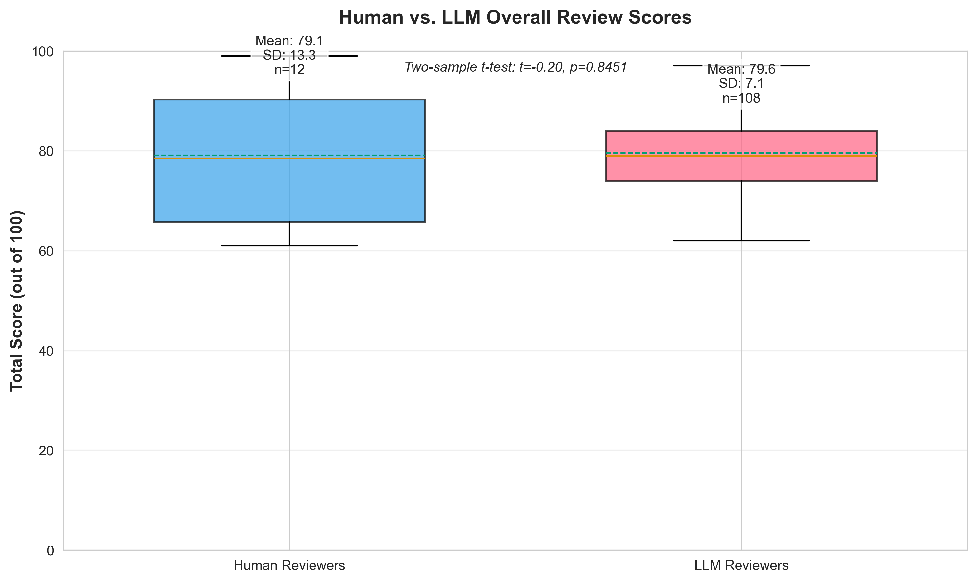

Slide 10
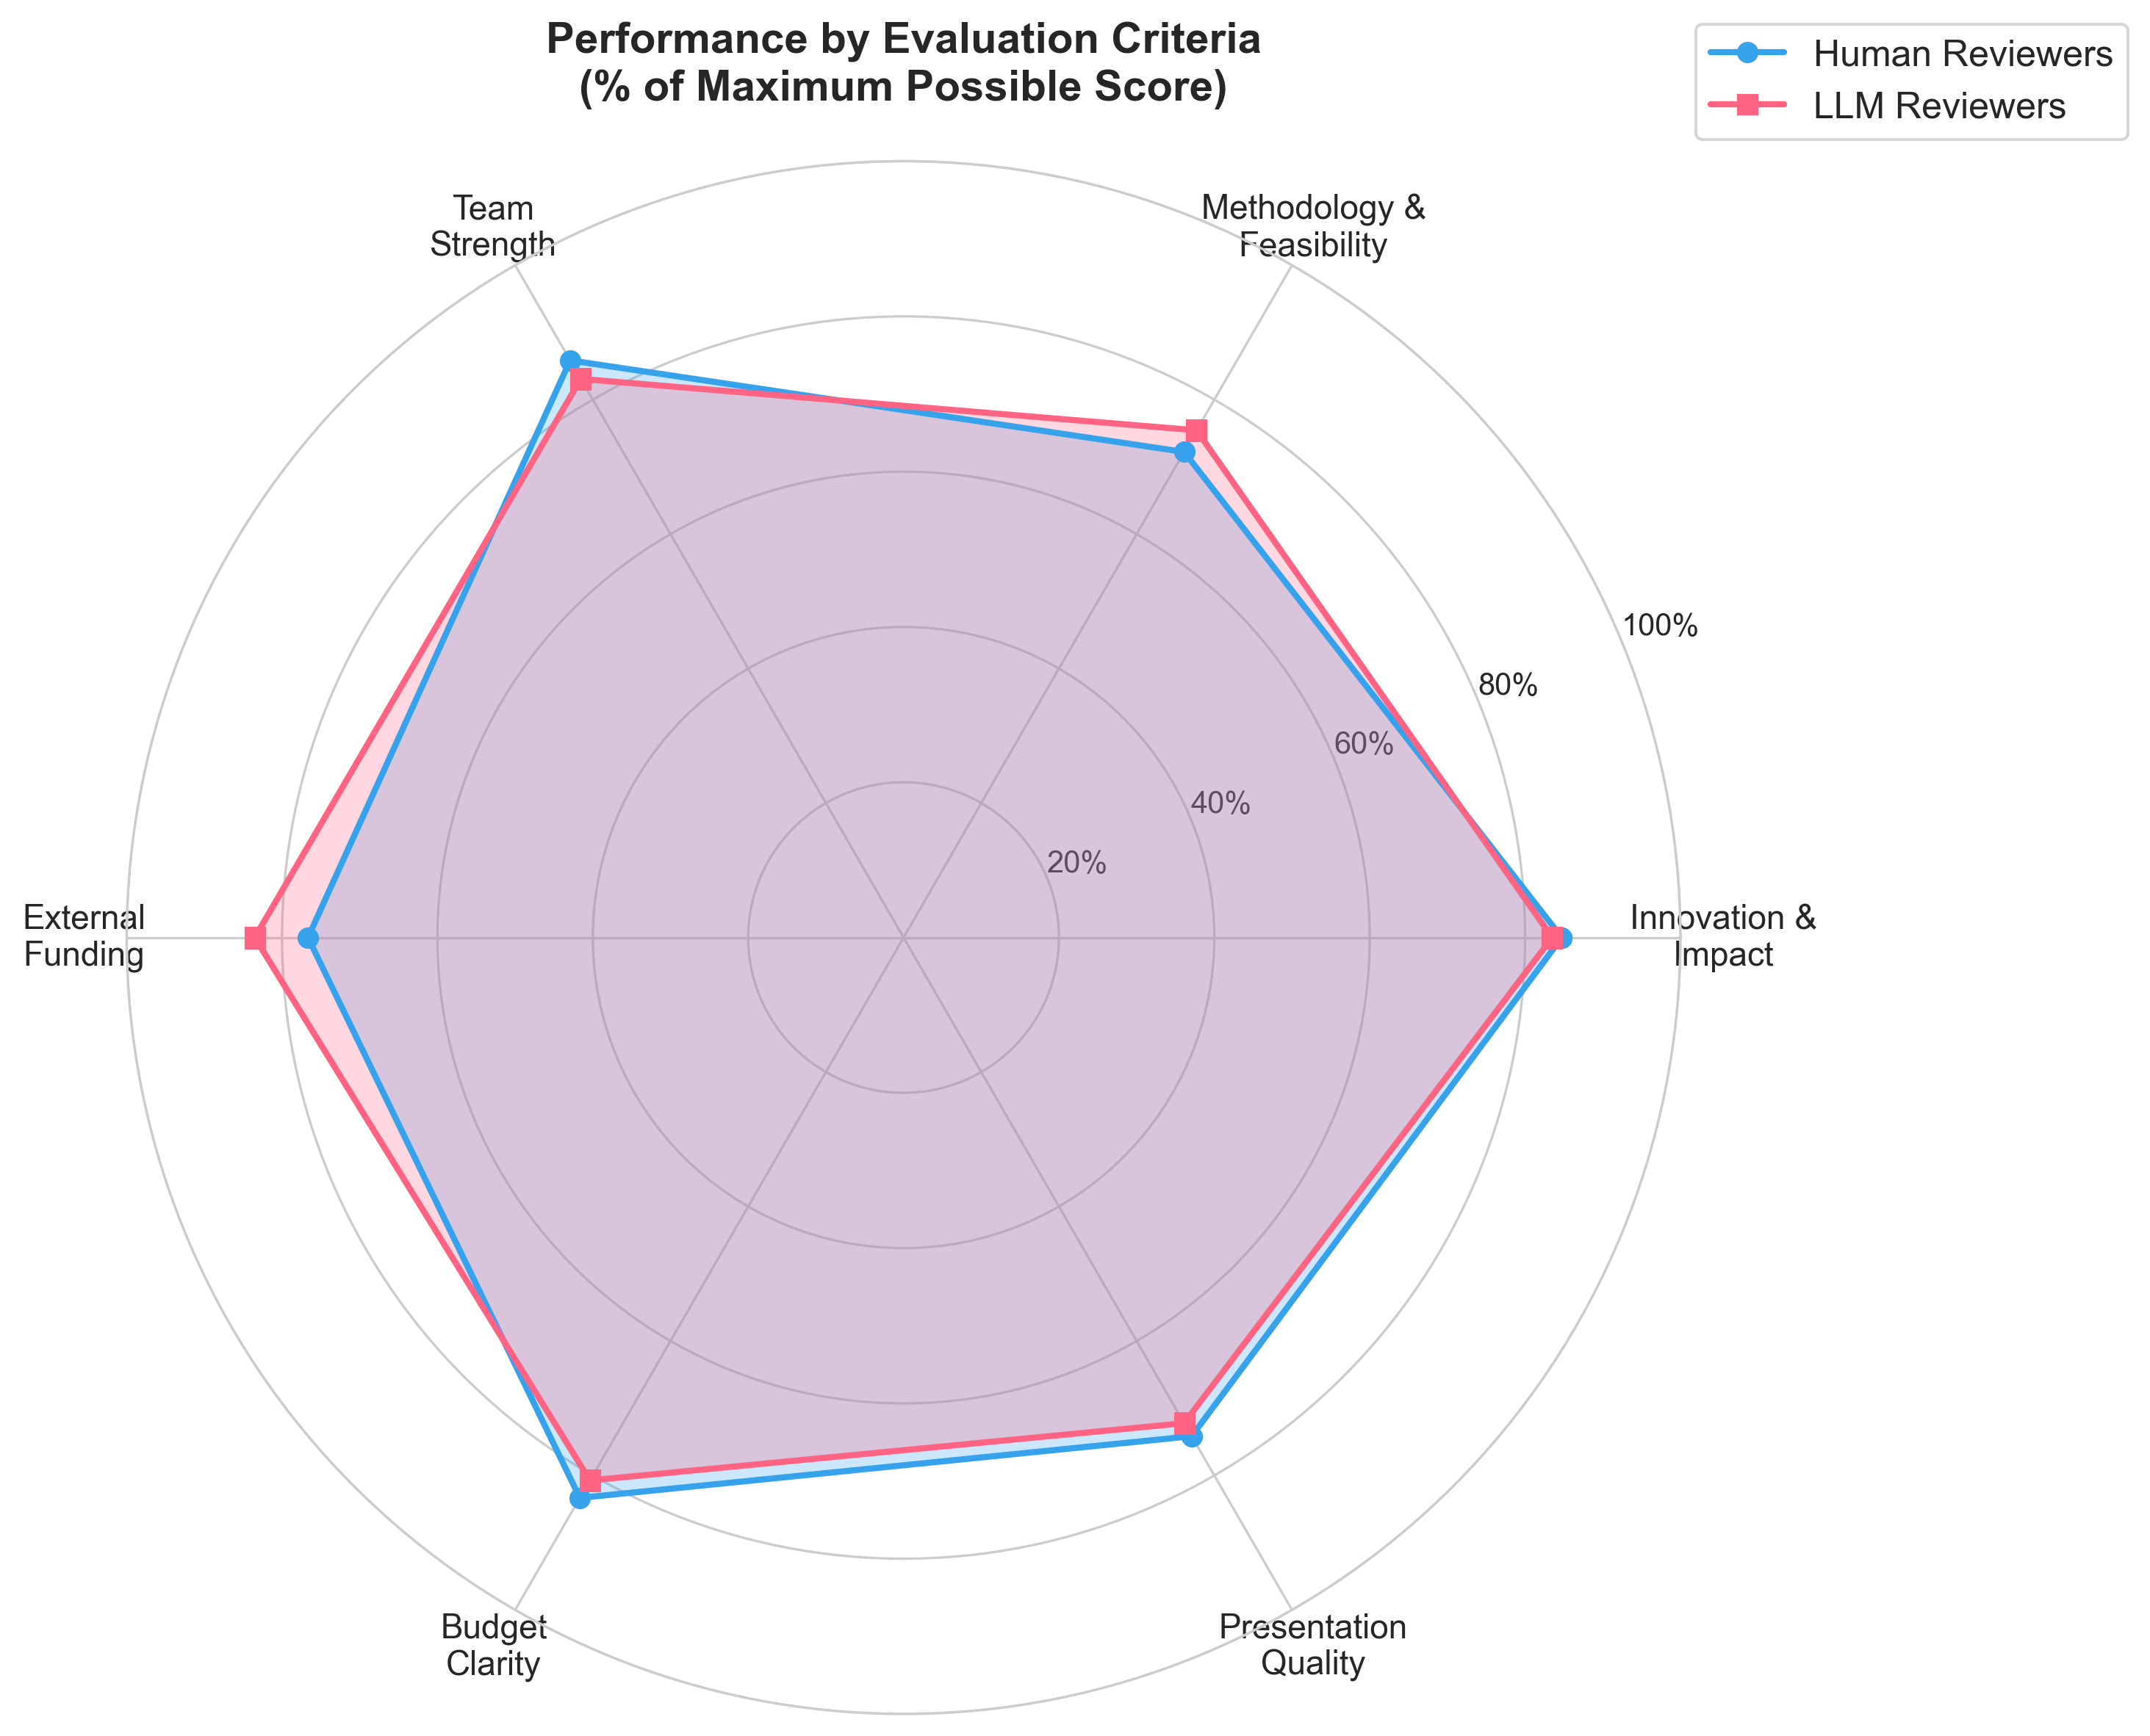

Slide 11
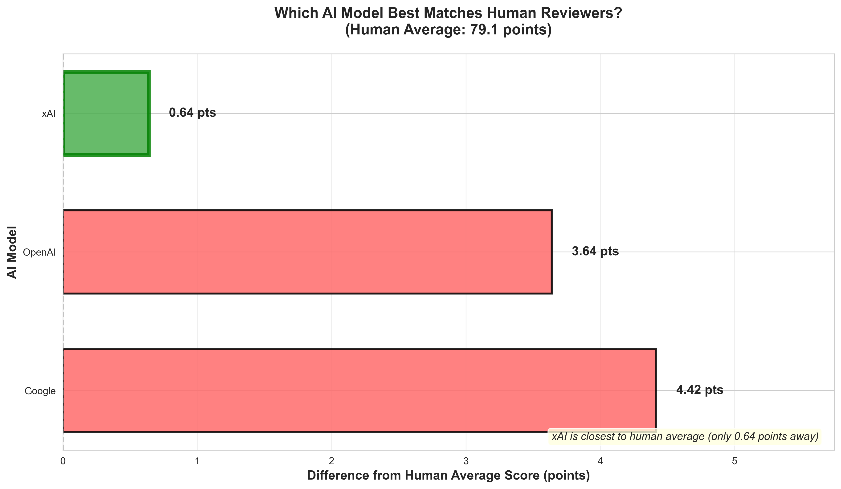

Slide 12
Finding 2
AI is More Consistent
How much reviewers disagreed with each other:
      - Human reviewers varied by 11 points on average
      - AI reviewers varied by 7 points on average
      - AI was 39% more consistent
What this means: Relates to issue of how different reviewers sometimes give very different scores. AI is more consistent: your grant is less likely to get a very different score based on which AI reviews it.

Slide 13
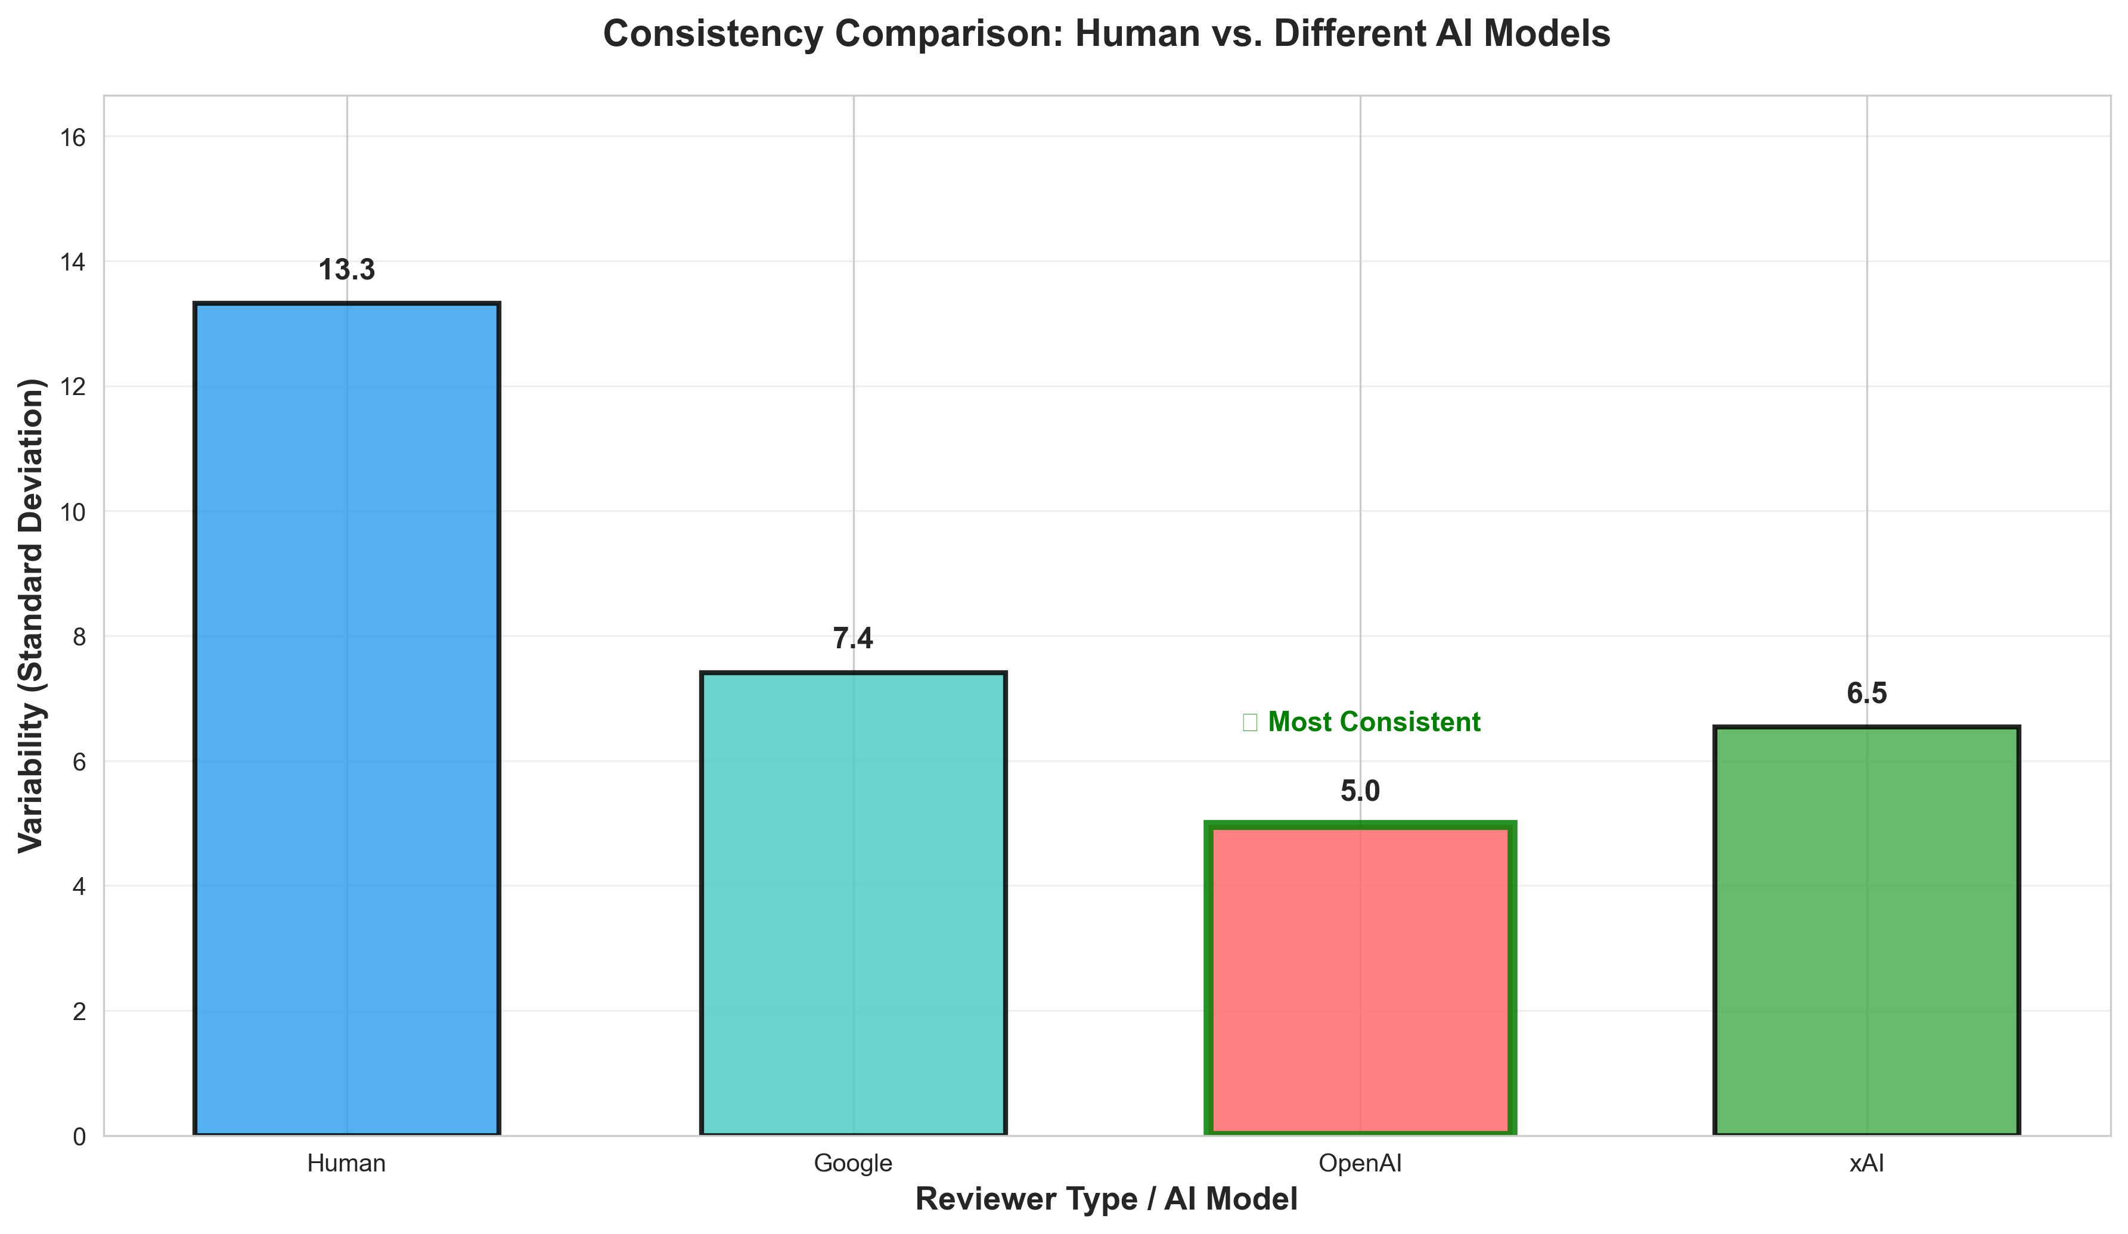

Slide 14
Finding 3
AI and Humans differ in there final determination - Ai is more optimistic
Recommendation | Human Reviewers | AI Reviewers
Fund | 33% | 19%
Do Not Fund | 42% | 20%
Fund with Revisions | 25% | 61%
What this means: Even when AI gives similar scores, it recommends "fund with revisions" much more often. AI seems more optimistic that problems can be fixed.

Slide 15
Finding 4
Training Data with AI Matters
We tested 4 different ways to "train" the AI:
1. No training → AI scored 4.6 points higher than humans
2. Showed 1 example review → AI scored 5.9 points higher
3. Showed 4 example reviews → AI scored only 1.5 points higher
4. No training, But told AI to be stricter → AI scored 6.6 points lower
What this means: Like training a new reviewer, AI needs good examples to calibrate properly. Multiple examples work better than strict instructions.

Slide 16
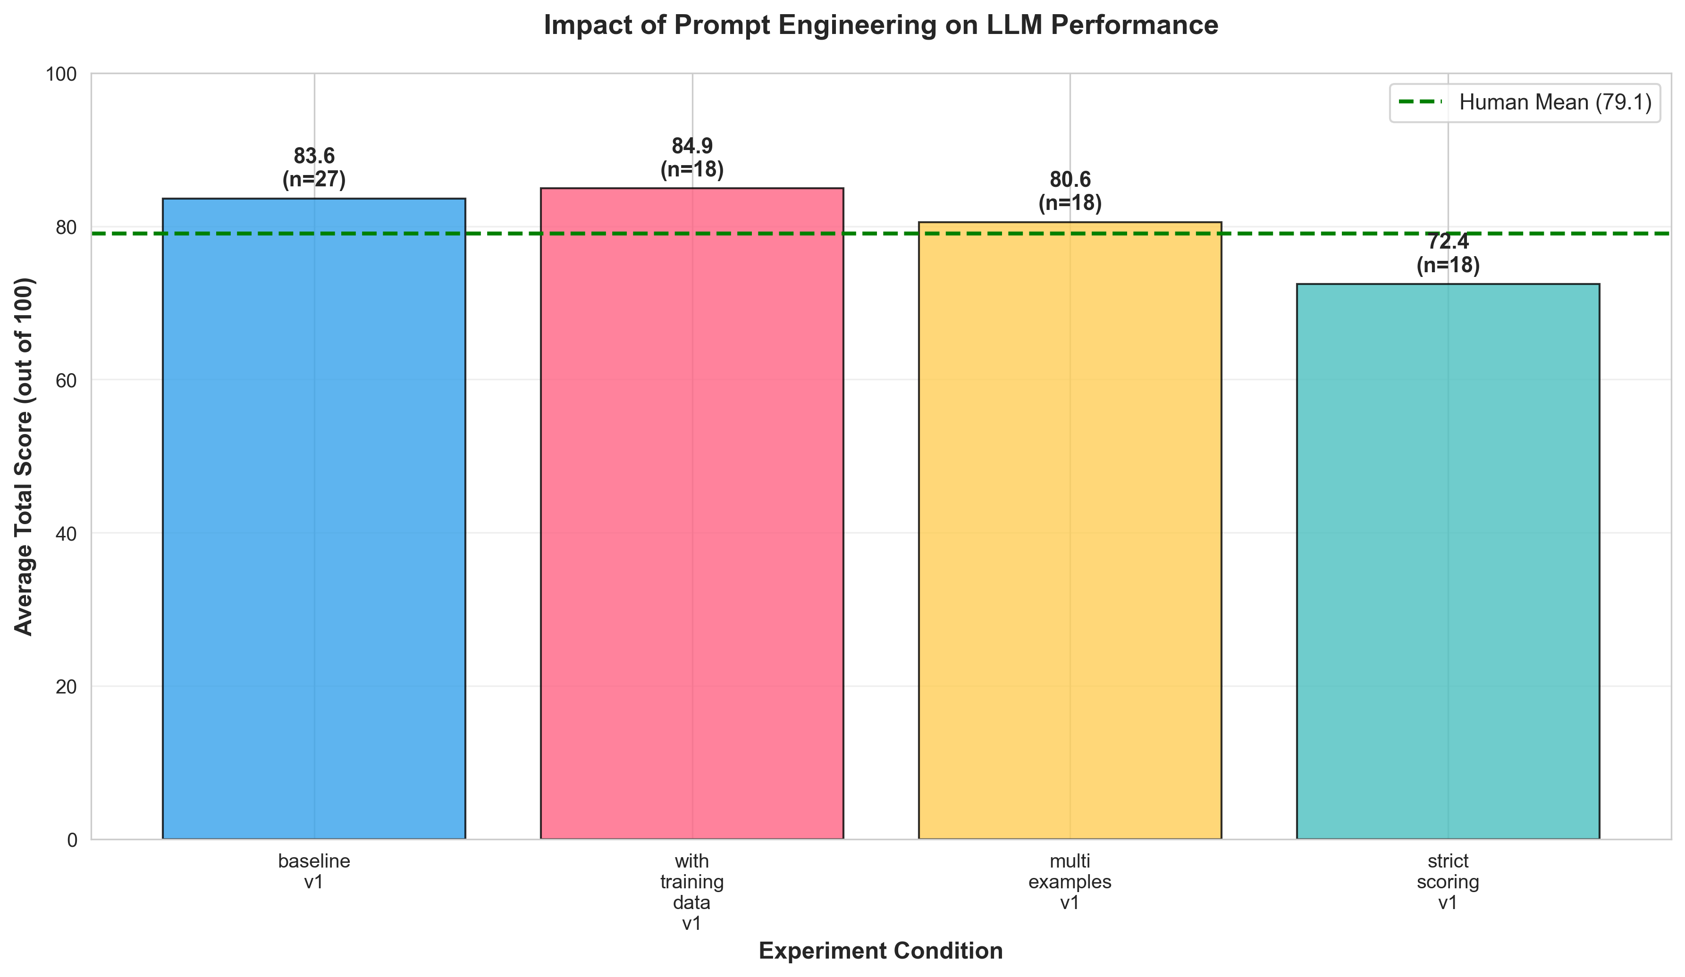

Slide 17
What Ai Can do well:
✅ Good uses for Ai in grant review process:
- First screening: AI can quickly identify strong vs. weak proposals
- Consistency checks: Compare if your reviewers are aligned
- Detailed feedback: AI writes thorough critiques of each section
- Reduce workload: Handle initial reviews, save expert time for final decisions
- Speed: AI reviews 100+ grants in minutes, not weeks
Cost savings: AI review costs ~$0.50 per grant vs. $200-500 for human expert

Slide 18
What Ai Cannot Replace
…yet? ❌ Humans still needed for:
- Final funding decisions: Borderline cases?
- Understanding context: strategic priorities of department, school, university
- Nuanced judgement: reading between lines; e.g., assessing feasibility within your institute
- Accountability: Human
- Unexpected scenarios: Novel research areas, unusual proposals
Recommendation: Use AI as an assistant, not a replacement. Best approach = AI does initial screening → Humans make final decisions.

Slide 19
Key Takeaways
From our preliminary work
1. AI reviews closely resemble human scores (within 1 point)
2. AI reviews are internally more consistent than humans (39% less variation)
3. AI has different judgment on funding decisions (prefers revisions, more optimistic)
4. Training matters (show AI examples of good reviews - better output)
5. Best use for now = Hybrid approach (AI screens → Humans decide)

