Slide 1

MovieLens Rating Prediction
-Review 2

Slide 2
Team Members:
M.HANUMAN SAI (19BPS1066)
G.VIJAY (19BPS1078)

Slide 3
Purpose
The purpose of this project is to create a model that will predict how a user will rate a specific movie, similar to a movie recommendation system.
Our model will make predictions based on user ratings of other movies and the average rating of the specific movie.

Slide 4
Workflow
First, we will run an exploratory data analysis to get a general overview of the data and explore possible predictor variables.
Then, we will include the most important features into numerous models i..e We are planning to test three different regression models to predict each rating . Then, we will select the best model and apply it to the test data set (validation).
Here Model Performance is evaluate with RMSE (residual mean squared error).
Finally, we will deploy the model with the smallest error to the test set and evaluate the results.

Slide 5
Data Description
For this project, we used the 10M version of the MovieLens dataset which we collected from “https:// grouplens.org/datasets/movielens/10m/”.
The dataset presents information about 10 million movie ratings including user id, movie id, user rating of the movie (between 0.5 to 5 stars), timestamp of the rating (seconds since midnight Coordinated Universal Time of January 1, 1970), title of the movie, and movie genre(s): Action, Adventure, Animation, Children’s, Comedy, Crime, Documentary, Drama, Fantasy, Film-Noir, Horror, IMAX, Musical, Mystery, Romance, Sci-Fi, Thriller, War, and/or Western

Slide 6
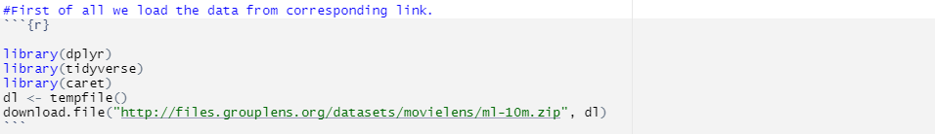
After downloading and unzipping the data file, I will extract its contents and place the data in a dataframe. Next, I will split the data into two sets: a training set and a validation set. The training set will contain 90% of the data (9 million ratings) which the model will learn from. The validation set will contain the remaining 10% of data (1 million ratings) which will be used to evaluate the performance of my model.

Slide 7
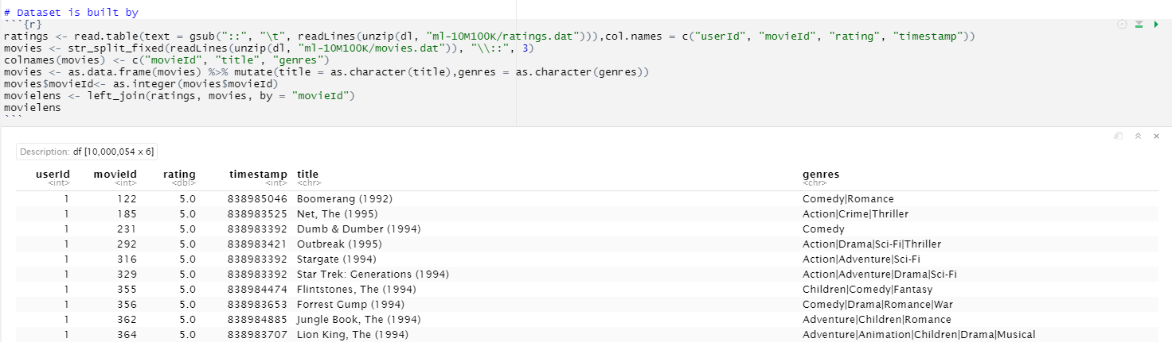

Slide 8

Split Raw Data: Train and Test Sets
We now create a validation set of 10% of Movielens data and 90% set for training
Training dataset used for building the algorithm and the validation set used for testing.

Slide 9

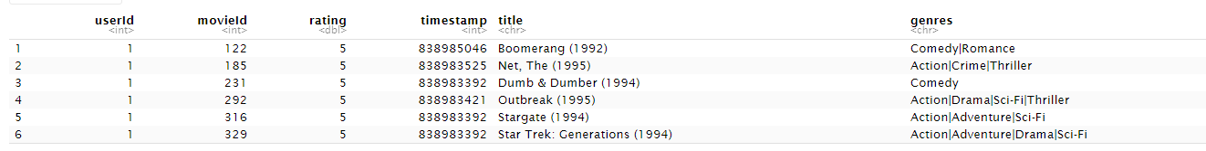
Exploring train set
OUTPUT:

Slide 10
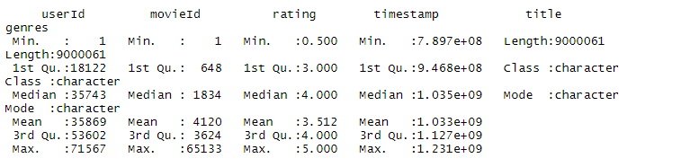

Summary
No of unique movies and users in train set

Slide 11

Check for NA Values
Next we going to check if dataset contains any missing values
There are no missing values in the dataset.

Slide 12
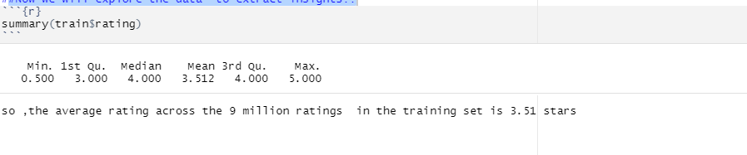
Data Exploration
Now we will explore the data to extract insights!!

Slide 13
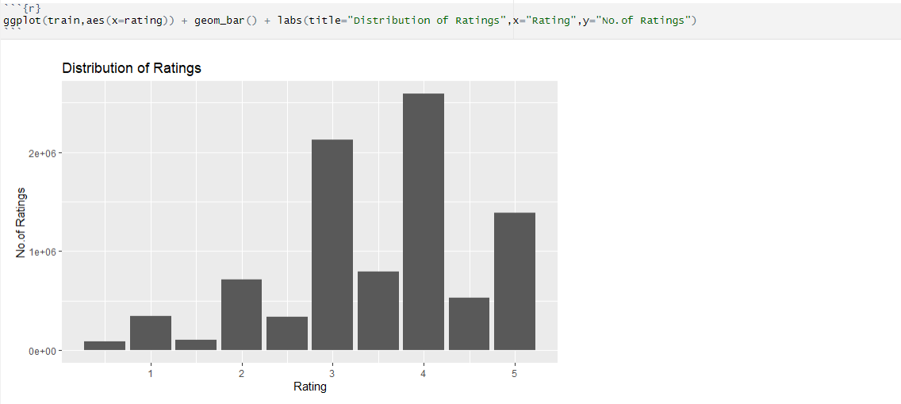
As you can see, the ratings appear to be left-skewed since there are few ratings b/w 0 to 2 stars and many ratings b/w 3 to 5 stars .
In general , half star ratings appear to be less common than whole star ratings.

Slide 14
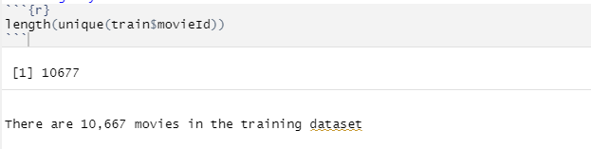
Ratings by movie
Now we will perform a deeper analysis of ratings by movie.Specifically we will compare the average rating of movies and determine whether the number of ratings a movie receives impacts its average ratings

Slide 15
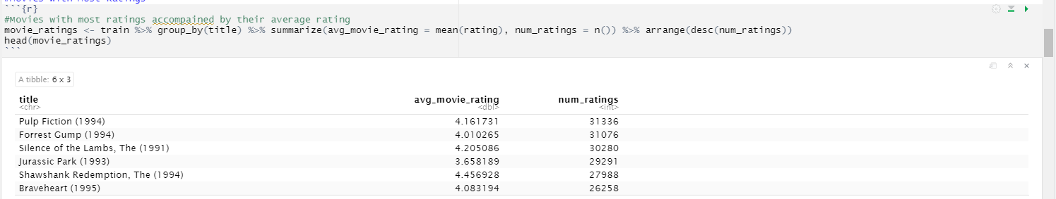
Movies with Most Ratings
Pulp Fiction, Forrest Gump, The Silence of the Lambs, Jurassic Park, Shawshank Redemption, and Braveheart have the most ratings (about 30,000 each) with an average rating ranging between 3.66 and 4.46.

Slide 16
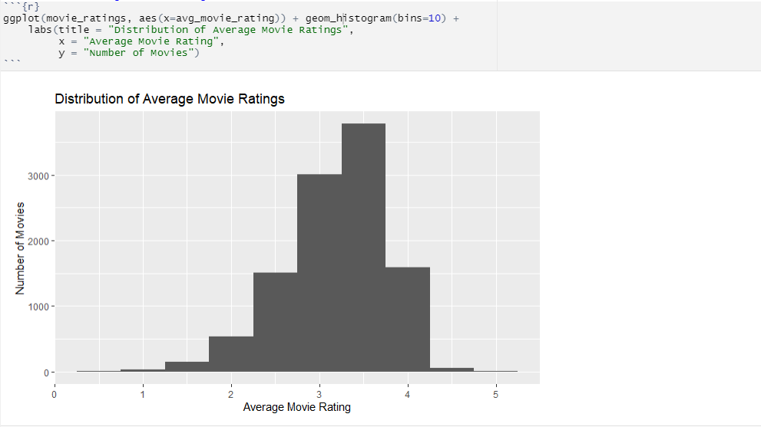
Most common average movie rating
Based on the histogram above, most movies appear to have an average rating between 2.5 and 4. In addition, there are only be a few movies with an average rating of 0.5 stars (worst possible rating) and 5 stars (perfect rating).

Slide 17

Ratings by User
There are 69,878 users in the training dataset.

Slide 18
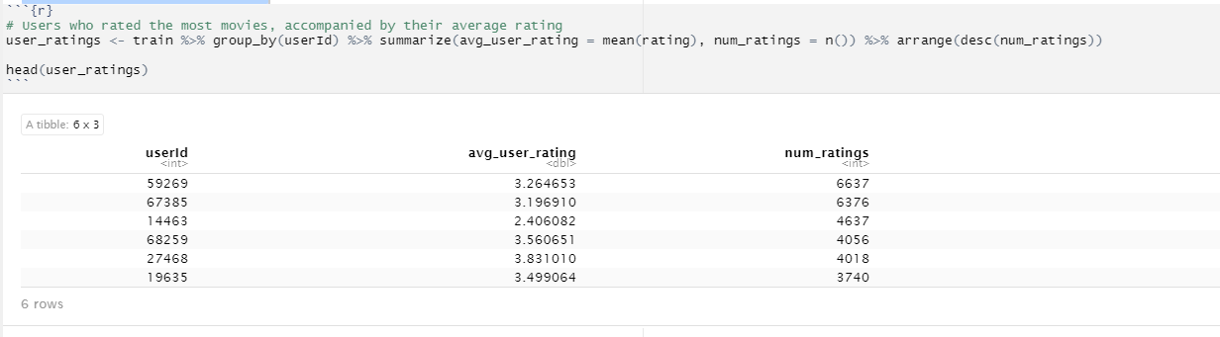
Users Who Rated the Most Movies
The user that rated the most movies rated a total of 6637 movies with an average rating of 3.26.

Slide 19
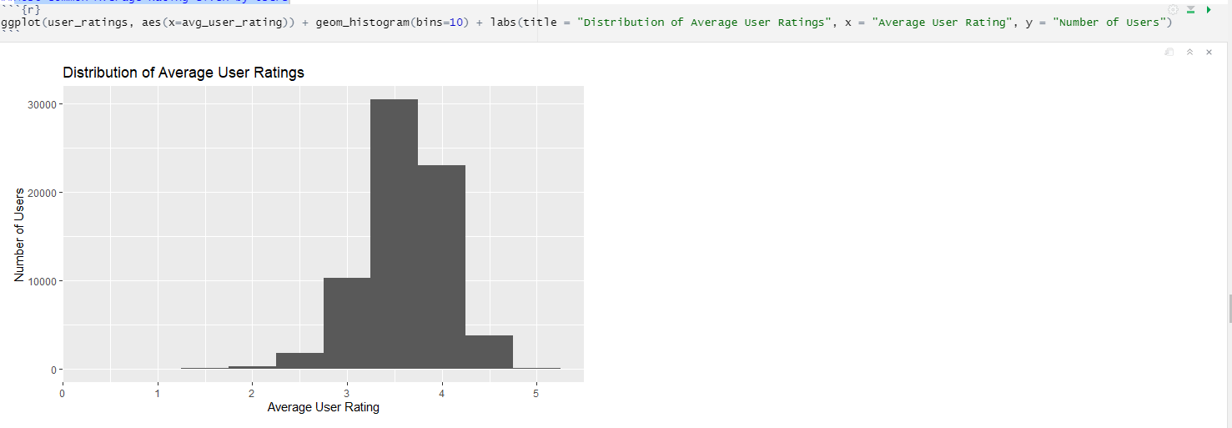
Most Common Average Rating Given by Users
Based on the histogram, most users give an average rating between 3 and 4.5. In addition, only a few users have a very high or very low average rating (i.e. 0 to 2 stars; 5 stars).

Slide 20
Model Development
we will test three different regression models to predict each rating in the training set . Then, I will select the best model and apply it to the test set .
Model 1 : Predicted Rating = Global Average Rating + Movie Effect
Model 2 : Predicted Rating = Global Average Rating + User Effect
Model 3 : Predicted Rating = Global Average Rating + Movie Effect + User Effect
he global average rating is the average rating across all entries in the dataset.
The movie effect is the difference between the average rating for the specific movie and the global average rating.
Similarly, the user effect is the difference between the average rating for the specific user and the global average rating. To evaluate three models we will use RMSE(Root Mean Square Error).

