Slide 1

RABIN KARP PARALLELIZATION AND COMPARATIVE ANALYSIS
PDC J-Component Review

Slide 2
TEAM MEMBERS:
HANUMAN SAI 19BPS1066
N CHARAN REDDY 19BCE1594
P VARSHITH 19BCE1585

Slide 3

Abstract:
Correct string coordinating alludes to the pursuit of each and any events of a string in another string. These days, this issue presents itself in different portions in a lot, beginning from standard schedules for the correct hunt, which schedules are executed into projects for word processing and preparing, through databases and the distance to their different applications in different sciences. The errand of discovering strings that match to a given example is of enthusiasm for an assortment of useful applications, including DNA sequencing and message looking. The endeavour of finding strings that match to a given model is of excitement for a grouping of sensible applications, including DNA sequencing and message looking. Owing to its essentialness, decisions to revive the precedent planning task have been extensively investigated in the composition. The guideline responsibility of this work is to present a parallel type of Accelerated Rabin-Karp.
The Rabin-Karp algorithm is an implementation of exact string matching that uses a rolling hash to find any ‘one’ set of pattern strings in a text. The Rabin-Karp algorithm is used in detecting plagiarism because, given a pattern and a source of texts, the algorithm can quickly search through papers for patterns from the source
material. We have parallelized this algorithm using MPI, Distributed Python –disPy.

Slide 4
Introduction:
A rolling hash (also known as recursive hashing) is a hash function where the input is hashed in a window that moves through the input. A few hash functions allow a rolling hash to be computed very quickly—the new hash value is rapidly calculated given only the old hash value, the old value removed from the window, and the
new value-added to the window— similar to the way a moving average function can be computed much more quickly than other low-pass filters.
The Rabin–Karp algorithm is a string searching algorithm created by Richard M. Karp and Michael O. Rabin that uses hashing to find any ‘one’ of a set of pattern strings in a text. For the text of length n and p patterns of combined length m, its average and best-case running time is O(n+m) in space O(p), but its worst-case time is O(nm).
This project aims to improve the process of hashing by parallelizing the process using MPI. A given set of input will be tested first by the serial method and then by parallel and we will see the advantage of parallelism.
In light of this significant assignment and step by step expanding research in various fields, industry, institute individuals requesting such programming to identify whether submitted articles, books, national or global papers are certified or
not.

Slide 5
One of the more productive calculations is Rabin-Karp calculation, whose multifaceted nature is direct. This work furnishes us with one approach to parallelize this calculation for execution on multiprocessor frameworks. The Rabin-Karp algorithm is used in detecting plagiarism because, given a pattern and a source of texts, the algorithm can quickly search through papers for patterns from the source material.
Problem Statement:
The Rabin–Karp algorithm is a string searching algorithm created by Richard M. Karp and Michael O. Rabin that uses hashing to find any ‘one’ of a set of pattern strings in a text. For the text of length n and p patterns of combined length m, its
average and best-case running time is O(n+m) in space O(p), but its worst-case time is O(nm).
This project aims to improve the process of hashing by parallelizing the process using MPI. A given set of input will be tested first by the serial method and then by parallel and we will see the advantage of parallelism.

Slide 6
Methodology:
We have used the master-slave model in MPI to parallelize the Rabin Karp algorithm. Files with a large amount of text and a pattern to be searched within them, are given as input. The master process takes this input and divides the files
among the slave processes. Each slave process performs the Rabin Karp algorithm on its input file and returns the results to the master. The master process compiles the results and displays them.
Algorithm:
Rabin-Karp algorithm is an algorithm used for searching/matching patterns in the content utilizing a hash function. Unlike Naive string matching algorithm, it doesn't go through each character in the underlying stage. It channels the characters that don't match and then perform the comparison.

Slide 7
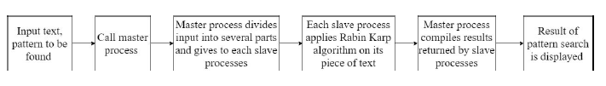
Block Diagram:
Hardware and Software Specifications:
Processor: Intel(R) Core i5
RAM : 8GB
OS: Windows 10
Python 3.8
Microsoft MPI 10.1.12498.18

Slide 8
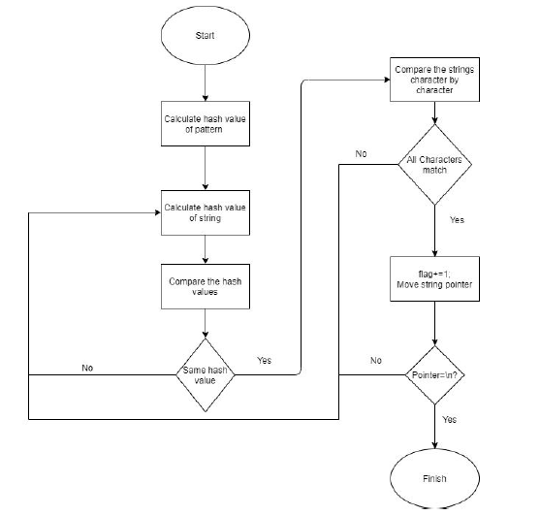
Flowchart:

Slide 9
References:
[1] Maurice Herlihy, Nir Shavit, The Art of Multiprocessor Programming, Morgan Kaufmann Publisher, 2008
[2] M. C. Schatz, C. Trapnell, Fast Exact String Matching on the GPU, Technical report
[3] S. Viswanadha Raju, A. Vinayababu, Optimal Parallel Algorithm for String Matching on Mesh Network Structure, International Journal of Applied Mathematical Sciences, Vol.3 No.2(2006), pp. 167-175
[4] T. F. Smith, M. S. Waterman, Identification of common molecular subsequences, J Mol Biol, vol. 147, pp. 195-197, 1981
[5] T. H. Cormen, C. E. Leiserson, R. L. Rivest, C. Stein, Introduction to Algorithms, The MIT
Press
[6] Y. Utan, M. Inagi, S. Wakabayashi, and S. Nagayama, “A GPGPU implementation of approximate string matching with regular expression operators and comparison with its FPGA implementation,” in Proc. Int. Conf. Parallel and Distributed Processing Techniques and Applications, 2012.
[7] W.-m. W. Hwu, GPU Computing Gems Emerald Edition, 1st ed. San Francisco, CA, USA: Morgan Kaufmann Publishers Inc., 2011.
[8] NVIDIA Corporation, “NVIDIA CUDA C Programming guide,” http: //docs.nvidia.com/cuda/cuda-c-programming-guide/, April 2015.s, 2005.

Slide 10
THANK YOU

