Slide 1
Git – Quick Overview
Git – Quick Start
Building Your First Repository
Working in a Team
Advanced Features

Slide 2
Basics of version control
Keeping history of working versions of your projects
know who made changes as well as when and why
Merge Conflicting changes

Slide 3
How Git approaches version control
Each commit is a snapshot of entire project not just the changes made
Developers works on clones of the repository with complete access to history

Slide 4
Advantages of distributed version control
Multiple clones means multiple backups
Ability to work offline
Setup multiple independent workstation

Slide 5
Choosing Workflow
Centralized Workflow
Feature branch workflow
Forking workflow

Slide 6
Centralized Workflow
It is similar to CVCS repository
Team members all work off a single branch in a central repository
Rebase unpushed commits on top of updates to the master branch
Requires frequent synchronization on larger team
It is suitable for smaller team but in larger team it required frequent synchronization to keep divergence manageable

Slide 7
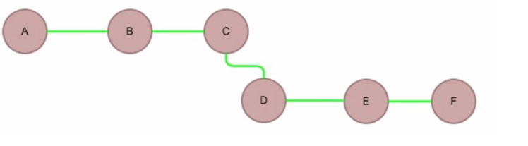
Tom’s Local Branch

Slide 8
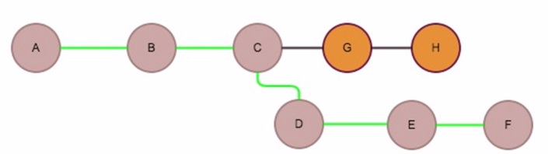
Tom’s Diverged Branch
Branch get diverged cause of bob’s commit

Slide 9

Tom’s Rebased Branch
Tom needs to incorporate Bob’s changes

Slide 10
Feature Branch Workflow
Feature developed in dedicated branches
Issue pull request from feature branch to master
Keep main code base clean and working during development

Slide 11
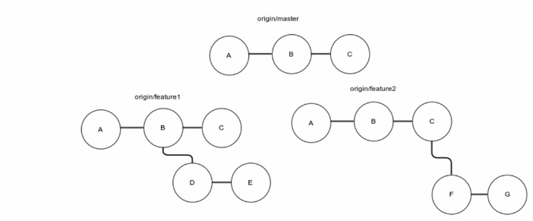
Feature Branch Workflow

Slide 12
Forking Workflow
Each developer has dedicated online repository
Write access is restricted to administrators
Pull request are issued to main repository
Every fork has information about its master branch
It can track divergence between different repositories
In this type of workflow the write-access is restricted to the maintainers only
Here developers push commits to their own forks and make pull requests to the central repository
Admin view these changes and decides if the changes can be merged

Slide 13
Workflow Summary
Different team dynamics requires different collaboration techniques. Choose the workflow that suits your group.
Choose the familiarity of a centralized workflow while capitalizing on Git's additional advantages
Create feature branches to keep new development from interfering with the stable code base
Use the open source forking model to allow collaborators from anywhere while keeping your main repo protected

Slide 14
Building Your First Repository
Repository Initialization
Making your first commit
Managing remotes
Viewing commit history

Slide 15
Initialization
It is important to maintain logs:
Initializing a local repository
Tracing new files
Example
Let meet a friend tom who has an idea for app
To starts developing his idea into reality with his programming skills
He takes the support of open source community for this purpose

Slide 16
Initialization (Commands)
yum install git
mkdir -p /opt/gitdemo
cd /opt/gitdemo
git init
ls -a
vim problem_solver.rb
git status
git add problem_solver.rb
git status

Slide 17
The First Commit
Make changes in working directory
Move changes to staging area
Commit the changes to the repository
README.md
What it does exactly
System requirements
Installation and running instructions
How to contribute to the project
md stands for markdown which is a simple syntax for providing semantic information and representing common formatting in plain text
.gitignore is a hidden file which lists the files to ignored while commiting

Slide 18
The First Commit (Commands)
vim problem_solver.rb
class Problem Solver
def solve_easy_problem
end
end
vim README.md
Install Ruby
Vim .gitignore
*.swp
gt status
git diff problem_solver.rb
git config --global user.mail “mahesh.s.kharwadkar@gmail.com”
git config –global user.name “maheshkharwadkar”
git add .
git commit -m "first commit"

Slide 19
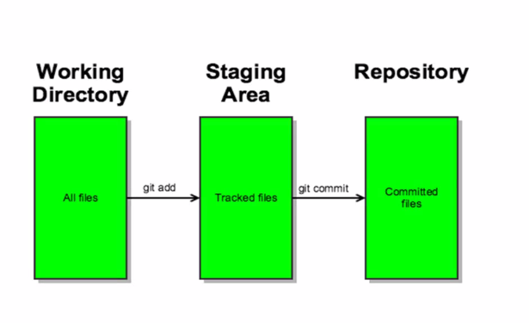
The First Commit

Slide 20
The First Commit (Commands)
vim problem_solver.rb
class Problem Solver
def solve_easy_problem
end
def solve_hard_problem
end
end
git add .
git diff
vim problem_solver.rb
class Problem Solver
def solve_easy_problem
end
def solve_hard_problem
end
def solve_tougher_problem
end
end
git diff HEAD
git diff

Slide 21
Managing the Remotes
What a Remote is
A copy of your repository hosted online
Makes your repository available for collaboration
E.g. Github, Bitbucket,beanstalk and codebase
Adding a remote and pushing changes
Create your repository in github.com
git remote add origin https://github.com/maheshkharwadkar/gitdemo.git
git remote
git push origin master
Authentication options
ssh-keygen -t rsa -C "mahesh.s.kharwadkar@gmail.com"
cat ~/.ssh/id_rsa.pub
copy ssh key to git hub -> settings -> New SSH key
git remote set-url origin git@github.com:maheshkharwadkar/gitdemo.git
touch new_file.txt
git add new_file.txt
git commit -m “new blank file”
git push origin master

Slide 22
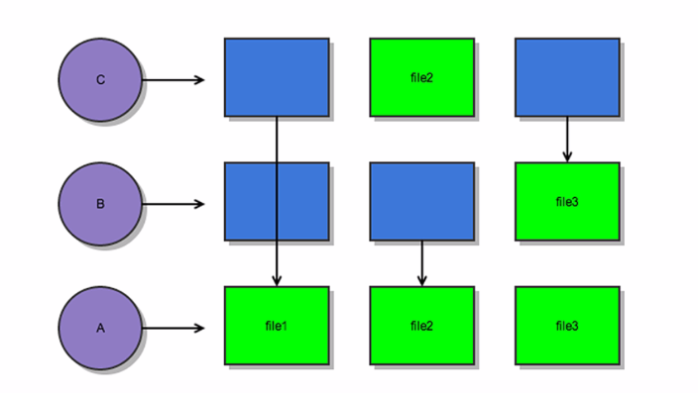
Viewing History
Origin/master – points to tip of master branch on remote
HEAD – points to tip of current local branch
git log command used to see the history
Use Commit hash to view the state of the project at any point in history

Slide 23
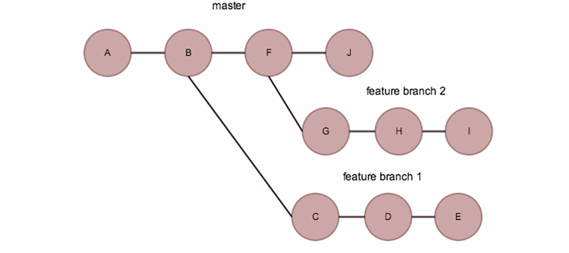
Branching and Forking
Origin/master – points to tip of master branch on remote
HEAD – points to tip of current local branch
git log command used to see the history
Use Commit hash to view the state of the project at any point in history

Slide 24
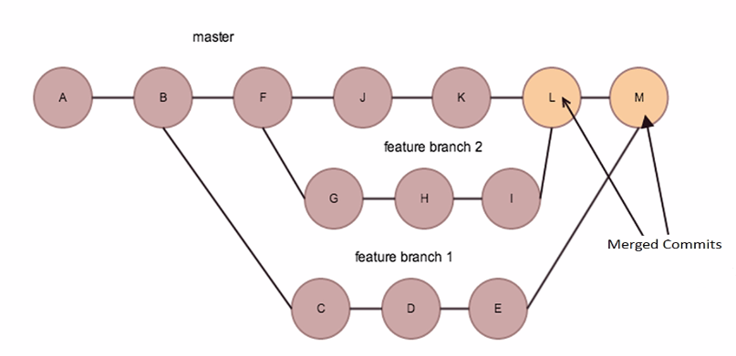

Slide 25
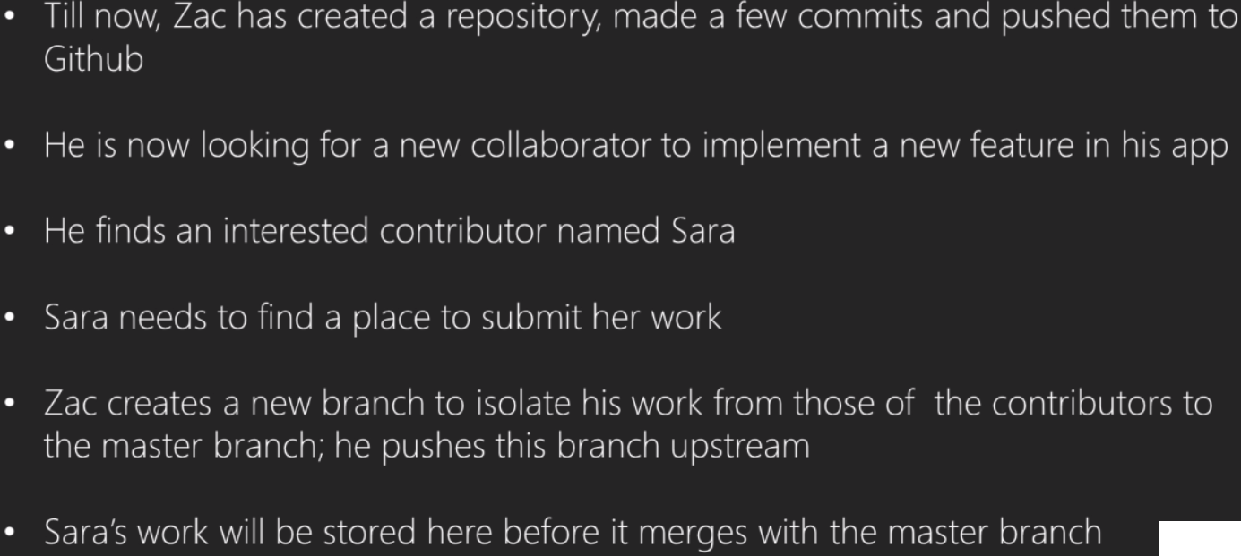

Slide 26
--Branching Example
git branch my-awsome-feature
git push origin my-awsome-feature
---Forking Example
git clone git@github.com:shyamkharwadkar/gitdem02.git
git remote add upstream https://github.com/maheshkharwadkar/gitdem02.git
git remote show

Slide 27
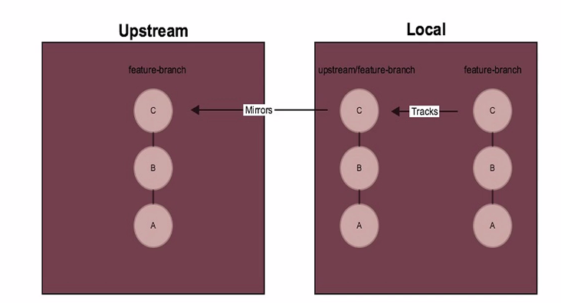

Slide 28
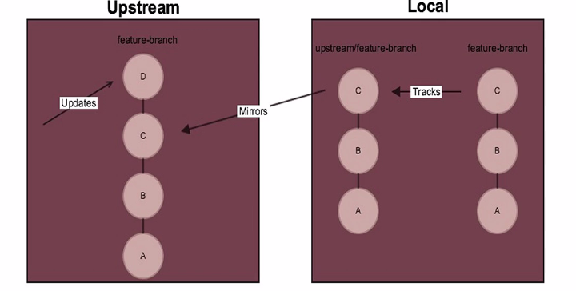

Slide 29
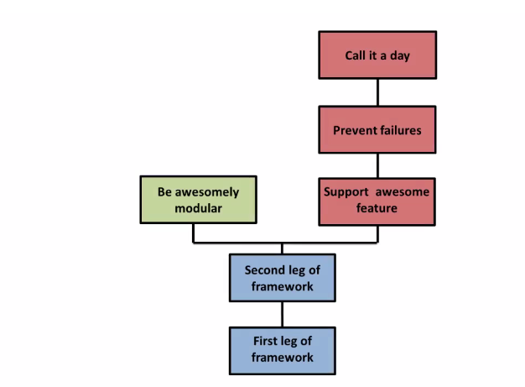

Slide 30
git fetch upstream
git checkout --track upstream/my-awssome-feature
git pull << Update local branch>>
git fetch
git status

Slide 31
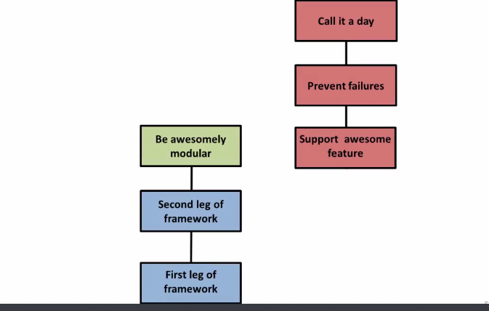

Slide 32
Rebasing - Detaching your commits from the point of divergence
git pull --rebase

Slide 33
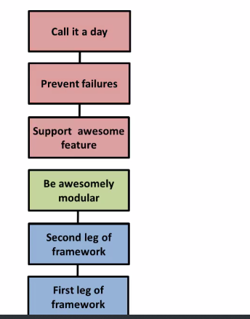

Slide 34
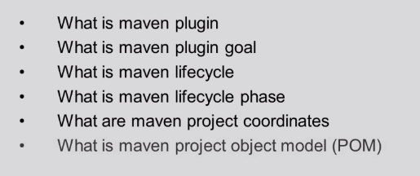
Maven

Slide 35
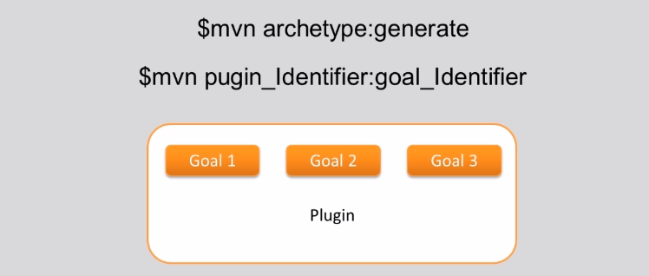
What is Maven Plugin

Slide 36
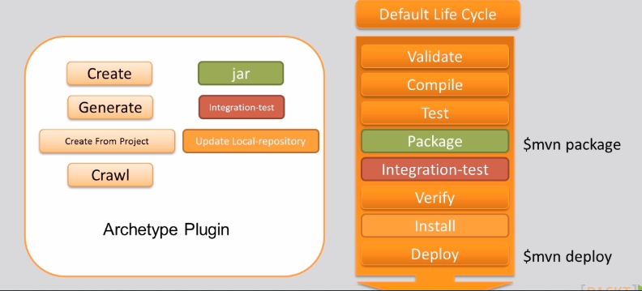
What is Maven Plugin

Slide 37
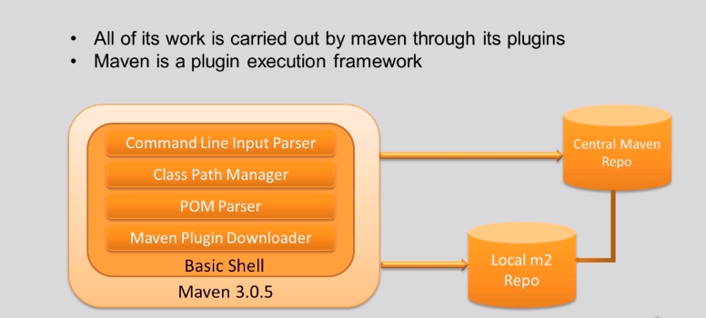
Maven Plugin Architecture

Slide 38
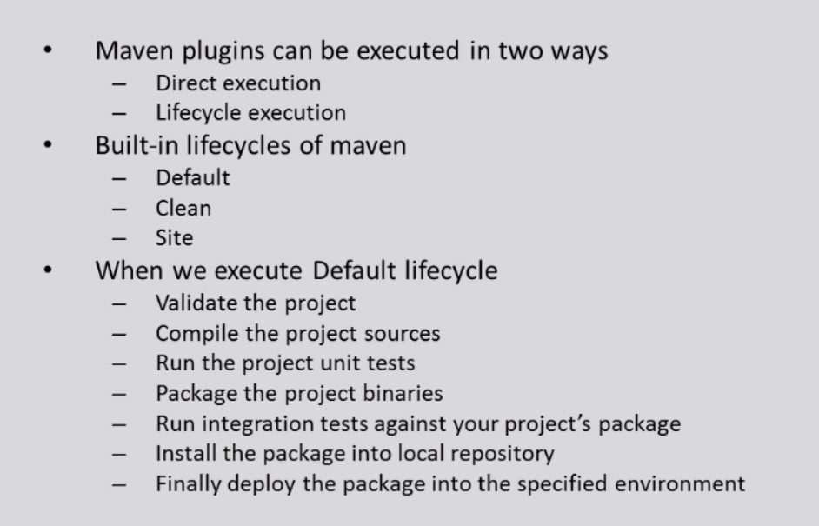
What is Maven Lifecycle

Slide 39
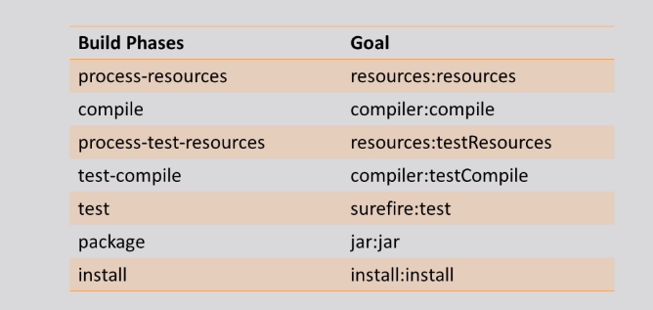
Execution of Default Lifecycle

Slide 40
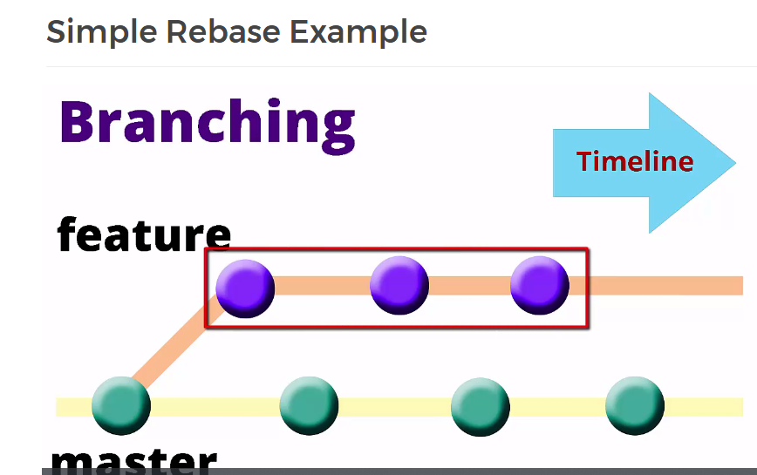

Slide 41
