Slide 1


PLEDGE TO PROGRESS Sustainability Hackathon
Sponsored By
Your Team Name : Innobank
Your team bio : Innovation for Fintech Acceleration
Date :29/04/2023

Slide 2
Problem Statement?
Automation is a key challenge for Finance and Banking sector where AIML has a great potential. AI software helps banks in streamlining and automating every task which is done by humans and making the entire process simple and virtual. AI applications can reduce the workload of bankers and optimize the quality of work. One of the best AI use case is Credit underwriting for Payments Process using Smart contract Infrastructure whose problem scope is described here:
Lack of integration: There is lack of integration at both Fintech’s IT sub-system and data organization layers, that are currently operational in Funds Release and Cash credit sub-process
Transactional visibility: Transaction handling are not very secure and tamper-proof which requires provisioning for business-oriented or decision-enabling strategic information at each stage of credit workflow automation.
Automation of tasks: Eliminate manual workloads where there is no value addition and provide end-to-end solution for the entire financial processes in Fintech.
Manual intervention: Identify those decision segments which may still require manual checks and integrate with main work workflow in payemensts process
Disparate tools – Do way with mutiple disparate tools and move to a complete MLOps supported Platform like Azure ML Studio and drive innovation.

Slide 3
User Segment & Pain Points
By integrating business and technology in jointly owned platforms run by cross-functional teams, banks can break up organizational silos, increasing agility and speed and improving the alignment of goals and priorities across the enterprise.
Artificial Intelligence Machine Learning tools have played a pivotal role in modernizing Fintech’s legacy systems and mobility solutions. Predictive business analytics solutions have helped Fintech industry in predicting customer churn, detecting and preventing fraudulent activity, managing risk, controlling unnecessary discounting patterns and improving user experience. This branch of data science is transforming our understanding in deriving exceptional insights from credit cards and payment statements, transactions, point-of-sale data, mobile payments, and much more.
AIML solutions in Fintech enables the vast datasets to be transformed into customizable dashboards and interactive advanced data visualizations. These enterprise solutions can be used to leverage information about customer behavior, needs, and preferences to achieve customer retention, improve risk controls, and enhance productivity. Having a strong analytics practice that encompasses each unit in the organization, is a strategic move to exact long-term digital transformation.

Slide 4
Pre-Requisite
MLOps Platforms Evaluted for Payments Automation Process: GCP Vertex AI, Amazon SageMaker, Azure ML Studio are analyzed for Payment Process automation and reengineering in Fintech. This ML and Blockchain workflow entails building ML container images for automating decision making. We can create a common ML custom container image for use during experimentation in user-managed notebooks instances and for training models in production at scale in Azure ML Platform Training. This ML container images will have the following properties:
Standard Deep Learning Container images from JFrog Artifactory
MLflow to run as a local service on Azure ML Studio
Cloud SQL proxy to allow the MLflow local service to communicate with the Cloud SQL backend database. It can be used with AI Platform Training. When used this way, mlrunner.py manages the execution. The script acts like a parameter gateway between the environment and the actual training session.
The container image is defined in a Dockerfile. Both Cloud SQL Proxy and MLflow start as defined in init.sh. The init.sh script is generated automatically during environment provisioning. The entrypoint.sh script routes and executes training jobs or runs Jupyter Notebooks.

Slide 5
Tools or resources
Azure ML Studio and Azure Resource Manager REST APIs will be used as the foundation for new value propositions and distinctive customer experience as envisaged below. - Design, implement and test decision models and strategies using a fully graphical drag-and-drop editor. Deploy and operationalize decision strategies and machine learning models in real-time - Put the control over risk models in the hands of the business and risk management teams: Achieve regulatory compliance by making fully documented and traceable decisions - Seamlessly manage and integrate existing ML models: Seamlessly integrate decision models into existing workflows and systems using standard APIs on Azure Resource Manager REST APIs. - Simulate & Evaluate different decision scenarios against historical credit application data of customers - Analyze the impact of model changes at a portfolio level : Run models in parallel on Azure cloud infrastructure and automate testing of models for rapid deployment. - Data-ingestion pipelines that capture a range of data from multiple sources both within Banks (e.g., clickstream data from apps) and beyond (e.g., third-party partnerships with telco providers). - Data platforms that aggregate, develop, and maintain a 360-degree view of customers and enable AIML models to run and execute in near real time. - Campaign platforms that track past actions and coordinate forward-looking interventions across the range of channels in the engagement layer.

Slide 6
Any Supporting Functional Documents
The solution includes ingesting data into a lake, cleaning and labeling the data required for diverse use cases (e.g., regulatory reporting, business intelligence at scale, AIML diagnostics), segregating incoming data (from both existing and prospective customers) to be made available for immediate analysis from data to be cleaned and labeled for future analysis.
As banks design and build their centralized data-management infrastructure, they should develop additional controls and monitoring tools to ensure data security, privacy, and regulatory compliance—for example, timely and role-appropriate access across the organization for various use cases.
Intelligent infrastructure. Fintech industries can choose Azure cloud-based platforms for higher scalability and resilience in line with AI strategy.
Azure Cloud-based infrastructure reduces costs for IT maintenance and enables self-serve models for development teams, which enable rapid innovation cycles by providing managed services
Payments - Cash credit process Business rules:
There is a sequential flow of business rules applied at multiple stages to arrive at credit decisions.
These business rules/agreements can be written in computer code (IF-Else-Then Rules) that are executed when certain conditions (Business Rules) are met.

Slide 7

Supporting Functional Documents
Smart contract makes a perfect choice in this context and have the potential to replace manual banking processes. Banks can use it to ensure compliance, evaluate credit eligibility, and create required workflow. Transactional Support for – Immutable, Tamperproof and Audit Trail enabled.
At a high level, Ethereum/Blok.One Dapps (smart contract applications) request data from Chainlink (Oracle Middleware), which in turn retrieves data from a web service built with Azure Infrastructure
Chainlink connects smart contracts with external data using its decentralized oracle network. Chainlink API requests are handled 1:1 by an oracle.
Smart contract platform (Ethereum/Block.One) can interoperate with an enterprise Azure Cloud data warehouse via oracle middleware (Chainlink).
This assembly of components allows a smart contract to take action based on data retrieved from an on-chain query to Azure Cloud Infrastructure-hosted data warehouse. Details shown in below Figure.

Slide 8
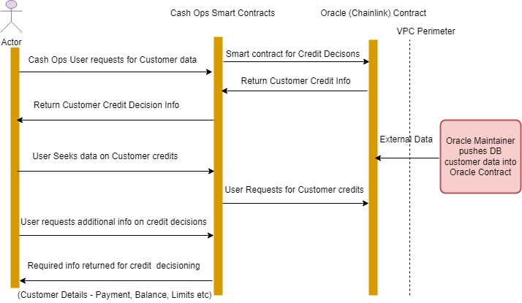
Credit Payment Automation Workflow

Slide 9
Key Differentiators & Adoption Plan
While most banks are transitioning their technology platforms and assets to become more modular and
flexible, working teams within the bank continue to operate in functional silos under suboptimal collaboration models and often lack alignment of goals and priorities. In this digital world, AI can be leveraged to bring back that customer personal connection.
Artificial Intelligence and Machine Learning can process huge amount of information about customers.
This data and information are compared and present results in a suitable services/products that customers want. This essentially means finding what’s right for your customers and hence can achieve customer satisfaction at the high level.
To ensure sustainability of change, we recommend a two-track approach that balances short-term projects that deliver business value every quarter with an iterative build of long-term institutional capabilities.
Fintech segment might elect to keep differentiating core capabilities in-house and acquire non-differentiating capabilities from technology vendors and partners, including AIML specialists.
For many banks, ensuring adoption of AI technologies across the enterprise is no longer a choice, but a
strategic imperative. As financial services providers continue on their digital transformation, there will be an increase in AI and ML security solutions in near future.

Slide 10
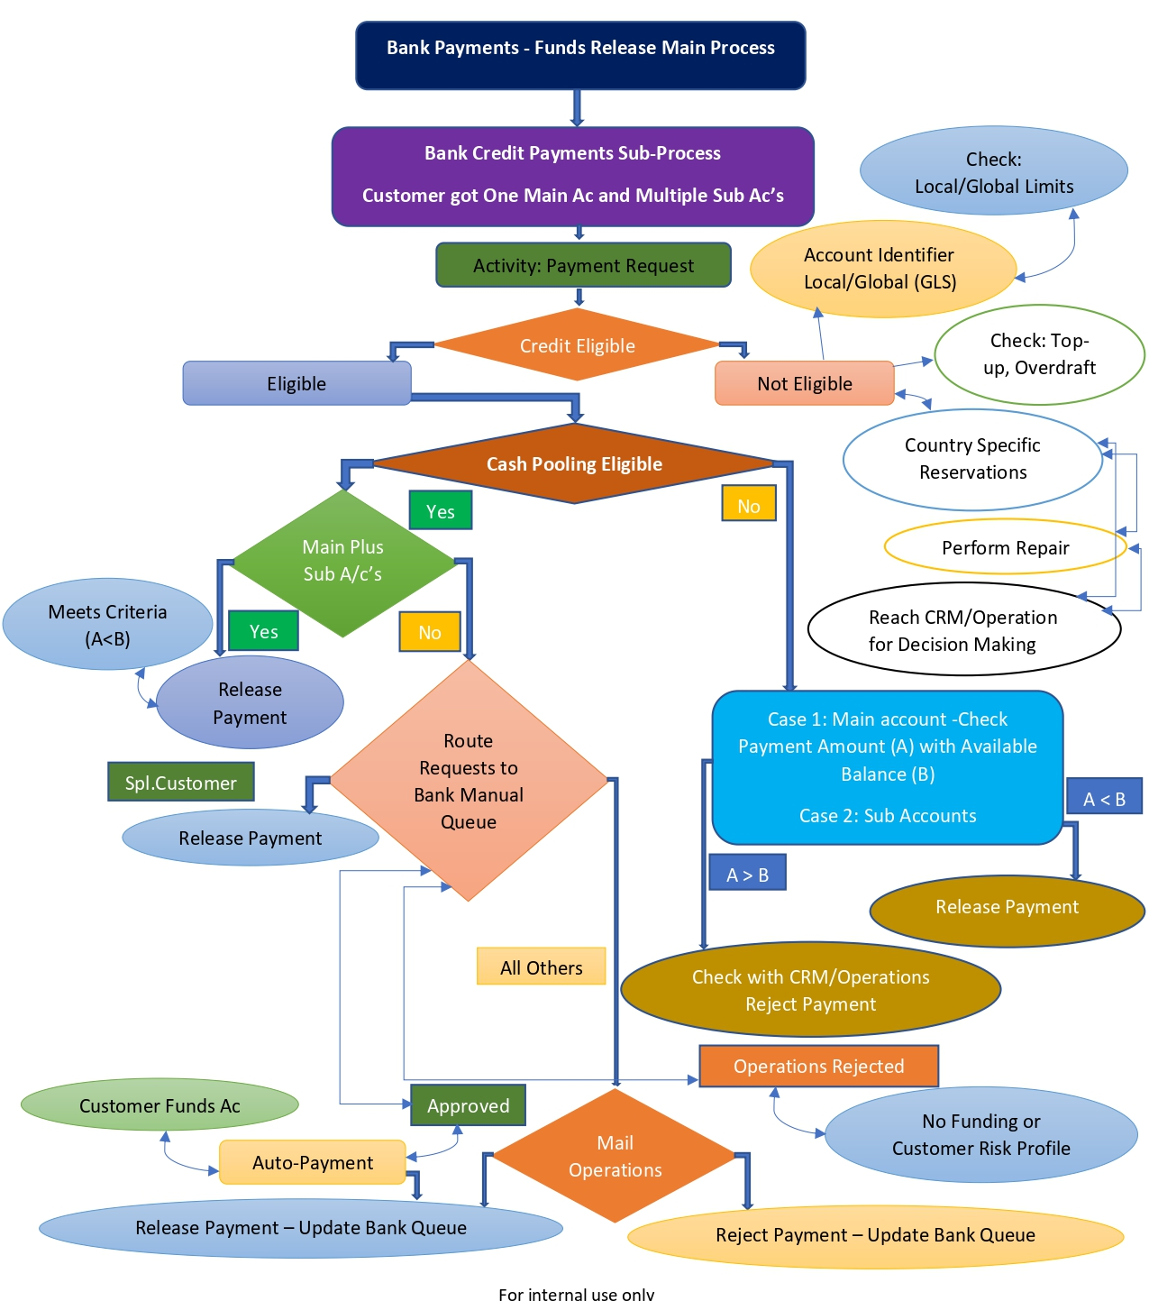
GitHub Repository Link- https://github.com/hanumanthsistla/hanu-ml-hack

Slide 11
Thank You
Dr Hanumanth Sastry Sistla PhD (Computer Science & Systems Engineering)

