Slide 1
Zepto Product & Pricing Insights Workflow
Data Analysis Flow | Visual Breakdown

Slide 2
Agenda
1. Import Libraries
2. Load & Clean Data
3. Create Derived Columns
4. Exploratory Data Analysis (EDA)
5. Visual Workflow Diagram
6. Key Insights & Next Steps

Slide 3
Workflow Steps
1. Import Libraries (pandas, matplotlib, seaborn, etc.)
2. Load Excel Dataset (zepto_v1.xlsx)
3. Clean Data (normalize columns, convert types)
4. Create Derived Columns (e.g., discount_bucket)
5. Visual Analysis:
- Bar: Avg Discount / Product Count
- Pie: Category Share
- Sunburst: Category → Discount → Stock
- Boxplot / Scatterplots / Histogram
6. Generate Insights or Reports

Slide 4
Visual Workflow Diagram
Refer to the flowchart image on the next slide for a visual overview.

Slide 5
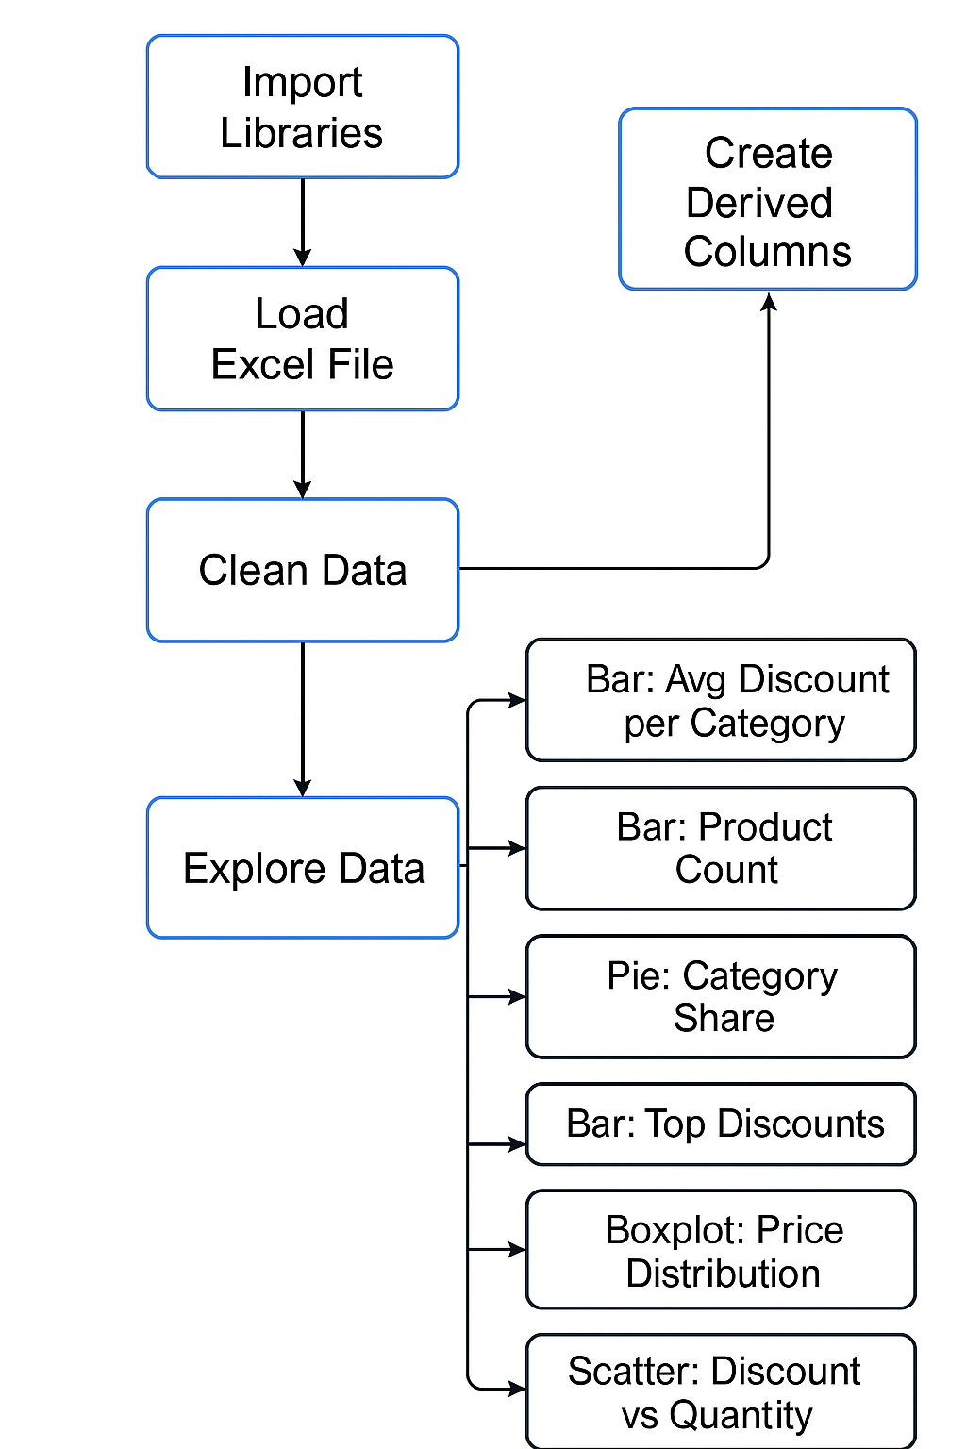

Slide 6
Key Insights & Next Steps
Insights:
- Highest discounts in Category X
- Low stock in Category Y
- Outlier prices in Category Z
- Top 10 products by revenue
Next Steps:
- Validate missing data
- Analyze low-stock SKUs
- Share dashboards
- Plan follow-up analysis

