Slide 1
Rendering 3D Objects
In C++
Using OpenGL ES
By Stephanus Hanurjaya

Slide 2

Personal Info:
Stephanus Hanurjaya
“"A gaming enthusiast, passionate in coding,
and want to learn more about game development.".
Contact : 088219719445 /
stephanus.hanurjaya@gmail.com

Slide 3
The purpose :
To Render 3D Objects

Slide 4
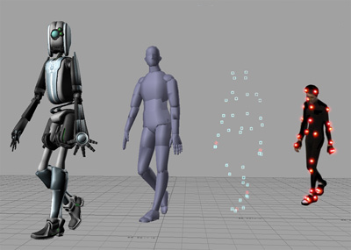
“3D rendering is a two dimensional representation of a computer wireframe model that has been given properties such as texture, color, and material”
Source :
https://www.easyrender.com/3d-rendering/3d-rendering-a-brief-explanation
https://en.wikipedia.org/wiki/3D_rendering#/media/File:Activemarker2.PNG

Slide 5

OpenGL for Embedded Systems (OpenGL ES or GLES) is a subset of the OpenGL computer graphics rendering application programming interface (API) for rendering 2D and 3D computer graphics such as those used by video games, typically hardware-accelerated using a graphics processing unit (GPU).
Source :
https://en.wikipedia.org/wiki/OpenGL_ES#/media/File:OpenGL_ES_logo_(Nov14).svg
https://en.wikipedia.org/wiki/OpenGL_ES

Slide 6
The
Goals
Create Android app that render multiple 3D objects
Make the 3D objects move
Change the colour of the 3D objects

Slide 7

Why C++?
The advantages :
Can be used for low-level programming, such as scripting for drivers and kernels and it also supports functions of high level programming languages, such as scripting for software applications etc
C and C++ are near universal to every computing platform
Many C libraries to support games development
The disadvantages :
By choosing to use C++, you are not being “more native” to Android than using a managed language such as Kotlin or Java.
Source :
https://en.wikipedia.org/wiki/C%2B%2B#/media/File:ISO_C%2B%2B_Logo.svg

Slide 8

Result of the Research
Rendering 3D Objects in C++ using OpenGL ES
Source :
https://en.wikipedia.org/wiki/Android_(operating_system)#/media/File:Android_robot_2014.svg

Slide 9
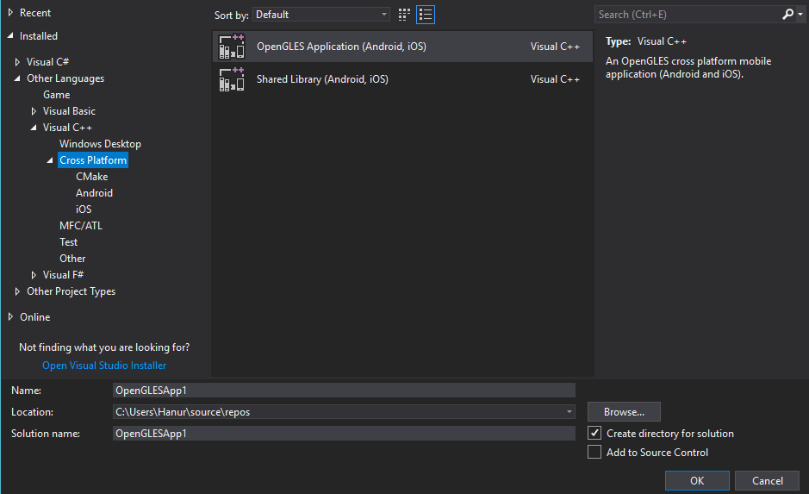
Visual Studio 2017
No OpenGLES2 …
According to Visual Studio developer community, openGL ES 2 application template has been removed…
There are many development files designed to implement openGL 2 and 3 to Windows and still I can’t make it works. There are always errors when compiling the program.
Source :
https://developercommunity.visualstudio.com/content/problem/31899/where-is-the-visual-c-opengles-2-application-andro.html

Slide 10
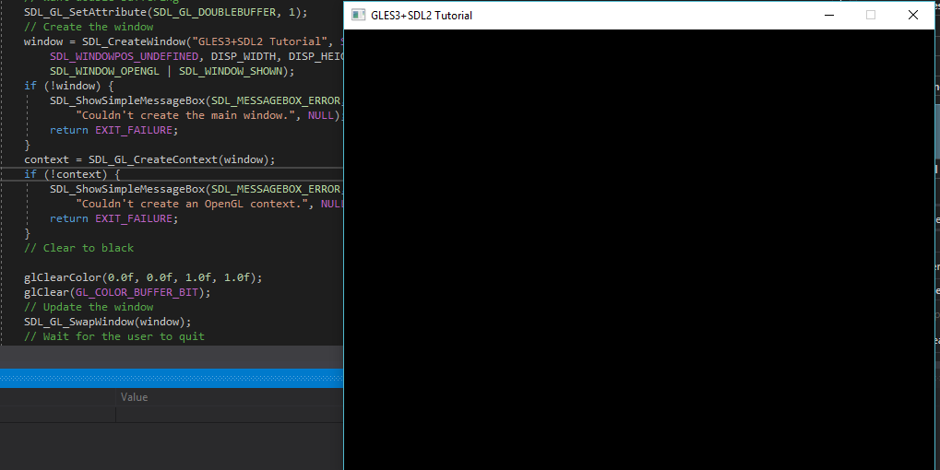
One of the errors. The background colour won’t change despite all the efforts that had been done.
Because of that, the only option left is using the “openGLES Application (Android, iOS)”.

Slide 11
The Big Plan
Read | Use Example | Modify
Read the openGLES 1 Reference pages to understand the function for openGLES. The Site : https://www.khronos.org/registry/OpenGL-Refpages/es1.1/xhtml/ | Using the Cube example from openGLES template in Visual Studio to learn the implementation of openGLES in 3D rendering. | Modify the code from cube example and try to make something new.

Slide 12

The Realization

Slide 13
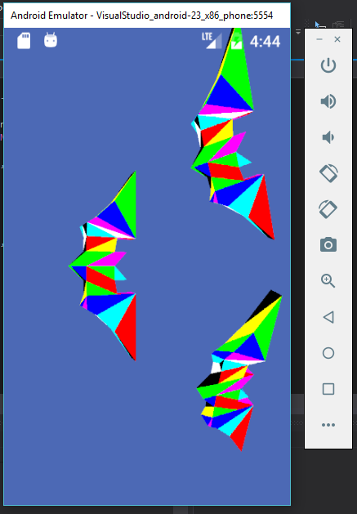
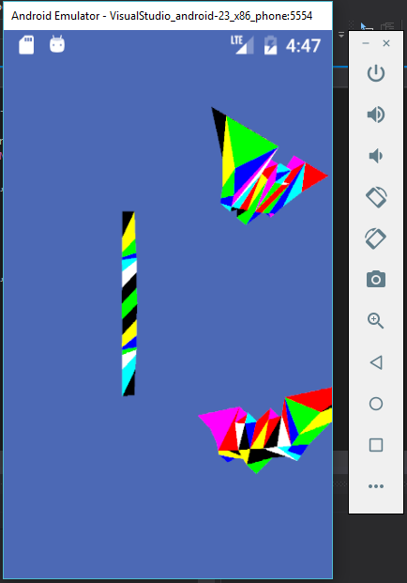
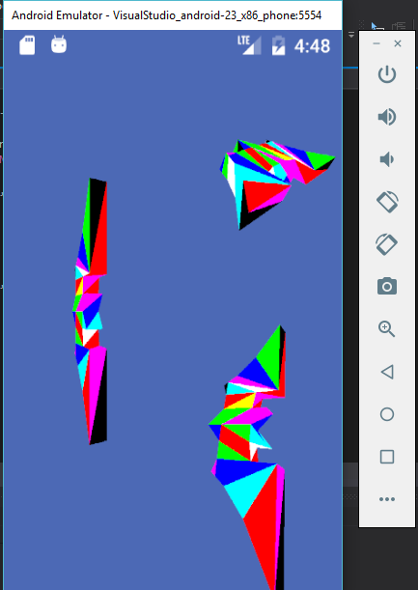
Spinning Batman Symbol
The app debugged using android emulator

Slide 14
The Tasks | The functions
Change Background Color | Use glClearColor()
Colouring the triangle mesh without gradation | glEnable(GL_CULL_FACE)
Make the object spin | glRotatef()
Drawing objects method | Using GL_TRIANGLES. Not triangle fan or strip

Slide 15
The Conclusion
OpenGLES can be use to develops app for android and iOS
Most tutorial create the app using android studio. With the many problem when compiling code in Visual Studio, it seems that moving to Android Studio is a reasonable choice.
There are still plenty things to learn in 3D programming using openGLES like shading, shadowing, using texture, etc.

Slide 16
References
Https://www.easyrender.com/3d-rendering/3d-rendering-a-brief-explanation
https://en.wikipedia.org/wiki/3D_rendering#/media/File:Activemarker2.PNG
https://en.wikipedia.org/wiki/OpenGL_ES#/media/File:OpenGL_ES_logo_(Nov14).svg
https://en.wikipedia.org/wiki/OpenGL_ES
https://en.wikipedia.org/wiki/C%2B%2B#/media/File:ISO_C%2B%2B_Logo.svg
https://medium.com/androiddevelopers/getting-started-with-c-and-android-native-activities-2213b402ffff
https://en.wikipedia.org/wiki/Android_(operating_system)#/media/File:Android_robot_2014.svg
https://developercommunity.visualstudio.com/content/problem/31899/where-is-the-visual-c-opengles-2-application-andro.html

Slide 17
Documentations

Slide 18
Thanks You!

