Slide 1
TABLEAU
Airbnb Pricing Analysis
What drives listed prices: location, bedroom count, and time
Hanu Sri | Data Analyst | Dubai, UAE
Notes:
Introduce yourself in one sentence, then say this project is about what drives Airbnb listing prices.

Slide 2
Three questions I set out to answer
1
2
3
Where?
What size?
When?
Which zipcodes have the highest and lowest listed prices?
How does the number of bedrooms change the price, and which sizes are most common?
How do listed prices change over time?
Notes:
These are the same kinds of questions a market analyst asks about any region: where is demand strong, what size sells, and how does it change over time.

Slide 3
Data and approach
Listings table
92 columns of property details
Tableau
5 views
1 dashboard
Price by zipcode, bedrooms, time
joined
Calendar table
Daily listed prices
Note: prices are listed prices, not confirmed bookings, so they show asking prices rather than revenue.
Notes:
Say clearly that these are listed prices, not actual revenue. It shows you understand what the data can and cannot prove.

Slide 4
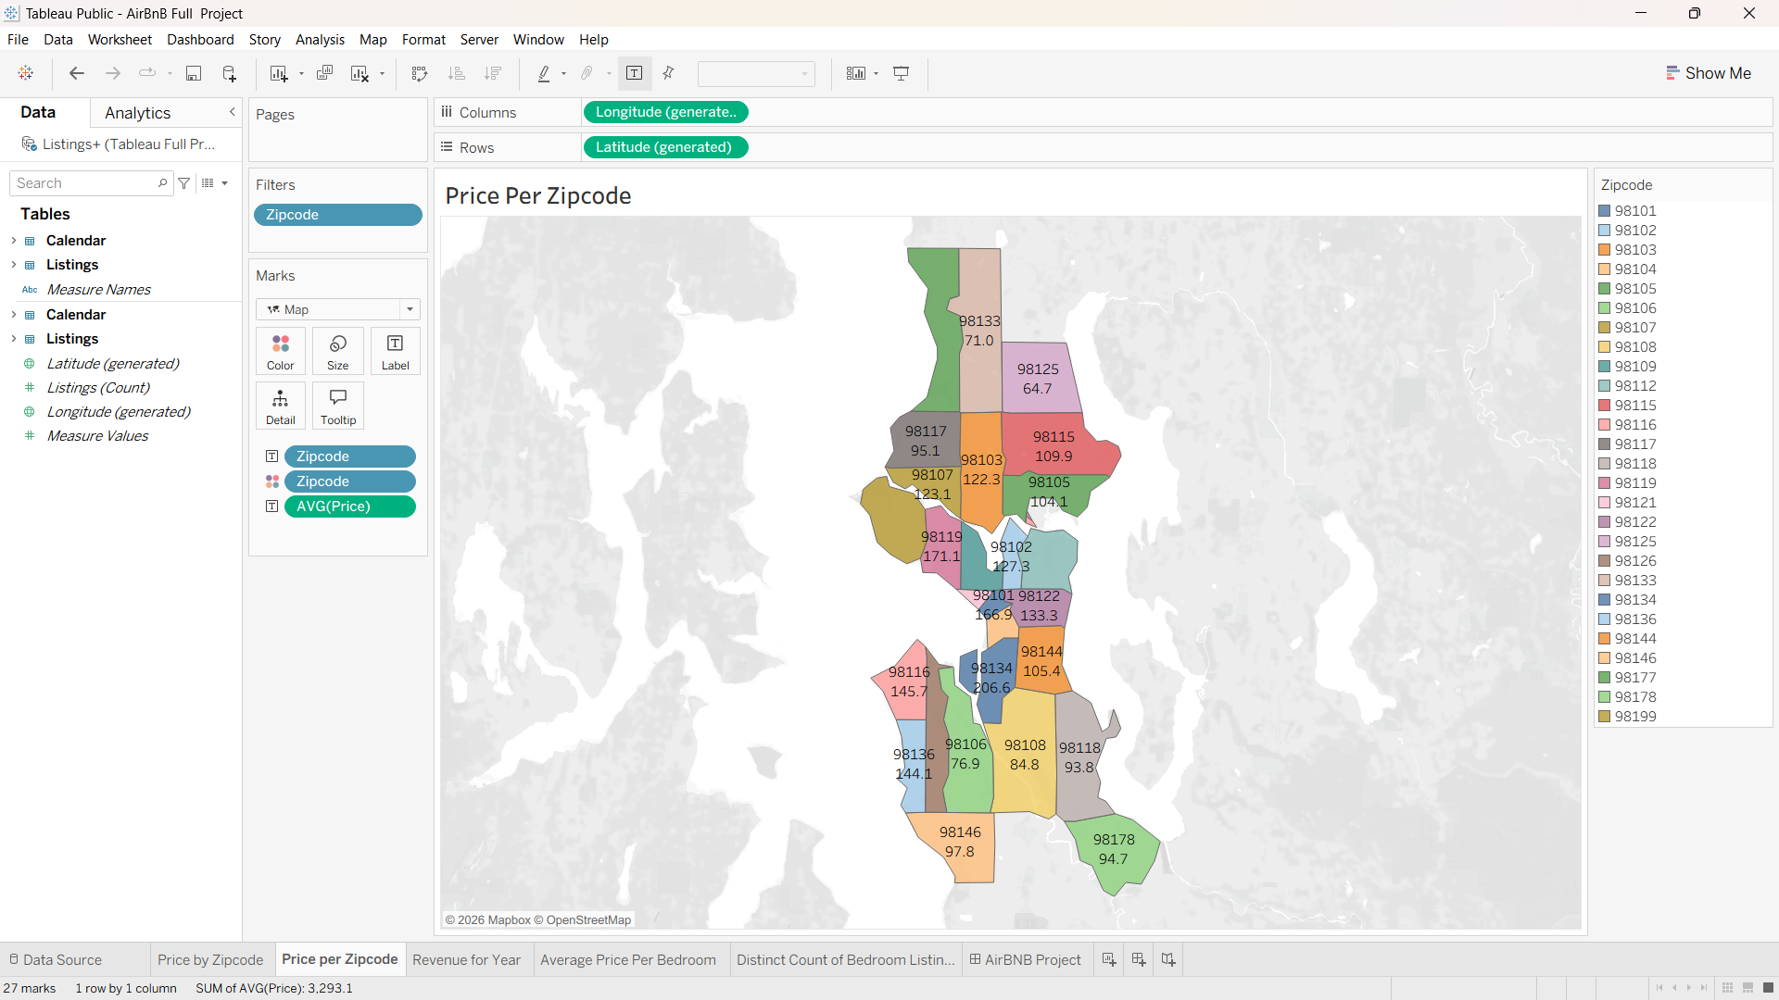
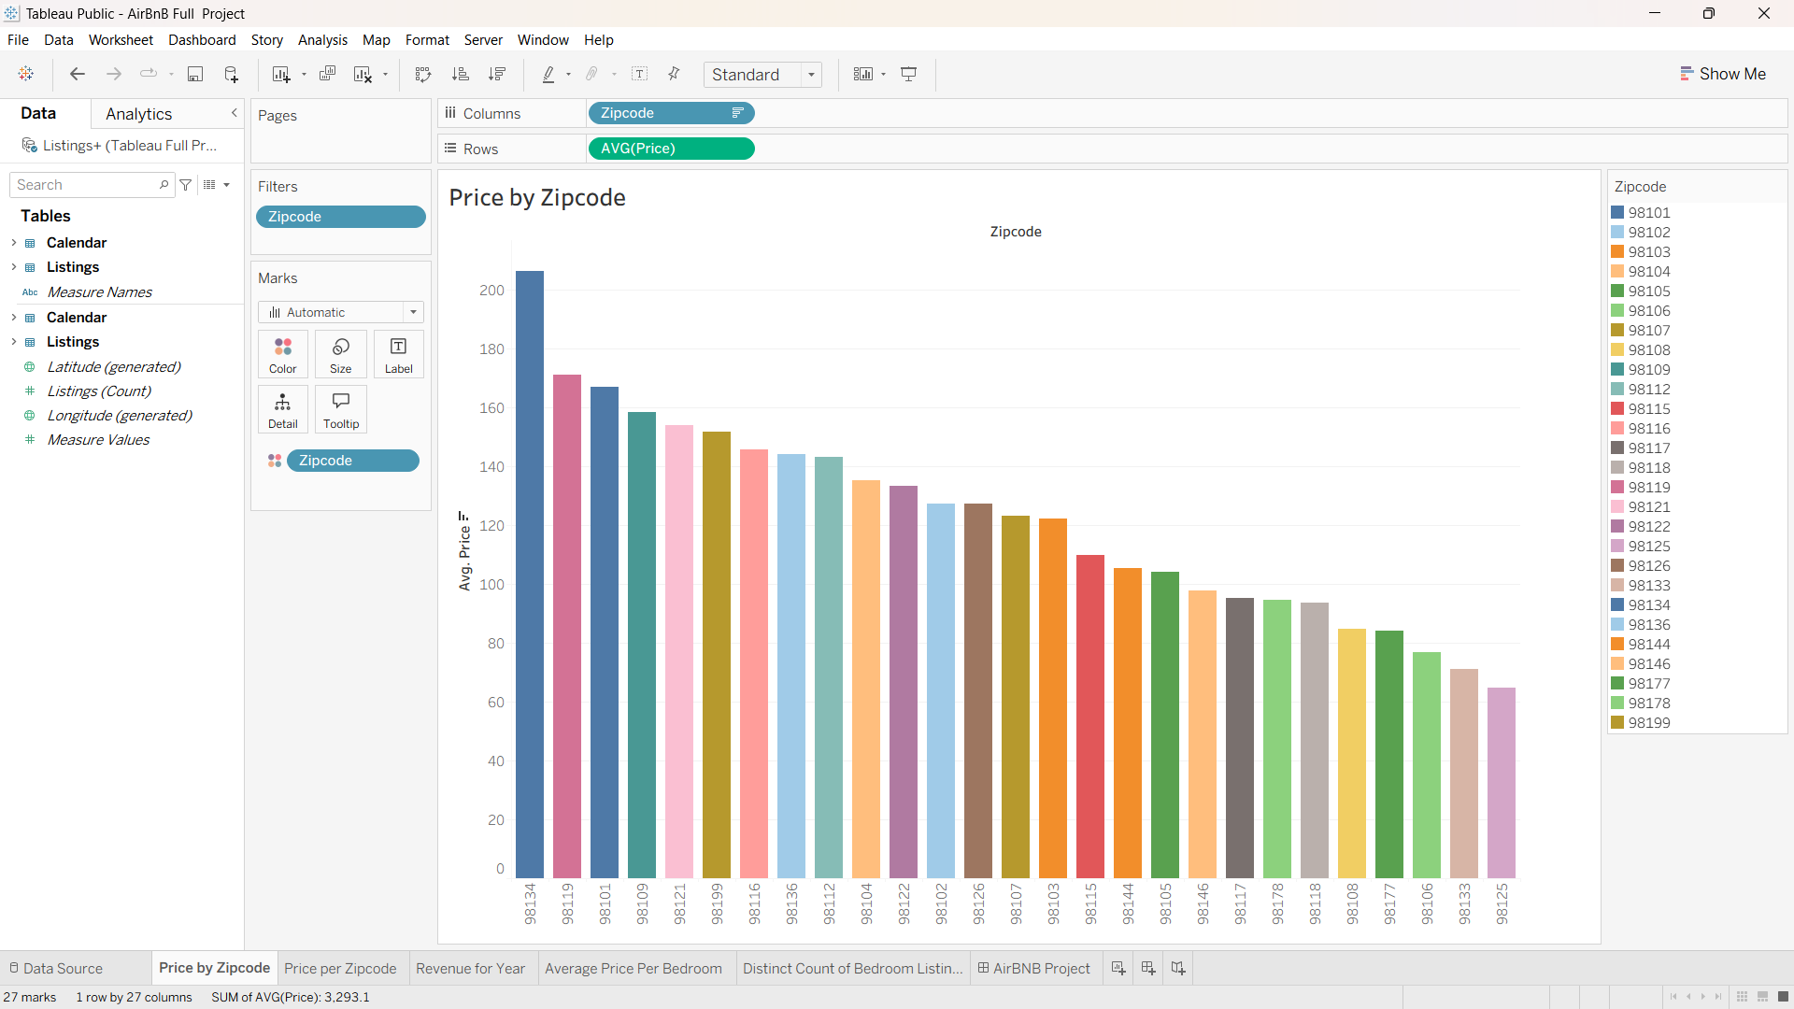
Price varies by location
Two views: average price by zipcode, and the same data on a map.
Paste your Tableau screenshot here
(Insert > Pictures)
Notes:
Replace the box on the right with your zipcode chart or map screenshot. Then edit the key finding with the real numbers from your dashboard.

Slide 5
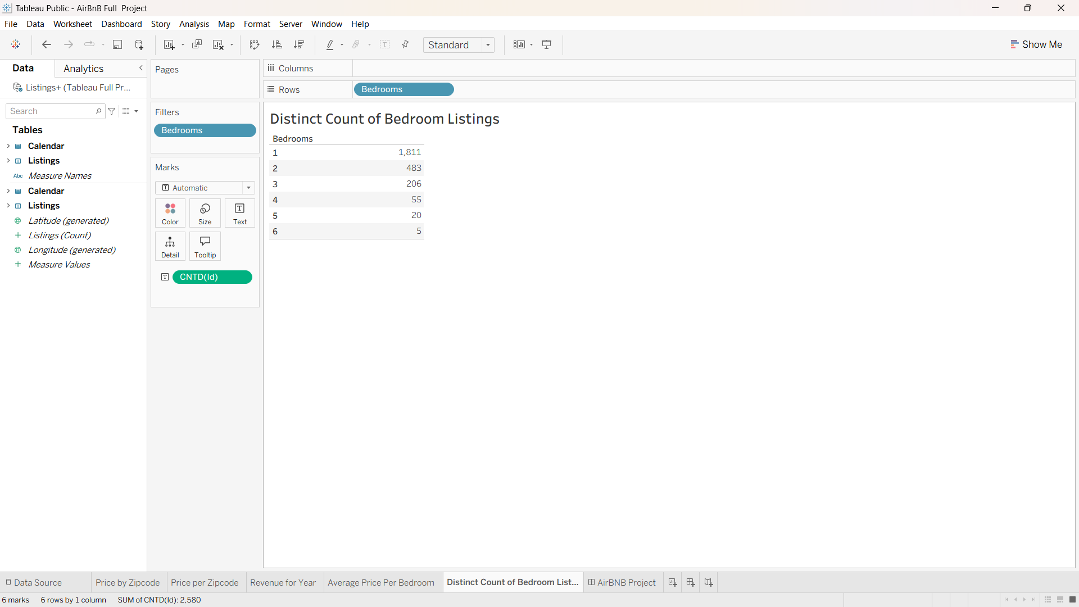
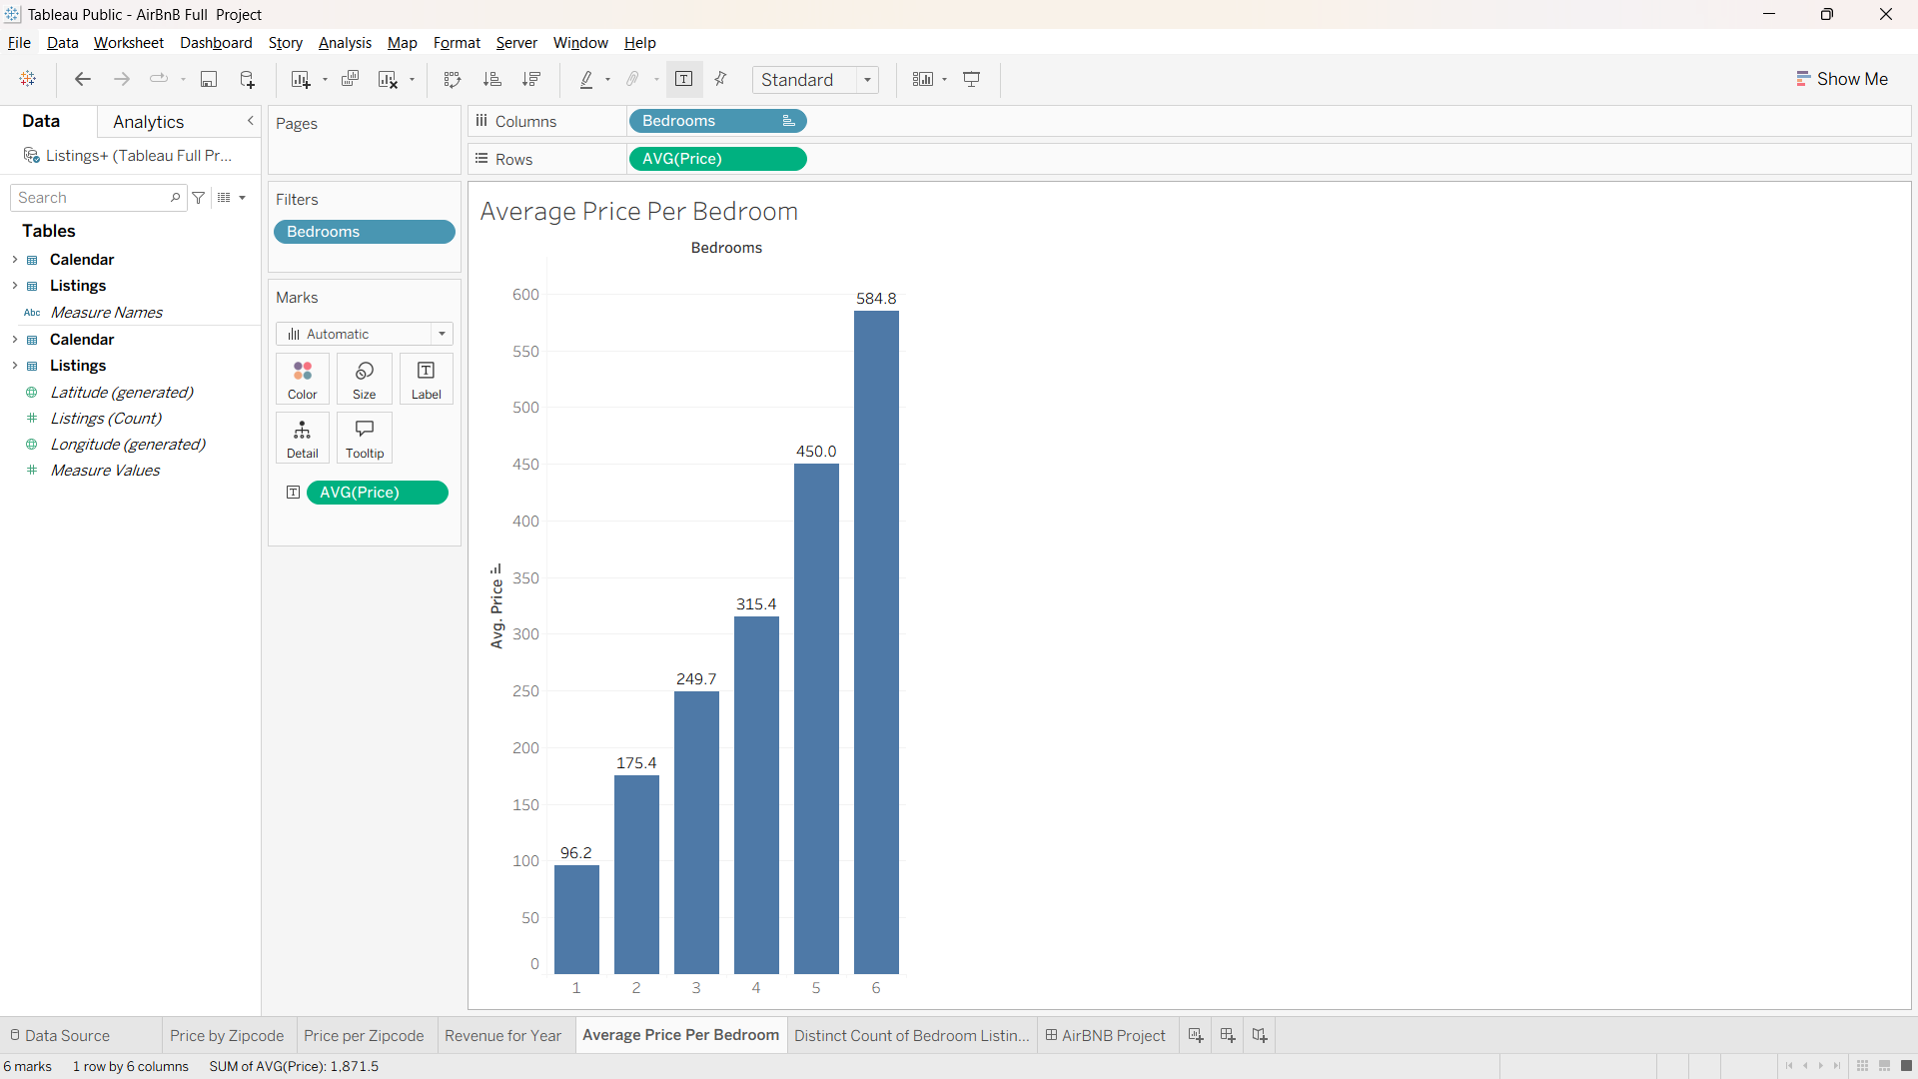
Price rises with bedroom count
Paste your Tableau screenshot here
(Insert > Pictures)
Views: Distint count of Bedroom Listings and Average price for bedroom
Key finding: [ Most listings have 1 bedrooms; average price rises from $96.2 to $584.8]
Notes:
Check the title matches your chart. If price does not rise steadily with bedrooms, change the title to describe what you actually see.

Slide 6
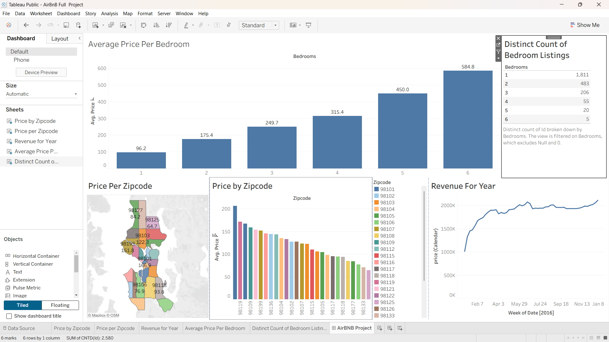
Listed prices change over time
Paste your Tableau screenshot here
(Insert > Pictures)
Key finding: :Revenue peak in December and are lowest in Feb]
Notes:
Describe the trend in one sentence: when prices are highest and lowest, and a likely reason.

Slide 7
What this project shows
1
Compare places
Comparing prices across locations is the same skill as comparing markets.
2
Spot patterns
Size and timing patterns show where demand is strong.
github.com/hanusriuae-a11y | linkedin.com/in/hanusrib
Notes:
Connect it to the job: market research means comparing places, spotting gaps, and presenting clearly.

