Slide 1
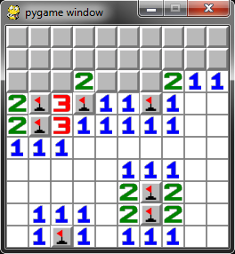
MINESWEEPER AGENT
https://github.com/hanv81/minesweeper

Slide 2
Outline
Introduction
Framework
Model
Train
10x10x10
6x6x3
4x4x4
Test
10x10x10
Application Demo

Slide 3
Introduction - Framework
Numpy
Keras
Matplotlib
Gym
Pygame

Slide 4
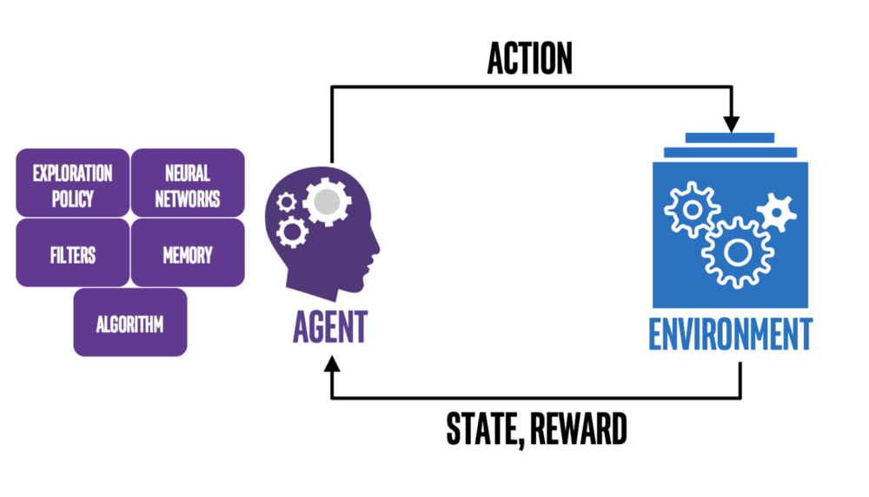
Introduction - Model

Slide 5
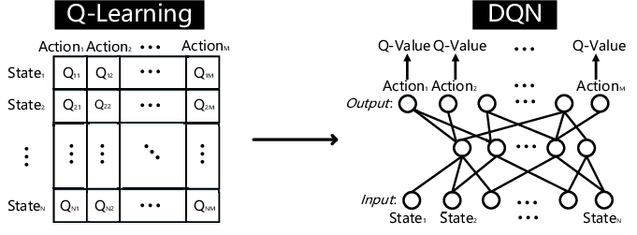
Model

Slide 6
Model
Input: state (2d array rows * columns)
Hidden layer: 512 nodes, relu
Output: vector Q value, linear
Loss: MSE
Metrics: Accuracy

Slide 7
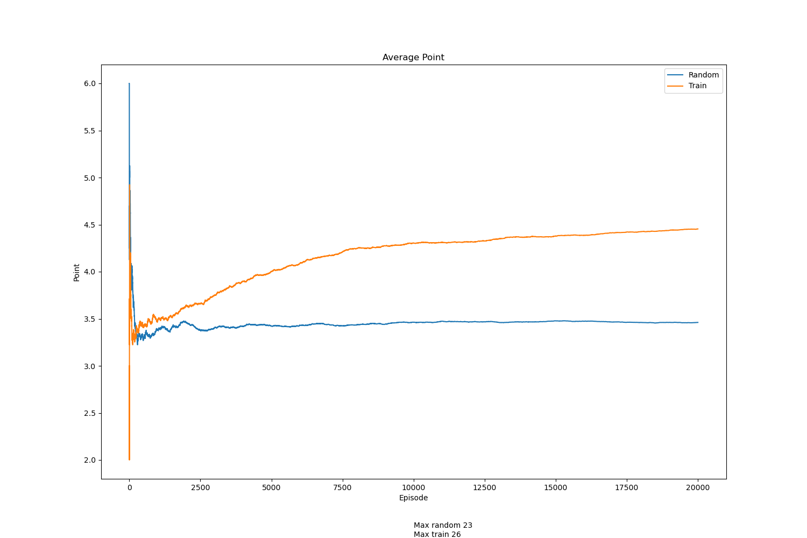
Train 10x10x10

Slide 8
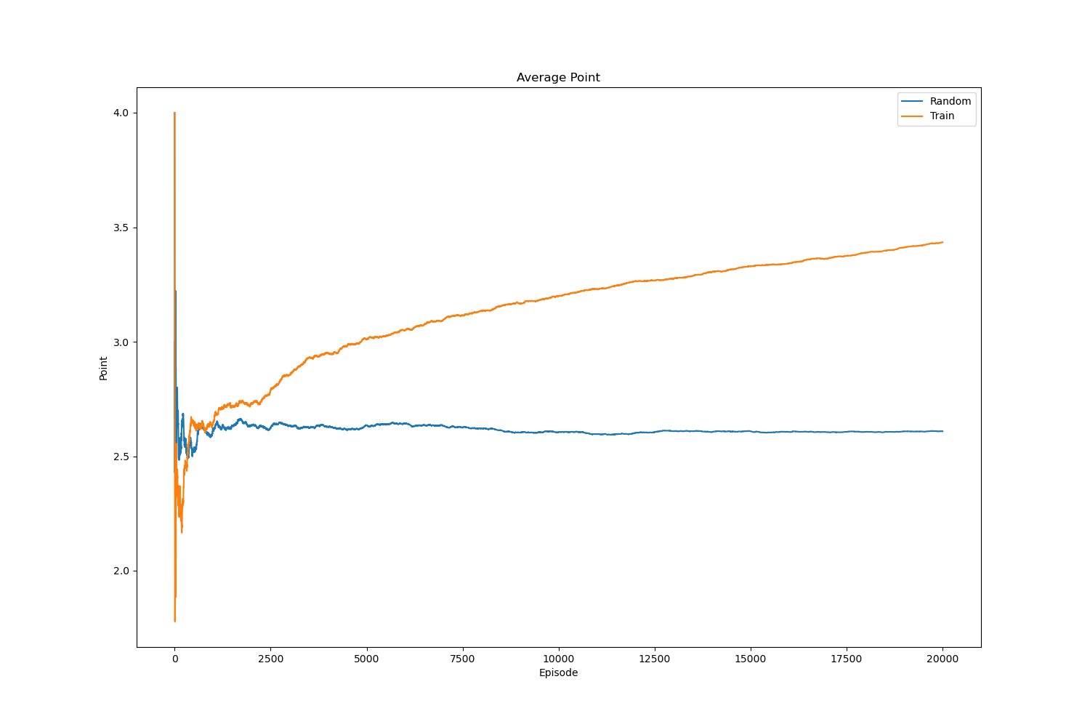
Train 6x6x3

Slide 9
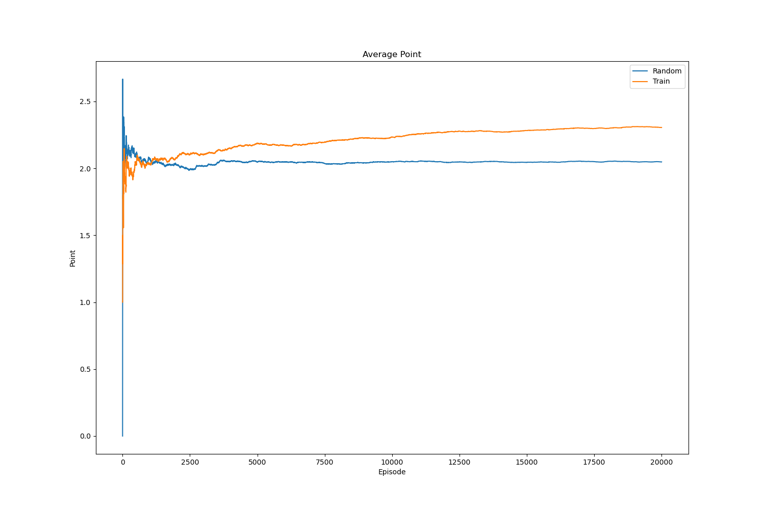
Train 4x4x4

Slide 10
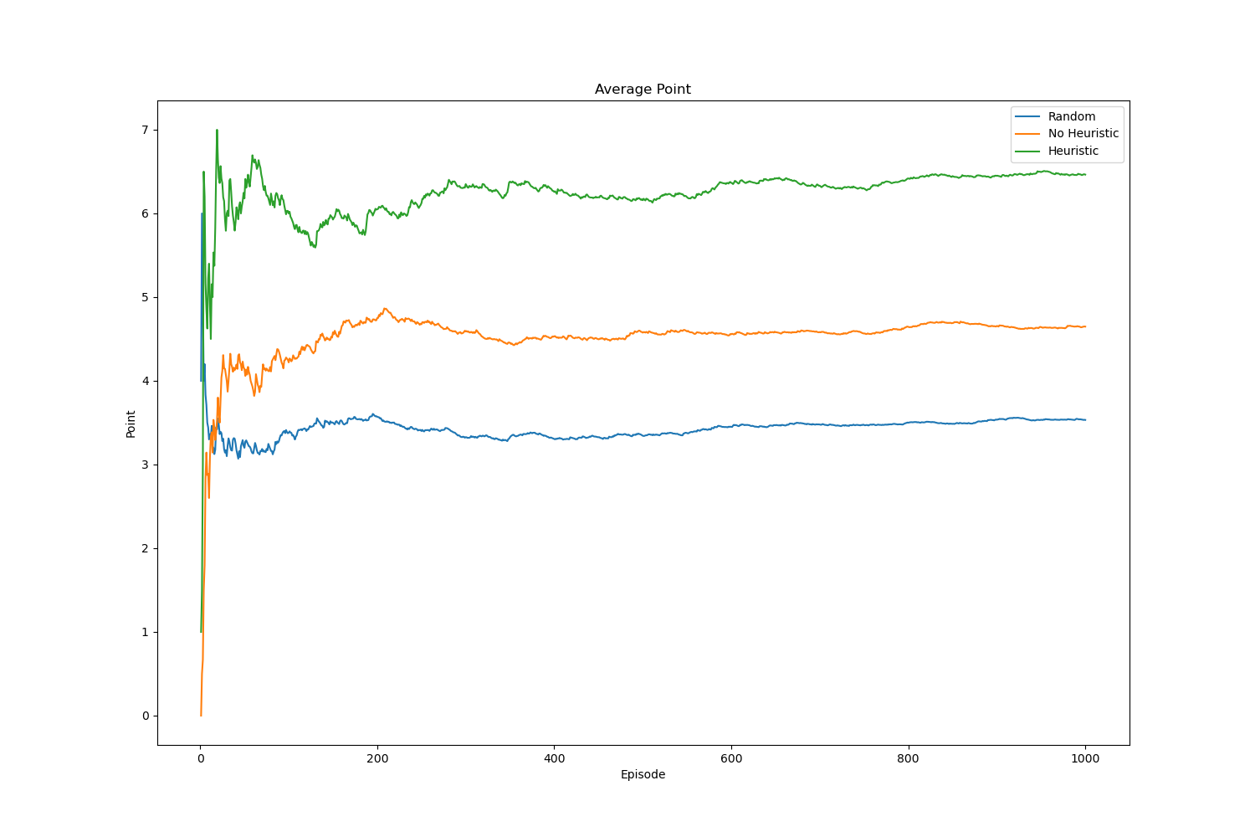
Test 10x10x10

Slide 11
Demo

