Slide 1


Reproducibility in (Scientific) Machine Learning
Materials at: https://github.com/hanveiga/amld-2021-repML
Organizers:
Maria Han Veiga (MIDAS)
Miles Timpe (UZH)

Slide 2
Agenda
State of affairs
Types of reproducibility
Reproducibility checklist
Useful tools

Slide 3
State of affairs
There are various guides in industry (e.g: google hand book, etc)
There is a difference between ML for industry and ML for academia
There’s no standard practices for ML development in the scientific context

Slide 4
Industry Perspectives on AI/ML
Proprietary, closed source and closed data
Generally concerned more with the underlying data than the models
Iterate quickly to keep performance edge over competitors
Not usually concerned with how the model is making its predictions
No peer-review and no need for reproducibility
Some exceptions, for example in banking for regulatory compliance, safety-critical applications such as autonomous driving and flight, and some medical applications. But still the Wild West mostly.
Emphasis on deployment / online systems

Slide 5
Scientific Perspectives on AI/ML
Surrogate model for complex problems
How is the model making its predictions?
Is the model actually learning physical laws and relationships?
Can the model be generalized to other problems?
How does the model compare to non-ML approaches?
Can the results be independently reproduced?

Slide 6
Scientific Perspectives on AI/ML
Big datasets are readily available in most scientific fields.
In recent years, increasingly accessible machine learning frameworks (e.g., Keras) have led to an exponential rise in the number of AI/ML papers in scientific journals.
An emergence of lazy papers often with no discernible scientific aim, e.g.: “We applied sklearn’s MLPRegressor to this problem and achieved higher accuracy than previous models. QED.”
Many of these papers breeze through the peer-review process, likely because there is lack or rigor and/or understanding when it comes to reviewing machine learning methods.

Slide 7
Scientific Perspectives on AI/ML
Some data can’t be openly shared (e.g., medical records)
Nonetheless, those who do have access to the protected data still need to be able to reproduce your results
Reproducibility may not always go hand-in-hand with explainability
Even so, the author(s) should make every effort to explain how the model arrived at its predictions.
Consider when explainability is indispensable to the scientific goal. Higher accuracy isn’t always a result worth publishing without explainability.

Slide 8
The Pillars of Scientific AI/ML
Reproducibility
Open access
Open data
Open source
Explainability / Interpretability

Slide 9
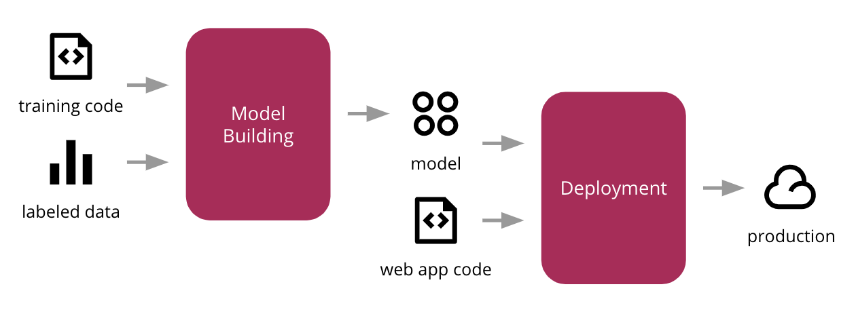
Scientific ML vs Industry ML
Iterative process
Business question
Paper
Scientific question
Dataset
re-use
Notes:
Typically, we are not interested in deploying an online ML system.
We usually operate in a more controlled execution environment. (No end users)
We want the system to be reproducible.

Slide 10
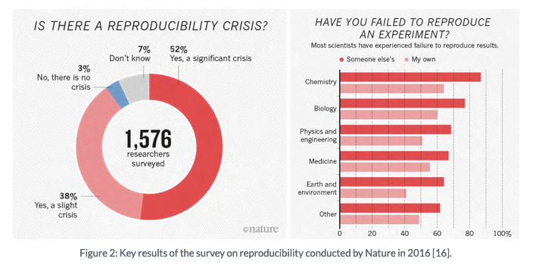
Reproducibility
Notes:
ML reproducibility is not the first time that we come across issues with reproducing scientific results. A survey conducted in 2016 shows that in “hard” sciences, many fields struggle with reproducibility (this becomes worse in soft sciences).

Slide 11
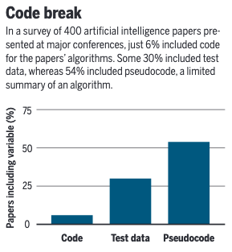
Reproducibility in ML
Notes:
An article in science magazine from 2018 looked at 400 articles from top journals / conferences and has found that:
- unable to reproduce cutting edge results - paper by goodman eventually retracted
people don’t share their code - 2018 - 6% of authors shared codes in 400 algos
Training data is not shared
Sensitivity to hyperparameters
And this is in machine learning conferences, not scientific fields that are using ml as a tool. Best believe this is worst…

Slide 12
Reproducibility in ML
In 2018, 6% of authors shared codes (out of 400)
Training data is not shared
This is in machine learning conferences
Scientific fields using ML as a tool are likely worse
Notes:
An article in science magazine from 2018 looked at 400 articles from top journals / conferences and has found that:
- unable to reproduce cutting edge results - paper by goodman eventually retracted
people don’t share their code - 2018 - 6% of authors shared codes in 400 algos
Training data is not shared
Sensitivity to hyperparameters
And this is in machine learning conferences, not scientific fields that are using ml as a tool. Best believe this is worst…

Slide 13
Reproducibility
Why is it important? Real world consequences
Reproducibility is not only an epistemological concern, but also an urgent ethical and political problem.
AI/ML is increasingly being used drive decision making. For example:
How should the government respond to a deadly pandemic?
Should a patient undergo further testing for cancer or be sent home?
In which communities should an NGO invest foreign aid?
The trolley problem for self-driving cars (maybe)
Notes:
An article in science magazine from 2018 looked at 400 articles from top journals / conferences and has found that:
- unable to reproduce cutting edge results - paper by goodman eventually retracted
people don’t share their code - 2018 - 6% of authors shared codes in 400 algos
Training data is not shared
Sensitivity to hyperparameters

Slide 14
Reproducibility
Why is it important?
In many contexts it is clearly unethical to make use of so-called “black box” models when the predictions have real-world consequences
At best, it’s lazy science. At worst, it’s pseudo-science that informs bad decisions and gets people killed.
While reproducibility is only one part of mitigating bad science, it does:
Showing that the outcomes are not random or a fluke
Demonstrating understanding of the underlying methodology
Failure to replicate results often leads to disproving original claims
Notes:
An article in science magazine from 2018 looked at 400 articles from top journals / conferences and has found that:
- unable to reproduce cutting edge results - paper by goodman eventually retracted
people don’t share their code - 2018 - 6% of authors shared codes in 400 algos
Training data is not shared
Sensitivity to hyperparameters

Slide 15
Types of reproducibility
What does research reproducibility mean?, S. Goodman et al., Science Translational Medicine, 2016
According to Goodman et al., there are 3 types of reproducibility:
Methods
Results
Inferential
Notes:
Let’s formalize what we mean by reproducibility. --- the paper of goodman from 2016 refers to medical research, but it makes sense to apply these definitions also to ml.

Slide 16
Methods reproducibility
What does research reproducibility mean?, S. Goodman et al., Science Translational Medicine, 2016
Methods reproducibility is (…) the ability to implement, as exactly as possible, the experimental and computational procedures, with the same data and tools, to obtain the same results as in an original work.
Methods reproducibility involves providing enough detail about the procedures and data in the study so the same procedures could be exactly repeated.
Notes:
An article in science magazine from 2018 looked at 400 articles from top journals / conferences and has found that:
- unable to reproduce cutting edge results - paper by goodman eventually retracted
people don’t share their code - 2018 - 6% of authors shared codes in 400 algos
Training data is not shared
Sensitivity to hyperparameters

Slide 17
Methods reproducibility
Why is it important?
Establishing baselines to compare new techniques with
Proof of correctness
Rebuilding model if necessary
https://blog.ml.cmu.edu/2020/08/31/5-reproducibility/
Notes:
Using baselines to prove a new technique is better – We need to obtain the same accuracy for the baseline as the original research if we want to prove that our approach is an improvement.
Proof of correctness – If no one obtains the same results as us, it is likely that we are doing something wrong.
Without methods reproducibility, scientists risk claiming gains from changing one parameter while the real source of improvement may be some hidden source of randomness.
It is concerning to rely on models in production systems if we do not have ways of rebuilding them since requirements as well as platforms keep changing

Slide 18
Methods reproducibility
What are the difficulties?
Keeping exact track of experiments:
Hyper-parameter choice
Non-deterministic aspects of methods:
random initialization
shuffling of dataset (generating different training, test and validation sets)
regularisation through drop-out
Stochastic gradient descent type optimization
Changes in machine learning frameworks / non consistent development environments
Non-deterministic CPU/GPU floating-point calculations when it comes to parallelizing
Notes:
An article in science magazine from 2018 looked at 400 articles from top journals / conferences and has found that:
- unable to reproduce cutting edge results - paper by goodman eventually retracted
people don’t share their code - 2018 - 6% of authors shared codes in 400 algos
Training data is not shared
Sensitivity to hyperparameters

Slide 19
Methods reproducibility
What can we do?
Provide details on:
Code
Dataset
Development environment (e.g.: docker or virtual environment)
Computational platform
Notes:
An article in science magazine from 2018 looked at 400 articles from top journals / conferences and has found that:
- unable to reproduce cutting edge results - paper by goodman eventually retracted
people don’t share their code - 2018 - 6% of authors shared codes in 400 algos
Training data is not shared
Sensitivity to hyperparameters

Slide 20
Results reproducibility
What does research reproducibility mean?, S. Goodman et al., Science Translational Medicine, 2016
Results reproducibility is (…) the ability to produce corroborating results in a new (independent) study having followed the same experimental procedures.
Notes:
Replicability –
Not replicating the exact experiment, but using the same methods , recover the same results or corroborating results

Slide 21
What can you do?
Why is it important?
Don’t be afraid to reject or send back papers during the peer review process that aren’t reproducible or where it’s clear that the authors don’t understand what their model is doing.
Encourage (nay, demand!) open access, open data, open source
Accuracy isn’t enough in science. Use explainability metrics in your work (e.g., SHAP values,
Notes:
An article in science magazine from 2018 looked at 400 articles from top journals / conferences and has found that:
- unable to reproduce cutting edge results - paper by goodman eventually retracted
people don’t share their code - 2018 - 6% of authors shared codes in 400 algos
Training data is not shared
Sensitivity to hyperparameters

Slide 22
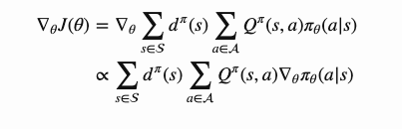
Results reproducibility
What are the difficulties? An example from Reinforcement learning.
Professor Joelle Pineau at McGill University looked at reproducibility in Reinforcement Learning
They studied the behaviour of common baseline algorithms that are used to compare to new algorithms
Survey of 4 commonly used policy gradient baseline algorithms
https://www.youtube.com/watch?v=wVkViYY_fwA
Notes:
Explain a little bit Reinforcement learning

Slide 23
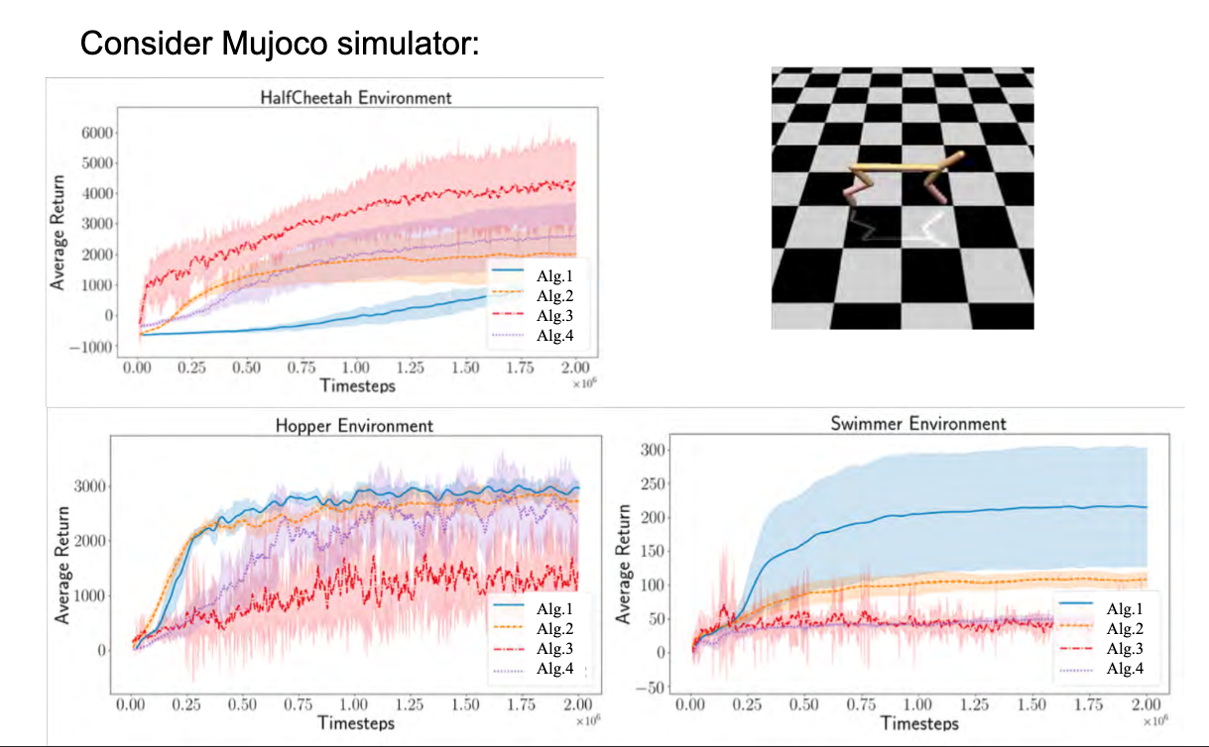
Results reproducibility
What are the difficulties?
https://www.youtube.com/watch?v=wVkViYY_fwA
Notes:
Turns out this is quit difficult.
Professor Joelle Pineau at mcgill university, with her graduate students, looked at reproducibility in the context of reinforcement learning.
What they found was that across different enviroments (we can think of this as benchmark problems), different algorithms perform better.
So while in the Halfcheetah environment , algoritm 3 performs the best, changing the problem (to hopper or swimmer), algorihm 3 does actually the worst.

Slide 24
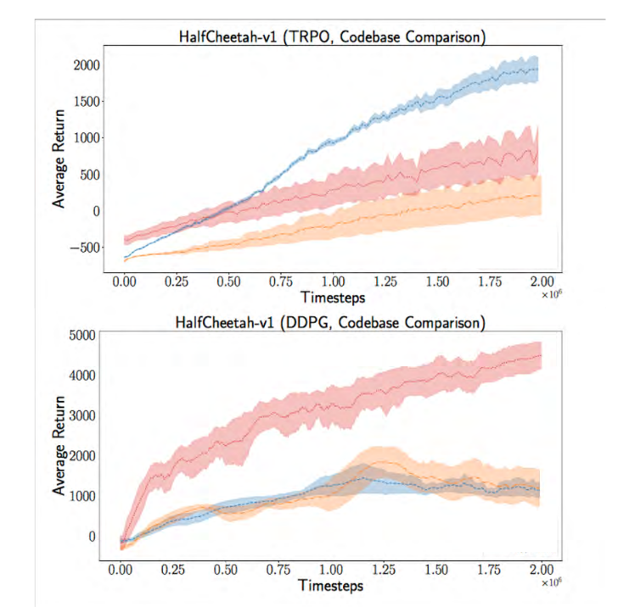
Results reproducibility
What are the difficulties?
https://www.youtube.com/watch?v=wVkViYY_fwA
Notes:
Ok, what if we use the same algorithm? There are many algorthims which have been implemented many times, in different code bases.
Again, there is a large variance in terms of performance for the same algorithm. (in this case, TRPO and DDPG).
What they found was that this is in part due to hyperparameters which are engineering choices.

Slide 25
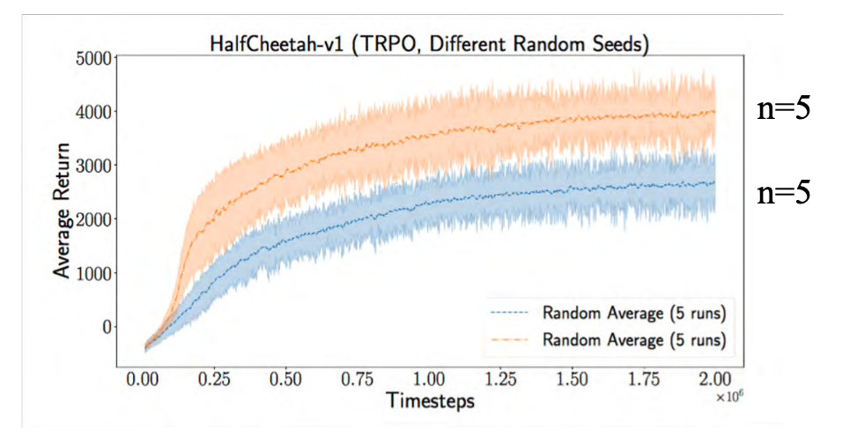
Results reproducibility
What are the difficulties?
https://www.youtube.com/watch?v=wVkViYY_fwA
Notes:
Ok, so what if we really take the same algoritm, and we run it different times (using different random seeds)?
They found that even then, while trying to account for most differences, the results are quite different for the same algorithm,using the same hyper parameters, just different random seeds.
What is the solution?

Slide 26
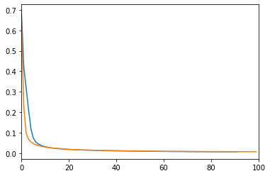
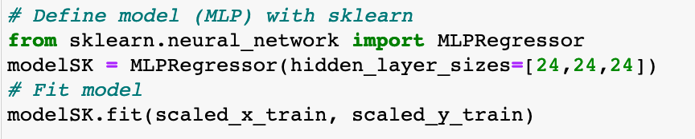
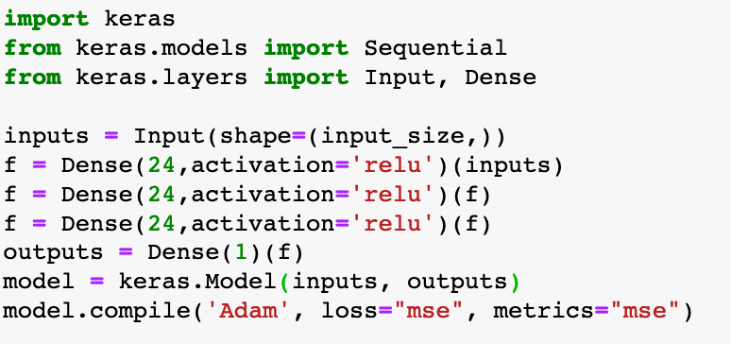
Results reproducibility
What are the difficulties?
Training loss
 | SK-Learn | Keras
R2 score | 0.9789 | 0.9844
Same training / test set
Same optimizer
Architecture
Notes:
We will also see in the practical session, that https://umich.zoom.us/j/95138845161https://umich.zoom.us/j/95138845161keras / scikit learn, for the same configuration, do not give the same results.

Slide 27
Results reproducibility
What can we do?
Clear description of the algorithm along with the complexity analysis (space, time, sample size)
Provide downloadable source code and dataset along with the dependencies
Clear description about the data collection process, and how samples were allocated for training, testing, and validation.
Specify range of the hyperparameters considered and the method employed to select the best hyperparameters.
Include the computing infrastructure used.
Notes:
An article in science magazine from 2018 looked at 400 articles from top journals / conferences and has found that:
- unable to reproduce cutting edge results - paper by goodman eventually retracted
people don’t share their code - 2018 - 6% of authors shared codes in 400 algos
Training data is not shared
Sensitivity to hyperparameters

Slide 28
Inferential reproducibility
A study is (…) inferential reproducible when an independent replication of the study or a reanalysis of it arrives at qualitatively similar conclusions to that of the original study.
Notes:
Given the same data, not controlling method or scientist choices, the same conclusons should be found

Slide 29
Inferential reproducibility
Why is it important?
Conclusions are robust and not due to scientists’ choices (e.g.: processing data, methodology, etc…)
https://blog.ml.cmu.edu/2020/08/31/5-reproducibility/
Notes:
Using baselines to prove a new technique is better – We need to obtain the same accuracy for the baseline as the original research if we want to prove that our approach is an improvement.
Proof of correctness – If no one obtains the same results as us, it is likely that we are doing something wrong.
Without methods reproducibility, scientists risk claiming gains from changing one parameter while the real source of improvement may be some hidden source of randomness.
It is concerning to rely on models in production systems if we do not have ways of rebuilding them since requirements as well as platforms keep changing

Slide 30
Inferential reproducibility
Why is it hard?
Different assessments of prior probability
Different choices (by the scientist) regarding what to focus on in the analysis and reporting of data
Lack of contextualisation of results using systematic review, selective citation of prior studies that agree with the results
Overinterpretation or misinterpretation of findings
Incomplete acknowledgement, analysis, and assessment of study limitations.
https://blog.ml.cmu.edu/2020/08/31/5-reproducibility/
Notes:
Using baselines to prove a new technique is better – We need to obtain the same accuracy for the baseline as the original research if we want to prove that our approach is an improvement.
Proof of correctness – If no one obtains the same results as us, it is likely that we are doing something wrong.
Without methods reproducibility, scientists risk claiming gains from changing one parameter while the real source of improvement may be some hidden source of randomness.
It is concerning to rely on models in production systems if we do not have ways of rebuilding them since requirements as well as platforms keep changing

Slide 31
Inferential reproducibility
What can we do?
Present a wholesome picture of the previous work in the area
Accurately report all versions of the experimental protocol to assure the reader that selective outcome reporting has not occurred
https://blog.ml.cmu.edu/2020/08/31/5-reproducibility/
Notes:
presents a wholesome picture of the previous work in the area. This means that it needs to include reviews of articles which oppose the authors’ hypothesis. Such a review will allow the reader to have a balanced opinion of the previous work and more objectively evaluate the study being presented. P
Verymuch open –
Some suggestions are removing completely the discussion section, or have someone independent write the discussion section, upon seeing the results.

Slide 32
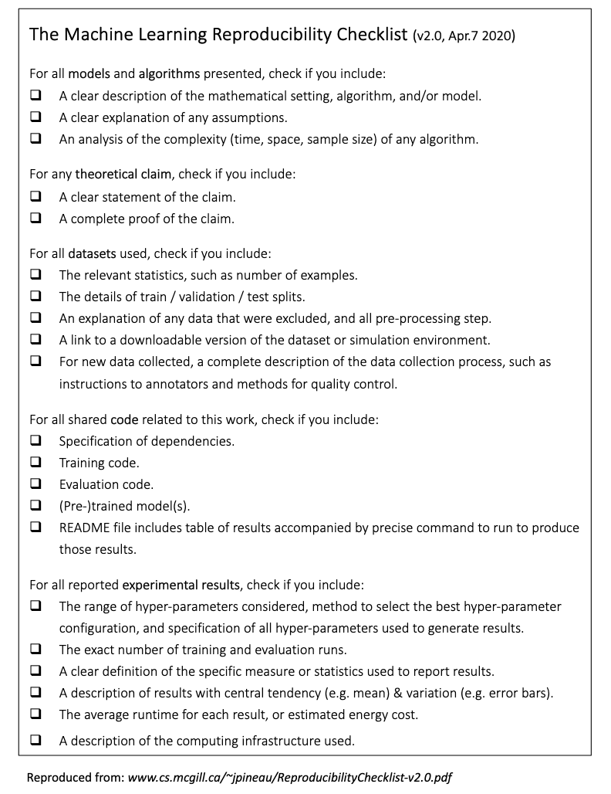
The Machine Learning Reproducibility Checklist
Proposed by Joelle Pineau (Managing Director, Facebook AI) in 2018
Adopted by NeurIPS
Notes:
An article in science magazine from 2018 looked at 400 articles from top journals / conferences and has found that:
- unable to reproduce cutting edge results - paper by goodman eventually retracted
people don’t share their code - 2018 - 6% of authors shared codes in 400 algos
Training data is not shared
Sensitivity to hyperparameters

Slide 33
Tools that can help us
Dataset
Open Repositories
Dryad https://datadryad.org/stash/
Zenodo https://zenodo.org/
University-hosted repositories

Slide 34
Tools that can help us
Experiment tracking
Entire lifecycle tracking, free
MLFlow https://mlflow.org/
TensorBoard https://www.tensorflow.org/tensorboard
GitHub or other VCS (to some extent)

Slide 35
Tools that can help us
Presenting results
Jupyter notebooks https://jupyter.org/
Google CoLab https://colab.research.google.com

Slide 36
Tools that can help us
Summary of Best Practices
environment.yml to recreate runtime environment
Versioned dataset (if size allows it, otherwise use timestamps)
Full code used to preprocess data
Full code used to train and evaluate model(s)
Saved models in universally readable format
Code to generate any analysis and plots in published work
Strict version control if GitHub repo (for example) will continue to be modified

