Slide 1


Reproducibility in (Scientific) Machine Learning
Organizers:
Maria Han Veiga (MIDAS)
Miles Timpe (UZH)

Slide 2
Agenda
State of affairs
Types of reproducibility
Reproducibility checklist
Useful tools

Slide 3
State of affairs
There’s no standard practices for ML development in the scientific context
There are various guides in industry (e.g: google hand book, etc)
There is a difference between ML for industry and ML for academia

Slide 4
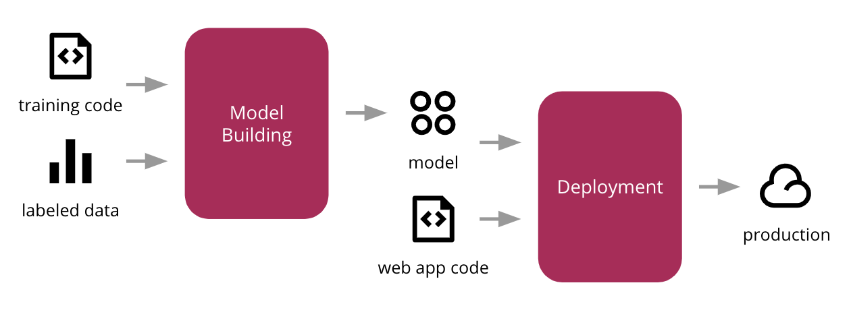
Scientific ML vs Industry ML
Iterative process
Business question
Paper
Scientific question
Dataset
re-use
Notes:
Typically, we are not interested in deploying an online ML system.
We usually operate in a more controlled execution environment. (No end users)
We want the system to be reproducible.

Slide 5
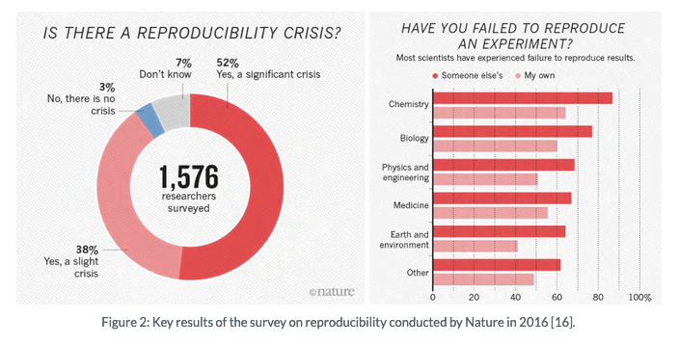
Reproducibility
Notes:
ML reproducibility is not the first time that we come across issues with reproducing scientific results. A survey conducted in 2016 shows that in “hard” sciences, many fields struggle with reproducibility (this becomes worse in soft sciences).

Slide 6
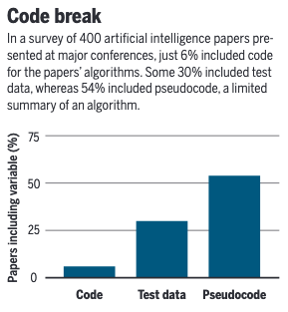
Reproducibility in ML
Notes:
An article in science magazine from 2018 looked at 400 articles from top journals / conferences and has found that:
- unable to reproduce cutting edge results - paper by goodman eventually retracted
people don’t share their code - 2018 - 6% of authors shared codes in 400 algos
Training data is not shared
Sensitivity to hyperparameters
And this is in machine learning conferences, not scientific fields that are using ml as a tool. Best believe this is worst…

Slide 7
Reproducibility in ML
In 2018, 6% of authors shared codes (out of 400)
Training data is not shared
This is in machine learning conferences
Scientific fields using ML as a tool are likely worse
Notes:
An article in science magazine from 2018 looked at 400 articles from top journals / conferences and has found that:
- unable to reproduce cutting edge results - paper by goodman eventually retracted
people don’t share their code - 2018 - 6% of authors shared codes in 400 algos
Training data is not shared
Sensitivity to hyperparameters
And this is in machine learning conferences, not scientific fields that are using ml as a tool. Best believe this is worst…

Slide 8
Types of reproducibility
What does research reproducibility mean?, S. Goodman et al., Science Translational Medicine, 2016
According to Goodman et al., there are 3 types of reproducibility:
Methods
Results
Inferential

Slide 9
Methods reproducibility
What does research reproducibility mean?, S. Goodman et al., Science Translational Medicine, 2016
Methods reproducibility is (…) the ability to implement, as exactly as possible, the experimental and computational procedures, with the same data and tools, to obtain the same results as in an original work.
Methods reproducibility involves providing enough detail about the procedures and data in the study so the same procedures could be exactly repeated.
Notes:
An article in science magazine from 2018 looked at 400 articles from top journals / conferences and has found that:
- unable to reproduce cutting edge results - paper by goodman eventually retracted
people don’t share their code - 2018 - 6% of authors shared codes in 400 algos
Training data is not shared
Sensitivity to hyperparameters

Slide 10
Methods reproducibility
Why is it important?
Establishing baselines to compare new techniques with
Proof of correctness
Rebuilding model if necessary
https://blog.ml.cmu.edu/2020/08/31/5-reproducibility/
Notes:
Using baselines to prove a new technique is better – We need to obtain the same accuracy for the baseline as the original research if we want to prove that our approach is an improvement.
Proof of correctness – If no one obtains the same results as us, it is likely that we are doing something wrong.
Without methods reproducibility, scientists risk claiming gains from changing one parameter while the real source of improvement may be some hidden source of randomness.
It is concerning to rely on models in production systems if we do not have ways of rebuilding them since requirements as well as platforms keep changing

Slide 11
Methods reproducibility
What are the difficulties?
Keeping exact track of experiments:
Hyper-parameter choice
Non-deterministic aspects of methods:
random initialization
shuffling of dataset (generating different training, test and validation sets)
regularisation through drop-out
Stochastic gradient descent type optimization
Changes in machine learning frameworks / non consistent development environments
Non-deterministic CPU/GPU floating-point calculations when it comes to parallelizing
Notes:
An article in science magazine from 2018 looked at 400 articles from top journals / conferences and has found that:
- unable to reproduce cutting edge results - paper by goodman eventually retracted
people don’t share their code - 2018 - 6% of authors shared codes in 400 algos
Training data is not shared
Sensitivity to hyperparameters

Slide 12
Methods reproducibility
What can we do?
Provide details on:
Code
Dataset
Development environment (e.g.: docker or virtual environment)
Computational platform
Notes:
An article in science magazine from 2018 looked at 400 articles from top journals / conferences and has found that:
- unable to reproduce cutting edge results - paper by goodman eventually retracted
people don’t share their code - 2018 - 6% of authors shared codes in 400 algos
Training data is not shared
Sensitivity to hyperparameters

Slide 13
Results reproducibility
What does research reproducibility mean?, S. Goodman et al., Science Translational Medicine, 2016
Results reproducibility is (…) the ability to produce corroborating results in a new (independent) study having followed the same experimental procedures.
Notes:
replicability

Slide 14
Results reproducibility
Why is it important?
Showing that the outcomes are not random / are well understood
Failure to replicate results often leads to disproving original claims
Notes:
An article in science magazine from 2018 looked at 400 articles from top journals / conferences and has found that:
- unable to reproduce cutting edge results - paper by goodman eventually retracted
people don’t share their code - 2018 - 6% of authors shared codes in 400 algos
Training data is not shared
Sensitivity to hyperparameters

Slide 15
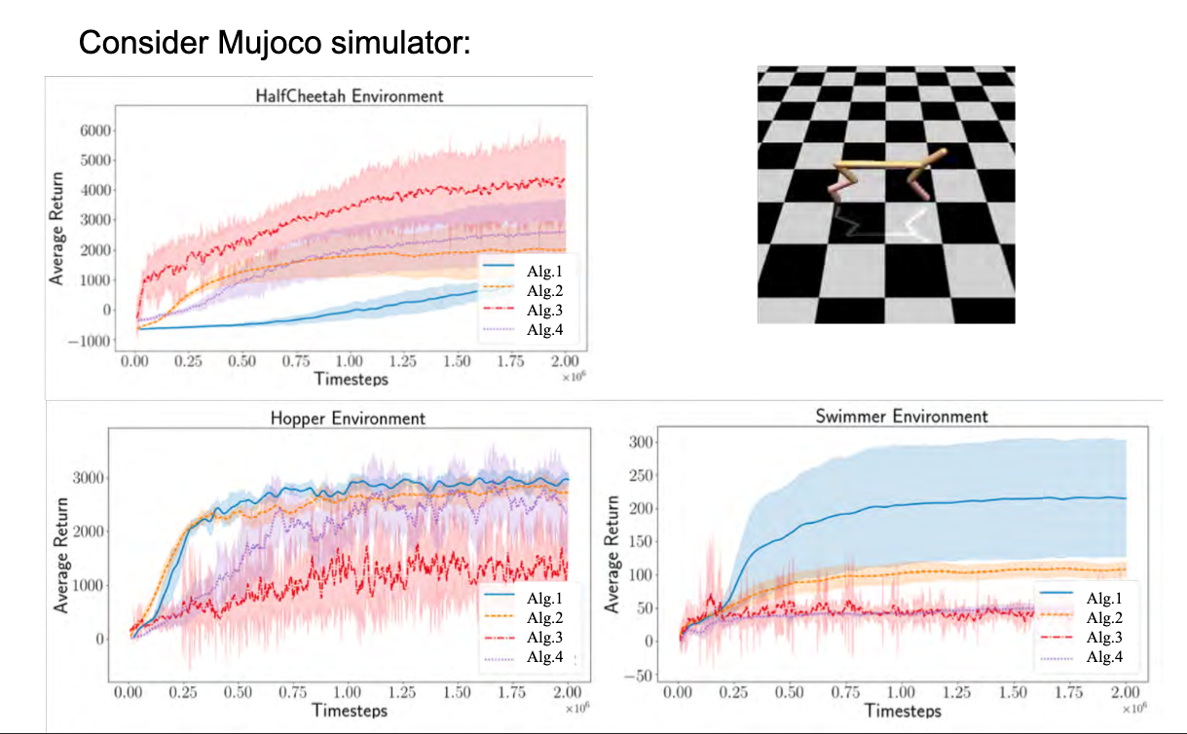
Results reproducibility
What are the difficulties?
https://www.youtube.com/watch?v=wVkViYY_fwA
Notes:
An article in science magazine from 2018 looked at 400 articles from top journals / conferences and has found that:
- unable to reproduce cutting edge results - paper by goodman eventually retracted
people don’t share their code - 2018 - 6% of authors shared codes in 400 algos
Training data is not shared
Sensitivity to hyperparameters

Slide 16
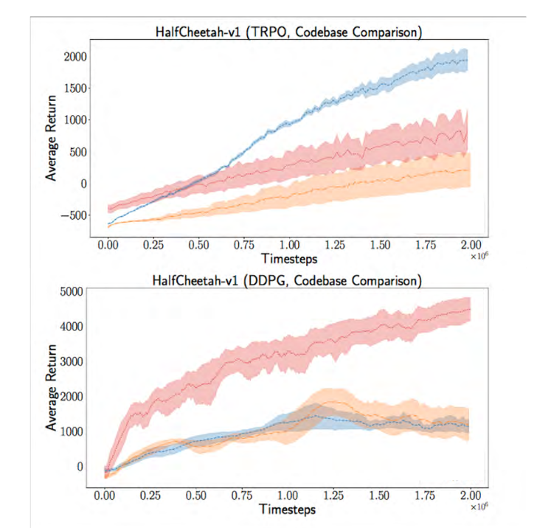
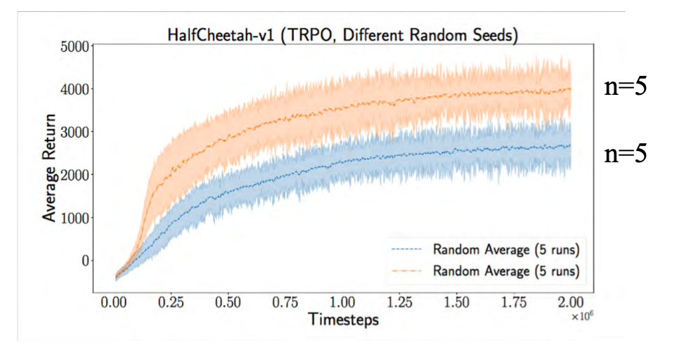
Results reproducibility
What are the difficulties?
https://www.youtube.com/watch?v=wVkViYY_fwA
Notes:
An article in science magazine from 2018 looked at 400 articles from top journals / conferences and has found that:
- unable to reproduce cutting edge results - paper by goodman eventually retracted
people don’t share their code - 2018 - 6% of authors shared codes in 400 algos
Training data is not shared
Sensitivity to hyperparameters

Slide 17
Results reproducibility
What are the difficulties?
https://www.youtube.com/watch?v=wVkViYY_fwA
Notes:
An article in science magazine from 2018 looked at 400 articles from top journals / conferences and has found that:
- unable to reproduce cutting edge results - paper by goodman eventually retracted
people don’t share their code - 2018 - 6% of authors shared codes in 400 algos
Training data is not shared
Sensitivity to hyperparameters

Slide 18
Results reproducibility
What can we do?
Clear description of the algorithm along with the complexity analysis (space, time, sample size)
Provide downloadable source code and dataset along with the dependencies
Clear description about the data collection process, and how samples were allocated for training, testing, and validation.
Specify range of the hyperparameters considered and the method employed to select the best hyperparameters.
Include the computing infrastructure used.
Notes:
An article in science magazine from 2018 looked at 400 articles from top journals / conferences and has found that:
- unable to reproduce cutting edge results - paper by goodman eventually retracted
people don’t share their code - 2018 - 6% of authors shared codes in 400 algos
Training data is not shared
Sensitivity to hyperparameters

Slide 19
Inferential reproducibility
A study is (…) inferential reproducible when an independent replication of the study or a reanalysis of it arrives at qualitatively similar conclusions to that of the original study.
Notes:
An article in science magazine from 2018 looked at 400 articles from top journals / conferences and has found that:
- unable to reproduce cutting edge results - paper by goodman eventually retracted
people don’t share their code - 2018 - 6% of authors shared codes in 400 algos
Training data is not shared
Sensitivity to hyperparameters

Slide 20
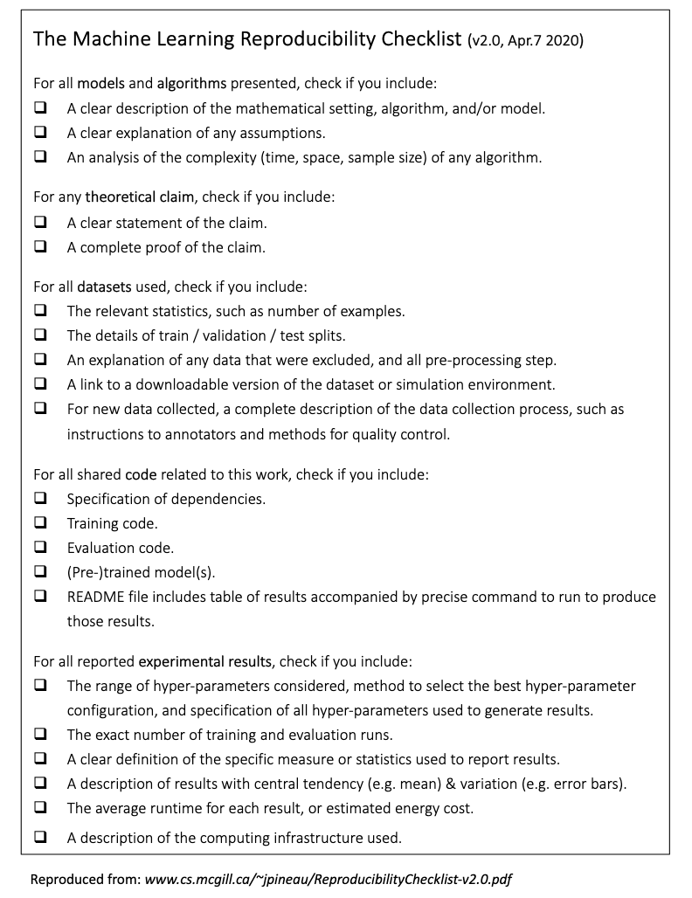
The Machine Learning Reproducibility Checklist
Proposed by Joelle Pineau (Managing Director, Facebook AI) in 2018
Adopted by NeurIPS
Notes:
An article in science magazine from 2018 looked at 400 articles from top journals / conferences and has found that:
- unable to reproduce cutting edge results - paper by goodman eventually retracted
people don’t share their code - 2018 - 6% of authors shared codes in 400 algos
Training data is not shared
Sensitivity to hyperparameters

Slide 21
Tools that can help us
Dataset

Slide 22
Tools that can help us
Experiment tracking

Slide 23
Tools that can help us
Presenting results

