Slide 1

Emotional Stroop Experiment
Final presentation
B. Holler, K. Fritsch, D. Gösser, B. Lutz, J. Reischl, M. Wesnitzer
Übung Psychologie der Mensch-Maschine-Interaktion am 29.01.2020

Slide 2
Overview
Introduction
Methodology
Results
Interpretation & Discussion
Sources

Slide 3
1. Introduction
Experiment: Emotional Stroop Task
Underlying theory: emotion …..
Existing studies:
Bilingual
Arousal
Research Question: (brauchen wir das?)
Hypothesis: Words that have a negative emotional meaning lead to slower reaction times when deciding on word color.

Slide 4
2. Methodolgy: Experiment Set-Up
16 neutral words, 16 negative emotion words (see Appendix)
3 word colors: blue, green, purple
Sample: 31 participants, all university students
Measured: reaction time, button input for each condition
Condition 1: Neutral words
Condition 2: Negative emotion words
Experiment implemented in JSPsych, conducted on local machines in a working environment

Slide 5
2. Methodology: Experiment Run
Task: Press correct button for each color!
Test phase: participants introduced to task demands (8 test words)
Experiment phase: random word-color combination
Evaluation: Comparison of the reaction times of condition 1 and condition 2 in the software environment R

Slide 6
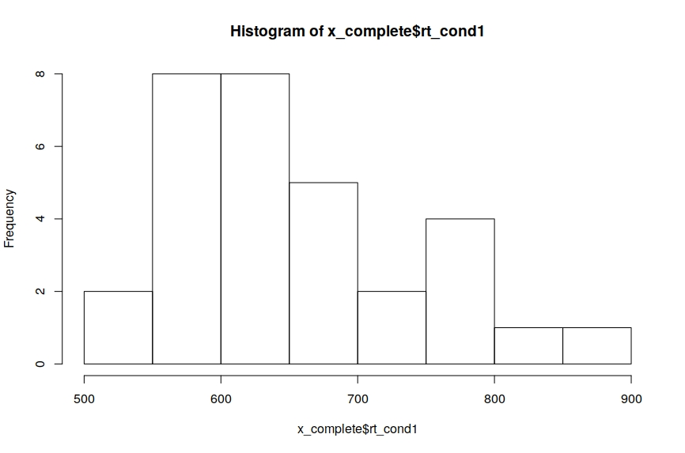
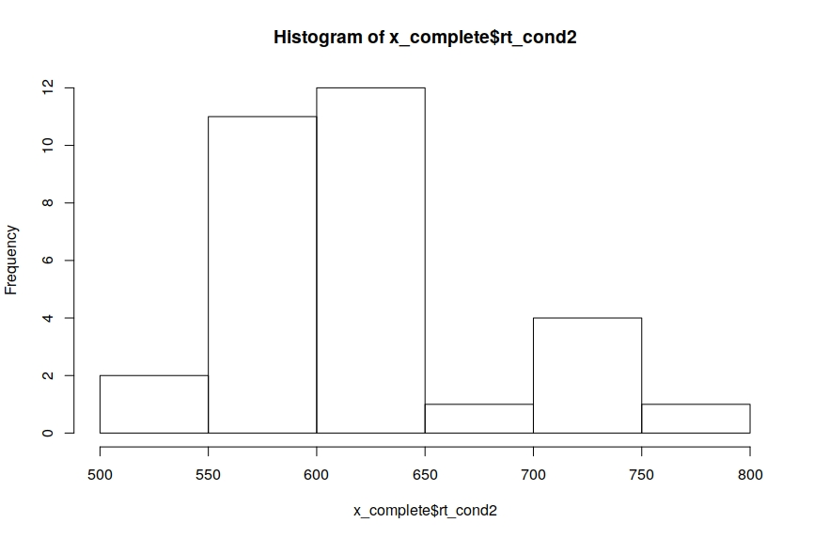
3. Results
Error rate: … HIER EVTL AUCH LINIEN/VERGLEICHE ziehen / aber Achtung Maßstab

Slide 7
4. Interpretation and discussion
Result not significant (Zahl/explanation hier einfügen)
Possible reasons:
Heterogeneous experiment environment
Participant selection not representative of whole population
… mehr?
However: similar response times in other scientific studies
E.g. L1 in Sutton et. Al (2007)

Slide 8
5. Sources
Dresler, T., Mériau, K., Heekeren, H. R., & Meer, E. (2009). Emotional Stroop task: effect of word arousal and subject anxiety on emotional interference. Psychological Research,73(3), 364–371. https://doi.org/10.1007/s00426-008-0154-6
MacLeod, C. M. (1991). Half a century of research on the Stroop effect: An integrative review. Psychological Bulletin, 109(2), 163–203. https://doi.org/10.1037/0033-2909.109.2.163
Princeton University "About WordNet." WordNet. Princeton University. 2010.
Sutton, T. M., Altarriba, J., Gianico, J. L., & Basnight-Brown, D. M. (2007). The automatic access of emotion: Emotional Stroop effects in Spanish–English bilingual speakers. Cognition & Emotion, 21(5), 1077–1090. https://doi.org/10.1080/02699930601054133

Slide 9
Appendix: Words
neutral
emotional
Papier
Haus
Anker
Stuhl
Fahrzeug
Pflanze
Stein
Lampe
Schrank
Tür
Straße
Stadt
Flasche
Schal
Schuhe
Fenster
Mord
Krieg
Tod
Grab
Schulden
Stress
Ekel
Prüfung
Diebstahl
Zerstörung
Kälte
Panik
Hunger
Ebola
Bombe
Krankheit

