Slide 1
Lab 6: House Price Prediction
Public domain data set from kaggle.com
Sales of houses in the Seattle area from May, 2014 - May, 2015.
Inputs to the models you will develop
id#, prop_id – identify each property – not useful inputs
number of bedrooms
number of bathrooms
size in square feet
lot size in square feet
number of floors
condition – small integer value
location – zip code; latitude and longitude
etc.
Output – predicted price

Slide 2
Example house_data.csv
house_data <- read.csv("house_data.csv")
head(house_data)
id date price bedrooms bathrooms sqft_living …
1 7129300520 20141013T000000 221900 3 1.00 1180 …
2 6414100192 20141209T000000 538000 3 2.25 2570 …
3 5631500400 20150225T000000 180000 2 1.00 770 …
4 2487200875 20141209T000000 604000 4 3.00 1960 …
5 1954400510 20150218T000000 510000 3 2.00 1680 …
6 7237550310 20140512T000000 1230000 4 4.50 5420 …

Slide 3
Goal: Predict House Prices
Divide data into training and testing sets
Training set
All inputs plus price
Testing set
Predict the price using the model you developed with the training set
Compute error between your predicted price and the actual priced provided in data set.
Measure of overall error = RMSE

Slide 4
RMSE - Root Mean Square Error

Slide 5
Models to Develop
Backward elimination using all data
Segment data by zip code
Train and test models for each zip code using specified predictors

Slide 6
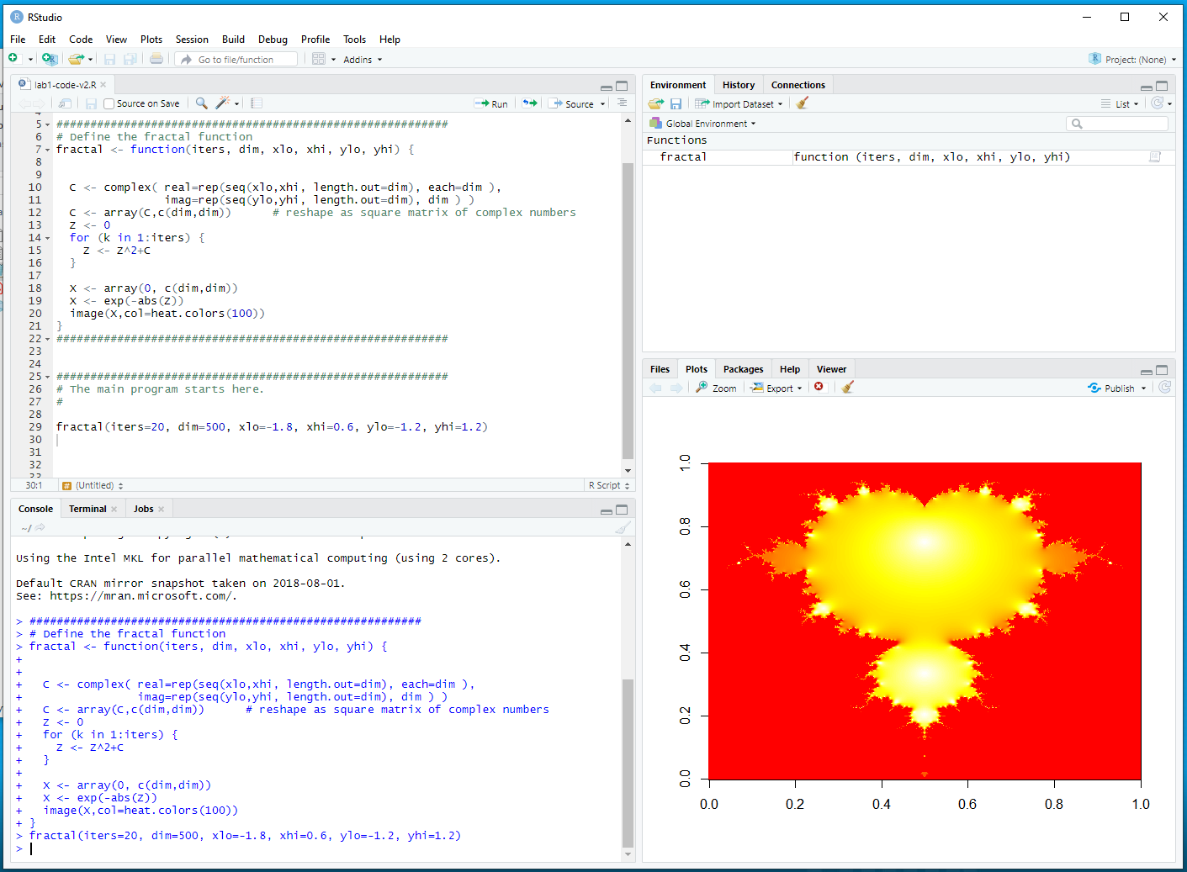
Packages in R
Package = library of functions developed by someone else for you to use
In RStudio
Window in lower right quadrant
“Packages” tab → “install” tab → type “package name” in box

Slide 7

dplyr package
dplyr package
Set of functions to easily access and change dataframes
group, filter, select, summarize, ….
Much more functionality than we will be using
We will focus on segmentation and summarizing
“Packages” tab → “install” tab → type “dplyr” in box

Slide 8
head(house_data)
house_data <- read.csv("house_data.csv")
id date price bedrooms bathrooms sqft_living …
1 7129300520 20141013T000000 221900 3 1.00 1180 …
2 6414100192 20141209T000000 538000 3 2.25 2570 …
3 5631500400 20150225T000000 180000 2 1.00 770 …
4 2487200875 20141209T000000 604000 4 3.00 1960 …
5 1954400510 20150218T000000 510000 3 2.00 1680 …
6 7237550310 20140512T000000 1230000 4 4.50 5420 …

Slide 9
Segmentation by zipcode
house_data <- read.csv("house_data.csv")
data_by_zipcode <- house_data %>%
group_by(zipcode) %>%
summarize(
count = n(),
med_price = median(price),
med_yr_built = median(yr_built),
)
Data flow of the pipeline operations:
house_data → group_by → summarize → data_by_zipcode
Pipeline operation
%>%
New columns that
we are generating
using summarize()

Slide 10
head(data_by_zipcode)
Zipcode | count | med_price | med_yr_built
98001 | 362 | 260000.0 | 1981
98002 | 199 | 235000.0 | 1966
98003 | 280 | 267475.0 | 1975
98004 | 317 | 1150000.0 | 1965
98005 | 168 | 765475.0 | 1967
98006 | 498 | 760184.5 | 1978

Slide 11
Adding Your Predictions
house_data <- read.csv("house_data.csv")
data_by_zipcode <- house_data %>%
group_by(zipcode) %>%
summarize(
count = n(),
med_price = median(price),
med_yr_built = median(yr_built),
error = price_prediction_error(price, bedrooms, sqft_living, …..)
)
Pipeline operation
%>%
Column names from
house_data
Within your function, divide into training and testing sets and return rmse of your
predictions.

Slide 12
head(data_by_zipcode)
Zipcode | count | med_price | med_yr_built | error
98001 | 362 | 260000.0 | 1981 | 10238.2
98002 | 199 | 235000.0 | 1966 | 9896.7
98003 | 280 | 267475.0 | 1975 | 4524.4
98004 | 317 | 1150000.0 | 1965 | ….
98005 | 168 | 765475.0 | 1967 | ….
98006 | 498 | 760184.5 | 1978 | ….
Your computed rmse values for each zip code.

Slide 13
Your price prediction function
price_prediction_error <- function(price, bedrooms, bathroom, sqft_living, sqft_lot, grade, yr_built) {
# Create a new data frame for the variables to be used in the price prediction
house_info <- data.frame(price, bedrooms, bathroom, sqft_living, sqft_lot, grade, yr_built)
# Separate the data into training and testing sets
This is the same as last lab, but using house_info
# Compute the linear model
This is the same as last lab, but using house_info, and the parameters above
# Use the model to predict the prices
This is the same as last lab, but using house_info
# Compute the rmse of the predicted - actual values
rmse <- compute rmse of (predicted – actual)
return(rmse)
}

Slide 14
To do
Download and complete Lab 6

