Slide 1
Lab 7: Plotting Data on a Map
Learn to use ggplot2 and gganimate packages to plot data on simple maps.

Slide 2
Data Format
(x, y, t, z1, z2, …)
x = longitude
y = latitude
t = optional time parameter
z1, z2, … = optional values of some interesting characteristics of the data point

Slide 3
Example Test Data
head(test_data)
lat long year temp
1 37.92775 -122.0816 2007 2.367641
2 37.73751 -122.5401 2017 28.682083
3 37.77283 -122.5401 2000 25.073657
4 37.18677 -122.3946 1999 -6.554683
5 37.93086 -121.9531 2017 27.434501
6 37.89064 -122.2742 2014 -2.052456

Slide 4
Basic Steps
Generate base map
Use existing database of maps
Focus on region of interest
Plot a dot on the map for each data point
Location specified by (x,y) coordinates
Optionally, color and size controlled by (z1, z2, …)
Use time parameter t to show change vs time
Philosophy – add new parts to the base map as a series of smaller steps to layer on desired information

Slide 5
Load the Packages Needed
library(ggplot2)
Extensive package for making many different types of plots
library(gganimate)
Package to provide simple animation
library(gifski)
Package to generate GIFs

Slide 6
Get the Map Information
From the “maps” package
Shapes of counties in U.S. states specified using (long,lat) of corners
which_state <- "california"
county_info <- map_data("county", region=which_state)
long lat group order region subregion
1 -121.4785 37.48290 1 1 california alameda
2 -121.5129 37.48290 1 2 california alameda
3 -121.8853 37.48290 1 3 california alameda
4 -121.8968 37.46571 1 4 california alameda
5 -121.9254 37.45998 1 5 california alameda
6 -121.9483 37.47717 1 6 california alameda

Slide 7
Create the Base Map
base_map <- ggplot(
data = county_info,
mapping = aes(x = long, y = lat, group = group)) +
geom_polygon(color = "black", fill = "white") +
coord_quickmap() +
theme_void()

Slide 8
Create the Base Map
base_map <- ggplot(
data = county_info,
mapping = aes(x = long, y = lat, group = group)) +
geom_polygon(color = "black", fill = "white") +
coord_quickmap() +
theme_void()
Tell ggplot which data frame to use

Slide 9
Create the Base Map
base_map <- ggplot(
data = county_info,
mapping = aes(x = long, y = lat, group = group)) +
geom_polygon(color = "black", fill = "white") +
coord_quickmap() +
theme_void()
How to use the specific data
in county_info

Slide 10
Create the Base Map
base_map <- ggplot(
data = county_info,
mapping = aes(x = long, y = lat, group = group)) +
geom_polygon(color = "black", fill = "white") +
coord_quickmap() +
theme_void()
Specify the line color (black) and
the color to fill the polygons (white)

Slide 11
Create the Base Map
base_map <- ggplot(
data = county_info,
mapping = aes(x = long, y = lat, group = group)) +
geom_polygon(color = "black", fill = "white") +
coord_quickmap() +
theme_void()
Make the map shape look good

Slide 12
Create the Base Map
base_map <- ggplot(
data = county_info,
mapping = aes(x = long, y = lat, group = group)) +
geom_polygon(color = "black", fill = "white") +
coord_quickmap() +
theme_void()
Set the background to nothing (white)

Slide 13
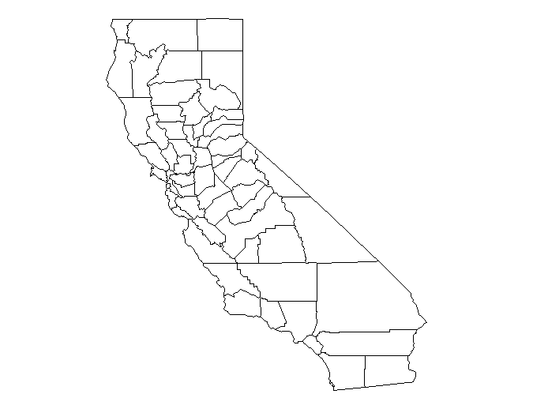
Type “base_map” at R prompt

Slide 14
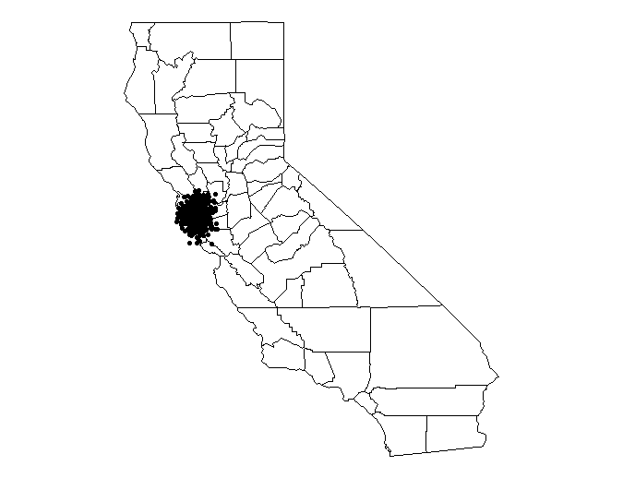
Add Data Points to the Map
map_with_data <- base_map + geom_point(data = test_data,
aes(x = long,y = lat, group=year))
map_with_data

Slide 15
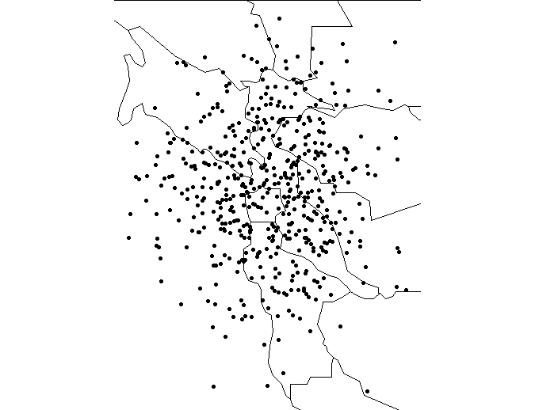
Zoom in to the Area with Data
min_long <- min(test_data$long)
max_long <- max(test_data$long)
min_lat <- min(test_data$lat)
max_lat <- max(test_data$lat)
map_with_data <- map_with_data +
coord_quickmap(xlim = c(min_long,
max_long), ylim = c(min_lat, max_lat))
map_with_data

Slide 16
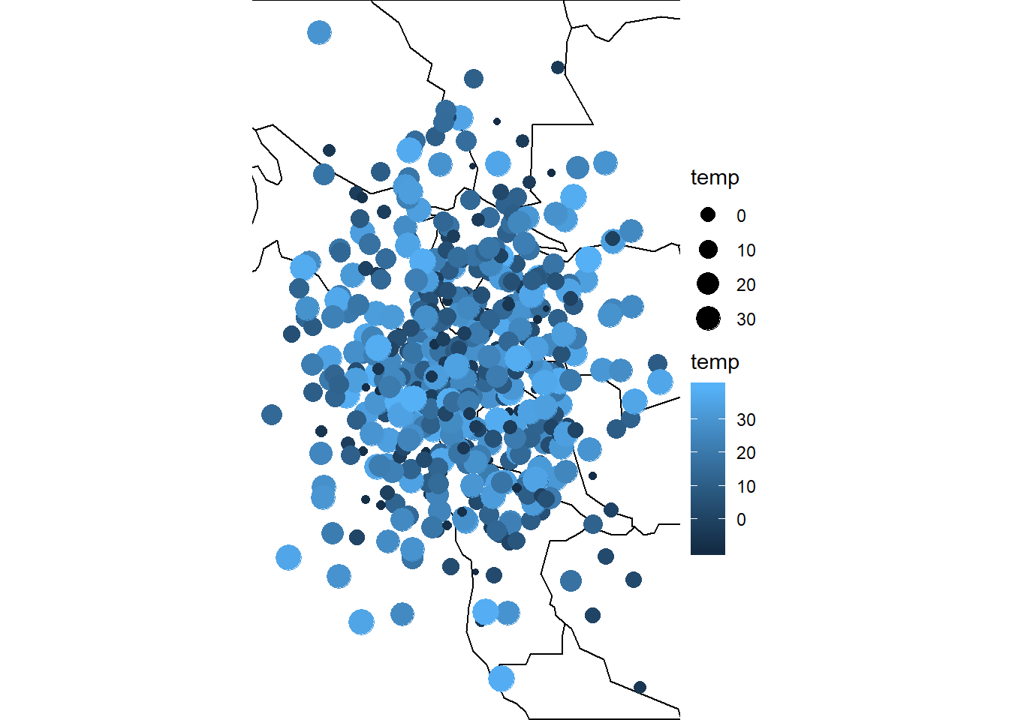
Set Color and Size of Data Points
map_with_data <- base_map + geom_point(data = test_data,
aes(x = long, y = lat, color=temp, size=temp, group=year)) + coord_quickmap(xlim = c(min_long, max_long),
ylim = c(min_lat, max_lat))
map_with_data

Slide 17
Add Motion
map_with_animation <- map_with_data +
transition_time(year) +
ggtitle('Year: {frame_time}’,
subtitle = 'Frame {frame} of {nframes}’)
num_years < max(test_data$year) - min(test_data$year) + 1
animate(map_with_animation, nframes = num_years)

Slide 18
Keep the Old Data Points
map_with_shadow <- map_with_animation + shadow_mark()
animate(map_with_shadow, nframes = num_years)

Slide 19
Lab 7: Plot House Price Predictions
Divide data into training and testing sets
Training set
All inputs plus price
Testing set
Predict the price using the model you developed with the training set
Compute error between your predicted price and the actual priced provided in data set.
Use “percent error” this time

Slide 20
Add Your Predictions and Location
house_data <- read.csv("house_data.csv")
data_by_zipcode <- house_data %>%
group_by(zipcode) %>%
summarize(
count = n(),
med_price = median(price),
mean_lat = mean(lat),
mean_long = mean(long),
med_yr_built = median(yr_built),
percent_error = price_prediction_error(price, bedrooms, sqft_living, …..)
)

Slide 21
head(data_by_zipcode)
Zipcode | count | med_price | mean_lat | mean_long | med_yr_built | Percent_error
98001 | 362 | 260000.0 | 47.30902 | -122.2706 | 1981 | 38.2
98002 | 199 | 235000.0 | 47.30878 | -122.2134 | 1966 | 96.7
98003 | 280 | 267475.0 | 47.31574 | -122.3101 | 1975 | 124.4
98004 | 317 | 1150000.0 | 47.61618 | -122.2052 | 1965 | ….
98005 | 168 | 765475.0 | 47.61153 | -122.1673 | 1967 | ….
98006 | 498 | 760184.5 | 47.55802 | -122.1468 | 1978 | ….
Now plot your prediction errors on an appropriate map.

Slide 22
To Do
Download and complete Lab 7
See the tutorial for detailed examples
z.umn.edu/mapsUsingR

