Slide 1



TRACEFINDER
FORENSIC SCANNER IDENTIFICATION
Presented By:
Mentor Revanth TEAM
1

Slide 2










TABLE OF CONTENT
INTRODUCTION
DATA PREPROCESSING
PROBLEM STATEMENT
DATASETS
OBJECTIVE
EXPLORATORY DATA ANALYSIS
SYSTEM ARCHITECTURE
UI & DEPLOYMENT
TECHNICAL STACK
CHALLENGES & SCOPE
2

Slide 3
INTRODUCTION
The rapid growth of digital documentation has increased the risk of
document forgery, duplication, and unauthorized scanning.
Every scanner device—regardless of its brand or model—introduces unique patterns, noise traces, and compression artifacts during the scanning process.
This technology plays a vital role in digital forensics, document authentication, legal verification, and fraud prevention.
3

Slide 4

PROBLEM STATEMENT
Digital documents are widely used in legal, corporate, and government environments. However, forged or manipulated scanned documents pose serious risks, including fraud, identity theft, and legal disputes.
Currently, there is no straightforward way to verify which scanner produced a document, making it difficult to detect unauthorized or tampered scans.
There is a need for a system that can:
Analyze scanner-specific signatures
Classify which scanner created a given image
Support forensic investigations and document verification
4

Slide 5
OBJECTIVE
The main objectives are:
1.To analyze scanner-specific noise, texture, and frequency-domain patterns present in scanned images.
2. To train machine learning models (XGBoost, CNN, Hybrid) to classify
scanned images based on their source scanner.
3. To evaluate and compare model accuracy for reliable forensic identification.
4.To develop an interface or simple app to upload a scanned image and predict the originating scanner device.
5.To support digital forensics, document authentication, and legal verification activities.
Studio Shodwe
5

Slide 6
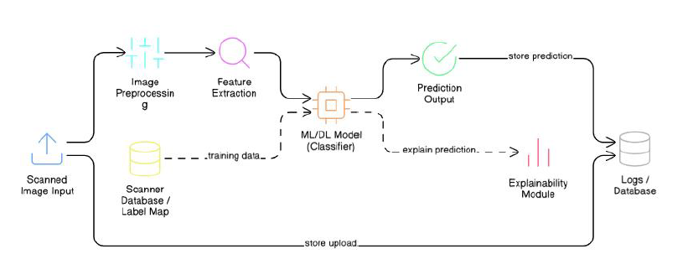
SYSTEM ARCHITECTURE
6

Slide 7








TECHNICAL STACK
Languages:
Frameworks & Libraries:
Models Used:
Tools & Platforms:
Model & Data Handling:
XGBoost
CNN
Hybrid CNN
Kaggle
VS Code
Joblib – Save/load ML models
Pickle – Serialize objects
Label Encoder / Scaler files
Studio Shodwe
7

Slide 8
DATA SETS USED
FLATFIELD
OFFICIAL
WIKIPEDIA
8

Slide 9
EXPLORATORY DATA ANALYSIS
Dataset Understanding
Multi-class scanner image dataset covering Canon, Epson, and HP devices.
Images captured under controlled settings and standardized to grayscale, 256×256 resolution.
Dataset is fairly balanced across scanner classes, enabling unbiased model evaluation.
Initial Observations
Visual differences between scanner outputs are extremely subtle.
Noise patterns and acquisition artifacts are not easily detectable by the human eye.
Highlights the need for advanced feature extraction and learning-based models.
9

Slide 10
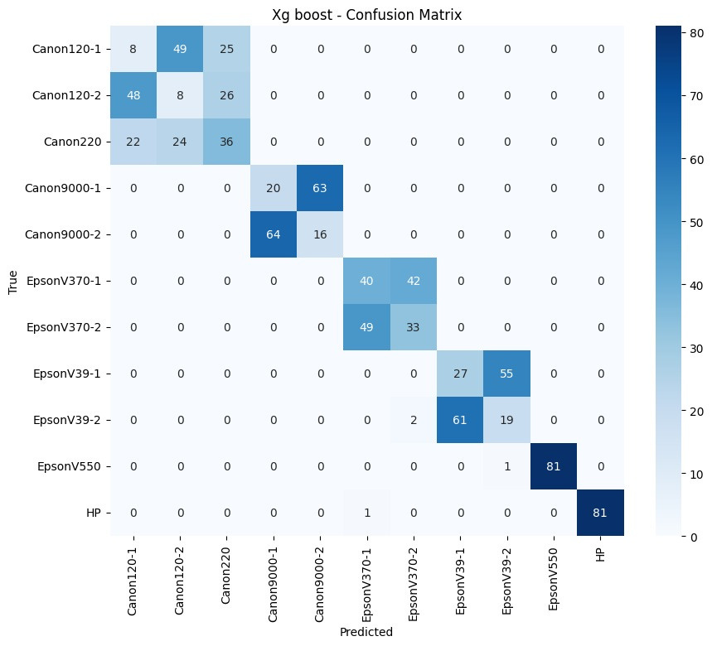
EXPLORATORY DATA ANALYSIS
XGBoost
Key Observations
The model often confuses scanner models from the same brand, such as Canon120 variants.
These features are not strong enough to clearly separate very similar scanner devices.
Many scanner classes share overlapping feature characteristics.
XGBoost performs reasonably well but struggles with fine-level scanner identification. This shows the limitation of traditional ML when features are very similar.
Hence, there is a need for deep learning-based feature extraction.
10

Slide 11
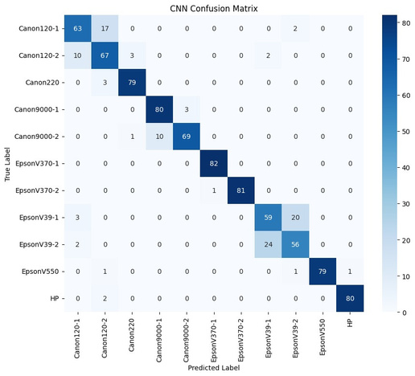
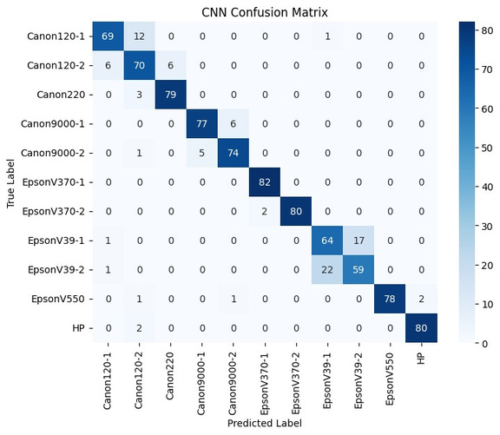
EXPLORATORY DATA ANALYSIS
CNN vs Hybrid CNN
CNN
CNN shows high accuracy with strong diagonal values, meaning most scanners are correctly identified.
Small confusion appears only between similar scanner models, while overall brand-level classification is robust.
Hybrid CNN
High classification accuracy: Most samples lie on the diagonal, showing the Hybrid CNN correctly identifies scanners with strong consistency across classes.
Reduced misclassification: Confusion between similar scanner models is lower than in the CNN, proving that combining deep and handcrafted features improves fine-grained recognition.
11

Slide 12
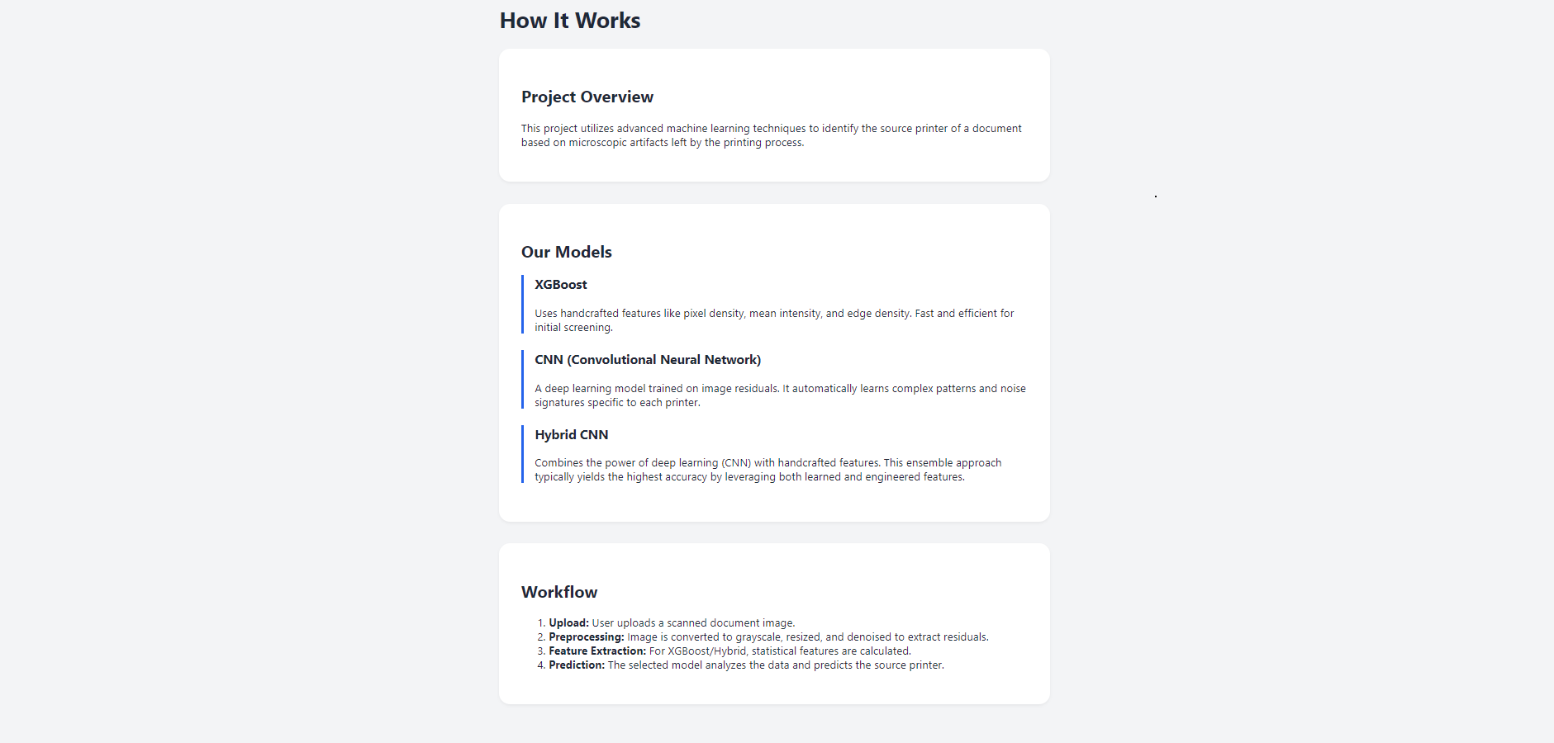
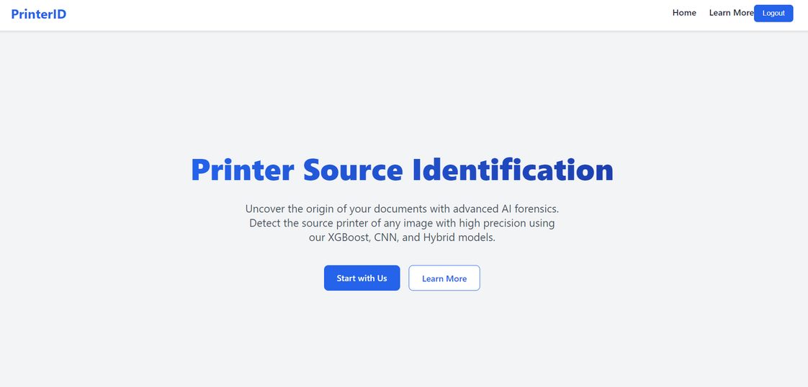
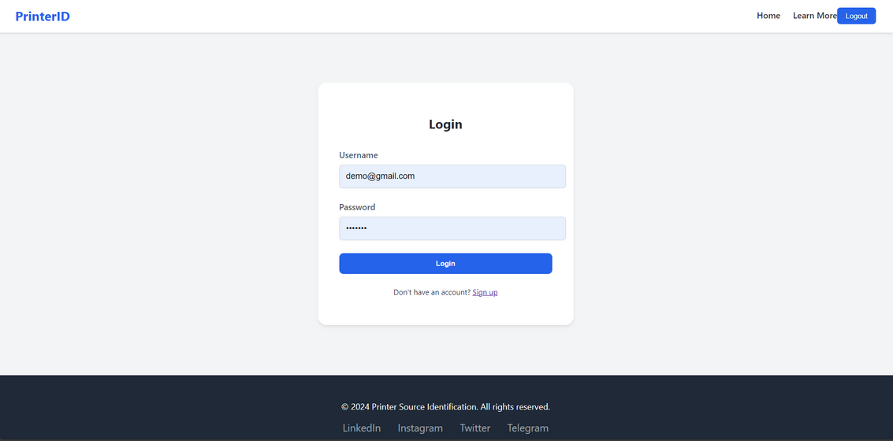
UI
ABOUT
LANDING
LOGIN
12

Slide 13
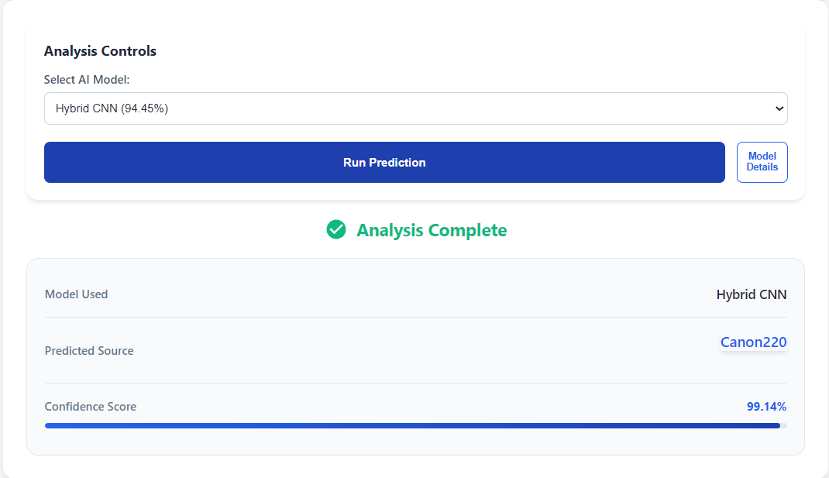
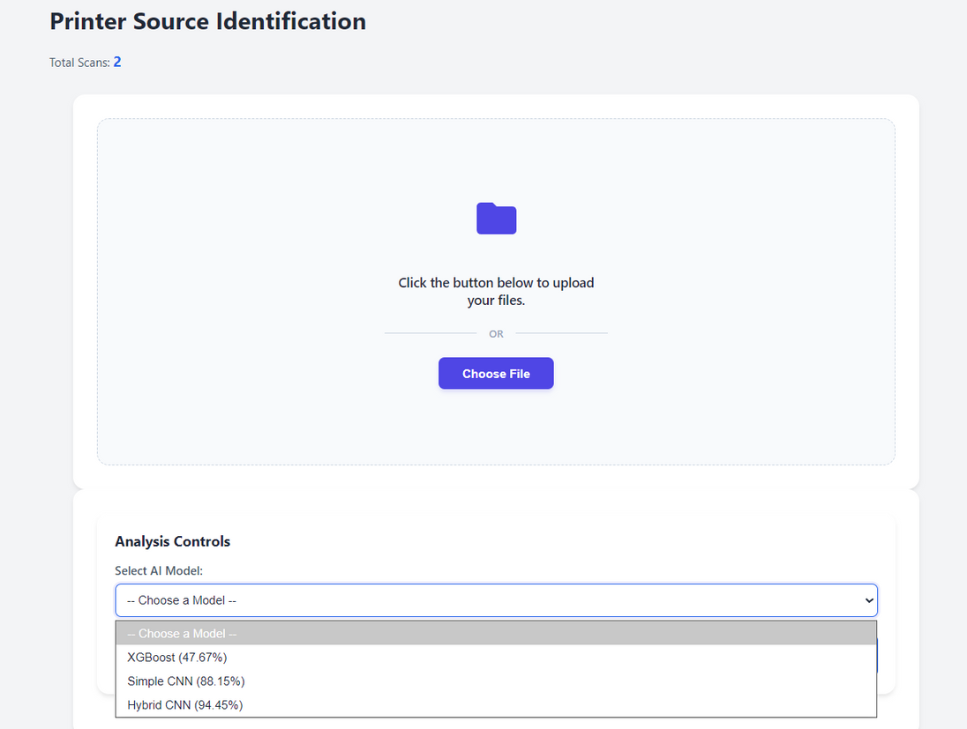
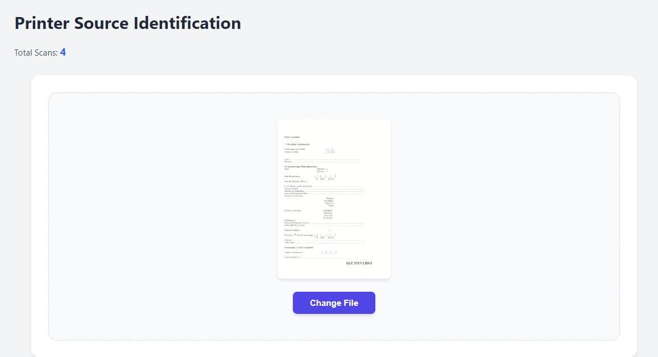
UI
RESULT
MODEL SELECTION
UPLOAD
13

Slide 14
DEPLOYMENT
Frontend–Backend Separation: React frontend deployed independently from the ML backend to ensure scalability and maintainability.
API-Based Integration : Backend exposes REST APIs for image upload, preprocessing, and prediction, consumed by the React frontend.
Model Serving Strategy : Trained models are serialized and loaded at startup to reduce inference latency.
Environment-Based Deployment : Separate configurations for development, testing, and production environments.
Cloud / Local Deployment : System can be deployed locally for demos or on cloud platforms for wider accessibility.
Scalability Strategy : Backend services can be horizontally scaled to handle multiple concurrent requests.
Security Strategy : Input validation, file-type checks, and controlled API access to prevent misuse.
14

Slide 15
CHALLENGES FACED
Scanner noise patterns are very subtle and hard to extract.
Images came from different sources with varying quality.
Some scanner classes had fewer training images.
Designing effective handcrafted features was challenging.
Integrating models with backend and frontend smoothly.
15

Slide 16
FUTURE SCOPE
Add support for more scanner and device models.
Improve accuracy using larger and diverse datasets.
Extend system to detect image forgery and tampering.
Add explainable AI to visualize model decisions.
Deploy as a real-time forensic investigation tool.
16

Slide 17
CONCLUSION
Successfully built an AI-based scanner identification system.
Used residual noise for reliable scanner fingerprinting.
CNN achieved the best performance among all models.
Hybrid model improved robustness using image + features.
End-to-end system deployed with FastAPI and React.
17

Slide 18
THANK YOU
MENTOR REVANTH
18
INFOSYS SPRINGBOARD 6.0

